Slide 1
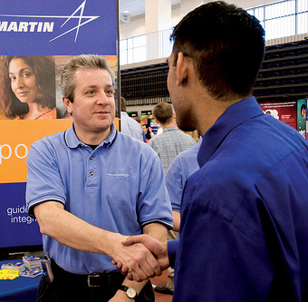
Academic Training Workshop
RIT International Student Services
www.rit.edu/iss

Slide 2
What is Academic Training?
Temporary employment for hands-on training directly related to your major/area of study.

Slide 3
Academic Training “AT” Eligibility
You must be primarily in the United States to study
rather than engage in academic training;
Academic training must be directly related to your major field of study at the school named on your Form DS-2019;
You must be in good academic standing; and
Obtain written approval in advance from the Responsible Officer for the duration and type of academic training.

Slide 4
Pre-Completion AT
Pre-graduation AT may be part-time* or full-time
Must have a job offer in advance
Generally full-time for a registered Co-op
Or, full-time during summer break
Or, part time while in classes (rare)
Must be authorized in advance by ISS or your J-1 sponsor (IIE, CBIE, American Councils, etc.)

Slide 5
Pre-Completion AT
Pre-graduation AT may be part-time * or full-time
* However, all academic training is counted as full time, even if used on a part-time basis.

Slide 6
Post-Completion AT
Post-graduation AT is always granted as full-time
You must have a job offer before graduation
Must provide job offer to ISS (or your J-1 sponsoring agency) before graduation
Must be authorized in advance by ISS or your sponsor (IIE, CBIE, American Councils, etc.)

Slide 7
Steps for AT Authorization
Present a job offer to ISS (or your sponsoring agency) before the completion of your studies and before the end date on your DS-2019.
An 18-month eligibility clock begins on the date you complete your program, and if you delay the actual start of employment, you will lose academic training time.
Academic training must commence not later than 30 days after completion of studies.

Slide 8
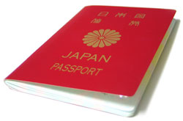
Application Materials
Job offer
(You can scan and email this to an ISS staff member)
Written certification from your Academic department that the training is related to your area of study
(A template is available by emailing a member of ISS staff)
New DS-2019 and academic training authorization letter are then issued by ISS (or your J-1 sponsor)

Slide 9
How much AT can I use?
18 months *
For undergraduate and pre-doctoral training, the AT must not exceed 18 months, inclusive of any prior academic training in the United States, or the period of full course of study in the United States, whichever is less;
36 months *
For post-doctoral training, must not exceed a total of 36 months, inclusive of any prior academic training in the United States as an exchange visitor, or the period of the full course of study in the United States, whichever is less.

Slide 10
So, what if…
What if my degree only took 12 months to complete?
You have a maximum of 12 months of Academic Training.
What if I’ve used 10 months of Academic Training to do Co-ops?
You have a maximum of 8 months left to use for post-graduation AT.
What if my (non-RIT) sponsor does not allow for Academic Training?
You cannot engage in Academic Training.

Slide 11
While Traveling, carry:
Required:
DS-2019 (with a valid travel signature)
Academic Training Authorization Letter
Valid passport
Valid visa*
Recommended
Employment letter (or recent paystub)
* If leaving the US, you will need a valid J-1 visa to re-enter.
Exception: Travel to Canada, Mexico and Caribbean, but, rules change, so, we recommend you contact ISS before making travel plans if your visa is expired.

Slide 12
What is “E-Verify”
E-Verify is an Internet-based system operated by U.S. Citizenship and Immigration Services(USCIS) in partnership with the Social Security Administration (SSA).
E-Verify is currently free to employers and is available in all 50 states.
E-Verify provides an automated link to federal databases to help employers determine employment eligibility of new hires and the validity of their Social Security numbers.

Slide 13
Can I change my status?
Many J-1 visa holders (and their dependents) are subject to a 2-year home residency requirement (212e) after completing their degree (and Academic Training).
It is difficult to obtain a waiver of this 2-year home residency requirement.
However, if you are subject to 212e, you would first need to obtain a waiver before you can switch to another status.
Waivers can take 6-9 months and generally require you to remain in the US if your visa has expired. (J-1 visa renewal is not recommended after applying for a waiver).

Slide 15
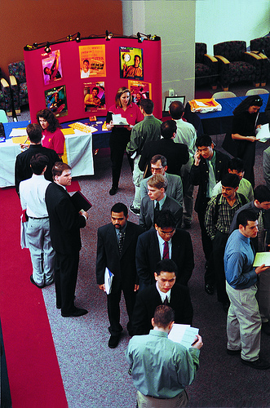
Please help us improve our workshops by completing an evaluation form. Thank you!

