Slide 1
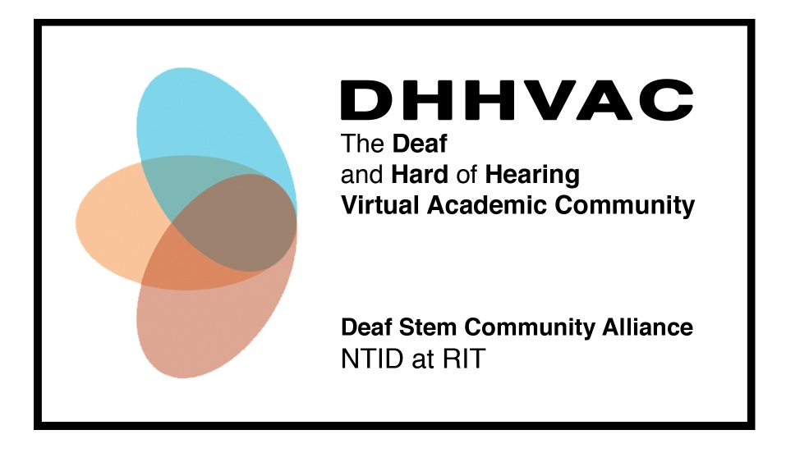
Lisa B. Elliot, Ph.D. & Robb Dooling RIT/NTID Center on Access Technology NTID Foundation Board Meeting, May 4, 2012 Rochester, NY

Slide 2
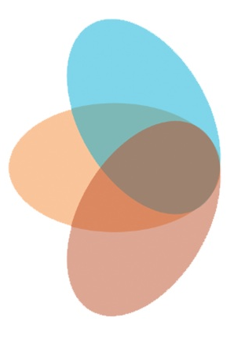
Who We Are
Supported by the National Science Foundation, HRD #1127955
3-5 year project
Leadership team
Lisa Elliot, PI
James DeCaro, Co-PI
E William Clymer, Co-PI

Slide 3
Campus Partners

Slide 4
Background: Two prior NSF grants
Summit to Create a Cyber-Community to Advance Deaf and Hard-of-Hearing Individuals in STEM (OCI-0749253, PI E.W. Clymer)
Three-day conference with 50 national and regional leaders, including D/HH students in the field of access and support service provision for postsecondary D/HH students in STEM programs
Report on current state of remote interpreting and captioning
Recommendations outlining desirable characteristics of a multimedia cyberinfrastructure to provide remote communication support for D/HH students in STEM mainstreamed classrooms

Slide 5
Background: Two prior NSF grants
Testing the Concept of a Virtual Alliance for Deaf and Hard of Hearing STEM Students at the Postsecondary Level, (HRD-0927586, PI E.W. Clymer)
Focus groups and needs assessments
Demographic information
Establish partnerships for this proposal

Slide 6
Goal and Objectives
Goal
Increase the graduation rates of postsecondary
D/HH STEM majors in the long term
Objectives
document and disseminate a description of the process of creating a model VAC for replication
increase the GPAs and retention rates of D/HH students in STEM majors.

Slide 7
Components of the VAC
Remote support services (Years 1-5)
Tutoring
Mentoring by D/HH STEM professionals
Remote access services (Years 4-5)
Captioning
Interpreting
Social networking
Electronic resource collection

Slide 8
Progress to Date
Remote tutoring
8 students/5 tutors at RIT (Biology, Chemistry, Computer Science, Engineering, Math, & Physics)
Using Google+ Hangouts as platform
Building Web Presence (www.dhhvac.org)
Recruiting mentors

Slide 9
Remote Tutoring Using Google+ Hangouts

Slide 10
Remote Tutoring Using Google+ Hangouts

Slide 11
Summer Plans
Building the website using Drupal 7
Making website accessible
Gathering accessible media links (e.g. STEM captioned videos, STEM dictionaries in ASL)
Creating guides for tutors, students, mentors

