Slide 1
Developing the academic program portfolio blueprint
A presentation to the Education Committee
Jeremy Haefner
Provost
November 10, 2011

Slide 2
Agenda
What is the portfolio?
What are the characteristics?
How is the portfolio managed?
Calendar conversion impact
Timeline
Impact
Moratorium
Academic Portfolio blueprint
Why have a blueprint?
What is the blueprint?
Discussion

Slide 3
What is the Portfolio?
What are the characteristics?
How is the Portfolio managed?

Slide 5
What are the characteristics?

Slide 6
Portfolio at its core…
Associate degrees (2 year)
Bachelor of Science and Bachelor of Fine Arts degrees (4-5 years)
Master of Science and Master of Fine Arts, Master of Business Administration, and (now) Master of Architecture
Doctorate of Philosophy (Ph.D.) degrees

Slide 7
RIT’s Academic Portfolio
Current Active RIT Degree Programs to be Converted = 240
Undergraduate Degree # |  | 2011 Enrollment FT / HC |  | Graduate Degree # |  | 2011 Enrollment FT / HC |  | Dual Degree # |  | 2011 Enrollment FT / HC
BS | 66 | 8,581 | 9,945 | MS | 48 | 1,113 | 1,944 | BS/ME | 5 | 27 | 36
BFA | 15 | 1,590 | 1,620 | MFA | 11 | 140 | 185 | BS/MS | 33 | 79 | 112
CT | 4 | 2 | 20 | MST | 2 | 91 | 109
AS |  |  |  | ME | 7 | 62 | 103
AAS | 22 | 565 | 579 | MBA | 4 | 120 | 129
AOS |  |  |  | M.Arch | 1 | - | 11
Dipl. | 0 | 0 | 129 | Ph.D. | 6 | 156 | 172
 |  |  |  | ACT | 16 | 1 | 24
Total: | 107 | 10,738 | 12,293 |  | 95 | 1,683 | 2,677 |  | 38 | 106 | 148

Slide 8
What RIT program has
the distinction
of the largest headcount?
Game design
Business
Mechanical engineering
Computer science
Philosophy

Slide 9
By the numbers…
Rank Program Headcount
1 Computer Science 925
2 Mechanical Engineering 858
3 Electrical Engineering 570
4 Information Technology 507
5 Mechanical Engineering Tech 480
6 Applied Arts & Science 448
7 Game Design & Development 428
8 Computer Engineering 405
9 Software Engineering 327
10 Graphic Design 281

Slide 10
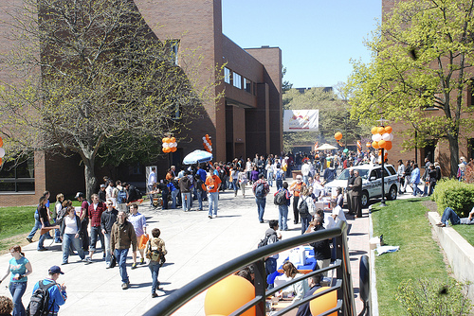
Academic Program Profile
Every program must fit the Academic Program Profile
Guiding principles: Lifelong learning and career orientation
5 Essential Learning Outcomes:
Critical thinking
Global interconnectedness
Ethical reasoning
Integrative literacies
Scientific
Computational
Mathematical
Communication
Technical
Aesthetic
Creative and innovative thinking

Slide 11
How is the Portfolio managed?

Slide 12
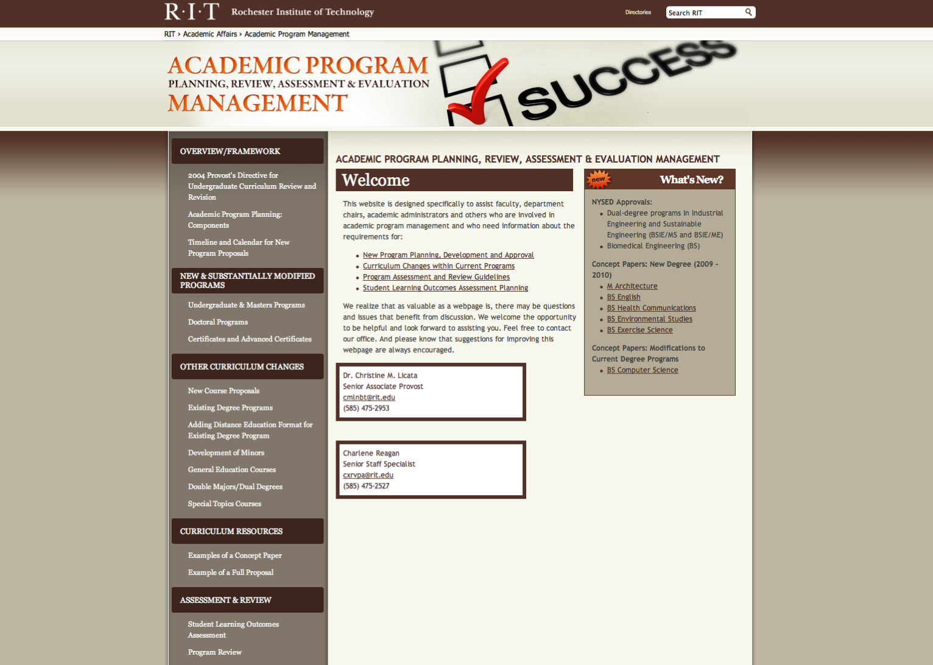

Slide 13
Management Framework
Planning and development
Concept paper review
Full proposal with cost model
Thorough
Evaluation
Program census: annual data
Delaware data: comparative data
New program tracking
Program review: 7 year cycle
Budget review
Improvement or discontinuance
Evaluation feeds improvement
Faculty or administration may choose reinventing or discontinuance

Slide 14
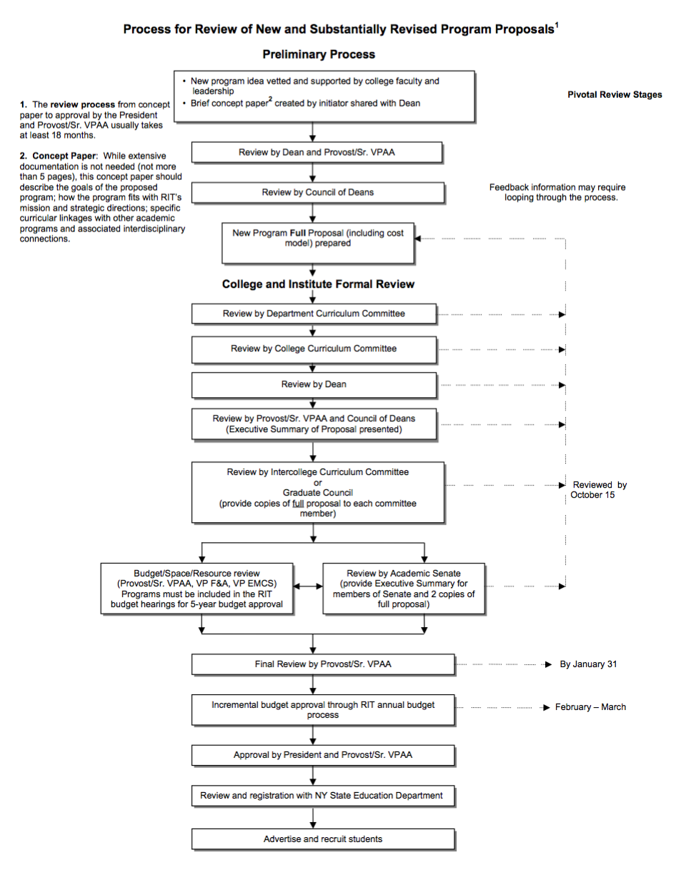

Slide 16
Academic Program Review Process: 7-Year Cycle
Self-Study
Site Visit: External Review Team
Department Chair/Head, Program Faculty and Dean: Prepare Response
Provost: Reviews all materials
Consults as Appropriate
Takes Action
a. Approval of Program’s Action Plan
b. Development of Recovery Plan
c. Resource Enhancement
d. Consolidation
e. Reduction
f. Discontinuance
Academic Program Review Advisory Council (APRAC)
Provides counsel to the Provost
Faculty governance represented
Always convened if program discontinuance is recommended

Slide 17
Since 2008, we now carefully track the performance of new degrees against their projections.

Slide 18
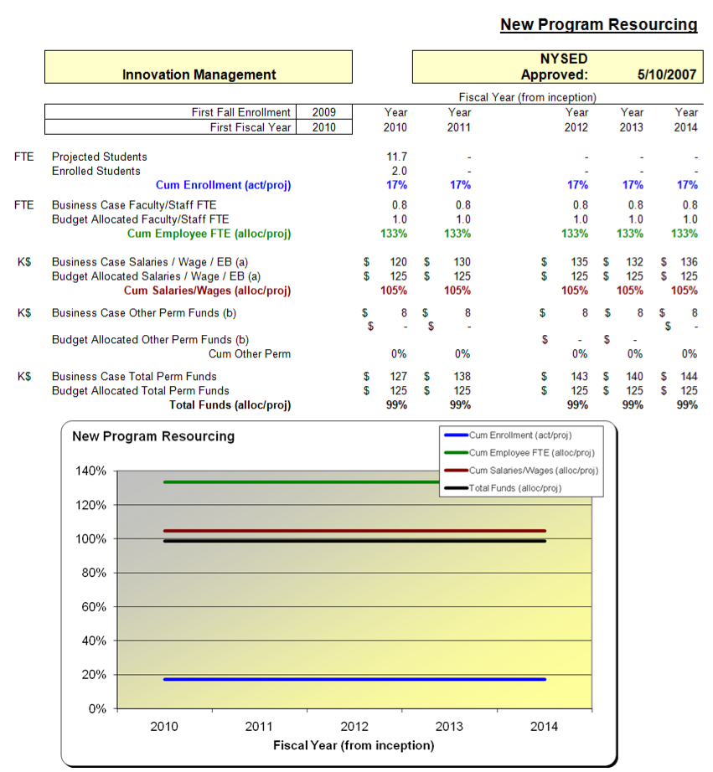

Slide 19
Semester Conversion Impact
Timeline
Impact of the conversion on portfolio
Moratorium

Slide 20
Timeline

Slide 21
Project Timeline: 2010 - 2013
Phase 1:
July 2010 – June 2011
Phase 2:
July 2011 – June 2012
Begin SIS Implementation
Complete expedited program review
Complete general education framework
Curriculum redesign and campus approval
Programs sent to NYSED
for review
SIS implementation complete
Revise processes and policies
Scheduling of courses
Phase 3: July 2012 – August 2013
Programs approved by state
2013 students admission process begins
Individual student advising begins for returning students

Slide 22
Impact of the conversion on the portfolio

Slide 23
Calendar Conversion: 56 Deactivation and Discontinuance
Degree Level | Deactivated | Discontinued
Associate Level/ Diploma | 0 | 27
Cert/AC | 2 | 11
Bachelors | 5 | 2
Masters | 1 | 3
Dual Degree (BS/MS) | 1 | 4
Totals: | 9 | 47
*In addition, 33 inactive programs eliminated

Slide 24
Calendar Conversion
Program Consolidation = 4:
BS Urban and Community Studies → BS Sociology and Anthropology (multiple program concentrations)
BS Biomedical Photographic Communications + BS Imaging and Photographic Technologies → BS Photographic and Imaging Technologies
MFA Computer Graphics Design + MFA Graphic Design → MFA Visual Communication Design
BFA Visual Media + BFA Professional Photographic Illustration → BFA Photographic and Imaging Arts
New Tracks/Options within Programs = 22
New Program Titles = 26

Slide 25
What is the significance of fall 2013?
RIT football begins (again)
The provostial fountain is finally finished
The provost launches a study abroad program in Antarctica and, curiously, the President launches a search for a new provost
The moratorium on new degree proposals
is lifted

Slide 26
Moratorium

Slide 27
What is the moratorium?
No new programs will be approved during conversion period 2010-2013
Focus on conversion and existing programs
Ensure that state reviews program changes expeditiously
Earliest Provost will approve new programs is Spring 2013 for 2014 start

Slide 28
Drafting a 5 year blueprint for the Academic Portfolio
Why have a Blueprint?
- Lessons learned
- Strategic alignment
- Clarity
The Academic Portfolio Blueprint: 2013-2018

Slide 29
Why have a blueprint?

Slide 30
How many programs did RIT create in 2006?
5
10
15
20
23

Slide 31
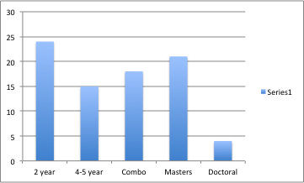
Lessons learned
 | 2003 | 2004 | 2005 | 2006 | 2007 | 2008 | 2009 | 2010 | Total
Certificate |  | 1 | 2 |  |  | 1 |  |  | 4
ACT | 3 |  | 3 | 2 | 3 | 2 | 1 |  | 14
AS | 1 | 1 |  | 1 | 3 |  |  |  | 6
BS |  | 1 |  | 4 | 3 | 4 | 1 |  | 13
BFA | 1 |  |  |  |  | 1 |  |  | 2
BS/MS | 2 |  |  | 8 | 1 | 1 | 1 | 1 | 14
BS/ME | 1 |  |  | 2 |  | 1 |  |  | 4
MS |  | 1 | 3 | 4 | 2 | 2 | 2 | 2 | 16
ME |  |  |  |  |  | 1 |  |  | 1
MBA type |  |  |  |  | 1 |  | 1 |  | 2
MFA |  |  |  |  |  |  |  | 1 | 1
M.Arch |  |  |  |  |  |  |  | 1 | 1
PhD |  |  |  | 2 |  | 2 |  |  | 4
Total | 8 | 4 | 8 | 23 | 13 | 15 | 6 | 5 | 81
St. John Fisher 20 programs
Nazareth 17 programs
SUNY Empire 8 programs
Alfred Univ . 6 programs

Slide 32
New program development: 2003-2011 (by type)
Degree Type | Number
BS | 13
BFA | 2
MS | 14
MST | 1
ME | 1
MFA | 1
MBA | 2
M Arch | 1
BS/MS (BS/ME; BSIE/MS; BSIE/ME) | 18
Ph.D. | 4
Certificate | 4
Advanced Certificate | 13
Total: | 81

Slide 33
New program enrollment: 2003 - 2011
College | Program | Degree | Registration Year | Enrollment 2007 | Enrollment 2011
KGCOE | Chemical Engineering | BS | 2008 | 0 | 164
COLA | Museum Studies | BS | 2007 | 0 | 16
COLA | Philosophy | BS | 2008 | 0 | 12
COLA | Political Science | BS | 2009 | 0 | 28
COLA | Journalism | BS | 2008 | 0 | 39
COLA | International Studies | BS | 2004 | 50 | 71
COLA | Urban & Community Studies | BS | 2006 | 7 | 14
CHST | Biomedical Sciences | BS | 2006 | 140 | 247
CIAS | Motion Picture Science | BS | 2006 | 12 | 41
GCCIS | Game Design & Development | BS | 2006 | 0 | 500
GCCIS | Information Security & Forensics | BS | 2007 | 2 | 3
KGCOE | Industrial Engineering/ Engineering Management | BS/ME | 2006 | 19 | 16
KGCOE | Industrial Engineering/ Systems Engineering | BS/ME | 2006 | 0 | 1
KGCOE | Mechanical Engineering | BS/ME | 2003 | 103 | 92

Slide 34
Lesson learned from new programs and enrollment growth?
From 2005 to 2011, overall enrollment at RIT grew by 2,452 students
From 2005 to 2011, new programs enrolled 2,139 students

Slide 35
Strategic direction
RIT Mission: career oriented educational programs…innovative, creative…global society
RIT Vision: …preparing students for innovative, creative, and successful careers in a global society
KRA 1 Student success
KRA 2
Innovation, creativity, research, and scholarship
KRA 3 Excellence
KRA 4 Stakeholder satisfaction

Slide 36
How can the future portfolio intentionally support the goals:
Student success
Excellence
Innovation, research, scholarship and creativity
Global education
Increasing the numbers of female and AALANA students on campus
5 Essential learning outcomes…

Slide 37
Lastly, clarity

Slide 38
The Academic Portfolio Blueprint (2013-2018) …This is where you come in

Slide 39
Academic Portfolio Blueprint
Effective: 2013-2018
Not prescriptive
Make-up
Boundary conditions or parameters that characterize the portfolio
Criteria for adding new programs to the portfolio

Slide 40
Academic Portfolio Blue Print Taskforce
TF jointly sponsored by Provost and Academic Senate
Co-chairs:
Carole Woodlock, Assoc. Professor, CIAS
Risa Robinson, Assoc. Professor, KGCOE
Other members from EMCS and 9 colleges

Slide 41
Guiding questions I
Number of Programs
Is the current size of the RIT portfolio appropriate?
Should the portfolio be limited to a certain number of undergraduate and graduate degree programs?
If not, should there be any parameter regarding the growth of the portfolio?
Attraction v. Retention
What is the appropriate balance between attractor and retainer programs?

Slide 42
Guiding questions II
Research & Scholarship
Is the current portfolio sufficiently supportive of this goal?
Is the balance of graduate versus undergraduate programs appropriate?
Types of Programs
The current portfolio has a number of technology-related, art and design, natural science, social science and humanity programs.
Is the current balance and synergy appropriate?
If not, what parameter would the taskforce recommend regarding this balance and synergy?

Slide 43
Guiding questions III
Inclusive Excellence
Is the current portfolio sufficiently supportive of these goals?
Is there a parameter or criterion for the portfolio that will support the campus in achieving these goals?
Career Education
Is the current portfolio sufficiently supportive of this goal?
Is there a parameter or criterion for the portfolio that will support this part of our mission?

Slide 44
Guiding questions IV
Use of Technology
Should one criterion address the extent to which the program will use technology (e.g., online, in class, etc.) to deliver content?
Co-op & Experiential Learning
To what extent should the criteria address experiential education?
Specifically, should the criteria include an experiential education factor?

Slide 45
Guiding questions V
Multicultural Education
To what extent should the criteria address global and multicultural education?

Slide 46
Discussion

Slide 47
Question #1: Do we have the right questions?

Slide 48
Questions posed
Is the current size of the RIT portfolio appropriate?
Should there be any parameter regarding the growth of the portfolio?
What is the appropriate balance between attractor and retainer programs?
Is the current portfolio supportive of research and scholarship?
Is the balance of graduate versus undergraduate programs appropriate?
Is the proportion of tech, arts, science, and humanities in the portfolio appropriate?
Should there be a parameter or criterion for the portfolio that supports inclusivity?
Should there be a parameter or criterion for the portfolio to support our mission of career education?
Should there be a criterion that addresses the extent to which the program will use technology (e.g., online, in class, etc.) to deliver content?
Should there be a criterion that addresses the extent to which the program includes an experiential education factor?

Slide 49
Question #2: What questions should we ask the members of the Education Committee to answer?

