Slide 1
Masters of Science in Software Engineering Masters of Science in Data Science
Academia Day Session
Fall 2020

Slide 2
Recording
Note: this meeting is being recorded

Slide 3
Agenda
9:00-9:15 Fill out paperwork
9:15-9:30 Class introductions
9:30-10:30 Program overviews
10:30-10:45 Break
10:45-11:15 Faculty introductions
11:15-12:00 Open Advising
(Software Eng. - Scott)
12:00-12:45 Open Advising
(Data Science - Travis)

Slide 4
Student Introductions
What is your name?
Where you are from?
Affiliated program (Software Engineering or Data Science)
Why Software Engineering or Data Science at RIT?

Slide 5
Software Engineering Program Overview
RIT was the first US university to offer the baccalaureate software engineering degree.
Building on our leadership position in undergraduate software engineering education, we implemented the Master of Science degree in Software Eng.
The program's core content ensures that graduates will possess both breadth and depth of SE knowledge.

Slide 6
Data Science Program Overview
The MSDS is an interdisciplinary program, housed in the SE Department, but supported by GCCIS and the College of Science.
The program's core content ensures that graduates will possess core DS skills such as statistics and machine learning, and the SE skills to be successful in modern companies.
The on campus (albeit temporarily online) program has more focus on gaining applied data science knowledge and experience across a variety, as well as participation in research; as compared to the online version.

Slide 7
What Does it Mean to Engineer Software?

Slide 8
The software engineer’s daily job is to answer questions about the software system.
How can I help the customer? What is required to solve the customer’s problem?
How will the user interact with the system?
What operating system, language, hardware is going to be used?
What is the overall software system structure and how do different components interact with each other?
What code do I have to write?
How do I organize my team so we are effective?
Can we finish the software in time to support our publication deadline?

Slide 9
Engineering Disciplines
Traditional engineering disciplines:
Civil Engineering
Mechanical Engineering
Industrial Engineering
Chemical Engineering
Electrical Engineering
More Specialized:
Nuclear, Biomedical, Aerospace, Aeronautical, Environmental, Computer, Software

Slide 10
What is Software Engineering All About?
Creating useful, high quality, cost-effective software solutions for individuals and industry
Define
What problem are we solving?
Can we solve it with software?
Design
What components do we need?
How do they interact?
Buy them, build them, or use a special purpose framework?
Develop
Flesh out details – coding
Test resulting program
Debug and repair flaws
Deliver
Distribution and installation
User documentation
Developer documentation
Maintenance: fix, extend, integrate

Slide 11
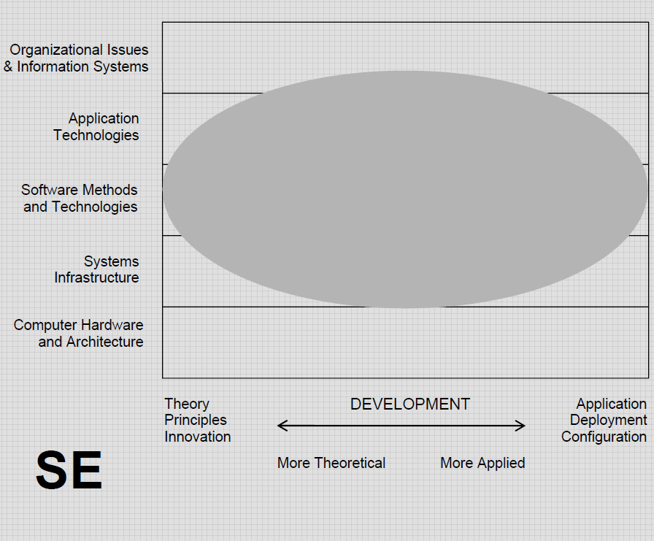
A software engineering program should be a balance of areas in the computing realm

Slide 12
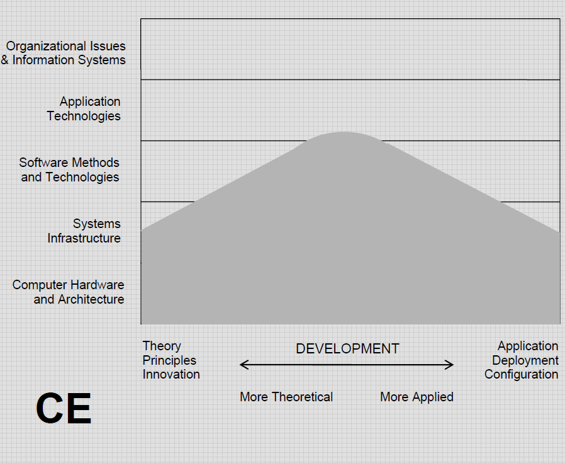
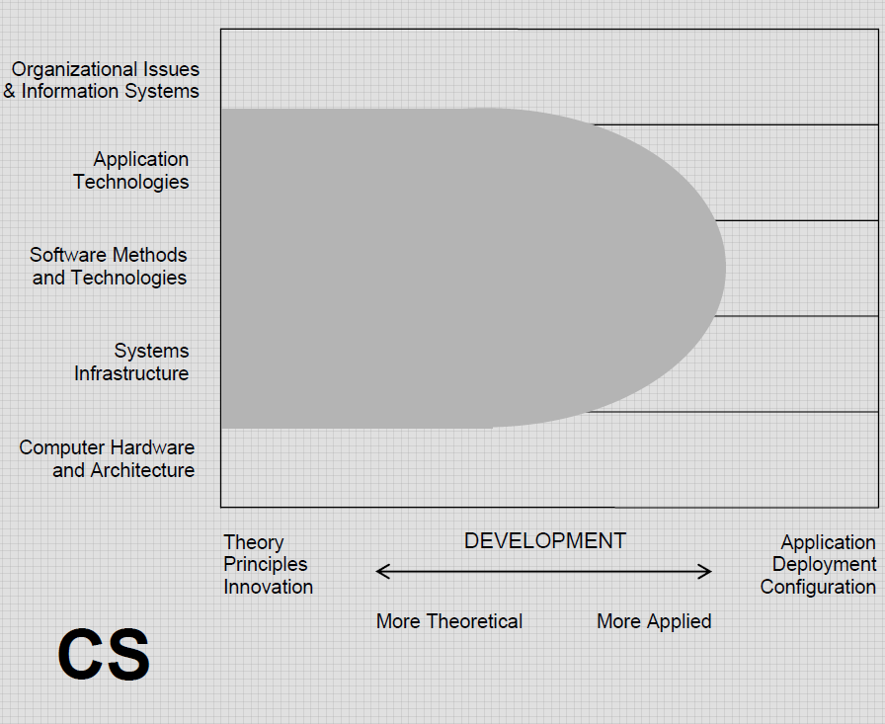
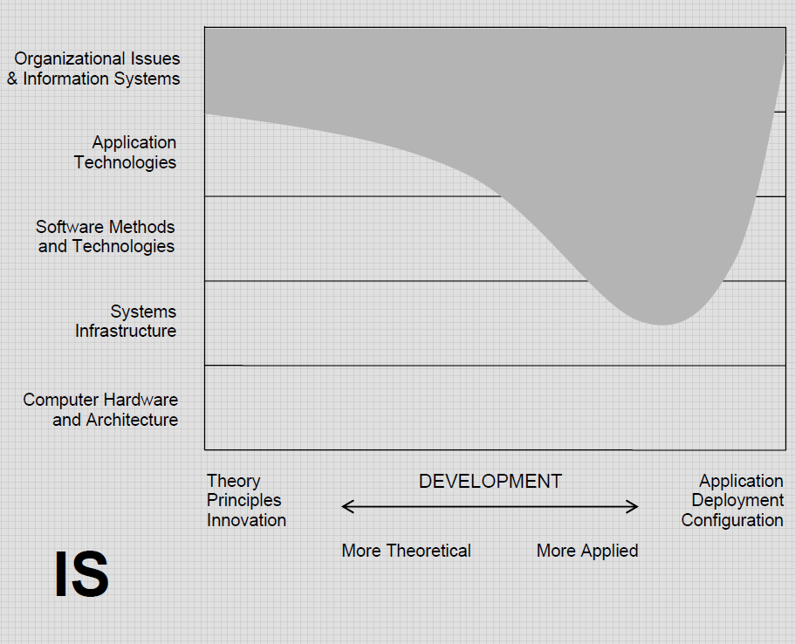
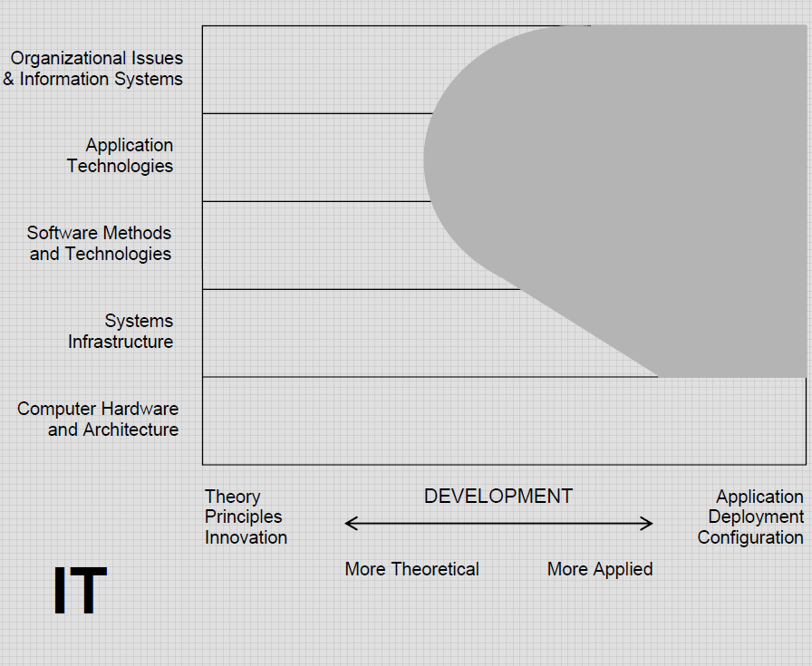
The ACM, AIS, IEEE-CS Computing Curricula 2005 Overview used diagrams to explain the range of computing disciplines
2020 draft includes Data Science and others

Slide 13
What Does it Mean to Be A Data Scientist?

Slide 14
The data scientist's daily job is to understand and create actionable information from data.
How do I clean my data to make it machine readable/usable?
How do I store my data to make it secure and appropriately/easily accessible (big data)?
What kind of data do I have and what is my approach (unsupervised, semi-supervised, supervised)?
What algorithms should I use to get the information I need?
How can I make my analysis as efficient as possible (distributed/high performance computing)?
How can I visualize and explain the data and my results?

Slide 15
Applied Domains
A good data scientist should have the core knowledge to successfully apply their data science skills to a wide range of applied domains, but it can be beneficial to specialize.
Example Data Science Specializations:
Bioinformatics
Computational Finance
Business Analytics
Computer Vision
Time Series Data Analytics
Software Engineering

Slide 16
What is Data Science All About?
Data science is a multi-disciplinary field that uses scientific methods, processes, algorithms and systems to extract knowledge and insights from structured and unstructured data.
-- https://en.wikipedia.org/wiki/Data_science
Pre-processing
Data sanitization
Storage
Big Data
Database Systems
Data Security
Computing:
Parallel / Multi-threaded
Distributed
High-Performance
Custom Hardware (GPUs)
Analysis/Analytics
Artificial Intelligence
Machine Learning
Statistics
Clustering / Unsupervised Learning
Visualization
Knowledge of visualization tools/frameworks
Types of visualizations

Slide 17
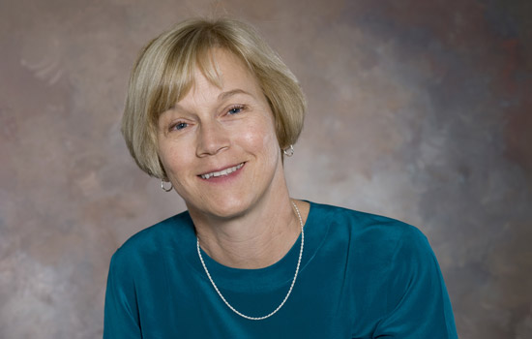
The College: GCCIS
Golisano College of Computing and Information Sciences
Founded July 2001
Dean: Dr. Anne Haake
www.gccis.rit.edu/anne-haake

Slide 18
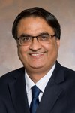
The College: GCCIS
Department of Software Engineering
Professor and Chair:
Naveen Sharma
Houses
Software Engineering program
Data Science program (on campus)
https://www.linkedin.com/in/nsharma2

Slide 19
The College – continued
Departments
Software Engineering
Including Data Science
Computer Science
Computer Security
Information Sciences and Technologies
Including Human Computer Interaction, Networking and Systems Administration, and on-line Data Science
School of Interactive Games & Media
Ph.D. Program

Slide 20
SE Program Overview
36 semester credit hours
4 semester program
Co-op is optional but encouraged
Courses are a mixture of hands-on projects and research
Thesis or Capstone option

Slide 22
DS Program Overview
30 semester credit hours
3 semester program
Co-op is optional but encouraged
Courses are a mixture of hands-on projects and research
Thesis or Capstone option

Slide 23
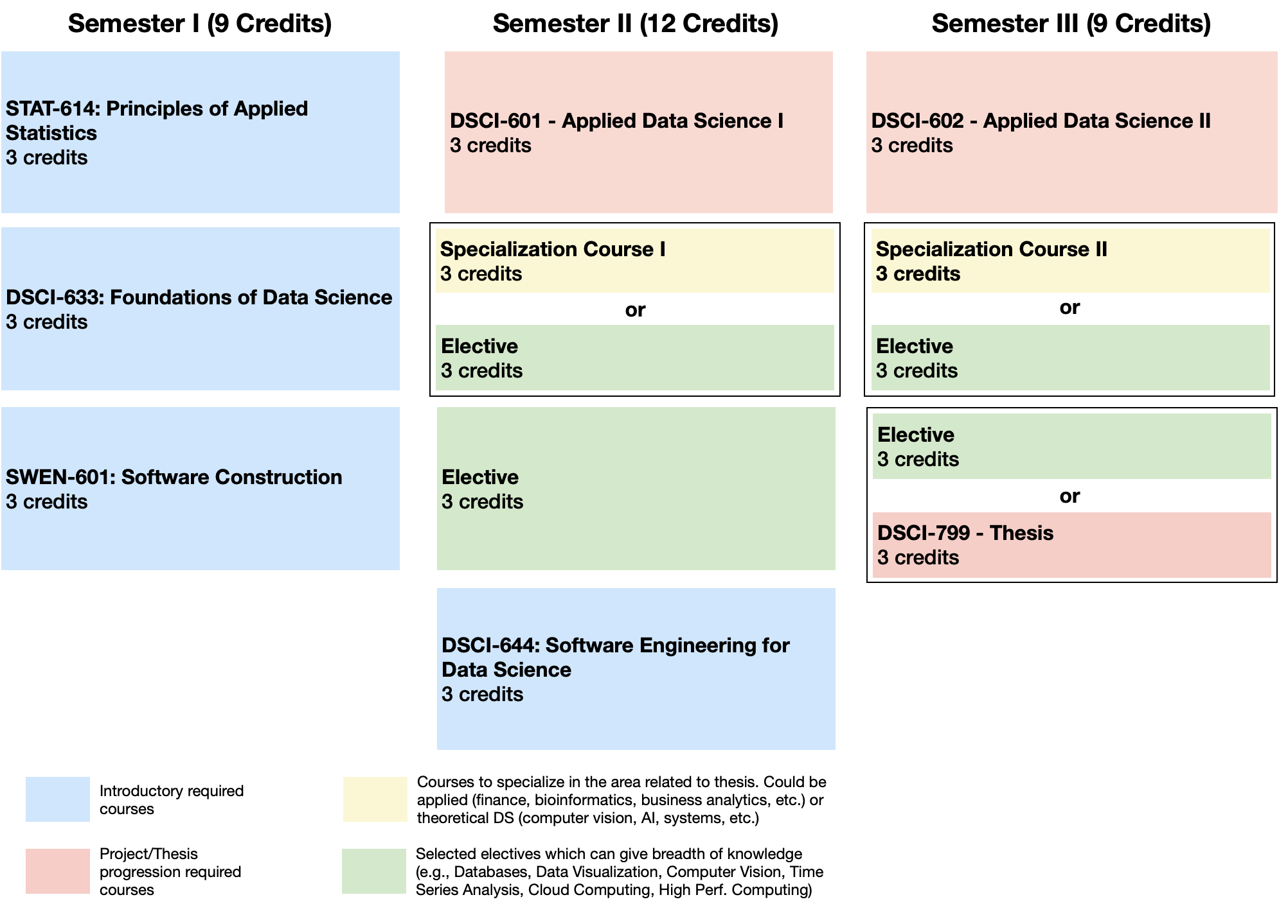
DS Curriculum Flowchart (Three Semester)

Slide 24
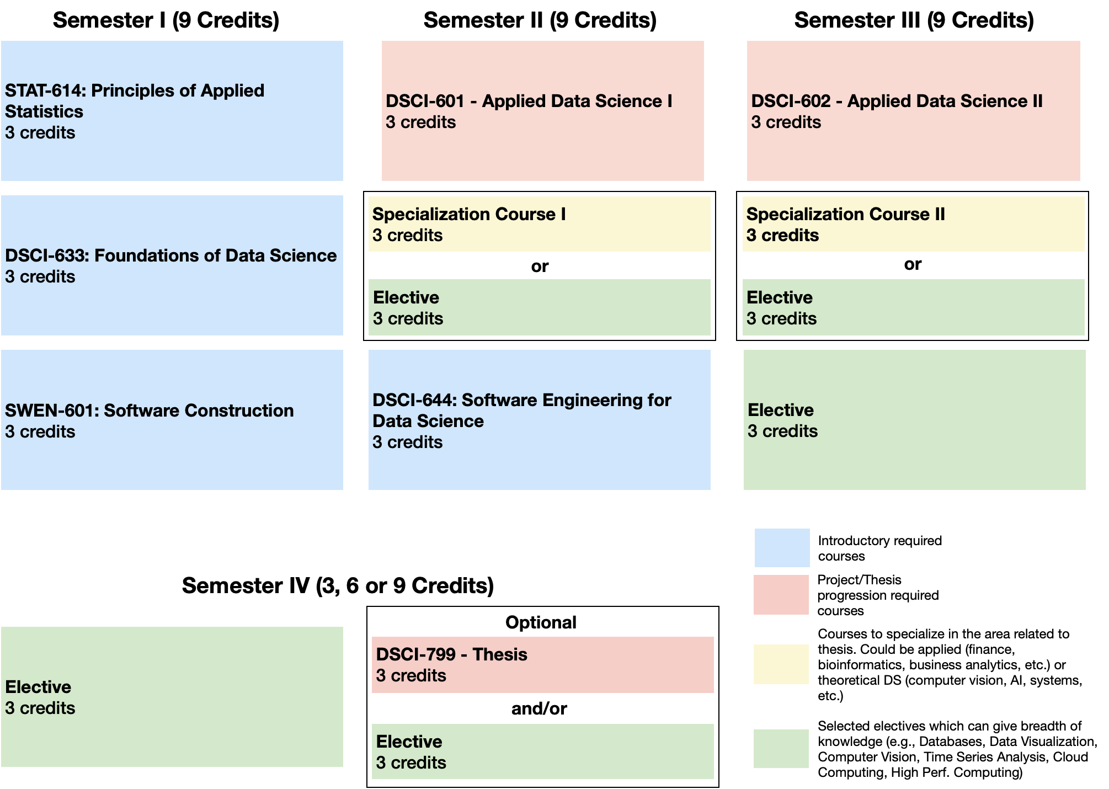
DS Curriculum Flowchart
(Four Semester)

Slide 25
Introductions – Graduate Program Faculty
Naveen Sharma – SE Department Chair
Scott Hawker – SE Grad Program Director
Travis Desell – DS Grad Program Director
Mihail Barbosu - DS Assoc. Program Director
Dan Krutz – SE Faculty
Andy Meneely – SE Faculty
Mehdi Mirakhorli – SE Faculty
Mohamed Wiem Mkaouer – SE Faculty
Christian Newman- SE Faculty
Qi Yu - IST/DS Faculty
Zhe Yu - DS Faculty
Robert Parody - Applied Statistics/DS Faculty

Slide 26
SE and DS Research Areas – Broad View
Faculty | Research Areas
Andy Meneely | Engineering Secure Software Systems | Empirical Software Engineering
Dan Krutz | Mobile Security/Privacy | Mining Software Repositories | Software Engineering Education
Mehdi Mirakhorli | Application of Machine Learning to Software Architecture | Software Traceability and Software Security
Mohamed Wiem Mkouer | Search-based Software Engineering | Software Refactoring and Re-modularization | Bug Management
Naveen Sharma | Self-* and adaptive software system for immune/resilient infrastructure | Urban data science and software applications
Scott Hawker | Software Process Mining | Model-Driven Software Development
Christian Newman | Source code analysis and transformation
Travis Desell | Data Science | High-performance & distributed computing | Machine learning
Mihail Barbosu | Mathematics | Statistics
Robert Parody | Applied Statistics
Qi Yu | Machine Learning
Zhe Yu | Machine Learning | Information Retrieval | Human-Centered Software Engineering

Slide 27
SE Computer Account
GCCIS has consolidated its system administration support (gccsit@rit.edu)
You will be assigned a departmental account
Can use it in SE classrooms, labs, team rooms
Print Quota
Storage Quota
Team Room Access

Slide 28
Codes & Abbreviations to Know
Software Engineering Data Science | SE DS
Golisano College of Computing & Information Sciences | GCCIS
Program Codes | SWEN or DSCI
Year level | 6

Slide 29
Contacts
Who to contact
Britt Stanford and Dawn Smith: Administrative issues
Scott: Academic/Career issues in SE
Travis: Academic/Career issues in DS
Kurt & Arnela: Computer Account Issues – gccisit@rit.edu
Messages from the Department:
RIT email

Slide 30
Department Facilities
Studio Labs/Classrooms
Team Rooms
CoLab
Mentoring Lab (Society of Software Engineers)
PhD Lab
Shared space with Information Systems
Primary: GOL 2670
Secondary: either GOL 2130 (Networking lab) or GOL 2320 (Sys Admin lab) when they are not being used for classes
Faculty and Staff Offices

Slide 31
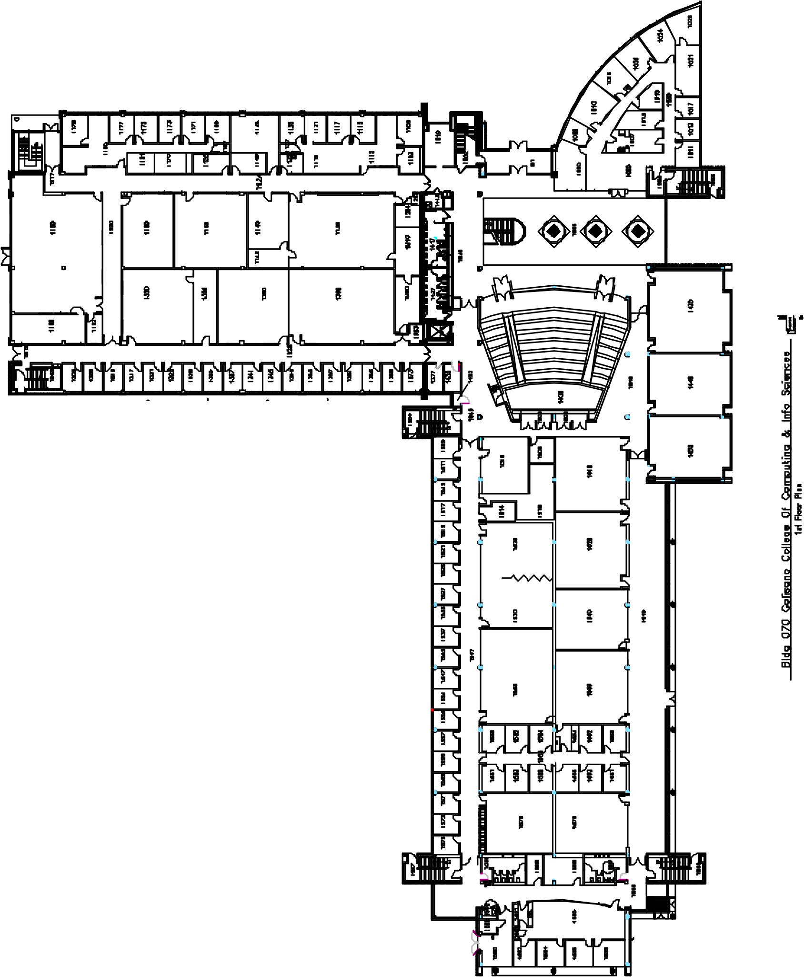
Golisano College, Bldg GOL (70)

Slide 32
Classroom Protocol
When you come to class, *wait for the prior class to leave* before entering.
Please don't congregate in the hall.
Try not to arrive till 5 minutes before class.
For students in class, please leave the room when class ends, so we have time for crowds to clear out.
Clean off the computer when you sit down, and clean it off again before you leave
Please don't congregate in the halls, or in class after class-time
If you come to class without a mask, you will be given a disposable mask or asked to leave the room
I know this is hard and this is inconvenient; but this is the right thing to do!

Slide 33
Curriculum
Plan of Study
Follow the curriculum flow chart
Meet with Dr. Hawker or Dr. Desell to discuss your goals and determine your courses
You can revise your selections
Within constraints

Slide 34
Recent Electives
More graduate faculty results in more elective opportunities
Software Engineering Methods in Data Science
Engineering Self-Adaptive Software Systems
Engineering Cloud Software Systems

Slide 35
New DS Electives
DSCI-789: Neural Networks for Data Science
DSCI-650: High Performance Data Science

Slide 36
Curriculum – Electives
Must be approved
Course number 600 or greater to count
Grade must be a ‘C’ or greater to count
‘C-’ is not a ‘C’
Elective courses typically from SE, DS, CS, CE, HCI, IST, Management (BUSI)
DS Elective courses can also include specializations from applied domains.
Pre-approved list is on-line
You can lobby for courses not on the pre-approved list
Either way, fill out an Elective Approval form

Slide 37
Curriculum
Optional Co-op
Can be after 18 on-campus credits
What is a co-op? When can I take it?
How do I find one?

Slide 38
Grading
You must maintain a grade point average >= 3.0
You must obtain at least a ‘C’ in every graduate course
A ‘C-’ is a failing grade
The GPA is calculated on ALL courses, including bridge; 36 (SE) or 30 (DS) credits used for certification
Repeating a graduate course does not replace the grade

Slide 39
SE Curriculum: Capstone or Thesis
Taken at the end of your program
Thesis: 6 credit-hour research experience with a faculty advisor and committee
Capstone: 3 credit-hour hands-on experience with a faculty advisor
Process starts the second semester with SWEN 640 Research Methods
Topic proposal, with literature review
Locate advisor and committee*
Refer to Graduate Student Handbook for further details

Slide 40
DS Curriculum: Capstone or Thesis
Can decide before third semester.
Capstone: Is developed as part of the Applied Data Science Project course sequence (ADS I, II, III and directed study) with a faculty advisor - begins your first semester.
Thesis: An additional 3 credit-hours of thesis credit can be taken in place of an elective in the last semester to extend your applied data science project into a full MS thesis.
Refer to Graduate Student Handbook for further details.

Slide 41
Course Registration Process
Know your registration date
Meet with Scott or Travis
Submit applicable forms
Elective Approval Form
Independent Study Form
Capstone or Thesis Registration Form
Capstone or Thesis Continuation Form
Register online using SIS/Tiger Center

Slide 42
Registration Tips
Don’t put off registration…. courses may fill up quickly
Most SE/DS courses are offered only once per year…. make sure you stay on track
Use the flowchart to track your progress

Slide 43
Add/Drop and Withdrawing
Add/Drop
First week of classes
Changed courses will not be recorded on your transcript
Withdrawal
After add/drop, you can withdraw from a course (consult the academic calendar)
You will receive a grade of ‘W’ on your transcript

Slide 44
Other Policies & Procedures
Academic Probation
Academic Honesty
7-Year Rule

Slide 45
Scheduling Appointments
Preference: During posted open office hours
Contact the front desk or send an email to schedule an appointment
No same day appointments
Sample advising topics:
Registration
Plan of Study Worksheet Review
Leave of Absence/University Withdrawal
Course Withdrawal
Academic Difficulty
Graduation/Remaining Requirements
Schedule Planning/Changes
Change of Program Out
Full-time Equivalency (FTE)
Co-op

Slide 46
How to Connect- Advisor/Advisee Etiquette
Be patient and respectful
Include your first name, last name, and University ID in email
Write professional, business-quality emails
Plan ahead – emailing the night before a deadline will not guarantee a prompt response
Do not consult your friends/peers for advising matters
Arrive to appointments on time

Slide 47
How to Connect - Resources
Graduate Director and Faculty
Staff
Tutoring Center
Academic Support Center
Campus Writing Commons
Graduate Meetings/Workshops
Email
Graduate Studies, International Student Services, Health Center, etc.
Office hours

Slide 48
Timing Is Everything - Full-time Status
Full-time students must register for and successfully complete nine or more credit hours per semester
If you fall below nine credits by dropping or withdrawing from a course, your scholarship, financial aid, student loans, and student visa (if any are applicable to you) will be affected in future terms
See Prof. Hawker or Prof. Desell before you do anything that will change your status

Slide 49
Helpful Hints – Full-time Status
Withdrawing/Dropping a course is NOT always possible
Full-time equivalency: course load credit for graduate work, such as a paid graduate assistantship or a paid research assistantship
You may use only two. It is important you use them wisely so you will have ample time to complete your degree
Intersession and summer terms are considered breaks in which you are not required to be enrolled
Can be less than full-time during last semester

Slide 50
Timing Is Everything- Application For Graduation
Registrar emails all grad students beginning their first semester inviting them to Apply for Graduation on the system
Apply TWO TERMS before you complete the program

Slide 51
Advisor and Program Directors
Britt, Dawn, Travis, and Scott work closely together
Do not ‘shop around’ for answers

Slide 52
Plagiarism and Cheating
Plagiarism and cheating will not be tolerated at RIT
Copying another person’s homework or models and code
Giving another student’s models, code, or answers on assignments
Copying from the Web
Copying text/writing that is not your own
Working with peers when not given permission
etc.
It is your responsibility to obtain a good understanding of what plagiarism is
The library is a good source of information
Plagiarism or cheating can result in an “F” for an assignment or an “F” in the course
Scholarship will be taken away
I-20 Program Extension may not be granted
Suspension is possible
THIS IS SERIOUS

Slide 53
Academic Dishonesty - Consequences
First offense:
Scholarship will be removed for the term it happens
This means you have to pay more money
Second offense:
Suspension or ‘not renewing of I-20’

Slide 54
Probation and Suspension
You must maintain a 3.0 semester and cumulative GPA
You will be placed on probation if your semester and/or cumulative GPA fall below 3.0
If your cumulative GPA is below 3.0, you will be placed on probation
You must raise GPA to a minimum of 3.0 the next academic semester or face suspension
Suspended students must leave the university for one year and then MUST reapply to obtain an RIT degree. Re-admission is not guaranteed.
Talk to Travis or Scott as soon as possible if this may happen to you

Slide 55
Co-Op
Co-op is a privilege
Full-time students and GPA >= 3.0
Completed >= 18 on-campus credits of the MS
8/16/2019

Slide 56
Co-Op – Bad Things
If you are found responsible for academic dishonesty
Future co-op will most likely not be granted
Scholarship will be removed
If co-op report from your employer is very bad
Future co-op will most likely not be granted
If you renege a co-op
Future co-op will not be granted
Scholarship will be removed

Slide 57
Etiquette
Behave as a Professional
Politeness
Humility
Honesty
Patience
Personal hygiene
Mindful of others

Slide 58




RIT SE Web Presence
Software Engineering at RIT
Data Science at RIT
SE Facebook
SE WhatsApp
DS WhatsApp

Slide 59
Wrap-up
Any questions?
Any comments?
Any concerns?
Any Excitement?!

