Slide 1
Academia Day Session
Fall 2021 (2211)
Masters of Science in Data Science
Travis Desell
DS Graduate Program Director
Masters of Science in Software Engineering
Scott Hawker
SE Graduate Program Director

Slide 2
Recording
Note: this meeting is being recorded

Slide 3
Agenda
9:00-9:15 Welcome and Agenda Review
9:15-10:15 Program Overviews
  Software Engineering
  Data Science
10:15-10:30 Break
10:30-11:00 Meet the faculty
11:00-12:00 Questions and Open Advising for those that need it

Slide 4
Software Engineering
Program Overview
RIT was the first US university to offer the baccalaureate software engineering degree.
Building on our leadership position in undergraduate software engineering education, we implemented the Master of Science degree in Software Engineering
The program's core content ensures that graduates will possess both breadth and depth of SE knowledge.

Slide 5
Data Science
Program Overview
The MSDS is an interdisciplinary program, housed in the SE Department, but supported by GCCIS and the College of Science.
The program's core content ensures that graduates will possess core DS skills such as statistics and machine learning, and the SE skills to be successful in modern companies.
The on campus program has more focus on gaining applied data science knowledge and experience across a variety, as well as participation in research; as compared to the online version.

Slide 6
What Does it Mean to Engineer Software?

Slide 7
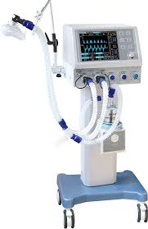

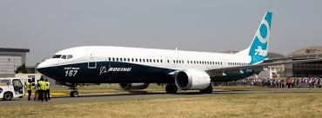

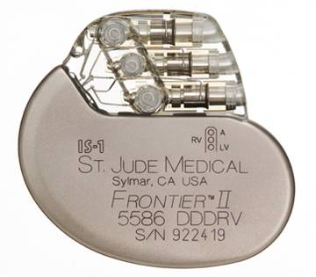


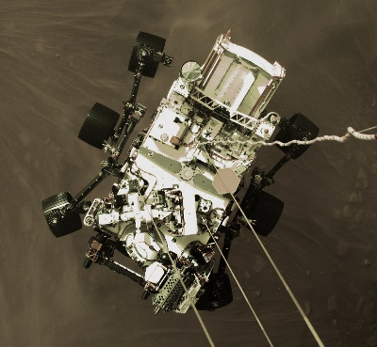

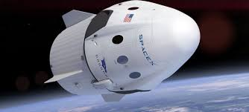

Software Systems & Products
More than just apps, web sites, and games!
Notes:
We all are very familiar with a number of software products.
It is unlikely we can go through an entire day without interacting with a software product, even if not consciously doing so.
Many are interactive (Madden, FB, etc.)
More are known as “embedded” applications. Often working with other systems and mechanical devices.
Aviation and spacecraft control.
Anti-lock brakes in your auto
Medical devices, like ventilators or pacemakers.
The latter are identified as “mission critical” – they absolutely have to work – all the time – reboot is not an option!

Slide 8























Our students and graduates are finding jobs in a broad array of companies across many application areas
Notes:
Where to our students co-op and work after graduation?
Every business that requires software = everywhere
Small vs large, different domains and applications, different parts of the country
Co-op = no strings attached opportunity to experiment and audition (both ways)

Slide 9
What is Software Engineering All About?
Creating useful, high quality, cost-effective software solutions for individuals and industry
Define
  What problem are we solving?
  Can we solve it with software?
Design
  What components do we need?
  How do they interact?
  Buy them, build them, or use a special purpose framework?
Develop
  Flesh out details – coding
  Test resulting program
  Debug and repair flaws
Deliver
  Distribution and installation
  User documentation
  Developer documentation
  Maintenance: fix, extend, integrate

Slide 10
Our program is based on the four elements of the software engineer’s daily practice.
Software engineering design
Software development process (including programming)
Teamwork
Communication
Software Engineering Video
By learning these four skills, you will be able to deliver software products that meet the customer’s needs, arrive on time, within budget, and operate without bugs.
Notes:
Our program’s learning outcomes align directly with the SE practices previously mentioned.

Slide 11
Teamwork & Communication*
* taken from actual SE job postings
“Candidate needs to thrive in a team environment.”
“Will be a member of a multi-function team where exceptional interpersonal, written and oral communication skills are desired.”
“Ability to adapt quickly and be effective in new situations.”
“Is a team player, adept at building relationships across organizations.”
“Maintain a professional attitude during all stages of development.”
Developing software is a highly social activity. A team sport.
Notes:
In addition to technical competencies, SE requires a high level of communication and teamwork. Not only collaborating with project team members, but also with project sponsors & customers – often in application domain language.
These are quotes taken from job postings from various companies for software engineering positions.
Developing software is a highly social activity.
Has noted, it also requires the ability to think on your feet, and adapt to constantly changing project requirements.

Slide 12
Differences Between
Computer Science and Software Engineering
Apply
Computer
Science
Software
Engineering
Needs
Science & Theory
Application to Systems & Products
  Programming
  Computing Theory
  Algorithms and Data Structures
  Data Management
    Where does technology need to be improved to meet application needs?
  Product Requirements
  Architecture & Design
  Software Construction
  Development Process
  What’s the most appropriate technology for the applications’ requirements?
Notes:
As promised – how is CS different from SE?
The arrow represents the spectrum of “focus” on science/theory vs application.
CS focus goes more to left towards science & theory. The continuous discovery and improvement of computing. Think new programming languages, algorithms, etc.
SE focus is on applying this core knowledge and new discoveries to the engineering of software products.
Note the strong link and dependency between the two disciplines.
It is not a black and white definition.
CS often slide to the right and participate in direct product development.
SE likewise move to left to delve deeper into a particular CS area based on the product they are developing.

Slide 13
What Does it Mean to Be A Data Scientist?

Slide 14
The data scientist's daily job is to understand and create actionable information from data.
How do I collect and clean my data to make it machine readable/usable?
How do I store my data to make it secure and appropriately/easily accessible (big data)?
What kind of data do I have and what is my approach (unsupervised, semi-supervised, supervised)?
What algorithms should I use to get the information I need?
How can I make my analysis as efficient as possible (distributed/high performance computing)?
How can I visualize and explain the data and my results?

Slide 15
Applied Domains
A good data scientist should have the core knowledge to successfully apply their data science skills to a wide range of applied domains, but it can be beneficial to specialize.
Example Data Science Specializations:
  Bioinformatics
  Computational Finance
  Business Analytics
  Computer Vision
  Time Series Data Analytics
  Software Engineering

Slide 16
What is Data Science All About?
Data science is a multi-disciplinary field that uses scientific methods, processes, algorithms and systems to extract knowledge and insights from structured and unstructured data.
-- https://en.wikipedia.org/wiki/Data_science
Pre-processing and Collection
  Data sanitization
  Scraping
Storage
  Big Data
  Database Systems
  Data Security
Computing:
  Parallel / Multi-threaded
  Distributed
  High-Performance
  Custom Hardware (GPUs)
Analysis/Analytics
  Artificial Intelligence
  Machine Learning
  Statistics
  Clustering / Unsupervised Learning
Visualization
  Knowledge of visualization tools/frameworks
  Types of visualizations

Slide 17
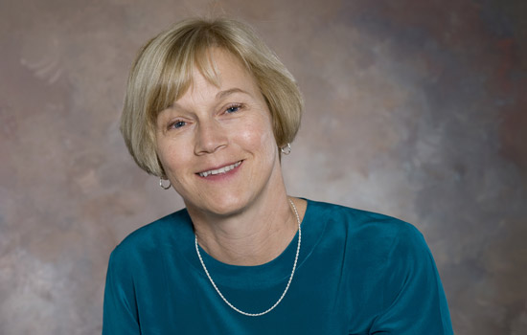
The College: GCCIS
Golisano College of Computing and Information Sciences
Founded July 2001
Dean: Dr. Anne Haake
www.gccis.rit.edu/anne-haake

Slide 18
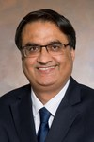
The College: GCCIS
Department of Software Engineering
Professor and Chair:
  Naveen Sharma
Department Houses
  Software Engineering program
  Data Science program (on campus)
https://www.linkedin.com/in/nsharma2

Slide 19
The College – continued
Departments and Administrative Academic Units in GCCIS
  Software Engineering
    Including Data Science
  Computer Science
  Computer Security
  School of Information Sciences (iSchool)
    Including Information Systems and Technologies, Human Computer Interaction, and on-line Data Science
  School of Interactive Games & Media
  Ph.D. Program
    A Separate administrative unit for Ph.D. students across the college
    Master’s Programs are in the Departments

Slide 20
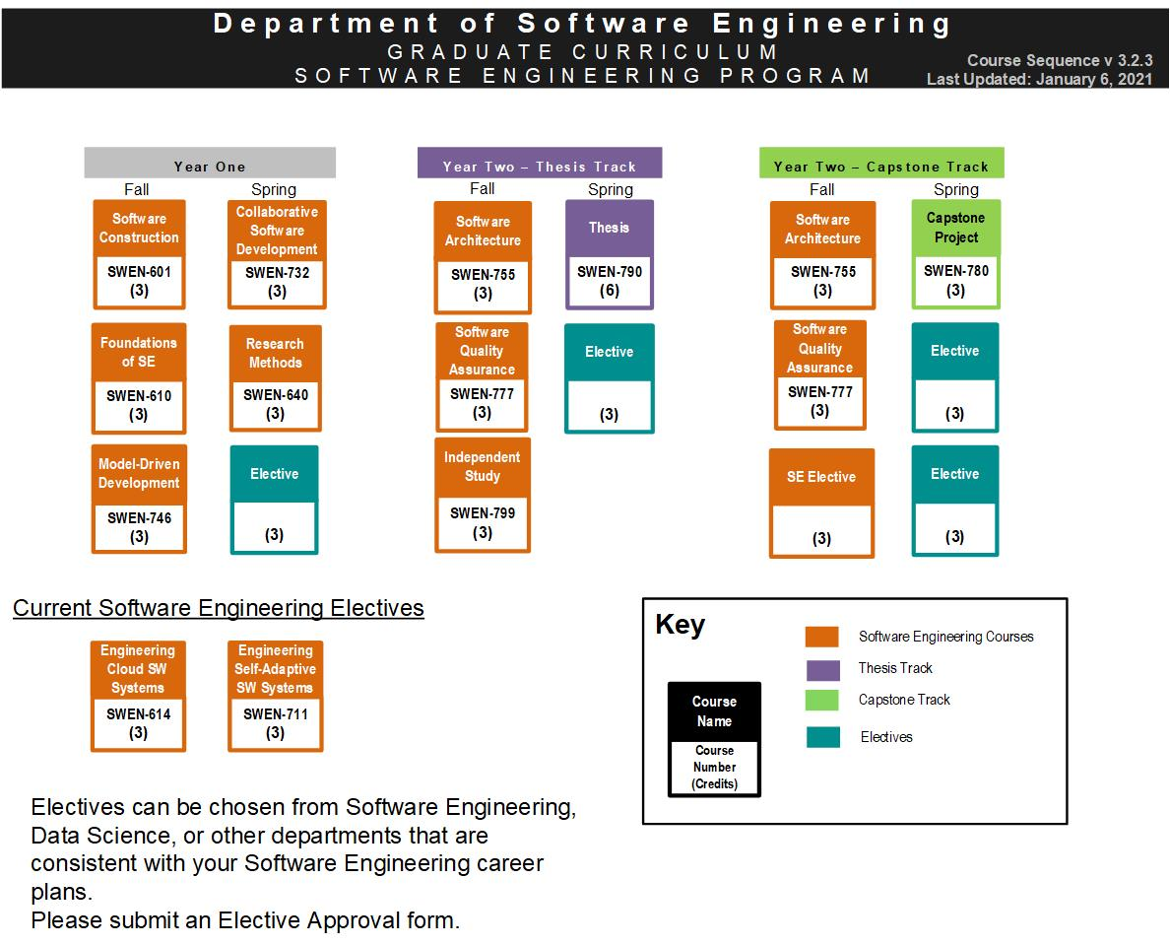
Software Engineering Curriculum
Hands-on: Team projects, Small classes, Co-op/Intern
Co-op

Slide 21
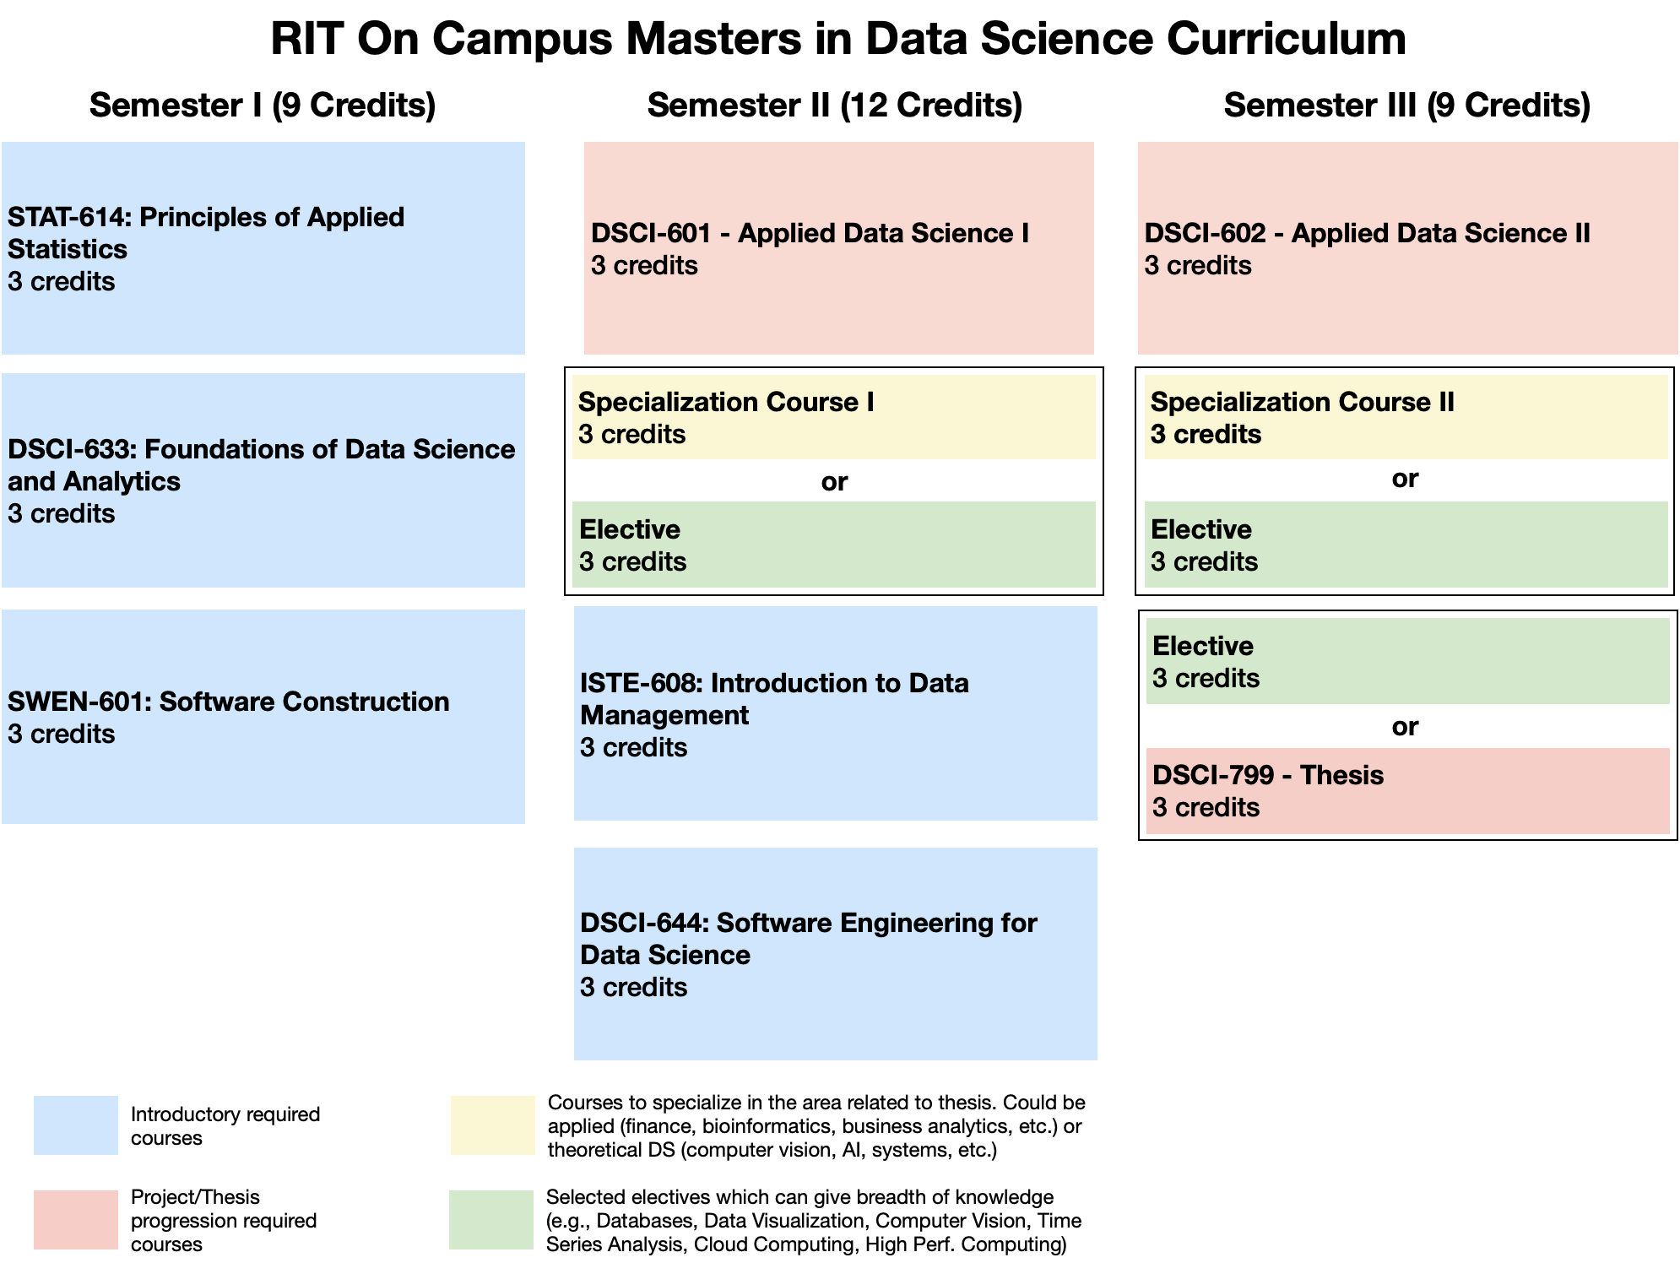
DS Curriculum Flowchart
(Three Semester)

Slide 22
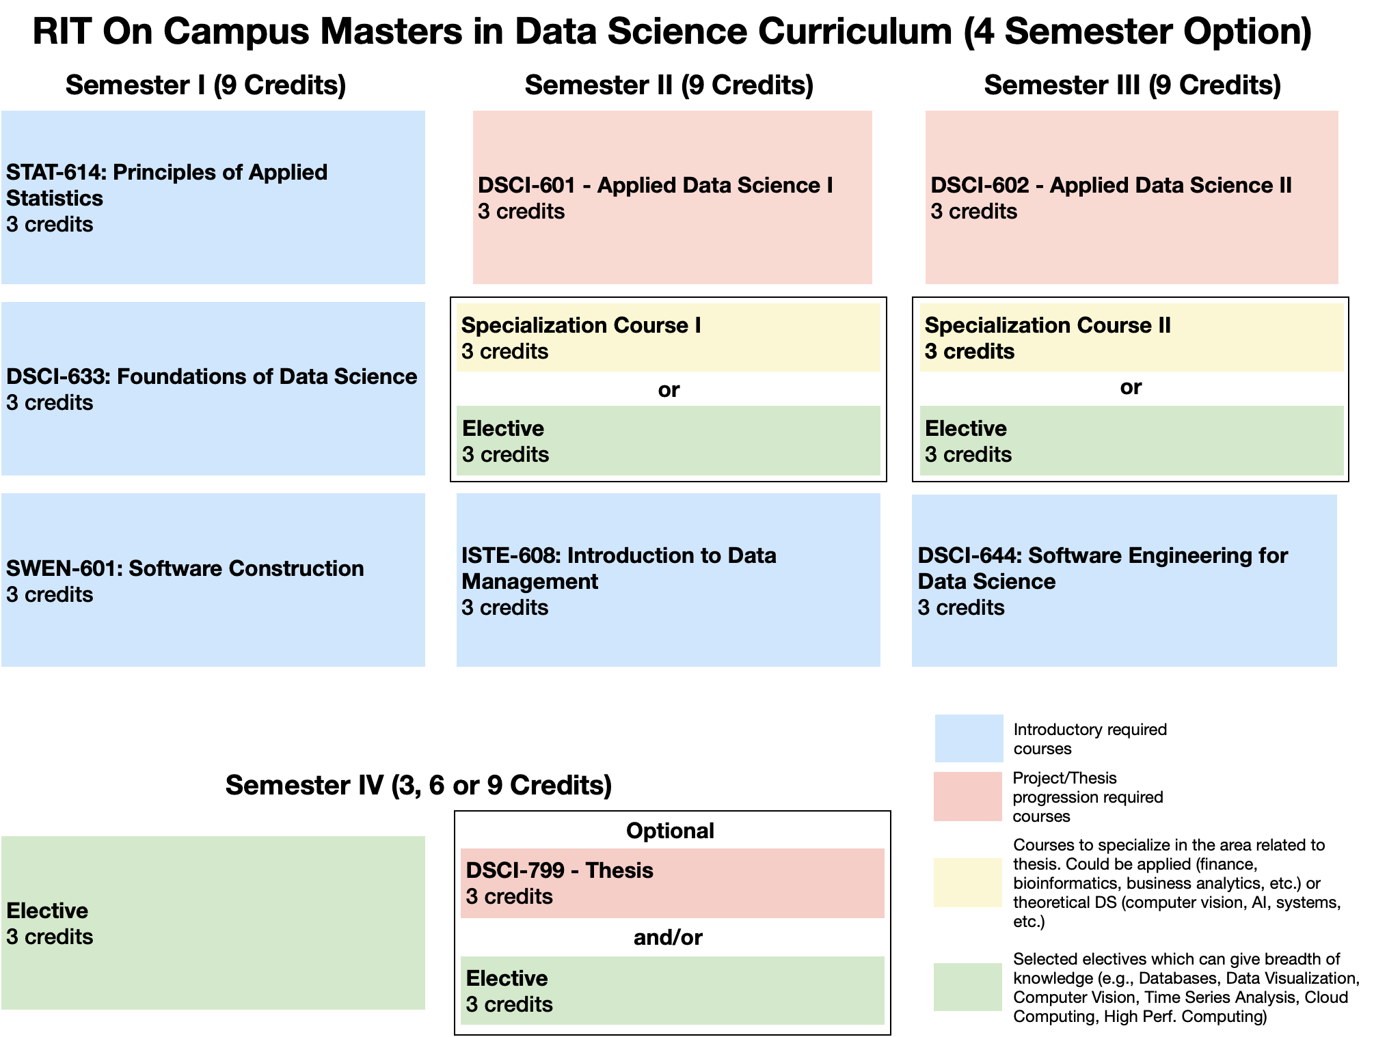
DS Curriculum Flowchart
(Four Semester)

Slide 23
SE and DS Research Areas – Broad View
Faculty | Research Areas
Andy Meneely | Engineering Secure Software Systems | Empirical Software Engineering
Ashique KhudaBukhsh | AI for social impact | Natural language processing | Machine learning
Christian Newman | Program Comprehension | Natural Language Processing | Empirical Software Engineering | Source Code Analysis
Dan Krutz | Self Adaptive Systems | Decision Support Systems | Computing Education
Mehdi Mirakhorli | Application of Machine Learning to Software Architecture | Software Traceability and Software Security
Mihail Barbosu | Mathematics | Statistics
Mohamed Wiem Mkouer | Search-based Software Engineering | Software Refactoring and Re-modularization | Bug Management
Naveen Sharma | Self-* and adaptive software system for immune/resilient infrastructure | Urban data science and software applications
Nidhi Rastogi | Applied Machine Learning | Security & Privacy | Autonomous Vehicles | Graphs
Robert Parody | Applied Statistics
Scott Hawker | Software Process Mining | Model-Driven Software Development | Domain-Specific Languages
Travis Desell | Data Science | High-performance & distributed computing | Machine learning
Qi Yu | Machine Learning
Zhe Yu | Machine Learning | Information Retrieval | Human-Centered Software Engineering

Slide 24
Co-Op
Co-op is a privilege
Full-time students and GPA >= 3.0
Completed >= 18 on-campus credits of the MS
Use the RIT Career and Co-op Services to find a co-op or permanent job upon graduation
8/16/2019

Slide 25
Co-Op – Bad Things
If you are found responsible for academic dishonesty
  Future co-op will most likely not be granted
  Scholarship will be removed
If co-op report from your employer is very bad
  Future co-op will most likely not be granted
If you renege a co-op
  Future co-op will not be granted
  Scholarship will be removed

Slide 26
TWO Important messages

Slide 27
Classroom Protocol for COVID
When you come to class, *wait for the prior class to leave* before entering.
  Please don't congregate in the hall.
  Try not to arrive till 5 minutes before class.
  For students in class, please leave the room when class ends, so we have time for crowds to clear out.
Clean off the computer when you sit down, and clean it off again before you leave
Please don't congregate in the halls, or in class after class-time
If you come to class without a mask, you will be given a disposable mask or asked to leave the room
I know this is hard and this is inconvenient; but this is the right thing to do!

Slide 28
Plagiarism and Cheating
Plagiarism and cheating will not be tolerated at RIT
  Copying another person’s homework or models and code
  Giving another student’s models, code, or answers on assignments
  Copying from the Web
  Copying text/writing that is not your own
  Working with peers when not given permission
  etc.
It is your responsibility to obtain a good understanding of what plagiarism is
The library is a good source of information
Plagiarism or cheating can result in an “F” for an assignment or an “F” in the course
Scholarship will be taken away
I-20 Program Extension may not be granted
Suspension is possible
THIS IS SERIOUS

Slide 29
Wrap-up
Any questions?
Any comments?
Any concerns?
Any Excitement?!

Slide 30
Administrative Details

Slide 31
Administrative Details
Read the following slides and raise any questions that you have
Reference the slides as you fill out forms, etc.
These slides will be available on the department web site
  The web site is your first stop for administrative and procedural information

Slide 32
SE/DS Computer Account
GCCIS has consolidated its system administration support (gccsit@rit.edu)
You will be assigned a departmental account
Can use it in SE classrooms, labs, team rooms
Print Quota
Storage Quota
Team Room Access

Slide 33
Codes & Abbreviations to Know
Software Engineering Data Science | SE DS
Golisano College of Computing & Information Sciences | GCCIS
Program Codes | SWEN or DSCI
Year level | 6

Slide 34
Contacts
Who to contact
  Britt Stanford and Dawn Smith: Administrative issues
  Scott: Academic/Career issues in SE
  Travis: Academic/Career issues in DS
  GCCIS IT: Computer Account Issues gccisit@rit.edu
Messages from the Department:
  RIT email

Slide 35
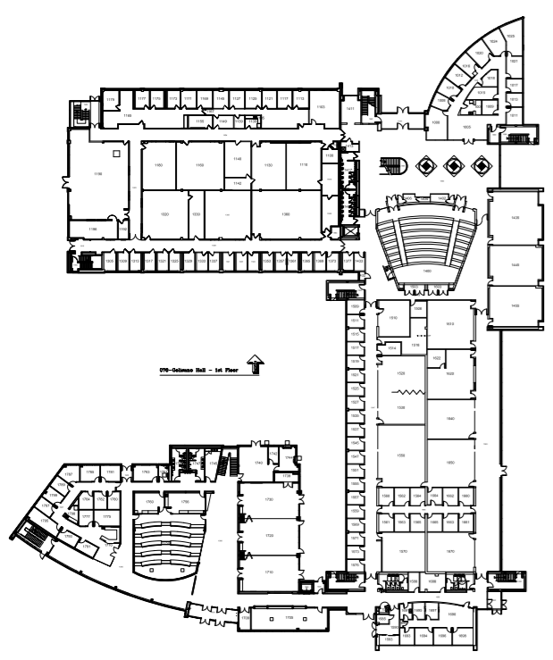
Golisano College Bldg GOL (70)
Global Cybersecurity Institute
Bldg GCI

Slide 36
Department Facilities
Studio Labs/Classrooms
Team Rooms
CoLab
Mentoring Lab (Society of Software Engineers)
PhD Lab
Faculty and Staff Offices
Data Science and Research Computing Clusters

Slide 37
Curriculum
Plan of Study
  Follow the curriculum flow chart
  Meet with Dr. Hawker or Dr. Desell to discuss your goals and determine your courses
  You can revise your selections
    Within constraints

Slide 38
Recent Electives
More graduate faculty results in more elective opportunities
  Software Engineering Methods in Data Science
  Engineering Self-Adaptive Software Systems
  Engineering Cloud Software Systems
  Neural Networks for Data Science
  High Performance Data Science

Slide 39
Curriculum – Electives
Must be approved
Course number 600 or greater to count
Grade must be a ‘C’ or greater to count
  ‘C-’ is not a ‘C’
Elective courses typically from SE, DS, CS, CE, HCI, IST, Management (BUSI)
DS and SE Elective courses can also include specializations from applied domains.
Pre-approved list is on-line (not quite current)
  You can lobby for courses not on the pre-approved list
  Either way, fill out an Elective Approval form

Slide 40
Curriculum
Optional Co-op
  Can be after 18 on-campus credits
  What is a co-op? When can I take it?
  How do I find one?

Slide 41
Grading
You must maintain a grade point average >= 3.0
You must obtain at least a ‘C’ in every graduate course
  A ‘C-’ is a failing grade
The GPA is calculated on ALL courses
Repeating a graduate course does not replace the previous grade

Slide 42
SE Curriculum:
Capstone or Thesis
Taken at the end of your program
Thesis: 6 credit-hour research experience with a faculty advisor and committee
Capstone: 3 credit-hour hands-on experience with a faculty advisor
Process starts the second semester
  Topic proposal, with literature review
  Locate advisor and committee
Refer to Graduate Student Handbook for further details

Slide 43
DS Curriculum:
Capstone or Thesis
Can decide before third semester.
Capstone: Is developed as part of the Applied Data Science Project course sequence (ADS I and II) with a faculty advisor - begins after completing foundational first semester courses.
Thesis: An additional 3 credit-hours of thesis credit can be taken in place of an elective in the last semester to extend your applied data science project into a full MS thesis.
Refer to Graduate Student Handbook for further details.

Slide 44
Course Registration Process
  Know your registration date
  Meet with Scott or Travis
  Submit applicable forms
    Elective Approval Form
    Independent Study Form
    Capstone or Thesis Registration Form
    Capstone or Thesis Continuation Form
  Register online using SIS/Tiger Center

Slide 45
Registration Tips
Don’t put off registration…. courses may fill up quickly
Most SE/DS courses are offered only once per year…. make sure you stay on track
Use the flowchart to track your progress

Slide 46
Add/Drop and Withdrawing
Add/Drop
  First week of classes
  Changed courses will not be recorded on your transcript
Withdrawal
  After add/drop, you can withdraw from a course (consult the academic calendar)
  You will receive a grade of ‘W’ on your transcript

Slide 47
Other Policies & Procedures
Academic Probation
Academic Honesty
7-Year Rule

Slide 48
Scheduling Appointments
Preference: During posted open office hours
Contact the front desk or send an email to schedule an appointment
No same day appointments
Sample advising topics:
  Registration
  Plan of Study Worksheet Review
  Leave of Absence/University Withdrawal
  Course Withdrawal
  Academic Difficulty
  Graduation/Remaining Requirements
  Schedule Planning/Changes
  Change of Program Out
  Full-time Equivalency (FTE)
  Co-op

Slide 49
How to Connect-
Advisor/Advisee Etiquette
Be patient and respectful
Include your first name, last name, and University ID in email
Write professional, business-quality emails
Plan ahead – emailing the night before a deadline will not guarantee a prompt response
Do not consult your friends/peers for advising matters
Arrive to appointments on time

Slide 50
How to Connect - Resources
Graduate Director and Faculty
Staff
Tutoring Center
Academic Support Center
Campus Writing Commons
Graduate Meetings/Workshops
Email
Office of Graduate Education, International Student Services, Health Center, etc.
Office hours

Slide 51
How to Connect - Program Slack Workspaces
Software Engineering Master’s Slack:
  https://ritsoftwareen-pg21467.slack.com
Data Science Master’s Slack:
  https://join.slack.com/t/ritmastersind-f1i5643/shared_invite/zt-ktnyq11i-bQAN0B3gh897JBrDMSkxvw

Slide 52
Timing Is Everything - Full-time Status
Full-time students must register for and successfully complete nine or more credit hours per semester
If you fall below nine credits by dropping or withdrawing from a course, your scholarship, financial aid, student loans, and student visa (if any are applicable to you) will be affected in future terms
See Prof. Hawker or Prof. Desell before you do anything that will change your status

Slide 53
Helpful Hints – Full-time Status
Withdrawing/Dropping a course is NOT always possible
Full-time equivalency: course load credit for graduate work, such as a paid graduate assistantship or a paid research assistantship
  You may use only two. It is important you use them wisely so you will have ample time to complete your degree
Intersession and summer terms are considered breaks in which you are not required to be enrolled
Can be less than full-time during last semester

Slide 54
Timing Is Everything-
Application For Graduation
Registrar emails all grad students beginning their first semester inviting them to Apply for Graduation on the system
Apply TWO TERMS before you complete the program

Slide 55
Advisor and Program Directors
Britt, Dawn, Travis, and Scott work closely together
Do not ‘shop around’ for answers

Slide 56
Plagiarism and Cheating
Plagiarism and cheating will not be tolerated at RIT
  Copying another person’s homework or models and code
  Giving another student’s models, code, or answers on assignments
  Copying from the Web
  Copying text/writing that is not your own
  Working with peers when not given permission
  etc.
It is your responsibility to obtain a good understanding of what plagiarism is
The library is a good source of information
Plagiarism or cheating can result in an “F” for an assignment or an “F” in the course
Scholarship will be taken away
I-20 Program Extension may not be granted
Suspension is possible
THIS IS SERIOUS

Slide 57
Academic Dishonesty - Consequences
First offense:
  Scholarship will be removed for the term it happens
  This means you have to pay more money
Second offense:
  Suspension or ‘not renewing of I-20’

Slide 58
Probation and Suspension
You must maintain a 3.0 semester and cumulative GPA
You will be placed on probation if your semester and/or cumulative GPA fall below 3.0
  You must raise GPA to a minimum of 3.0 the next academic semester or face suspension
Suspended students must leave the university for one year and then MUST reapply to obtain an RIT degree. Re-admission is not guaranteed.
Talk to Travis or Scott as soon as possible if this may happen to you

Slide 59
Etiquette
Behave as a Professional
  Politeness
  Humility
  Honesty
  Patience
  Personal hygiene
  Mindful of others

Slide 60




RIT SE Web Presence
Marketing pages – focused on prospective students and employers
Software Engineering at RIT
Data Science at RIT
Department pages
For current students, faculty, and staff
  Includes SE and DS
SE Facebook
SE WhatsApp
DS WhatsApp

Slide 61
Wrap-up
Any questions?
Any comments?
Any concerns?
Any Excitement?!

