Slide 1
CTO Community of Practice (CCoP) – Session
LEARNING
Purchasing Requisitions – Tips, Tricks, & Best Practices
4/18/24

Slide 2
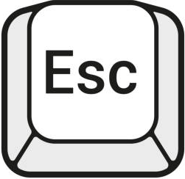





Welcome to Today’s CCoP Session!
Zoom Tips & Reminders:
Switch from Full Screen View to Partial Screen View by pressing ESC.
You can change your Zoom Name by viewing the Participants in the meeting.
Communicate with the Host or with other members by using the Chat feature.
To make speaker, interpreter, or shared screen larger choose Switch Screen on top right hand side of speaker box
Please remember to Mute your microphone during a presentation and always be mindful of your surroundings when your camera is enabled. Click the ^ icon to change your audio and video settings.

Slide 3




How to Subscribe to the CTO Newsletter
Log in to ritmail.rit.edu with your credentials
Select Community Lists from the home page
Scroll down to the Newsletters section
Click the button
Click to reveal the newsletters
Place a checkmark next to CTO Newsletter

Slide 4
Good to knows!!!
Interpreter will be spotlighted & Interpretation feature is turned on
Recordings and future trainings available on our website https://www.rit.edu/controller/community-practice
Please take the short survey that will be provided in chat to give us valuable feedback!
https://rit.az1.qualtrics.com/jfe/form/SV_2lVhX4XNj2KTh42
Let’s meet the SMEs for today!
Notes:
https://rit.az1.qualtrics.com/jfe/form/SV_2lVhX4XNj2KTh42

Slide 5
Oracle Requisitions
If you have not already, please take the training available in the Talent Roadmap.
Top 5 Reasons a Req is Returned
No Attachments
Unsigned Contracts
Wrong line type used (Goods vs. Services)
Req doesn’t match the quote
Using a supplier who is not approved for branding materials (print/promo/apparel, etc)

Slide 6
Tips and Tricks
Invoices that are used as back up documentation do NOT get sent to AP. That is up to you or your supplier to submit them with the PO # noted on it to accpay@rit.edu.
Appropriate attachments are: Quotes, invoices, bid documents, contracts etc. There is also a Purchasing 101 class on the Talent Roadmap that discusses the needed documents depending on what you are purchasing.
In the attachment section, you can add a note to your supplier. This is important if you want your item delivered somewhere other than Central Receiving.
Be aware of where your cursor is PRIOR to starting to do an attachment. Attachments should be done at the “header level” so that your approver can view them. DO NOT PUBLISH TO CATALOG.

Slide 7
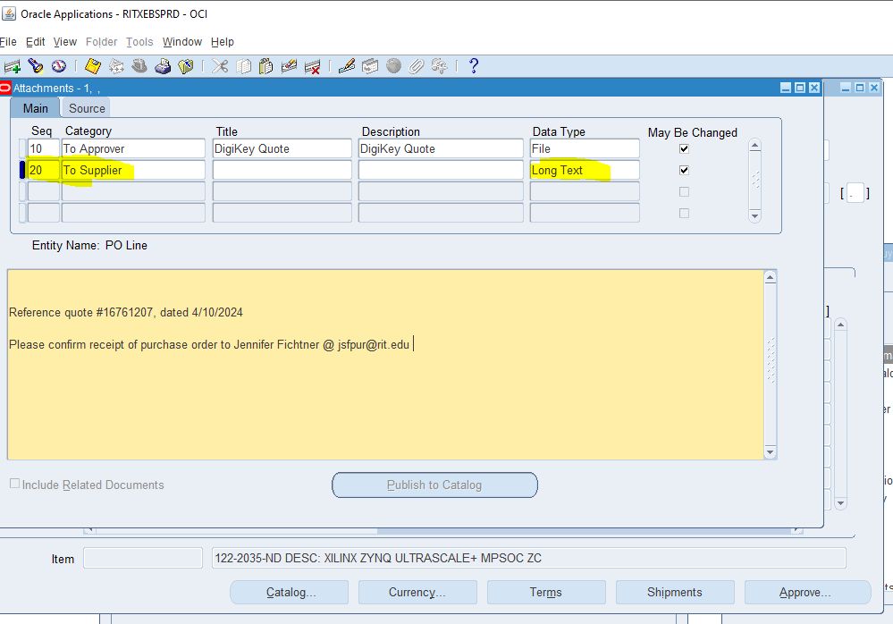
Attachments/Notes
Not needed

Slide 8
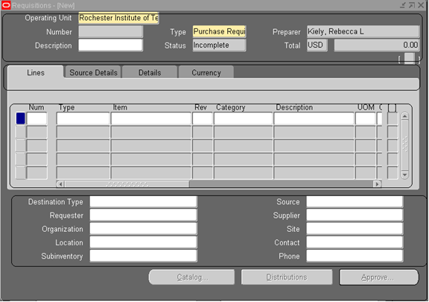
Cursor placement for attachments
Header

Slide 9
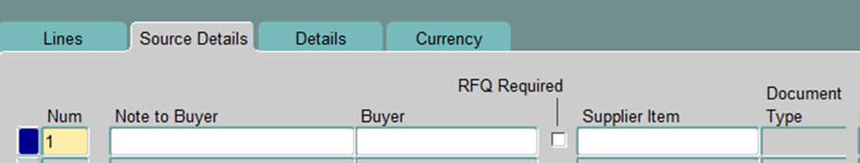
Tips and Tricks
The Notes to Buyer field is important for sharing details with us. Such as “Please send to: xxx@xxx.com” Or “Please add to PO XXXXX” for those reqs that are being created to add funds.
If a prepayment is required, you MUST note that in the description.
When creating a req, the line description must have the quote # noted AND part numbers if applicable. Do NOT include long notes to the supplier in the line description, please use the Attachment field for notes.
The green plus sign under the toolbar can be used for adding lines.

Slide 10
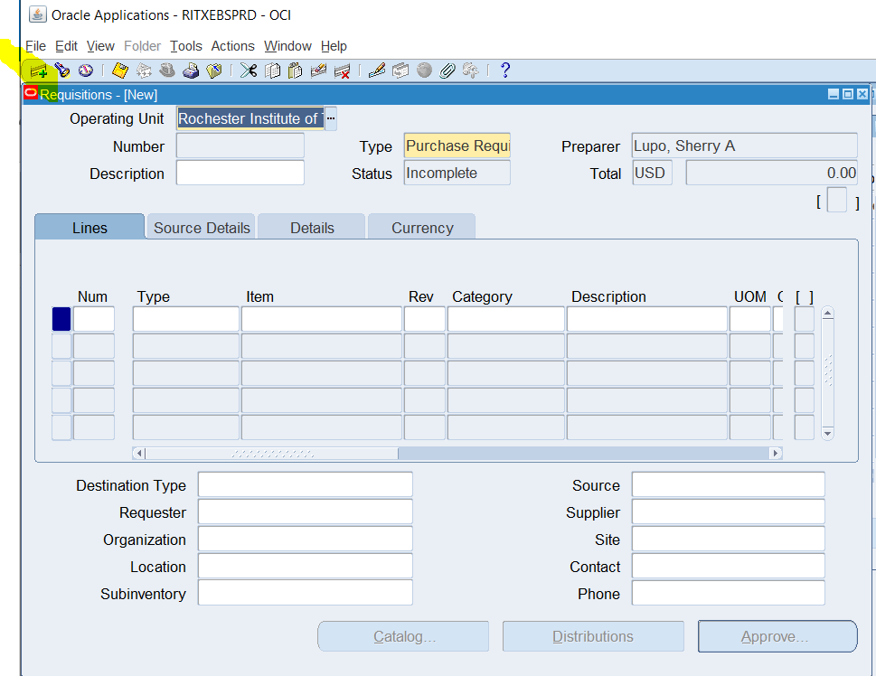
Where to find that green plus sign:

Slide 11
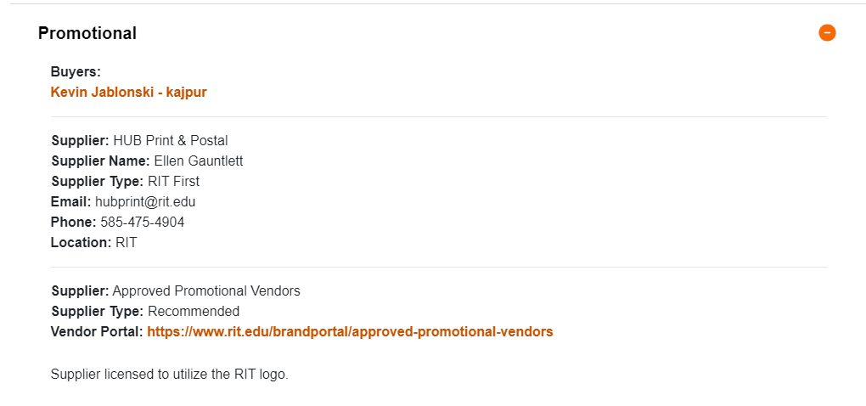
Tips and Tricks
Looping back to anything where the RIT logo is being used. All suppliers who will be replicating our brand must maintain a licensing agreement. We have 19 suppliers that can be found on our website that have a licensing agreement:
https://www.rit.edu/procurement/commodity-categories-and-suppliers

Slide 12
Tips and Tricks
There are furniture standards. These can also be found on our website and as a Knowledge Article on the RSC:
https://help.rit.edu/sp?id=kb_article_view&sys_kb_id=4792c9841b0ddd507cc34377cc4bcb77
Speaking of the RSC, there are many Knowledge Articles out there related to creating a requisition and purchasing procedures.
Also, if you are looking for established suppliers, please go to our website.

Slide 13
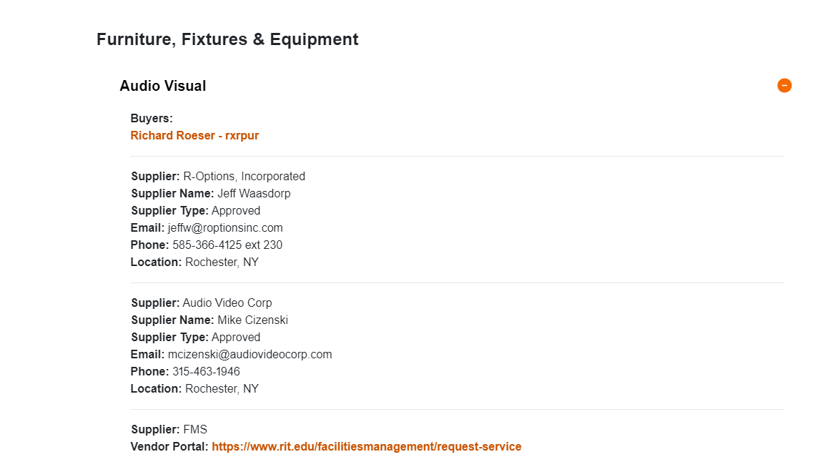
Where to find established suppliers:
https://www.rit.edu/procurement/commodity-categories-and-suppliers

Slide 14
Oversized Deliveries
Please note that FMS Receiving will be refusing any oversized deliveries. Anything that exceeds:
40 x 48 x 84 and/or 2500 lbs.

Slide 15
QUESTIONS?

