Slide 1
Best Practices in Sponsored Programs
Amanda Zeluff, SPA Supervisor
Tracy Zoellick, Director (Interim)

Slide 2
AGENDA
Introduction
Journal Entry Review and Approval Process
Expense Allowability
Participant Support
SPA’s Closeout Process

Slide 3
What is SPA??
Responsible for the fiscal administration of externally funded projects
Grants and contracts
Assist principal investigators and administrative staff in navigating through the fiscal and regulatory requirements related to sponsored projects.

Slide 4
The SPA Team
Read more about SPA: https://www.rit.edu/controller/about-cto
Meet the team: https://www.rit.edu/controller/cto-staff-directory#sponsored-programs-accounting

Slide 5
Journal Entry Review and Approval Process

Slide 6
Cost Transfers
Moving an expenditure previously recorded from one account to another via journal entry
From one sponsored project to another
From an operating account to a sponsored project
Receive a great deal of scrutiny
Sufficient justification and supporting documentation required
Must be processed with 90 days of original transaction

Slide 7
Cost Transfer Procedures
Supporting Documentation
Cost Transfer Coversheet
Explanation of how the error occurred. If transfer is beyond 90 days, PI must additionally provide an explanation of why the transfer is beyond 90 days and what steps they will take to prevent delays in the future.
PI Approval
PI certification of appropriateness/allowabililty of the charge on the sponsored project.
Grant Statement, Account Analysis, Other Required backup (TER, receipts, invoice, etc.)
JE Example

Slide 8
JE Approval Process
Dept. admin or PI will send journal entry (JE) to their SPA rep
Don’t send your JE to accounting. They will not post sponsored project JE’s without SPA approval.
SPA rep will review it and submit it to SPA Management for approval and posting. Note: JE’s over 90 days need the SPA Executive Director’s approval.
Timely submissions – SPA needs time to review and return JEs for corrections. If we don’t have enough time we will push the JE to the next month. Best Practice – Get JE’s in my end of month!

Slide 9
Expense Allowability

Slide 10
Office of Management and Budget
Uniform Guidance
2 CFR §200 Subpart E- Cost Principles
Allowable – Cost that are not specifically prohibited by federal regulation or the specific grant/contract.
Reasonable – Costs by their nature and amount support the research scope of work
Allocable – Costs are charged to sponsored projects in proportion to the relative benefit received
Treated Consistently – costs in similar circumstances should be treated the same.

Slide 11
Let’s play a around of Trivia!

Slide 12




What is not allowable on a NSF award?
Administrative and clerical salaries and wages
Entertainment (George Eastman House tickets)
Office supplies
It depends

Slide 13
What is allowable on a DoD award?
Purchase of computer equipment (laptops)
Memberships/Dues
Postage
It depends

Slide 14
“It Depends”
Determine Allowability
Ask your SPA rep for clarity on any allowability questions

Slide 15
Participant Support

Slide 16
What is Participant Support?
Per the Uniform Guidance, Participant Support Costs (PSC) are direct costs for items such as:
stipends or subsistence allowances
travel allowances
registration fees paid to or on behalf of participants or trainees (not employees) in connection with conferences or training projects

Slide 17
Cost Considerations
Budgeting:
All participant support requires prior approval; will usually be explicitly awarded
Costs cannot be rebudgeted from the approved participant support categories into other non participant support categories without PRIOR approval
F&A Limitations:
Recovery of indirect costs (F&A) is typically prohibited on participant support cost categories. These cost categories are excluded from modified total direct costs (MTDC)

Slide 18
Cost Considerations (cont’d)
3 & P accounts:
Use of a separate account is required when PSCs have been explicitly awarded and the agency requires approval for rebudgeting.
Ensures F&A is not assessed
Ensures PSC budget & expenses can be accurately identified
RIT Example:
Project 31245: Non Participant support costs (i.e., main award)
Project P1245: Participant support costs ONLY
Notes:
RIT uses the same last 4 digits to show there is a relationship between the 2 accounts

Slide 19
Who is not a participant?
A participant cannot be:
An employee of the grantee institution
Advisory board members
Interns who have paid appointments
Anyone who has a deliverable or is primarily providing a service to the project

Slide 20
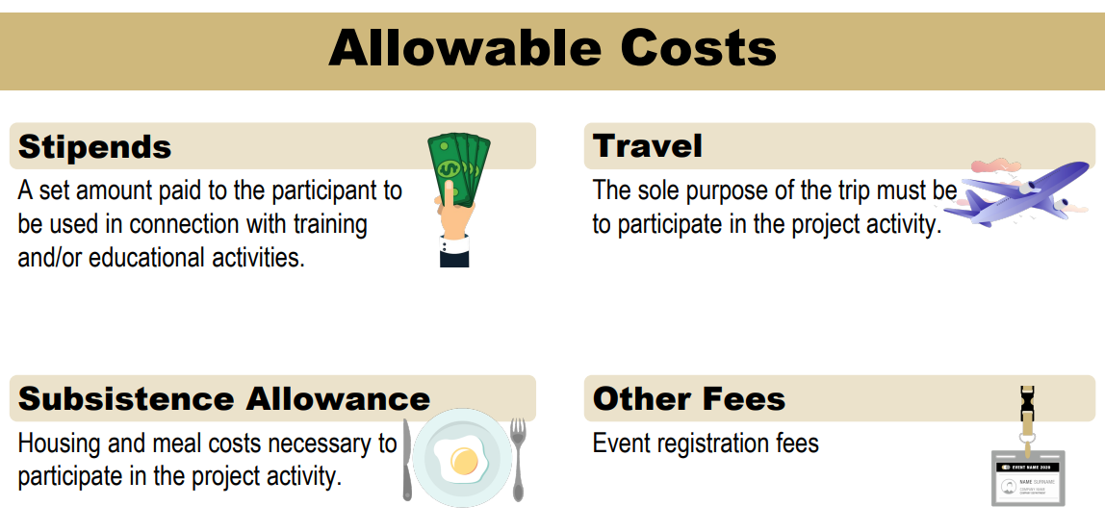
Notes:
These costs need to be associated with an individual participant

Slide 21
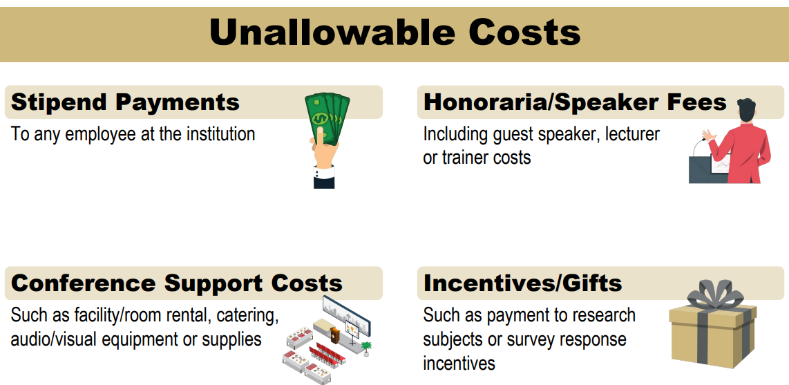
Notes:
Payments to employees
Travel for project PI or project staff
Travel for collaborators or consultants for purpose other than the training event or conference
Multi-purpose travel – I.e., to perform research in addition to attending a project related meeting
Event support cost not made on behalf of or paid to participants – Event support costs include rentals, media equipment rentals, food or refreshments – Usually, meals and refreshments are covered by the conference registration fees •
Expenses related to meetings of an administrative nature •
Human subject fees •
Honoraria paid to a guest speaker or lecturer

Slide 22
SPA’s Closeout Process

Slide 23
Closing a sponsored project
Involves ensuring that all work has been completed, reports have been filed and financials are accurate.
The close out process is a collaboration between the Principal Investigator, departmental staff, and SPA.

Slide 24
What happens during the closeout process?
Disable the object codes the day after the project ends.
Reviews the Current Grant statement.
Evaluate the last 3 months of expense activity.
PI will be required to sign off on the Final Grant statement.
Final Financials reports and/or Invoices.

Slide 25
Disable the object codes
Unless SPA reps are aware of additional funding, a time extension; or known allowable trailing expenses.
Why are we doing this?
Allowability - 2 CFR §200 Subpart E- Cost Principles
We are seeing an increase in non-allowable trailing expenses
This allows SPA reps to review those trailing expenses before they are allocated to the projects.

Slide 26
Review Current Grant statement
This includes Cost Share, Participant Accounts, and any Carve-out that are applicable.
What are we looking for?
Budget versus Expenses.
Encumbrances- any outstanding Purchase orders.
Capital Equipment – is the capital equipment property tagged and logged within Oracle.

Slide 27
Last 3 months of expense activity
We will require a justification from the PI. This needs to explain how this expense benefited the project within the remaining time frame and why it was necessary for the Statement of Work (SOW).
For any allowable trailing expenses supporting documentation is required. Travel expense reports with receipts; Supply/Equipment receipts; Kronos time cards, etc.
These are needed to determine if these expenses are allowable as unallowable expenses will need to be moved off with the project to an internal RIT account.

Slide 28
Final Grant Statement & Final Financials
Typically Sponsor requires a Final Invoice or a Final Financial Report
Time frame is between 30 days up to 120 days.
Final Grant Statement - PI is signing off that “I certify that all expenditures reported are for appropriate purposes and in accordance with the provisions of the application and award documents.”
Once the FGS is signed the project is closed and no further activity can be allocated to the project.
SPA then can submit the Final Financials within the allocated time frame.

Slide 29
Questions

