Slide 1
CTO Community of Practice Accounts Receivable Onboarding to the RIT Service Center
February 20, 2025
Kira Broccolo
Notes:
Set-up – Open everything in Google Chrome

Slide 2
Agenda
Quick AR Overview
Questions for RSC vs AR Team
RSC Knowledge Articles
AR Adjustment Form – Process Change
I will provide a copy of the slide deck to this group after this presentation.

Slide 3
Accounts Receivable - Overview

Slide 4
Accounts Receivable Team
Dedicated AR Team – Alicia Johnson & Kira Broccolo
Payments Applied to Invoices by Student Financial Services
Notes:
Alicia Johnson - Helps oversee our customer process, reviews and publishes invoices created in Oracle to our general ledger accounts, and maintains much of the information you see in Oracle A/R. A large portion of her role is also managing the invoice creation and submission for all our Sponsored Programs Accounting projects (on average approx. 140/month), which takes up the majority of her days. She is quickly becoming an Oracle guru and is a great resource for asking questions about making invoices.
Kira Broccolo - I help oversee the university’s overall accounts receivable listing, following up with individual departments. I am responsible for many different monthly reconciliations of our receivable accounts, helping customers get set-up for electronic ACH/Wire Transfer payments to RIT, I am able to provide our RIT W-9 to customers who need it, as well as helping our friends in SFS apply payments to invoices. I also oversee our Oracle A/R setup in the system and am available to help departments modify their current A/R process or develop a new A/R process if needed.

Slide 5
Oracle AR Access
Self Request Access
RIT Receivables Entry – Creating customers and invoices, pulling reports, etc.
RIT Receivables Inquiry – View only access to see invoices
Controller's Office - Oracle Accounts Receivable Access & Training

Slide 6
Invoicing Cycle
1 | Make sure the customer is already in Oracle, and the collector (department) is set-up for the address needed.
2 | Create invoice in Oracle.
3 | Print (physical or PDF) and submit the invoice to the customer for payment.
4 | Use Oracle reports to monitor the department’s outstanding A/R listing. Follow-up with customers with invoices outstanding.
5 | When payments are received, they should be routed to SFS to apply to the Oracle invoice. Once applied, the invoice creator will receive an automated notification.
6 | Any invoices requiring adjustment, submit an adjustment request through RSC
Notes:
At RIT, each department is responsible for the creation, submission, and management of their outstanding invoices.
Generally speaking, the cycle will be as shown:
Make sure your customers are set-up, or set-up any new customers/addresses needed.
Create the invoice in Oracle using the RIT Receivables Entry responsibility.
Once created, submit the invoice to the customer in their preferred format (email, online portal, etc).
Departments should monitor their outstanding receivables using Oracle invoicing (or your own internal tracking method).
When a payment is received and applied to the invoice by SFS, Oracle will send an automatic notification to the invoice creator.
If any adjustments are needed on an invoice, I have a form to work through that. We will talk through that a little later on this morning.

Slide 7
Flow of Funds $$
When an invoice is created in Oracle A/R:
Debit (Increase) to the Receivable General Ledger (GL) Account
Credit (Increase) to the Revenue GL Account entered at the time of invoice creation.
When an invoice is paid, the Receivable GL account is reduced at that time.
When using Oracle A/R correctly, departments receive revenue immediately when invoices are created.
Notes:
When an invoice is created, the transaction will:
Debit/Increase the Receivable General Ledger account
Credit/Increase the Revenue General Ledger account – This GL is a field that the department enters on the invoice, so it’s important they make sure they are using the appropriate account. Each department has their own revenue accounts enabled so A/R cannot advise you on which GL is appropriate for your individual circumstance.
This means that the Revenue from an invoice will be allocated to the department at the time the invoice is created (not when the payment is received).
When an invoice is paid, the transaction will:
Debit/Increase the Cash General Ledger account
Credit/Decrease the Receivable General Ledger account

Slide 8
AR – RSC Partnership

Slide 9
Topics Migrating to RSC:
How to gain access to Oracle Receivables
Viewing, adding, or changing Oracle customers
Viewing, creating, or printing Oracle invoices
Submitting a credit memo or adjustment request to adjust an Oracle invoice
Submitting a write off (bad debt) request after collections efforts
How to request a refund for an overpaid customer
How to pull Oracle reports to manage department receivables
Topics Remaining with AR:
Updating customer information for foreign customers (unable to see in Customer Request portal)
Complex payment or invoicing questions
Researching payment application concerns
Sponsored Programs Accounting (SPA) invoicing and payments
Modifications to Oracle AR setups (missing collector in department list)
Supplier set-up forms/requests
RIT banking information requests for electronic customer payments (ACH or wire transfers)

Slide 10
Knowledge Articles (with links)
Topic | Number | Short description (title) | Knowledge base | Category
1. General AR | KB0044540 | Oracle Accounts Receivable Access & Training | Controller's Office | Accounts Receivable
1. General AR | KB0044572 | The invoicing cycle for Oracle invoices | Controller's Office | Accounts Receivable
1. General AR | KB0044504 | How do customers pay an Oracle Accounts Receivable invoice (Remittances) | Controller's Office | Accounts Receivable
1. General AR | KB0044566 | How to pull Oracle AR reports to manage your receivables | Controller's Office | Accounts Receivable

Slide 11
Knowledge Articles (with links)
Topic | Number | Short description (title) | Knowledge base | Category
2. Customers | KB0044494 | How to view, add, or change customers in Oracle Accounts Receivable | Controller's Office | Accounts Receivable
2. Customers | KB0044573 | My department isn't listed as an option under "Collector Name" in the Customer Request portal | Controller's Office | Accounts Receivable

Slide 12
Knowledge Articles (with links)
Topic | Number | Short description (title) | Knowledge base | Category
3. Invoicing | KB0044498 | How to create an invoice in Oracle Accounts Receivable | Controller's Office | Accounts Receivable
3. Invoicing | KB0044501 | How does revenue get recorded in Oracle Accounts Receivable | Controller's Office | Accounts Receivable
3. Invoicing | KB0044574 | How to add sales tax to an Oracle invoice | Controller's Office | Accounts Receivable
3. Invoicing | KB0044505 | How to edit or delete (zero out) an invoice in Oracle Accounts Receivable | Controller's Office | Accounts Receivable
3. Invoicing | KB0044503 | How to print an invoice in Oracle Accounts Receivable | Controller's Office | Accounts Receivable
3. Invoicing | KB0044499 | How to view an invoice in Oracle Accounts Receivable | Controller's Office | Accounts Receivable

Slide 13
Knowledge Articles (with links)
Topic | Number | Short description (title) | Knowledge base | Category
4. Adjustments to Invoices | KB0044555 | Which Oracle invoice adjustment request should I submit? | Controller's Office | Accounts Receivable
4. Adjustments to Invoices | KB0044553 | How to submit a credit memo request for an Oracle invoice | Controller's Office | Accounts Receivable
4. Adjustments to Invoices | KB0044560 | How to submit a small balance write off request for an Oracle invoice | Controller's Office | Accounts Receivable
4. Adjustments to Invoices | KB0044559 | How to submit a bank fee adjustment for an Oracle invoice | Controller's Office | Accounts Receivable
4. Adjustments to Invoices | KB0044565 | How to submit a write off (bad debt) request for Oracle invoices | Controller's Office | Accounts Receivable

Slide 14
Knowledge Articles (with links)
Topic | Number | Short description (title) | Knowledge base | Category
5. Refunds | KB0044579 | How to request a refund for an overpaid customer (Oracle AR) | Controller's Office | Accounts Receivable

Slide 15
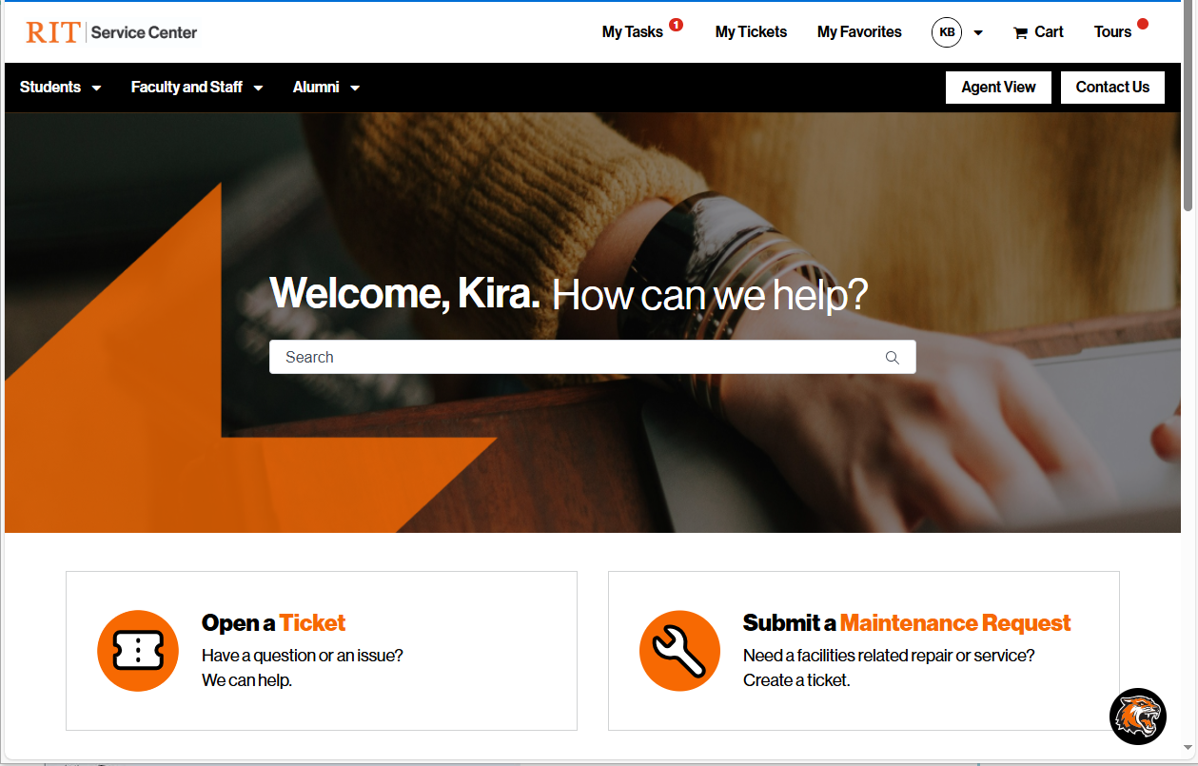
1st Demo - https://help.rit.edu/
Notes:
Search Items:
Create an invoice
Add a customer

Slide 16
*New Process* AR Adjustment Forms

Slide 17
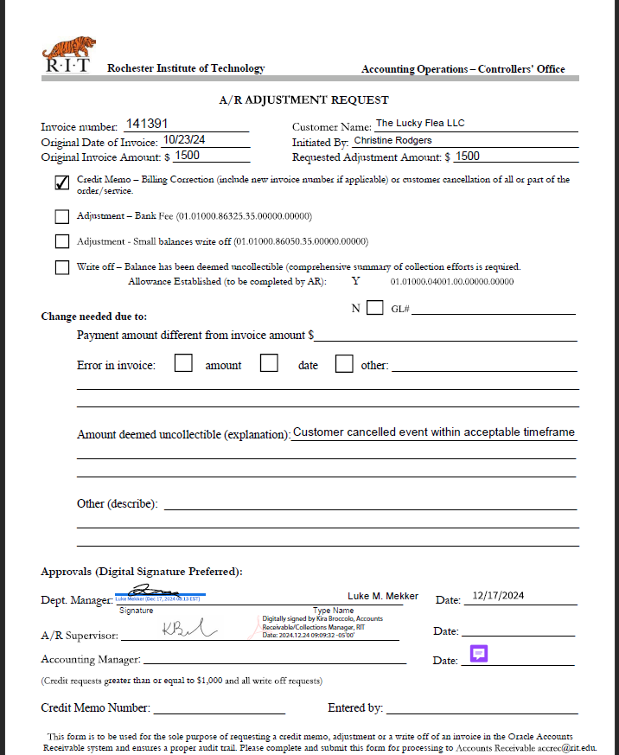
What Changed?
AR is no longer accepting the PDF “AR Adjustment Form”
All requests for credit memos or write offs against Oracle invoices will now need to be routed through the RSC requests

Slide 18
Adjustments Refresher
Credit Memo: This should be used when making a billing correction or the customer cancelled all/part of the order/service. The credit memo will reverse the adjustment amount back to the Revenue GL account used on the original invoice created.
Small Balance Write Off: This should be used when the customer short-pays the invoice, leaving an unpaid balance of $10.00 or less. Instead of asking the customer for an additional small payment, the unpaid portion is written off, clearing it from showing as an outstanding balance due. This adjustment does not hit the department that created the invoice (RIT absorbs this).

Slide 19
Adjustments Refresher
Bank Fee Adjustment: This should be used when a bank transaction fee has been deducted from the payment RIT received. This occurs frequently with payments from foreign customers. This adjustment will write off the unpaid portion, clearing it from showing as an outstanding balance due. This adjustment does not hit the department that created the invoice (RIT absorbs this).
Write Off (Bad Debt): This adjustment should be used after collections efforts have been exhausted, and the balance is deemed uncollectible. A comprehensive summary of collections efforts is required. When the request is submitted, Accounts Receivable will review the information to determine if the balance can be sent to our outside collections agency for additional legal action. Any amount determined to be written off will be recorded to the department's bad debt expense account.

Slide 20
2nd Demo - https://help.rit.edu/
Notes:
Search Items:
Oracle Invoice Adjustments
Credit Memo

Slide 21
Questions?

