Slide 1
CTO Community of Practice (CCoP) – Session
LEARNING
Cost Transfers on Grants & Contracts – Best Practices
3/21/24

Slide 2






Welcome to Today’s CCoP Session!
Zoom Tips & Reminders:
Switch from Full Screen View to Partial Screen View by pressing ESC.
You can change your Zoom Name by viewing the Participants in the meeting.
Communicate with the Host or with other members by using the Chat feature.
To make speaker, interpreter, or shared screen larger choose Switch Screen on top right hand side of speaker box
Please remember to Mute your microphone during a presentation and always be mindful of your surroundings when your camera is enabled. Click the ^ icon to change your audio and video settings.

Slide 3




How to Subscribe to the CTO Newsletter
Log in to ritmail.rit.edu with your credentials
Select Community Lists from the home page
Scroll down to the Newsletters section
Click the button
Click to reveal the newsletters
Place a checkmark next to CTO Newsletter

Slide 4
Good to knows!!!
Interpreter will be spotlighted & Interpretation feature is turned on
Recordings and future trainings available on our website https://www.rit.edu/controller/community-practice
Please take the short survey that will be provided in chat to give us valuable feedback!
https://rit.az1.qualtrics.com/jfe/form/SV_eJwVeXESsiOOfbw
Let’s meet the SMEs for today!
Notes:
https://rit.az1.qualtrics.com/jfe/form/SV_eJwVeXESsiOOfbw
For further training around grants and contracts administration at RIT check out this 5-part series of courses introduces users to Sponsored Programs Accounting for Research and Contracts (SPARC) and further guides them through the maze of workflows that SPA navigates on a day-to-day basis. These courses can all be found by logging into Talent Roadmap and searching for the SPARC.
Link: https://rit.sabacloud.com/Saba/Web_spf/NA3P1PRD0049/app/dashboard

Slide 5
Understanding Cost Transfers
Sponsored Programs Accounting
March 21, 2024

Slide 6
Agenda
What and Why
Common Scenarios
Demonstration
Risk of Cost Transfers
Real-World Examples
Q&A

Slide 7
What is a Cost Transfer?
Transfer of expenses from one account or project to another within an organization's financial records.
Caused by an “error”
Essential for accurate financial reporting and compliance

Slide 8
Why Cost Transfers Matter
Financial Reporting and Decision Making
  Accurate reflection of current spending is crucial for projections
Compliance Requirements
Audit Implications
  High-risk Area

Slide 9
Common Scenarios
Pro-card Errors
Effort Changes
Cost Unallowability
Split costing

Slide 10


Timeliness & Justification
Justification:
  Costs should be
    Reasonable
    Allocable
    Allowable
  Go thru entire form, and components of backup required
Timeliness: Emphasize the importance of promptly identifying and processing necessary cost transfers to maintain accurate financial records.
Justification and Explanation: Stress the need for clear and detailed explanations for each cost transfer, including reasons for the transfer and how it aligns with project objectives.
  Vague explanations vs clear explanations
    Show real examples
Approval Processes: Outline the appropriate channels for obtaining approvals for cost transfers, including designated personnel and required documentation.
90 Day procedure - including EAF's
Timeliness:
  Within 90 Days
  Assumption:
    charged appropriately at the time incurred
    should not be required if adequate financial policies exist

Slide 11
What Documentation to include:
Non-Salary Cost Transfer
Cost Transfer Cover Sheet
Salary (EAF)
Under 90 days – none
PI Approval
Documentation of original transaction
Account analysis, subledger, etc.
Receipts, invoices, etc
Method of allocation (if needed)
Over 90 days – Cost Transfer Cover Sheet
Notes:
Documentation

Slide 12
Language for Justification
Vague
  An explanation merely stating that the transfer was made “to correct error” or to “transfer to correct project” is not sufficient
Clear
  Cost benefits this project because….indicate reasonable, allocable explanation
  Explanation of what happened to prevent the charge from being correct

Slide 13
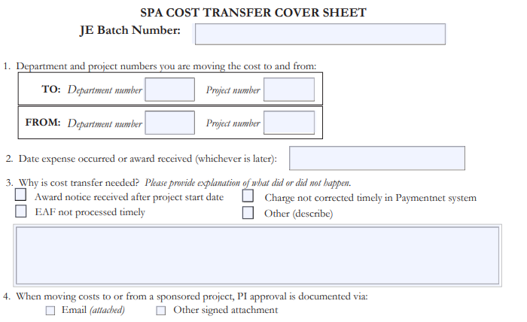
Cost Transfer Cover Sheet
123ABC0321-01
Have your documentation!
RIT Cost transfer cover sheet & procedures
  Located at https://www.rit.edu/controller/directindirect-costs#cost-transfer-documents
Jan-24
GRA Michael Scott’s effort was devoted toward this project effective Jan 1st, and the stipend paperwork did not get updated in time

Slide 14
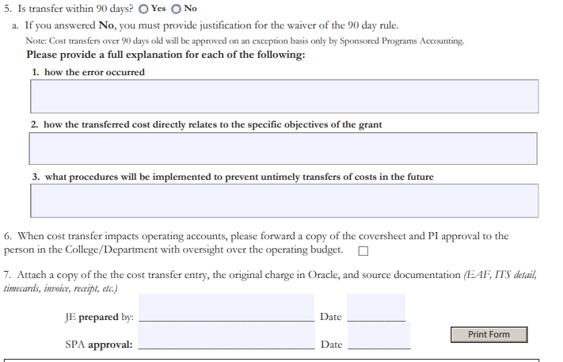
Cost Transfer Cover Sheet
Have your documentation!
RIT Cost transfer cover sheet & procedures
  Located at https://www.rit.edu/controller/directindirect-costs#cost-transfer-documents

Slide 15
Case Studies
Yale University
University of Illinois Champaign
Cost transfer made 21 days after the award ended. The transfer was for expenses incurred to install a rack system not completed until approximately 11 days before the award period expired.
Stanford
Equipment, travel, instrument usage, and lab supplies, were allocated to NSF awards using unsupported allocation methodologies.
E-mail stated salary cost transfers made to spend down funds
Charge for an internal billing in which the University could not provide support for how the billing rate was determined because the rate was not approved yet
Allocation percentage was PI’s estimate of expected future use, which appeared to be arbitrary and based on convenience

Slide 16
Participant Poll
Which cost transfer would you approve?
  Transaction Date – JAN-23; Cost Transfer Date – MAY-23
From Proj | To Proj | Info from Justification
A. Fed award | Fed award | To reflect actual effort
B. Fed award | Fed award | To charge project that was set up late
C. Discretionary/Operating | Fed Award | To charge 10% of Jane’s salary eff Mar 1st to project that was set up late. Award notification received 2/15/23. Approved by PI Smith
D. Discretionary/Operating | Fed award | To transfer cost of publication for conference to appropriate project

Slide 17

Challenges & Risks
Red Flags
  Volume:
    Frequent costs transfers
  Using award to “Park” charges
    Storing charges on an award that will subsequently be transferred elsewhere
    Cost transfers should NOT be a tool for managing sponsored awards
    Request contingent account when possible
      On SRS Forms & Agreements page
  Cost transfers near end of award
    Moving costs on to “spend down” award

Slide 18
Key Take-Aways
Cost transfers are high visibility
Documentation should be clear and thorough
Avoid the need for cost transfers wherever possible

Slide 19

Questions

