Slide 1

Summer Salary

Slide 2
Today’s Agenda
What is Summer Salary?
Key Considerations for planning
Completing the Summer Salary EAF Worksheet
Processing Summer Salary Payments Online
Questions
Notes:
The topics we will touch on today include:

Slide 3

What is Summer Salary?
Any compensation paid during the summer period to a faculty member in excess of their academic year (AY) salary.
  Summer service period: period outside of the institutional base salary(IBS) of the academic appointment
  May 16th – August 15th
Notes:
Summer salary is defined as “Any compensation paid during the summer period to a faculty member in excess of their academic year (AY) salary”
Its any period outside of their academic appointment – for faculty on a 9 month contract, there are 3 months available for summer salary; if a 10 month contract there are 2 months available, and so on
The summer session for 2023 is from May 18th thru Aug 15th - this breaks down to 3 months or 12 weeks.

Slide 4
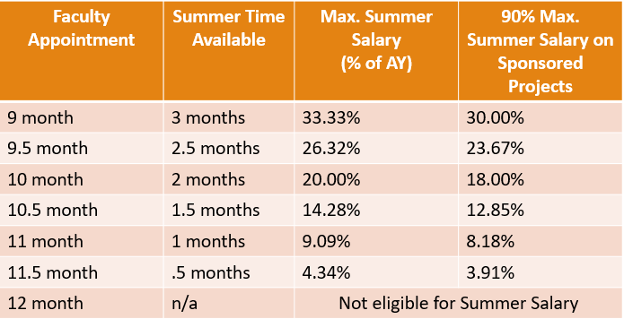
Max. Summer Salary per Appointment
Notes:
Here is the outline showing summer salary limits at each appointment level. You will notice that faculty on a 12 month appointment are not eligible for summer salary
(explain difference between 9 mo, 10 mo, etc). You can also find this information located on the RIT summer salary website. How to calculate the max summer salary. The months faculty are eligible for summer salary is dependent on their employee contract.
RIT does have a cap on the amount of summer salary that can be charged to sponsored projects – which is 90%. This allows for time devoted to other non-sponsored activities during the summer. There are options for any faculty member who believes they will be working more than 90% of the summer
FOR SPA ONLY:
It is common for faculty members to plan to use summer salary to perform concentrated work toward their research projects, that they might not have ample time for during the academic year. Some PI’s have projects that they only work on in the summer; and other projects that they work on throughout the year, but may increase effort in the summer

Slide 5
Summer Salary on Sponsored Projects
Requirements if over 90% on sponsored projects:
  Approved by faculty member’s department chair, dean, VP of Research, and SPA Executive Director prior to effort being expended
  Include Plan of Work form
Notes:
There are some options if a faculty member believes they will be working more than 90% of the summer.
* One option is to have the amount over 90% covered by an internal account – such as a departmental or discretionary account
* * The other option is to obtain extraordinary approvals for working over 90% on sponsored projects. Means that you are not doing assumed 10% of the summer you are going to be doing
*the full summer plan needs to be documented on a plan of work approved by faculty member’s dept chair, dean, VPR, and SPA executive director prior to effort being expended. The form that should be used for this is on RIT’s website.
SPA ONLY
For reference, we do not typically have any PI’s pursue this option, but its important to have this information if the question comes up.
If in the course of planning summer salary with your PI’s, if they communicate intentions to commit over 90% effort, be sure to get the ball rolling in collecting this documentation.

Slide 6
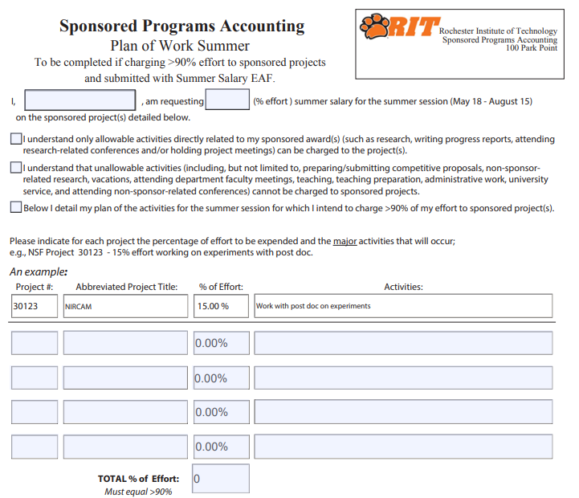
Plan of Work Form
Available Online:
Plan_of_work_form
Notes:
This form asks the PI to acknowledge:
all work conducted over the summer will be in support of sponsored projects
Then list projects
List % of effort
Provide a description of activities that will be conducted in support of those projects

Slide 7
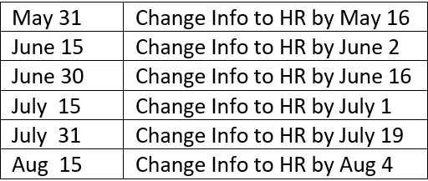
2025 Pay Dates & Approval Deadlines

Slide 8

Key Considerations
Summer salary charged to a sponsored project must be for activities related to that award
  Unallowable activities include:
    Preparing/submitting competitive proposals
    Non-sponsor related research
    Vacation
    Attending department/faculty meetings
    Teaching and teaching preparation
    Administrative work
    Note: These activities can be supported by internal funding sources
The faculty member’s home department should coordinate summer salary, using the Excel EAF worksheet to show all funding sources (ie, sponsored proj, discretionary, gift accounts)
Notes:
Now we will over some key considerations to keep in mind when developing summer salary workplans.
*it is important to keep in mind that summer salary charged to a sponsored project must be for activities related to that award.
There are some activities that would not be allowed to be covered by a sponsored project.
These included:
* preparing proposals
* any non-sponsored research
* vacation that the PI takes
* any general dept or faculty meetings the PI may attend
* teaching activities
* administrative work
-> These activities can be paid with summer salary as long as they are paid with internal funds (like a discretionary account)
Also, It is important that the faculty member’s home department coordinate all summer salary plans using the worksheet to show all funding sources. If a PI is planning to work on a sponsored project in another college, Oracle will know to route the EAF to the other college’s PI for approval.
SPA ONLY
A best practice that we recommend – is for the faculty member’s home department to coordinate all summer salary plans. So you could have a PI that is planning to work on a sponsored project for a PI in another college, however the PI’s own college should still submit the EAF for that effort and in Oracle it will include routing to the other college’s PI for approval. The benefit of this, is that the PI’s total summer effort is visible in one location and we have an accurate picture of that PI’s full summer plans. It also eliminates the need to share faculty member salaries across multiple departments.

Slide 9
Key Considerations cont’d
NSF “2-Month Rule” formally known as 2/9ths Rule
  NSF maximum summer effort is 22.22% (2 months/9 months)
    This limit is for combined summer and academic year salary received from all NSF-funded agreements
    Exceptions where NSF has approved higher proportions in the award doc
Must be paid as a % of Effort
  Flat rate payments are unallowable
  Faculty working partial summer will be paid during each pay period over the time span actually worked (not averaged over the full summer)
Paper worksheets must be submitted via email (hreaf@rit.edu) for the following scenarios
  If a faculty member was on leave of absence or full-year sabbatical during the prior AY at a reduced salary
  If the number of accounts/payments exceeds 10 at any point in time
Notes:
Additionally – some sponsors have their own limitations as to what can be charged as summer salary –
For example NSF has a limit of 2 months worth of effort charged – and this limit is combined for summer and academic year. That means if a PI had no academic year effort on NSF projects, they have 2 months of summer salary available to them, but that 2 months would be reduced by whatever effort may have already been charged to the NSF projects in the academic year. Also keep in mind that this applies to all NSF’s awards the PI has in total – so if a PI has 3 NSF projects, than effort on NSF project 1 + Project 2 + project 3 – cannot be more than 2 months.
* Some NSF projects have approved effort in the award that is greater than 2 months effort – for these projects the limit would not apply.
The next thing to remember is that summer salary must be paid as a % of effort – it is not permitted to submit a request for a flat amount. Also summer salary will be paid over the period of time that work is actually performed. If working the whole summer, the payments will be made over 6 pay periods between May 31 and Aug 15. If only working July, We would not average the effort over the entire summer; but instead payment will be over 2 pay periods July 14 & July 31..
Lastly, if the PI was on sabbatical or a leave of absence in the prior academic year, then their salary in oracle will show a reduced amount and will result in incorrect payment calculations. For these individuals, the EAF worksheet will have to be submitted directly to HR.

Slide 10
Worksheet/EAF
2025 Summer Salary Employee Action Form (EAF) Worksheet
Worksheet and Instructions Available Online:
    2025 Summer Salary EAF Worksheet
    Additional items on website:
  Examples of summer salary plans
  Summer salary FAQ’s
Notes:
To assist you in planning your summer salary, there is a worksheet available on RIT’s website linked here (click) – which is an excel spreadsheet that asks the user to input some key information and it automatically calculates the summer salary limits and payments. You will want to prepare one worksheet for each PI.
Additionally, you can find examples of summer salary worksheets and Frequently Asked Questions’s on RIT’s summer salary website. We’ll also discuss a few examples here….

Slide 11
Example #1:
9 month AY faculty; multiples sponsored projects; 5/16 – 8/15
Base academic year contract:
  $50,000
Effort:
  Sponsored Project #1: 40%
  Sponsored Project #2: 20%
  Sponsored Project #3: 20%
  Sponsored Project #4: 10%
                Total: 90%
Maximum SS allowed:
  $50,000 x 33.33% = $16,666.67
Maximum SS on Sponsored Projects allowed:
  $50,000 x 30% = $15,000.00
Contract Amount:
  $16,666.67 x 40% = $6,666.67
  $16,666.67 x 20% = $3,333.33
  $16,666.67 x 20% = $3,333.33
  $16,666.67 x 10% = $1,666.67
  $15,000.00
Notes:
Here is example #1: PI is planning to work on 4 different sponsored projects for the summer…..Explain how amounts are calculated
In this example, a 9 month faculty member, earning $50k per year, is planning to work on 4 different sponsored projects over the full summer.
Using the previous chart, that shows limits by appointment level -

Slide 12
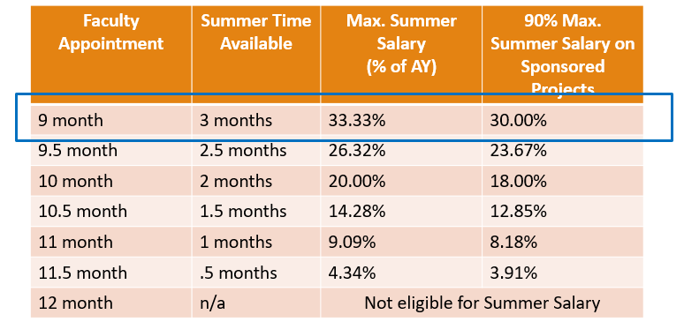
Max. Summer Salary per Appointment
Notes:
We can find the limits associated with the 9 month appointment – which are 33.33% for the full summer, and 30% for sponsored projects

Slide 13
Example #2:
9 month AY faculty; sponsored projects & discretionary; 5/16 – 8/15
Maximum SS allowed:
  $50,000 x 33.33% = $16,666.67
Maximum SS on Sponsored Projects allowed:
  $50,000 x 30% = $15,000.00
Contract Amount:
  $16,666.67 x 40% = $6,666.67
  $16,666.67 x 20% = $3,333.33
  $16,666.67 x 30% = $5,000
  $16,666.67 x 5% = $833.33
  $15,833.33
Base academic year contract:
  $50,000
Effort:
  Sponsored Project #1: 40%
  Sponsored Project #2: 20%
  Sponsored Project #3: 30%
  Discretionary: 5%
  Total: 95%
90%
Notes:
Here is example #2:
Let’s look at a similar example, but in this case, the PI is planning to work 95% of the summer. The amount charged to sponsored projects is still 90%, (click) and the PI opted to use an internal funding source (their discretionary account) for the 5% that is over the limit.

Slide 14
Oracle Online Summer Salary Processing
Summer Salary payments can be processed through RIT’s Employee/Adjunct Payment responsibility
Two payment options (Compensation Types):
Summer Course - for payments for teaching courses listed in SIS
Summer Other Work - for all other activities other than teaching including:
    Course development
    Research – use for sponsored projects
    Administrative duties
Start/end dates must be entered
System will automatically calculate the per pay period amount
Start & end dates should coincide with pay period dates
Take note of Project end dates – cannot pay summer salary beyond the end date of an award
Notes:
Next we’ll talk about processing summer salary payments online.
Summer Salary payments are entered similar to an academic year EAF.
When submitting summer salary there will be 2 payment options: Summer Course (for teaching) or Summer Other Work. Summer Other Work is what should be used to submit payments for sponsored projects
The amounts for payment should be entered directly from the worksheet, that was previously prepared and approved.
Be aware that the start and end dates submitted should correlate to the start and end dates of the summer pay periods.
Finally – be sure to pay attention to the award end dates of the sponsored projects being entered – RIT cannot pay summer salary beyond the end date of an award

Slide 15
Oracle Online Summer Salary Processing
Once entered, Oracle will:
  Validate the account number combination
  Verify that total Summer Salary contracts submitted online and via paper do not exceed the percentage allowed on the institutional base salary (for all faculty on less than 12 month contracts).
  Assign the appropriate PI and SPA rep as approvers for the transaction
Go to the Manager Self Serve website for more instructions on entering the payments or on how to request access: https://www.rit.edu/fa/humanresources/content/self-service-and-access-requests-manager
Suggestion: Example comments to approver: “30% effort on Proj# 31544”
Notes:
There are some built in validations when entering summer salary payments. When you are entering the projects and effort associated with each one– Oracle will:
check that the account number put in is enable
ensure that the % effort being entered does not exceed the maximum % allowed for that faculty member.
3. When it begins routing, - it will route to any PI’s for the sponsored projects being charged, as well as the appropriate SPA reps.
Prior to submission, You can also use the Comments to Approver box to summarize the salary being requested – showing the project number(s) and the percentage effort for each as a descriptive note. This helps PI and SPA rep quickly understand the request & review it, which can expedite the approval process.

Slide 16
Oracle Online Summer Salary Processing
Be aware of the deadlines for individual pay dates to ensure enough time for the electronic forms to route and be approved
  2025 Payroll Schedule
  Reminder - Worksheets must be submitted via email (hreaf@rit.edu) for the following scenarios:
    If the number of accounts/payments exceeds 10 at any point in time
    Institutional Base salary at time of submission is incorrect for
    determining overall AY Salary (Leave of absence, sabbatical, other)
Notes:
Again – you’ll want to keep in mind the deadlines for summer EAF approval in order to be included in the next payrun – you can use the link to view RIT’s payroll schedule online
Also, if you either of these scenarios apply to you – a PI charging more than 10 accounts, or a leave of absence occurred in the prior year - the worksheet should be printed to PDF and submitted to HR (hreaf@rit.edu. )

Slide 17
Oracle Online Summer Salary Processing
  You may get a notice that the summer salary is in excess of the faculty member’s allowed amount.
    Oracle rounds down, so may need to decrease amounts by $.01 or $.05
  Make sure faculty are setting up vacation rules if they are going to be away so it avoids delays in the processing of payments.
Home department enters summer salary – even if faculty working on a project in another area/department.
Notes:
Upon entering the online summer salary EAF, rounding will occasionally be an issue when Oracle is calculating the max salary. This can usually be resolved by adjusting the amounts entered by a penny or 2.
Lastly, if you plan on being away for vacation at all during the summer, remember to delegate your Oracle authority so that submissions for summer salary payments do not get held up.

Slide 18

Questions?
  If you have further questions, please contact
    your SPA rep.
  Current SPA rep assignments can be found at:
      https://www.rit.edu/controller/about-us
  This presentation, as well as additional resources are available on the RIT summer salary website:
    https://www.rit.edu/fa/controller/sponsored/summersalaries.html
Notes:
This concludes the presentation on summer salary.
If you have any further questions about anything discussed here, feel free to reach out to your SPA rep.
This presentation, as well as additional resources are available on the RIT’s summer salary website

