Slide 1
Timing and Availability
Transactions posted in PNC -> next day in Workday
Purchase date | Post to PNC | In Workday
Monday | Tuesday (likely) | Wednesday (afternoon)

Slide 2
Approval Flow
Cardholder (if delegate submitted PCV)
Cost Center Financial Specialist (if exists)
Cardholder’s manager
Gift/Grant/Project Manager (if applicable)
Cost Center Manager(s) (if applicable)

Slide 3
Process timing
8:30am on Day 3 of month-end close
Based on BILL DATE of transaction
https://www.rit.edu/controller/procurement-card-schedule

Slide 4
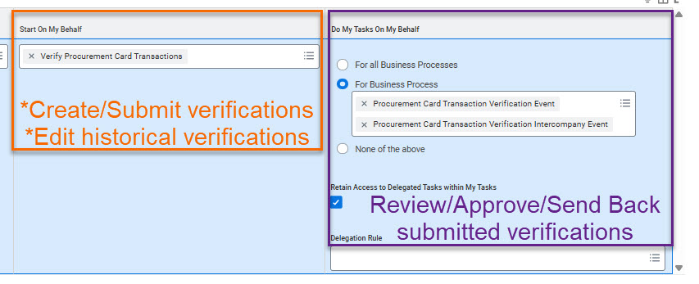
Creating a Delegation
Job Aid in Workday

Slide 5
Cardholder incorrect?
If you cannot see your pcard transactions:
Submit a ticket through the RSC: Report an Issue/Ask a Question
Include in the ticket:
Last 4 digits of card number
Embossed name on the card
Person wrongly assigned (if known)

