Slide 1
Building a MIND Field for Applied Critical Thinking- Structure
Dr. Jennifer Schneider, CIH
Eugene H. Fram Chair
2025

Slide 2
Agenda:
Review of the ACT model
When do you need ACT?
Cultivating ACT
Building the MIND Field: Structure

Slide 3
Applied Critical Thinking- ACT @ RIT
Our global society now comes with expectations: simply knowing is not enough.
Leaders must:
  think critically to assess and strategize within complex interconnected systems and processes
  continually adapt to rapidly evolving technological, aesthetic, and social environments
  manifest new ideas, both individually and collectively.
Application of critical thinking connects this performance chain of knowing-doing-creating.
Effective thinking in any context.
The framing is the same across domains; the emphasis and demonstration of capacity can be different.
Notes:
RIT’s mash up… PLEASE review the intro on ACT@RIT

Slide 4
Metacognition
Applied Critical Thinking
Scientific Method
Creative & Critical Design Thinking
Innovative Thinking
Socratic Method
Design Thinking
ACT draws upon many other models– these are more!

Slide 5
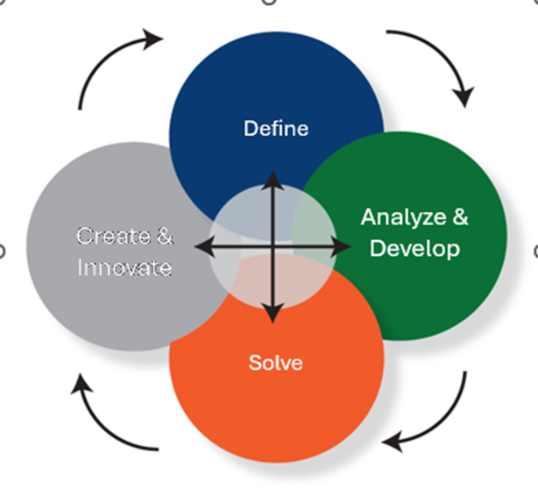
The ACT model:
ACT involves Agility and Pivoting
not a ladder, but a dance
another look at critical thinking development
multi-directional, steps and levels out of order as needed

Slide 6
Critical Thinking vs Passive Thinking:
Critical Thinkers
      Build capacity & creativity
      Leverage teams
      Craft solutions
      See through dense data & Information to decisions
      Practice informed strategic thinking
      Driven by opportunity
Passive Thinkers
  Fearful of making decisions
    Fear of failing
  Ineffective collaborators
  Frustrated by unpredictability
  Analyze using rote methods or only their own experiences & opinions
  Driven by norm

Slide 7
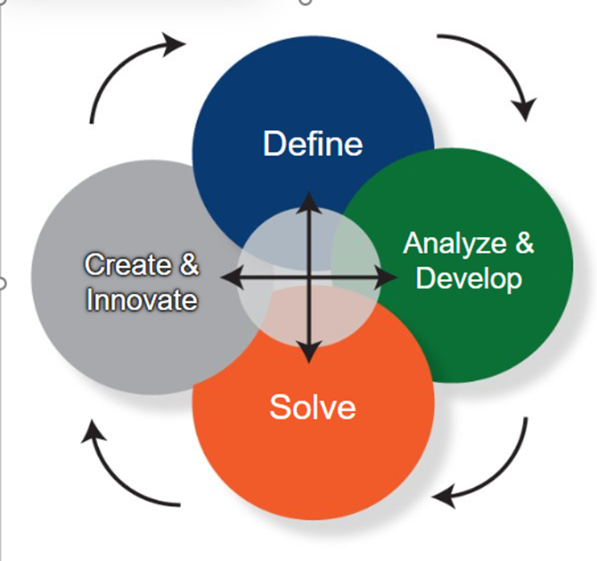
Do you need to integrate Applied Critical Thinking?
Solve: support reasoning without consistent guidance? Appreciate downsides? Consider alternatives?
Synthesize: build insights-: prioritize import, exclude unimportant, assess importance? Communicate it well?
Execute: all parts complete? On time? Quality?
Create: translate vision into reality? Viable solutions? Sense issues and resolve?
Define: scope parameters, know what to ask and why?

Slide 8
The FRAM Mind Field Elevates how thinking is cultivated
What do leaders need to cultivate critical thinking for?
Critical thinking is not cookie cutter learning, it is the cultivation of this ‘habit of mind’ that drives success in our professional lives (and personal lives too).
Skill
Problem
Process
Scenario
Expertise

Slide 9
ACT has two key capacities that integrate:
  Technical capacity (best parts)
  Evaluative capacity (best path)
  Examples of this in Apollo 13 movie:
  https://www.youtube.com/watch?v=TA8SXpyg4O4 (failure is not an option)
  https://www.youtube.com/watch?v=Sij7y-EEei0 (square peg, round hole- duct tape)

Slide 10
What is a Mind Field?
A MIND field is:
A focused learning/thinking opportunity structure that is customized
  With fun (hopefully),
  And sometimes-fast & furious!
Building applied critical thinking competency for
  addressing a challenging complex problem(s) with no direct answer
  a particular skillset, or both
  MIND Fields are built for active learning – focusing on specific issues and questions!
Notes:
Can also be used for assignment design

Slide 11
Characteristics
Great MIND Fields have:
Well curated learning opportunities (LOTS of prep)
Feedback
Style/ Framing to your context
Measure capacity/skill gains, not just final output

Slide 12
Best Practices
Great MIND Fields:
Are Scenario and/or question driven
Have an informed and connected audience or participant
Are Leveled/Scaled to participant capacity & expectation
Have explicit decisions by designer… a map and a goal

Slide 13
How to structure your field?
Structuring the Field
  Standard: What stays the same in the work?
  Custom: What relevant questions or issues do we want to examine?
Building the Context
  Situational awareness, data, rules, goals, biases
Determine Learner Path
  Where learners start and where you want them to arrive
Leveling the Field
  Assess learner capacities and adjust expectations
Scenario Garden
  Specific issues, areas of need, pain points relevant to the setting/purpose
Navigating the Field
  How will you guide students through the field?
Completion
  What does success look like? How will you assess outcomes?
After Action Review
  How did it go? What would you do differently next time?
Thinking in a linear fashion, there are 8 steps to creating a MIND Field (each with their own purpose).

Slide 14

How to structure your field? (cont.)
Define
1.Structuring the Field
2. Build out the Context-both details and team or individual
Analyze/Develop:
3. Determine Learner Path
4. Leveling the Field
5. Scenario Garden
Solve:
6. Navigating the Field
Create:
7. Completion
8. After Action Review

Slide 15
How to structure your field? (cont.)
However, following steps in sequence is not required.
Example:
While Determining the Learner Path (step 3) through the field, adjustments can be made to the field structure and context (steps 1 & 2).
When applying a scenario to the field (step 5), you may find steps 2 no longer applies and the field context must be adjusted.
Remember, this is a dance. Not a ladder.

Slide 16

Signal verbs within ACT
ETHICS:
Choices/priorities
Fundamentals
Applied Critical Thinking
Know
Define
Analyze & Develop
Solve
Create or Innovate
List
Name
Identify
Focus/Discuss
Calculate
Explain
Intro Research?
MAP
Differentiate
Examine
Connect
Deep Research
Assess
Validate
Evaluate
Originate
Construct
Design
Integrate
Notes:
Keep this handy… can tell you where you are in the process!
Use knowledge to derive meaningful results;
Don’t want to jump from labels to create… but NEED a good process.

Slide 17

Visualize thinking… as a first step ‘mini field’
Individual challenge (balls/balloons)
Team challenge (string)
  What did you notice?
  What did you do, what were your ACTIONS? (actions result from thoughts [fast & slow])
  How did you get to solving the problem?
Individual & Team ACT application – both ripples (that overlap)
J. Schneider, ChatGPT image ‘pebble in pond’. 2024 11 30
Notes:
So what ARE those ripples/ waves in the pond? They are overlapping thinking.. In an individual playing out options or in a team? This overlap and pivoting IS the key part of practicing critical thinking!

Slide 18
Teamwork and problem-solving
Powerful tools to build applied critical thinking
Teaming builds capacity across critical thinking, communication, collaboration
Requires individual and team expectations - control for “barnacles” that are not contributing
Rounds of feedback/iterative
Relationship building
AI may not be the best “teammate”
ACT
COMMUNICATION
COLLABORATION
  String exercise: map the thought movement
Notes:
Now the waves or ripples are noted by arrows….
In this process we put in guardrails/ frames/rules (and we throw ideas out too!) This IS how we should consider complex information, incomplete (also complex) information, competing priorities or voices, values, ethics, judgement, trust… all the hard stuff– TO
Build the thought story in our head!
IS AI a good teammate on this? What do you think? It depends!
On what does it depend???

Slide 19

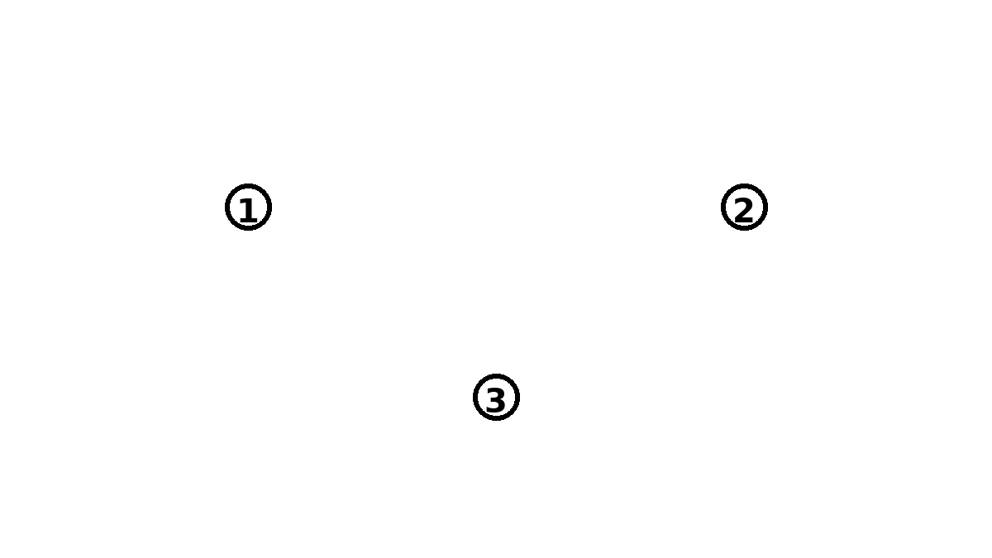
Active visual to stimulate thinking
Balloon/ ball batting
String exercise

Slide 20
Summary
MIND Fields are how we structure our processes for problem solving to use Applied Critical Thinking most effectively and build our thinking capacity.
CONTEXT is key– MIND Fields are:
Question and scenario driven
Leverage both group and individual resources to gain an advantage
Allow you to drive capacity building in a curated set of situations and applications
Works for enterprise applications and for teaching hands on learning!

Slide 21
Questions/ Support for Critical Thinking curricula
Jen Schneider, Fram Chair in Applied Critical Thinking
  jlwcem@rit.edu
Fram Resources Webpage:
  See: https://www.rit.edu/criticalthinking/resources

