Slide 1
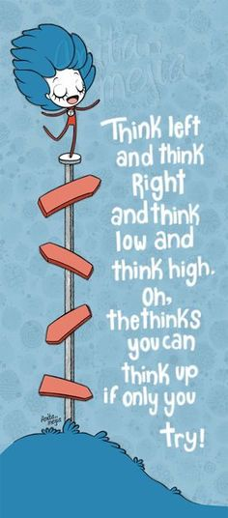
“All the thinks you'll think’’
Dr. Jennifer L. Schneider
Eugene H. Fram Chair for Applied Critical Thinking
Rochester Institute of Technology
February 22, 2016

Slide 2
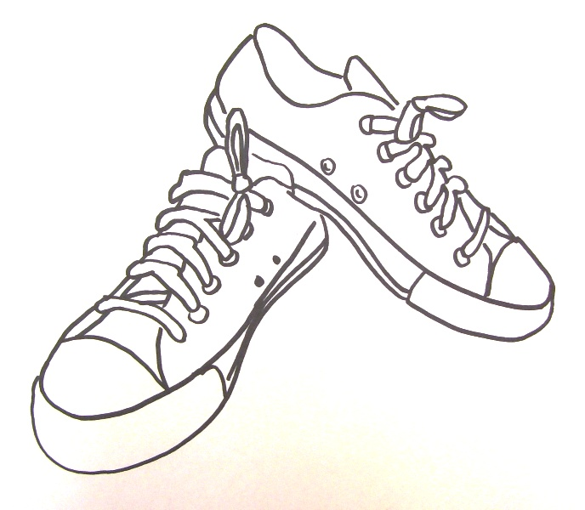
Let’s think!

Slide 3
General Agenda:
Definitions
How does this map?
Ideas & Practices
Cautions & Caveats
Questions & An Invitation

Slide 4
What is Applied Critical Thinking?
Many Definitions Out There…. There Is No Perfect One:
1. "Critical thinking is defined as those processes required to understand and evaluate complex claims of various sorts. It involves the evaluation of information, evidence, arguments, and theories, and the contexts in which these are encountered. It entails the questioning of different and competing perspectives, and challenging the (sometimes hidden) assumptions and inferences that determine what will count as evidence or argument. Critical thinking is learning to think in a disciplined and evaluative manner, to analyze and interpret the processes by which various claims are made and reliable conclusions are reached."
2. CT is: “the ability to identify, analyze, construct, and evaluate evidence and arguments in a deliberate and rigorous way.”
3. Applied: consider an issue, address a problem? Critical: review data and information, investigate and address weaknesses in your approach? Thinking: collect & analyze or evaluate or create to arrive at a result?

Slide 5
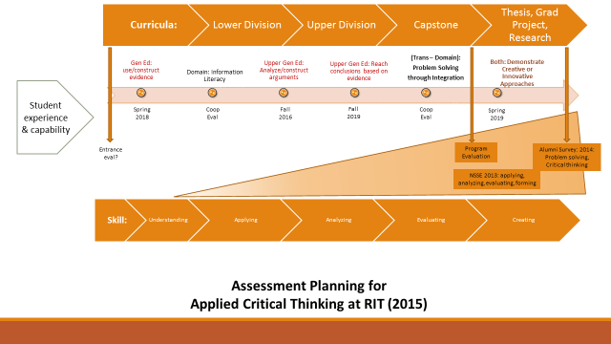
RIT Assessment Map for Critical Thinking

Slide 6
UsING Evidence & Information Literacy
Start from a point of comfort (or with a backup)!
  APPLY our Expertise
  Stretch thoughts from algorithms, SOPs, etc.
  Move across disciplines/domains
  Foundational evidence & information remains the same, may add to it…..
Change the context

Slide 7
Analyze & Construct arguments
Why did you choose?
  Tell me a story relating a big decision in your life….
  Present a discipline based case, asking students to choose/compose the end
  Use metacognition- think about your thinking….
A good way to poke at premises, bias, assumptions, etc.

Slide 8
Arguments & Conclusions => Problem solving
Increasingly more challenging cross/ trans-domain thinking driving toward analysis & resolution
Ways to up the ante:
Ways to soften the experience:
  Create complexity: less available information, vague or competing needs (what's the point?)
  Hot seat thinking
  Time constraints
  Competitive situation
Operate in teams (watch for barnacles!)
Allow for preparation
Break it up
Comedy
Watch out for 'sage on stage' stance
Notes:
Be a guide, not a guru.

Slide 9
Problem- Solving through Integration
But, not all ACT is problem solving!
What you are looking for:
  Independent thinking with a process orientation (not just a value judgement!)
  BUT: weave in ethics
  Management skills (within a context)
The beginnings of professionalism!

Slide 10
Demonstrate Innovative or creative approaches
Design & Creativity
  Look for:
  Willingness to look for sources, ideas, solutions
  Continuous evaluative thinking
  Iterative (the 'pivot point')
  Jazz! (when must we use the melody or baseline, and when can we move from that)?

Slide 11
Cautions & Caveats
Assessing only ability to communicate/ write
Assessing only the result: (ACT is about the process as well as the result)
Using only your world as reference
Why do ACT? Build an essential skillset for thriving, resilient students & alumni

Slide 12
Questions & An Invitation…
JOIN OUR COMMUNITY OF PRACTICE
jlwcem@rit.edu or Eastman 2113 or x5-2092

