Slide 1
Stay Connected with RIT Dubai!
Internships, Recruitment, Research, Projects, Advisory, Executive Education,
Tuition Discount Scheme…

Slide 2
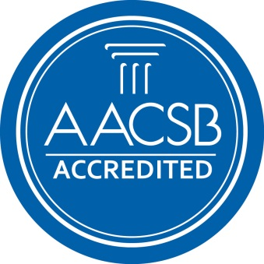
How to stay connected
Careers
Research
Executive Education
Learn
Senior Design & Capstone Projects
Student Site Visits
Specialized Knowledge and Trends Research
Advisory Board Membership
Cooperative Education Program (Interns)
Fresh Graduate Recruitment
Experienced Hires
Leadership Program Development
Learn
Specialized Courses in contemporary matters
Executive Diploma Programs
Tailored Courses to your staff’s needs

Slide 3
RIT gives back to its partners
Our Corporate Agreement Offers:
Learn
Learn
Tuition Discount to staff for Master studies
Tuition Discount to staff families for Bachelor studies
Special rates in executive training
Membership to RIT’s Corporate Network

