Slide 1
Administrative Unit Assessment at RIT

Slide 2
Agenda
| 2
Overview
Institutional Effectiveness
Goals and Model
RIT Practices and Processes
University Assessment Council
Institutional Effectiveness (IE) Maps
RIT’s Assessment Management System
Institutional Effectiveness Progress Report
Institutional Effectiveness Progress Report Results
Resources and Support

Slide 3
Institutional Effectiveness
| 3
The overarching question is, how well are we achieving our mission and goals?
We answer this question by engaging in a systematic and ongoing assessment process, using results to make informed decisions and to properly allocate resources. The assessment of institutional effectiveness essentially involves a documented comparison of institutional performance to institutional purpose.

Slide 4
RIT’s Mission, Vision, and Strategic Goals
| 4
RIT has a Vision and Mission, and corresponding Strategic Plan, Greatness Through Difference
RIT’s administrative units support the Vision, Mission, and Dimensions of the Strategic Plan; they demonstrate this by setting goals which align to the strategic plan
Administrative units measure their goals and use assessment results to inform and guide continuous improvement (enhancing operations, planning, guiding decision making, allocating resources, etc.)

Slide 5
Why do Administrative Unit Assessment?
| 5
To demonstrate how effectively administrative units support RIT’s mission, vision, and goals.
To provide evidence of systematic processes (meaningful and sustainable) for continuous quality improvement

Slide 6
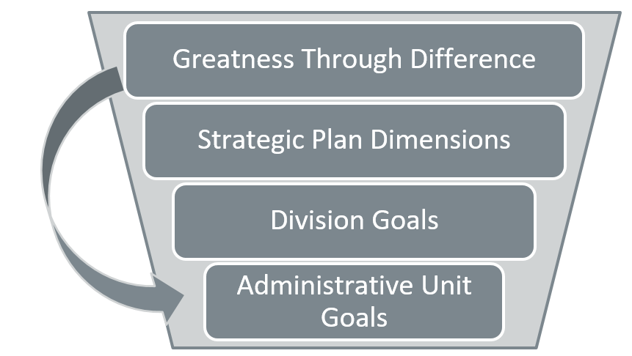
Institutional Effectiveness Model at RIT
| 6
Greatness Through Difference
Strategic Plan Dimensions
Division Goals
Administrative Unit Goals

Slide 7
RIT Practices and Processes
| 7
Oversight and Support – UAC
Institutional Effectiveness Map
Annual Progress Report
Review Process
Rubric Rating System
Assessment Management System

Slide 8
University Assessment Council (UAC)
| 8
All RIT divisions represented
Formal charge – oversight
Key support areas
Institutional Effectiveness (IE) Map
Annual Progress Report

Slide 9
The Institutional Effectiveness Map (IE Map)
| 9
Tool to help administrative units measure their strategic goals and align these goals to university goals
IE Maps contain six core elements:
A mission/charge
Measurable outcomes/objectives that align to the mission of the institution/division
Data sources/activities for assessment of those outcomes/objectives
Benchmarks to help assess achievement
The timeline and person(s) responsible for data collection/reporting
Use of results to guide decisions/changes to improve programs and services and inform planning, budgeting, and resource allocation

Slide 10
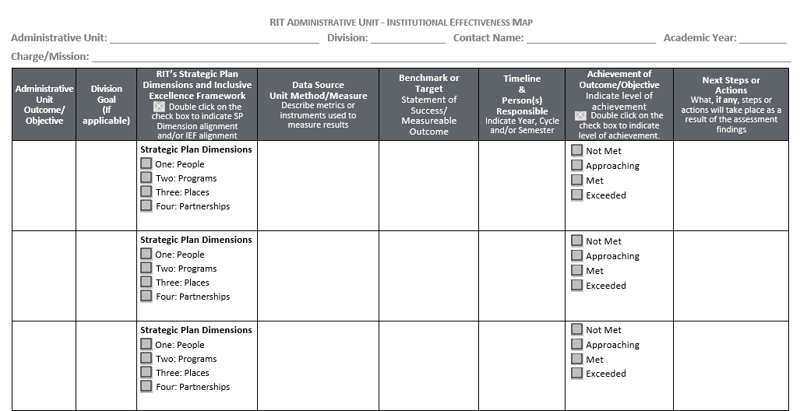
The IE Map: A Snapshot
| 10

Slide 11
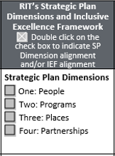
Aligning IE Maps to RIT’s Strategic Plan
| 11
Administrative Goals are mapped to RIT’s Strategic Plan Dimensions.

Slide 12
IE Maps and Watermark
| 12
IE Maps are housed in RIT’s Assessment Management System, Taskstream by Watermark
an online system that provides a communication and resource hub for outcomes assessment and continuous improvement initiatives
Office of EEA provides administrative units with Taskstream by Watermark training and support
Administrative units maintain their own work spaces in Taskstream by Watermark

Slide 13
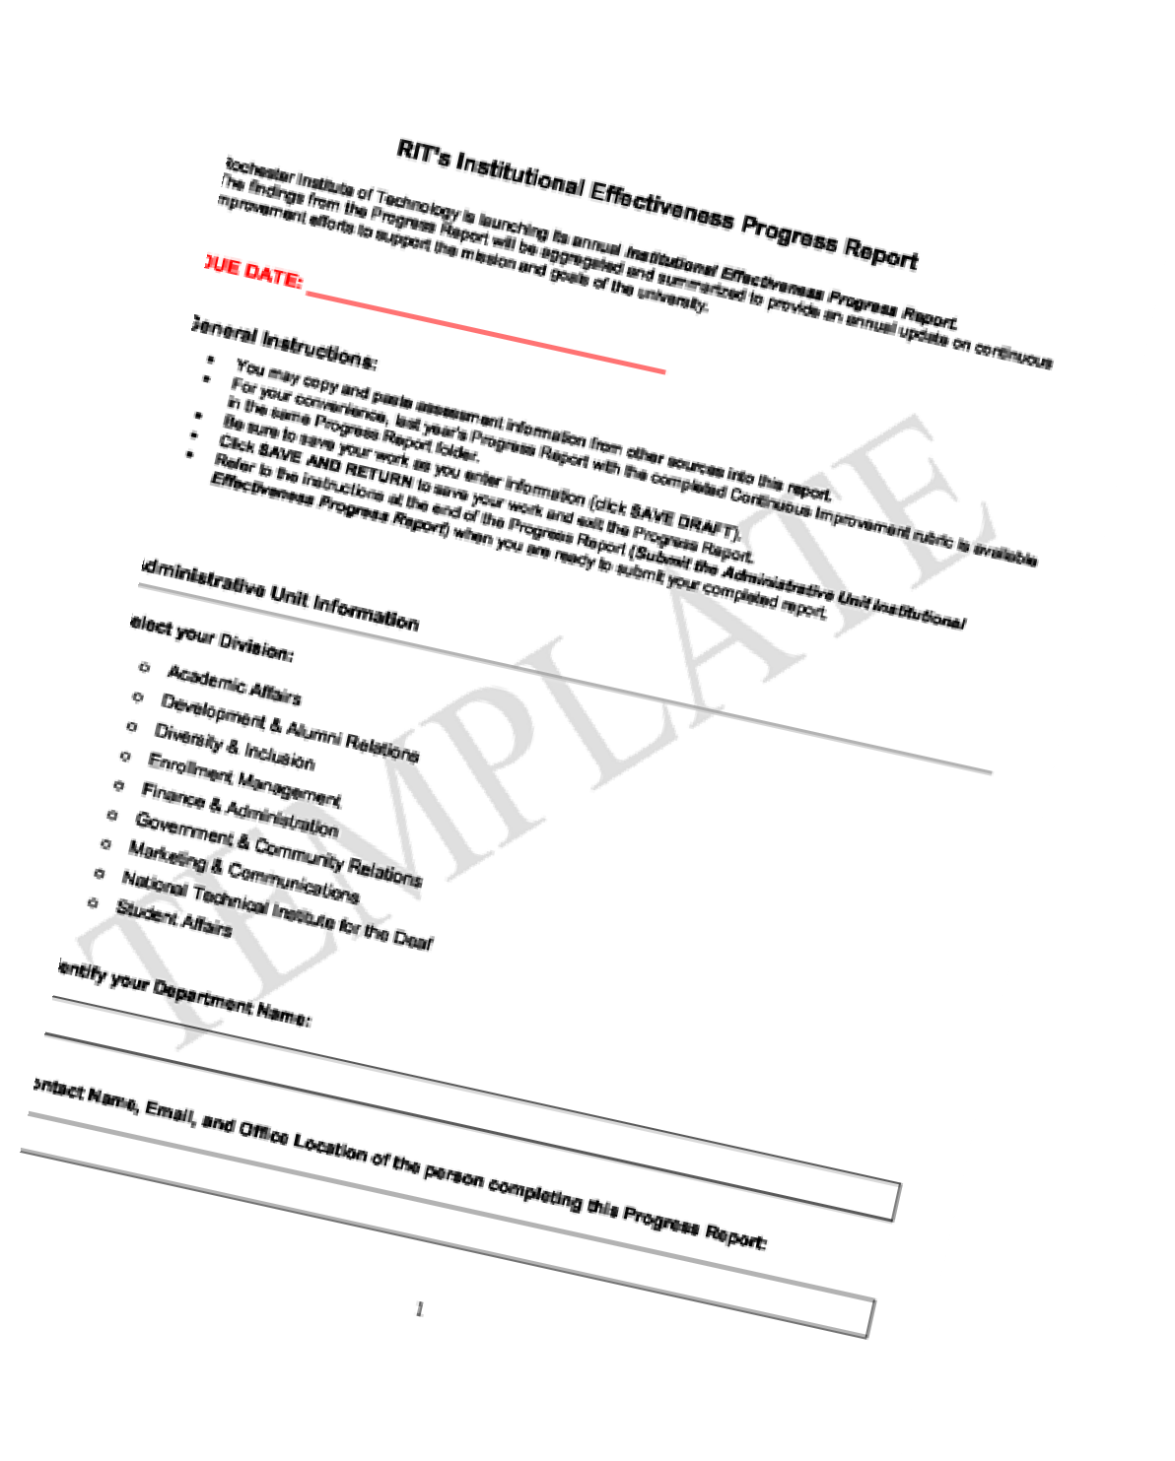
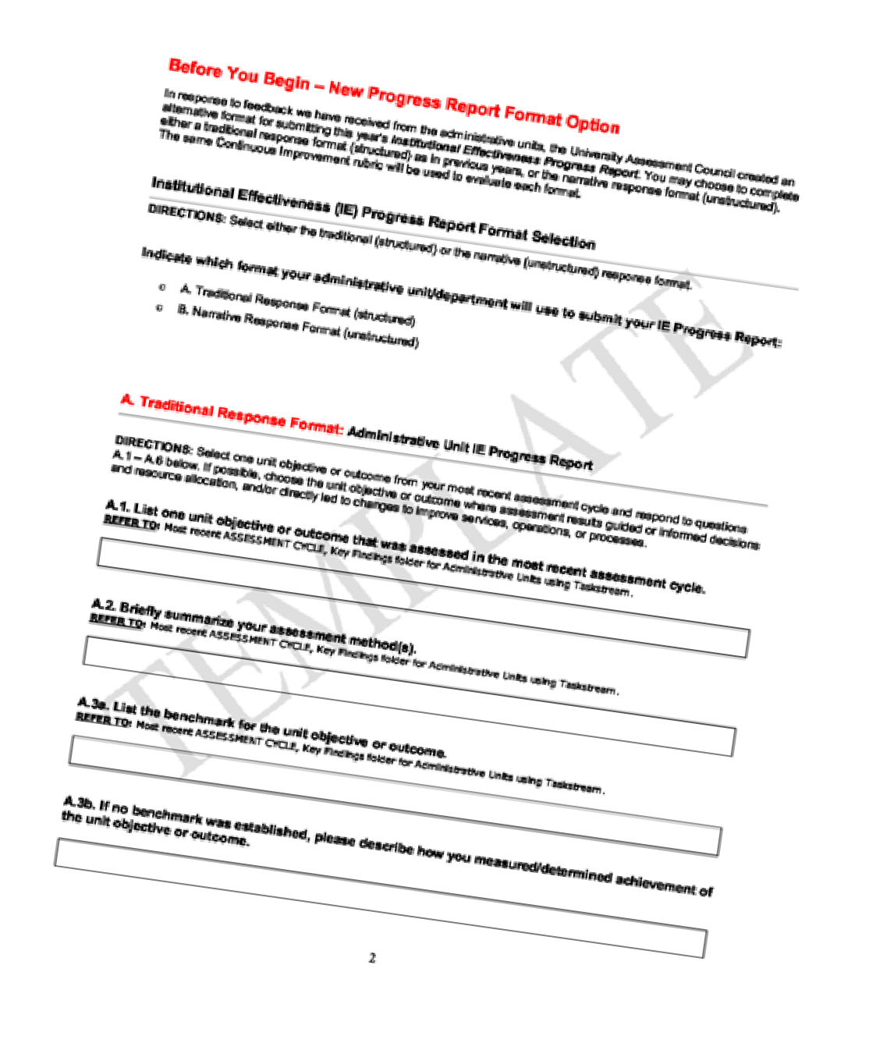
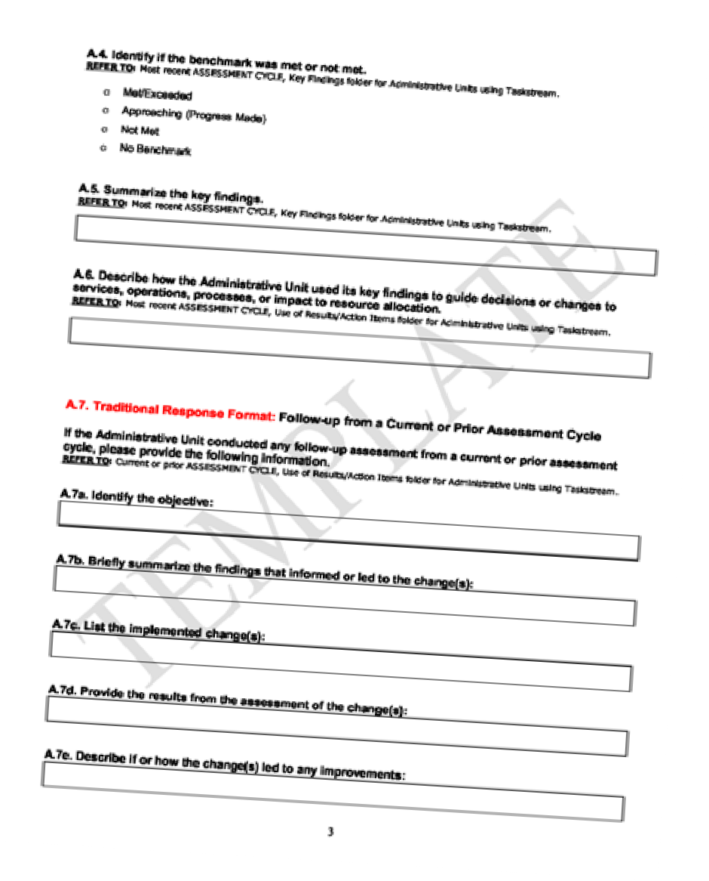
Institutional Effectiveness Progress Report
| 13
The annual Institutional Effectiveness Progress Report (IE PR) was developed by the UAC for administrative units to demonstrate how they are supporting the university’s mission and goals and using data to drive improvement processes.
The IE PR Survey is completed annually

Slide 14
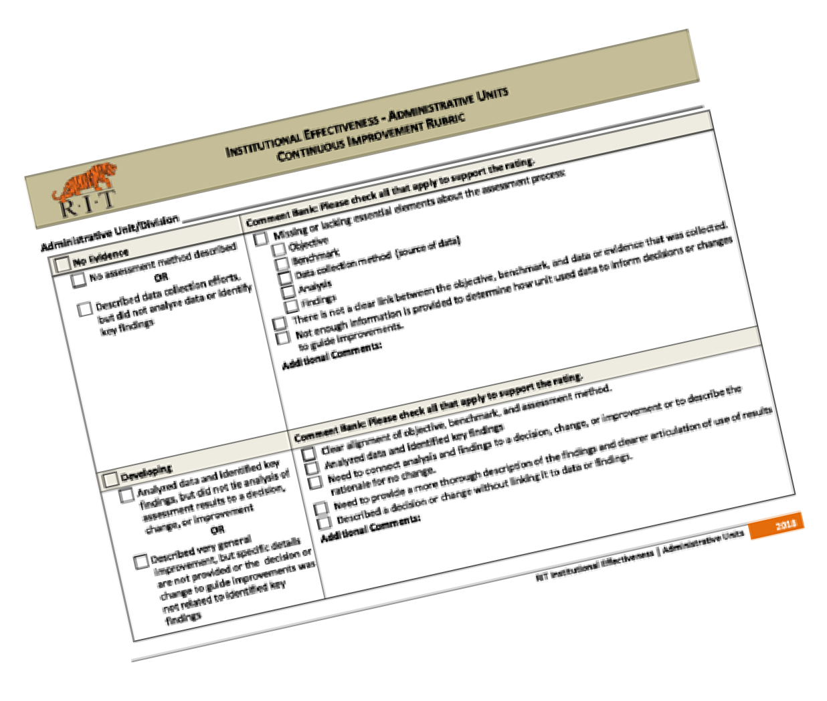
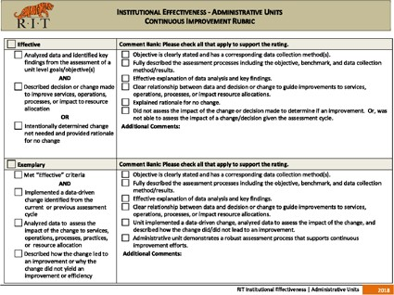
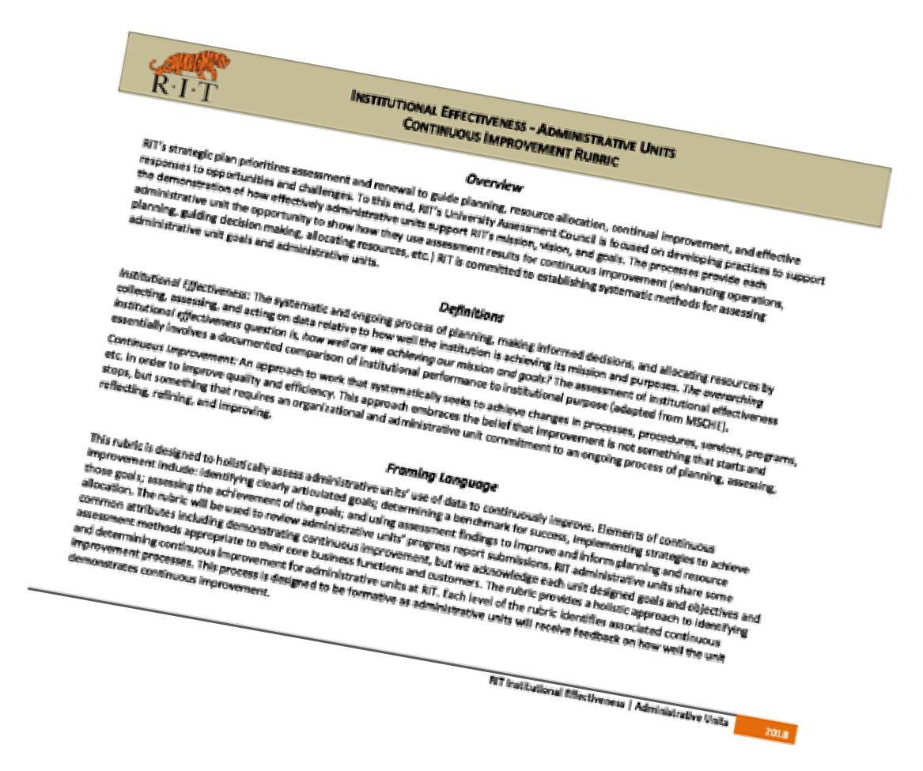
IE PR Evaluation
| 14
The University Assessment Council evaluates each IE PR using the Continuous Improvement Rubric.
Units receive a Continuous Improvement Rubric rating of “No Evidence,” “Developing,” “Evidence,” or to “Exemplary”

Slide 15
Sharing IE PR Results
| 15
RIT's annual Institutional Effectiveness Progress Report data is aggregated, analyzed, and shared with the campus community.

Slide 16
IE PR Goal
| 16
RIT’s goal is that 100% of its administrative units are rated “Effective” or higher on their annual progress report submissions.

Slide 17
Resources and Support for Administrative Units
| 17
Resources and support for administrative units are available at EEA website. Here, you will find:
IE Map Planning Guide
IE Checklist for Chairs and Directors
Sample IE Maps
Information about workshops and training

Slide 18
For Questions and Support, contact the Office of Educational Effectiveness Assessment:
Dr. Leah Bradley
Director
Kate Scahill
Assistant Director
Grace Rubin
Assessment Management System Coordinator
www.rit.edu/outcomes

