Slide 1
3D Printing:
Applications of 3D Printing
Toyota Production Systems Lab
Grade 9-12

Slide 2
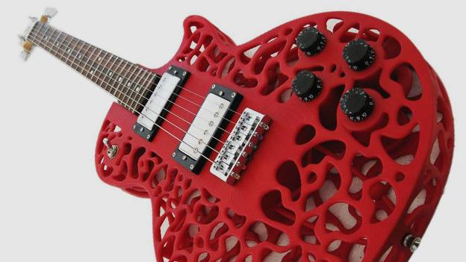
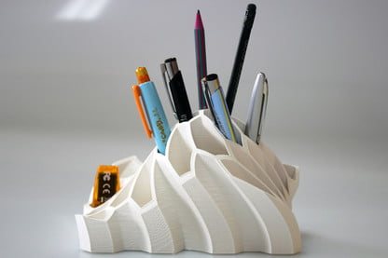
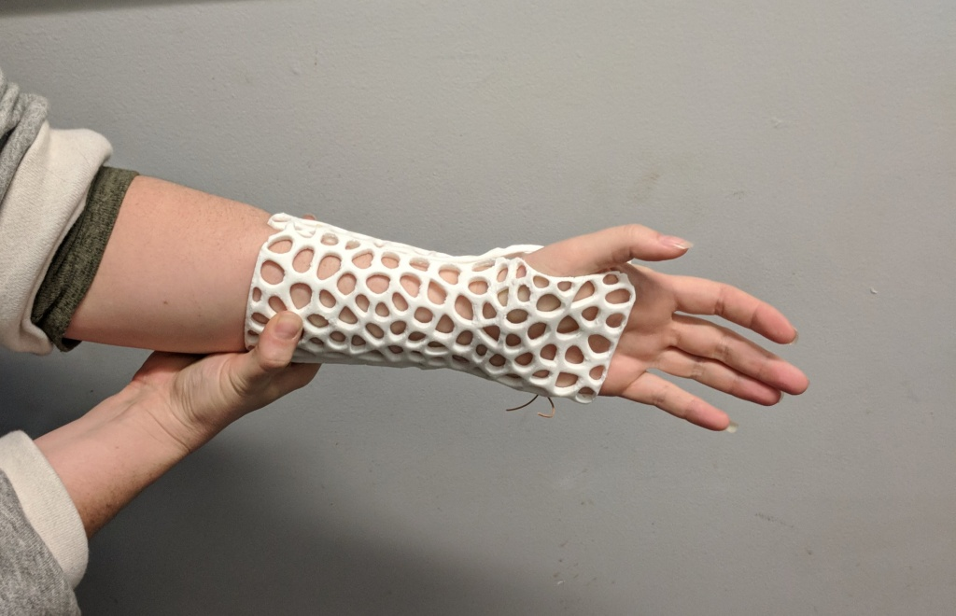
Applications of 3D Printing
3D Printing has endless capabilities that can be applied to any industry you can think of!
Here are some examples of the various industries that 3D Printing is utilized.
Automotive
Consumer Goods
Healthcare/Medical
Gaming/Film
Art/History
Manufacturing
Construction
Food

Slide 3
Applications of 3D Printing: Prototyping
3D Printing helps bring ideas to life. Therefore, it is widely used during the design, development and test stages of the design process.
Prototype – physical model of a concept or idea.
Since 3D Printing is inexpensive and easy to use, designers can create a rendering of an idea for a project using software such as SolidWorks or Creo and can print their idea to show to the team.
Then they can make changes and print another prototype again to test their designs before making the final product.

Slide 4
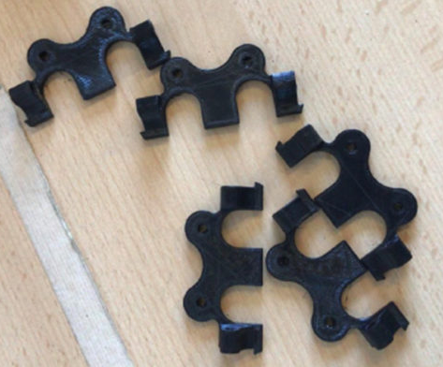
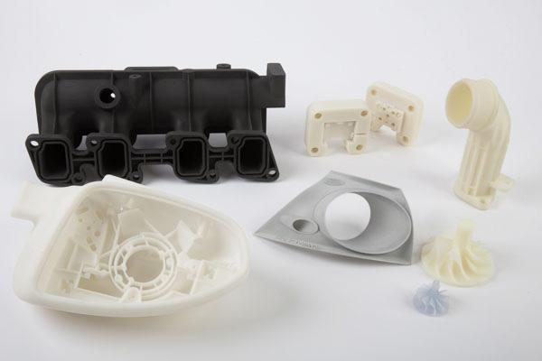
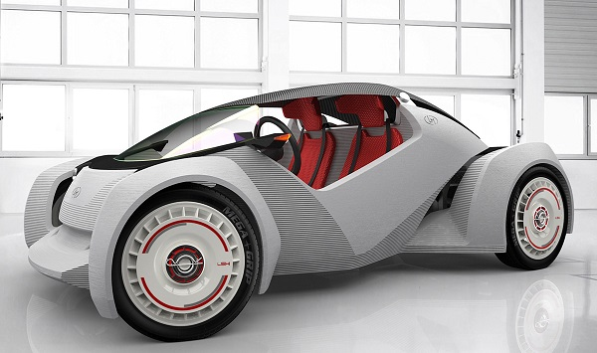
Manufacturing & Automotive
3D Printing is used in the automotive industry to make…
Special Tooling and Fixtures for unique parts
Make prototypes for parts to test
Can make customized pieces for specific cars
Can create parts that have complex geometries
Regular manufacturing machines could not produce
Notes:
https://www.raise3d.com/case/3d-printing-in-automotive/

Slide 5
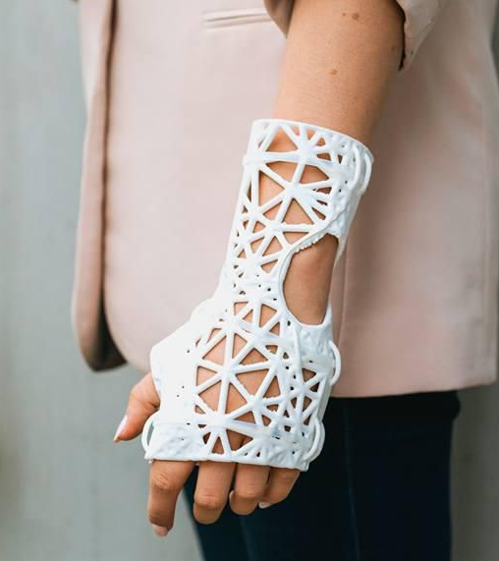
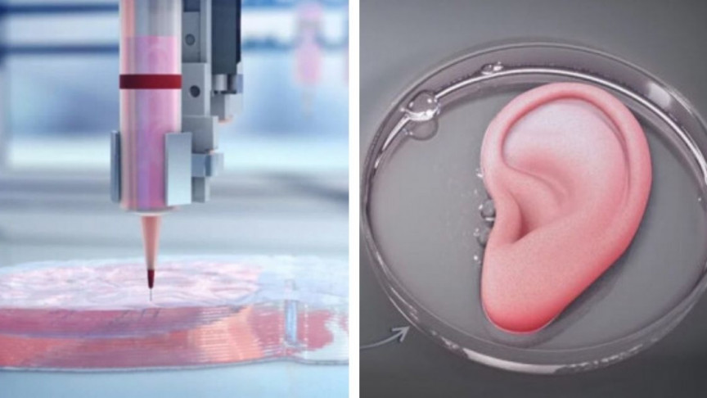
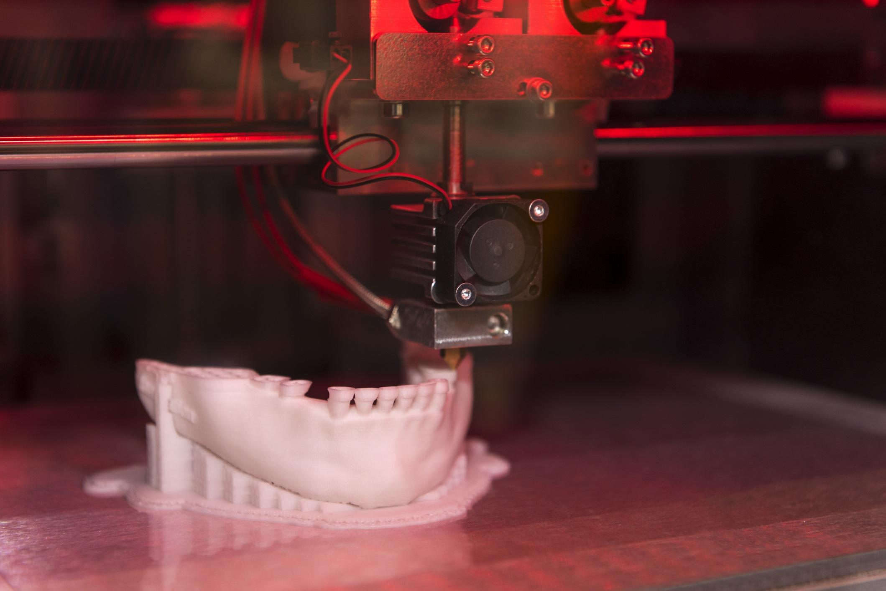
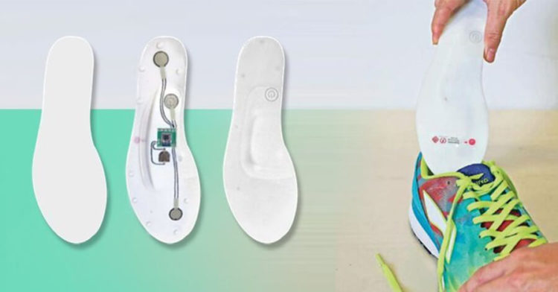
Healthcare
3D Printing is used in the healthcare industry to make…
Customized casts that fit perfectly to each patient
Research in 3D Printing human tissue!
Make prototypes for parts to test
Can 3D Print molds of teeth for Orthodontics
Notes:
https://www.raise3d.com/case/3d-printing-in-automotive/

Slide 6
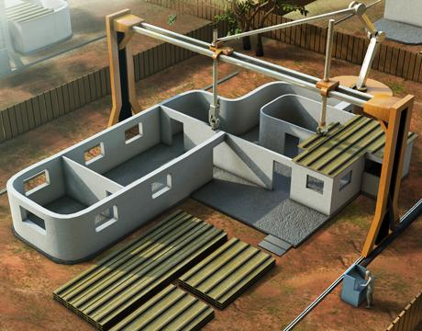
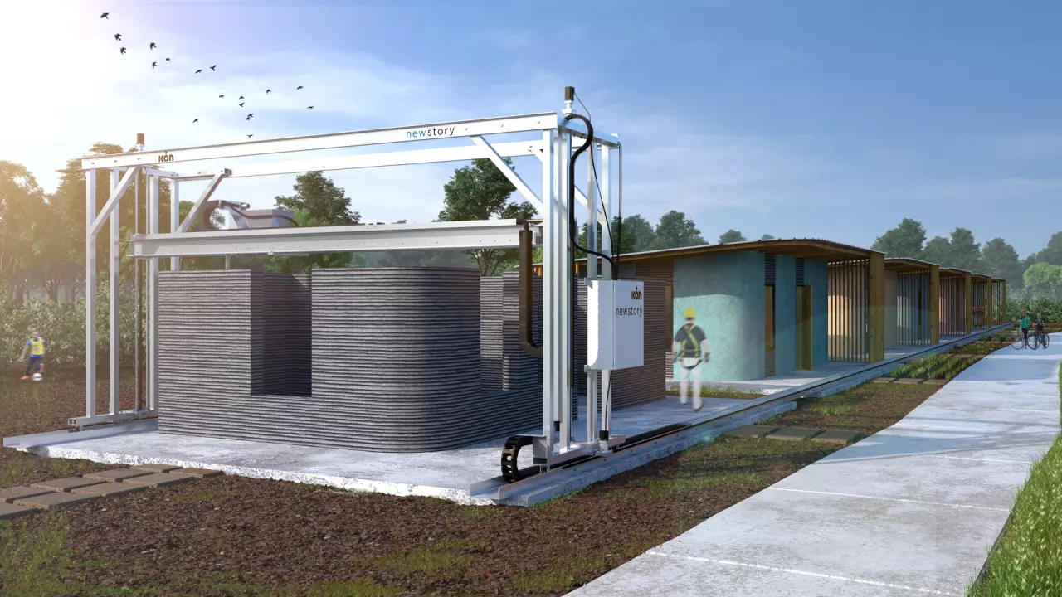
Construction
3D Printing has been used to create affordable housing by 3D printing houses using cement and other building material.
Need Industrial Sized 3D Printers
Much faster than traditional methods
More cost effective

Slide 7
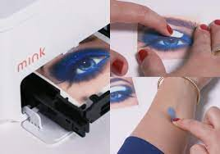
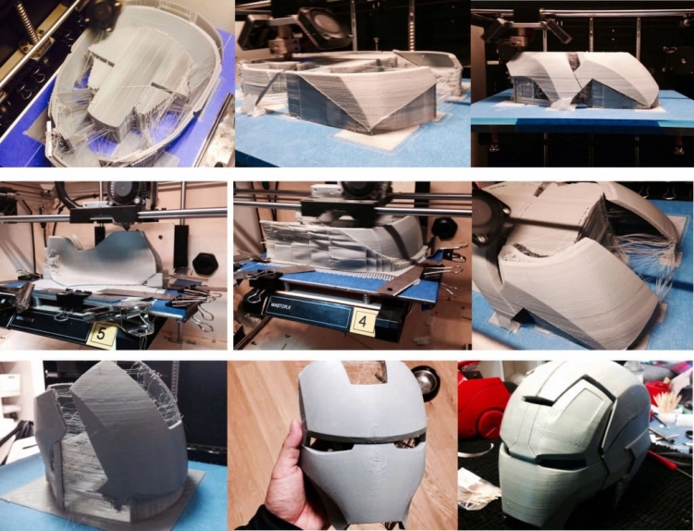
Film, Entertainment & Gaming
3D Printing is used by many make-up artists in the film industry to create unique props and characters
For Example:
Rick Baker – make up artist for Star Wars
Using 3D printing to create monsters and props
He was able to save so much time by printing specific pieces
Notes:
https://www.raise3d.com/case/monsters-and-makeup-effects-with-rick-baker/

Slide 8
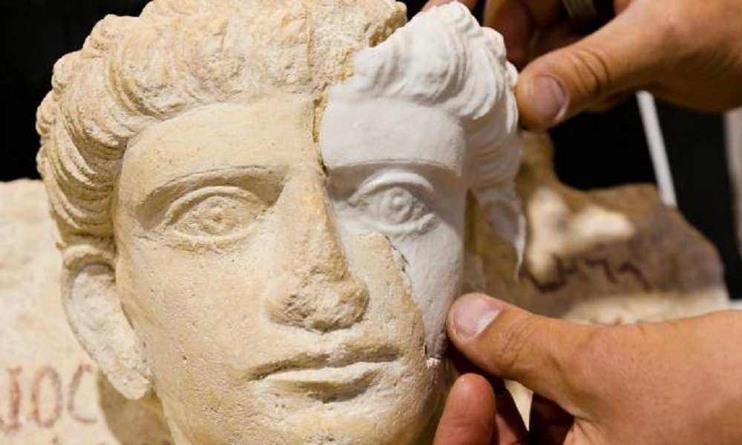
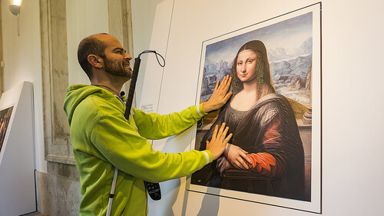
Art & History
3D Printing is being used in museums for artifact restoration.
Can create custom pieces that fit the original exactly.
Can pick materials that do not hurt the original piece.
Can also help visually impaired experience art.
Notes:
https://www.sculpteo.com/blog/2018/07/26/how-3d-printing-revolutionizes-the-world-of-visual-impairment/

Slide 9
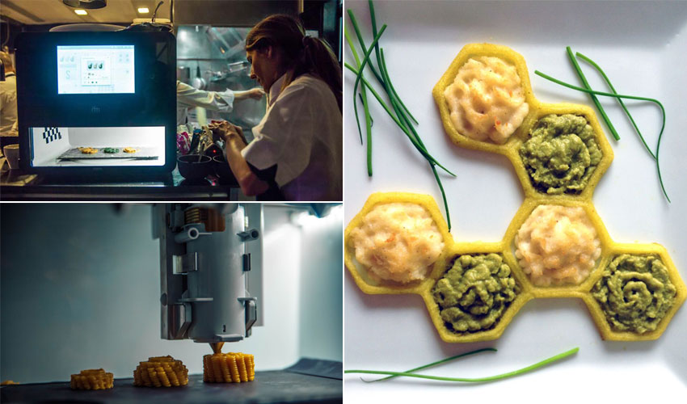
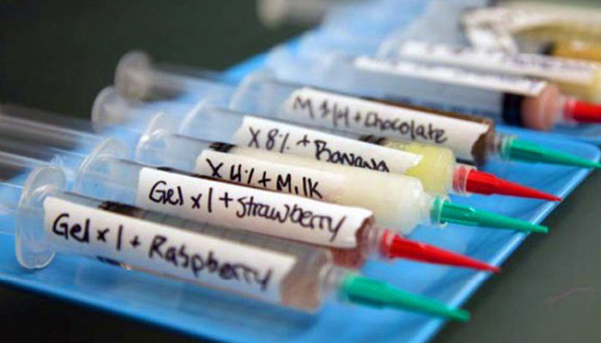
Food
In 2006 NASA started testing 3D printed food for astronauts who had long missions in space
So many opportunities for 3D Printing Food Such as…
Discovering different flavors, textures and recipes
Reducing Food Waste
Already experimenting with pasta, vegetables and chocolate.
Notes:
https://www.3dnatives.com/en/3d-printing-food-a-new-revolution-in-cooking/#!

Slide 10
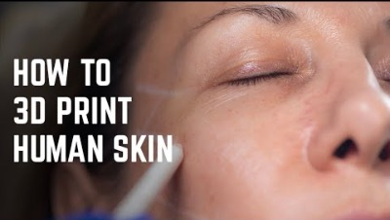
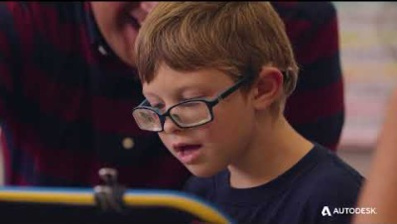
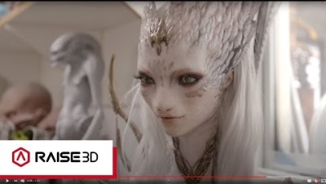
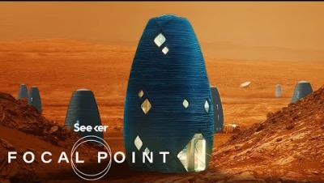
Activity
Exploring different applications of 3D Printing in various industries
As we can see there are so many ways in which 3D Printing is changing the world around us.
Watch these videos of 3D Printing Applications for different industries. Then write down your Top 3 Takeaways from each video.

Slide 11

What We Learned
There are many different applications of 3D printing, and it can be applied to every industry! As 3D Printing expands, there will be more and more opportunities to use 3D Printing to help improve out lives!

