Slide 1
3D Printing Introduction
Toyota Production Systems Lab
Grade 9-12

Slide 2

3D Printing
3D Printing is about utilizing a printer that builds a part or an object from the ground up, one layer at a time.
Also called Additive Manufacturing because it builds and creates parts by adding one layer of material on top of another.
Video: Introduction to 3D Printing

Slide 3
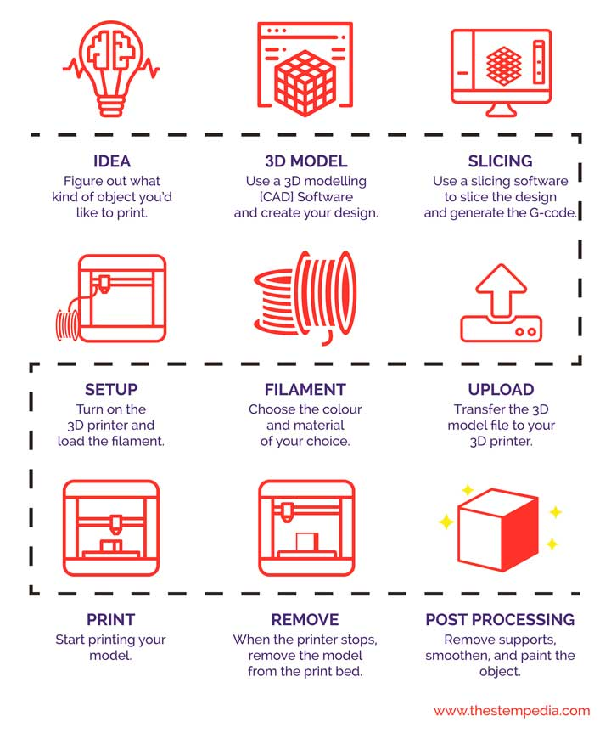
3D Printing Process
The process to 3D Print an object are shown to the right.
Always start with a design using software such as SolidWorks, Creo, AutoCAD or OnShape
The final design is saved as a .STL file and sent to the printer.
The printer has software connected to it which creates the G-Code. Code that tells the printer how to print the object. The process of making the G-code is called Slicing – think separating layers.

Slide 4
3D Printing Process
Then the printer needs to be set up, material or filament is chosen and then added to the printer, as well as, setting up the proper temperature of the nozzle and print bed.
Once the printer is set, the file is uploaded to the printer and selected to print.
After the object has printed there are post processing operations such as
  Removing support material
  Sanding rough edges
  Painting

Slide 5
Video: 3D Printer Parts & How it Works
Video: 3D Printer Parts & How it Works
  This is a great video detailing the important parts of a 3D printer, as well as, explaining how the printer works.
  This video focuses on the most general type of printer, the cartesian printer.
      Called “cartesian” because the print bed moves in X and Y direction and the carriage moves up and down in the z direction.
  Link to Video: The Parts of a 3D Printer you Need to know!

Slide 6
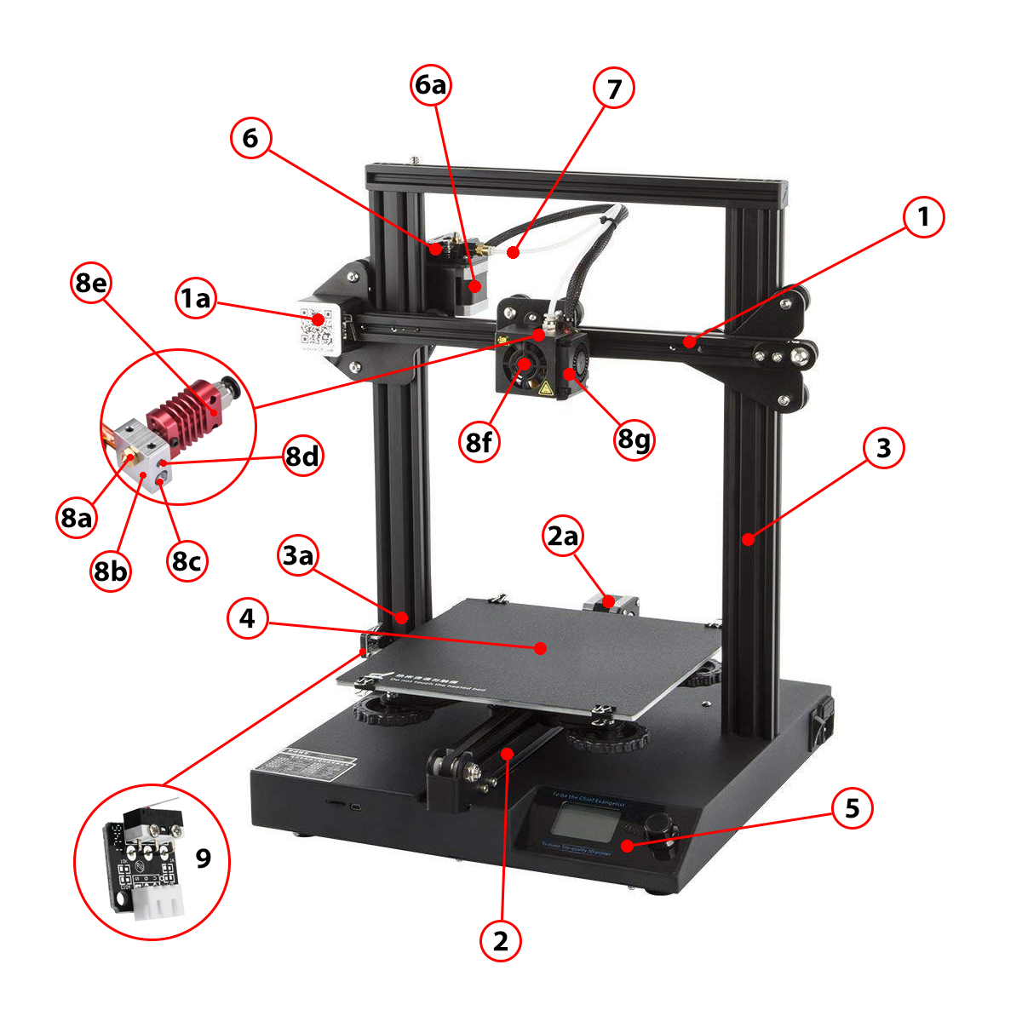
Parts of a 3D Printer
  From the video we learned that the general type of 3D printers are called “cartesian” because the print bed moves in X and Y direction and the carriage moves up and down in the Z direction.
  The next slide shows the parts of a 3D printer.

Slide 7
Parts of a 3D Printer
X Axis
  A. X-Axis Motor
Y Axis
  A. Y-Axis Motor
Z Axis
  A.Z-Axis Motor
Print Bed
Controller
Extruder
  A. Extruder Motor
Bowden Tube
Hot end
  A. Nozzle
  B. Heater Block
  C. Heater Cartridge
  D. Thermistor
  E. Heat Break and Heat Sink
  F. Cooling Fan
  G. Part Cooling Fan
End Stop/Limit Switches

Slide 8
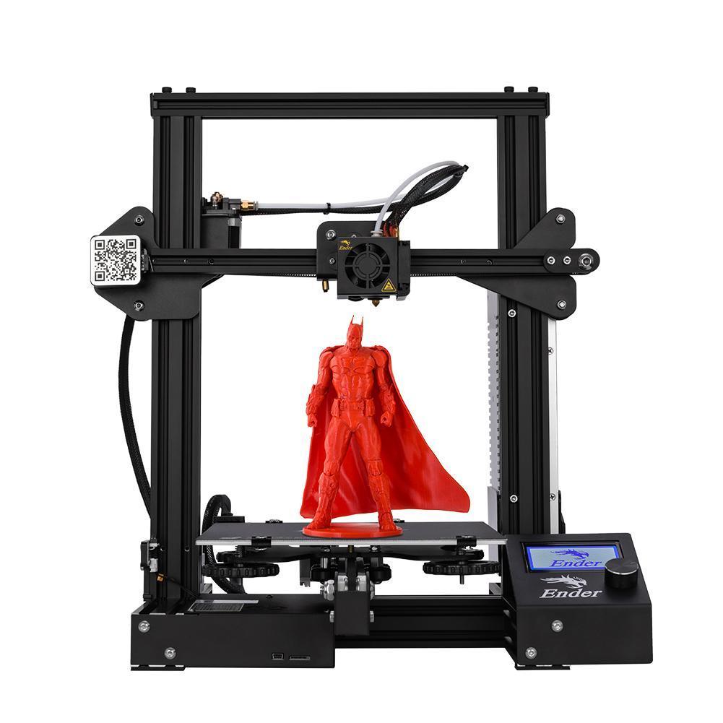
Activity
Labelling the Parts of a 3D Printer
  Before we dive into 3D Printing, we must understand the different parts that make up a 3D Printer and how they work.
  Go to the 3D Printer Universe website via the link below to read about each of the parts of a 3D printer and their functions. Then, label the parts of the 3D printer accordingly.
  Anatomy of a 3D Printer

Slide 9

What We Learned
You can take your designs and make anything with a 3D printer! Now that we know how a 3D printer works and the parts of the printer, we can explore different types of printers there are, as well as the different materials used in printing 3D products.

