Slide 1
3D Printing:
Printers & Materials
Toyota Production Systems Lab
Grade 9-12

Slide 2
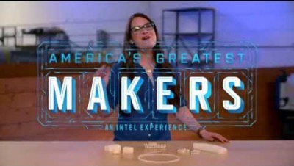
Let’s Start with a Video
This is a quick video that not only talks about the benefits of 3D printing but talks about the materials and printers that are widely used in industry.
Link: Intro to 3D Printing

Slide 3
Recap of Video – Benefits to 3D Printing
Experts say that 3D Printing could lead to a 3rd Industrial Revolution
3D Printing brings manufacturing directly into your own home
Save time and money by making it yourself!

Slide 4
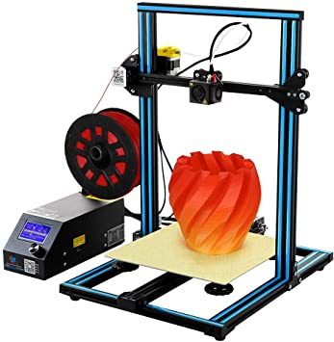
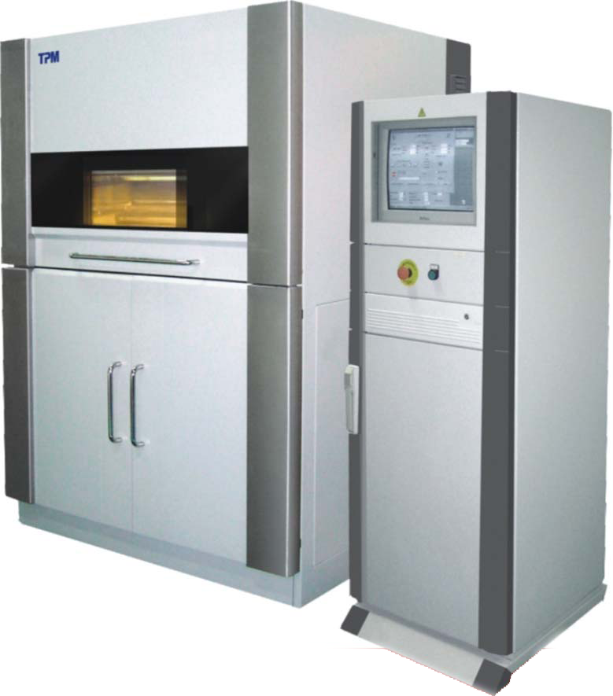
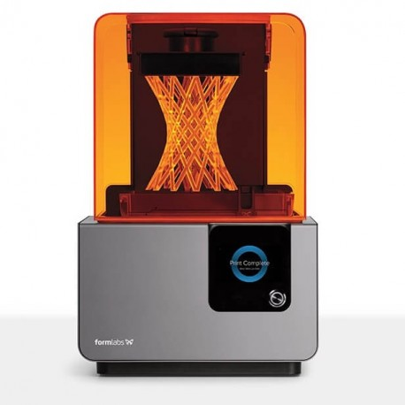
Types of 3D Printers
There are 3 Printers that are most used in Industry.
FDM
SLA
SLS

Slide 5
FDM – Fused Deposition Modelling
Each layer fuses to one another to create a finished part
Fairly inexpensive
Can print using a variety of different materials
Prints from the bottom up! As each layer is added the base moves down to make room for the next
Starting with building the foundation of the house and finishing with the roof!

Slide 6
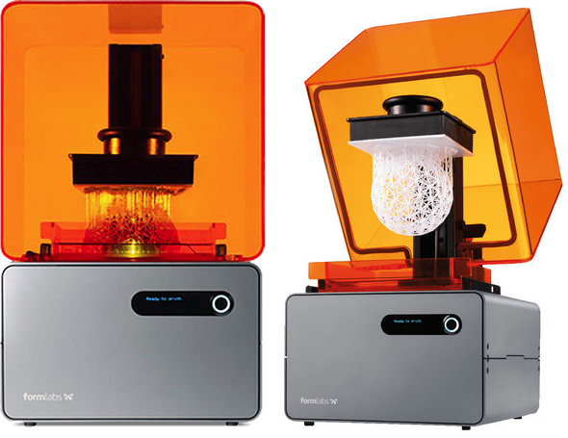
SLA – Stereolithography Printer
Original or first 3D Printing Method!
Uses a liquid resin as the material and a laser to print the material, which is then cured or solidified using ultraviolet light
Material is expensive
Unlike the FDM Printer this printer prints from the Top Down!
Meaning the print bed is at the top and the laser prints the top of the part first and the print bed moved up as each layer is made

Slide 7
Side Note: Support Material!
The part in the example is a sphere. However, in order to print the sphere, the printer needs to make sure that the part is attached to the print bed, or else it can’t print.
It prints support material to support the structure – all those little attachments.
These can easily be broken off after the part is printed and are there during the process.

Slide 8
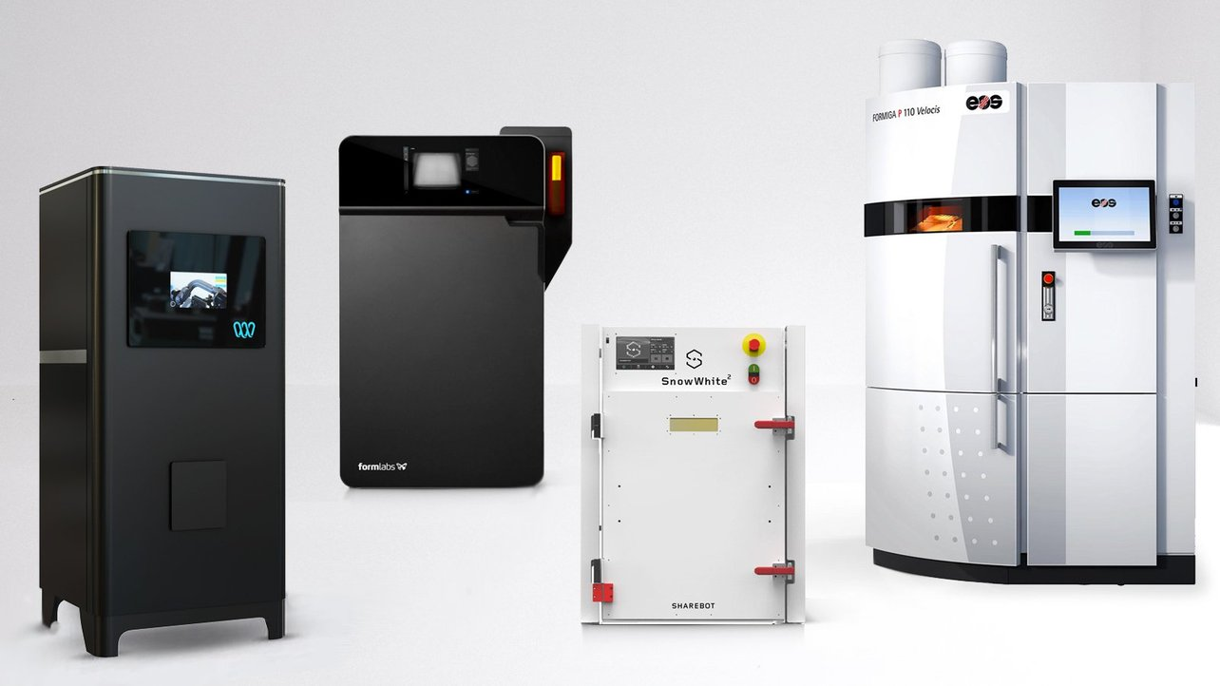
SLS – Selective Laser Sintering
SLS uses a powder as its material and a laser to cure/or solidify each layer of the print.
Powder is laid down for each layer. Then the laser will solidify the shape of each layer to form the part.
Prints from bottom up like the FDM machine.
Used in many different application.

Slide 9
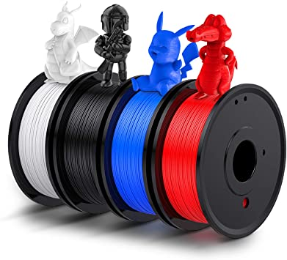
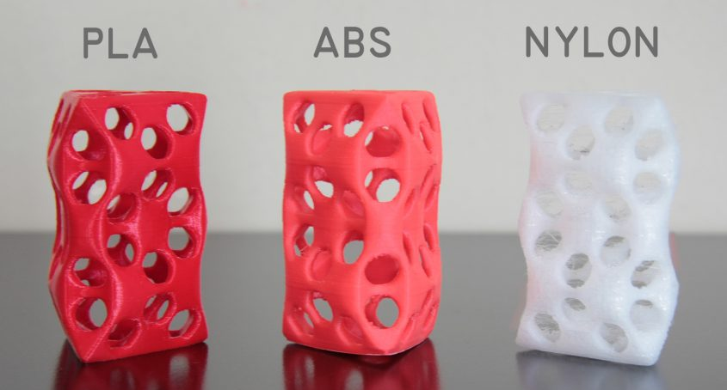
3D Printing Materials
As stated in the video, there are so many kinds of 3D printing materials. Let’s focus on the main ones.
PLA
ABS
Nylon

Slide 10
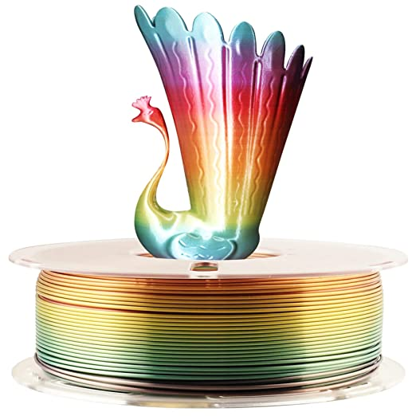
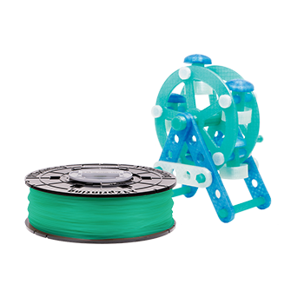
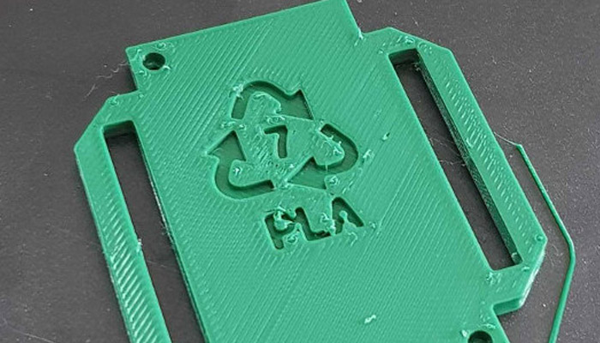
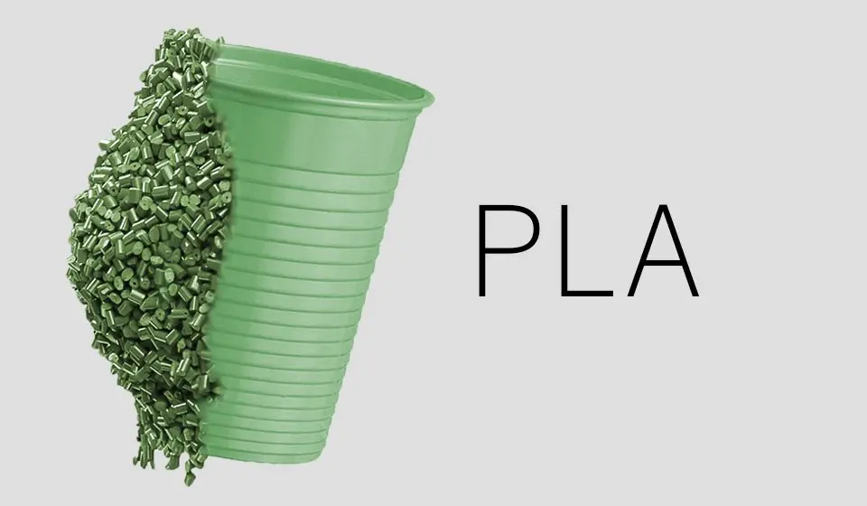
3D Printing Materials - PLA
PLA – Polylactic Acid
Most popular material for 3D Printing
Used on FDM machines
Can make parts for many different applications
It is inexpensive
Biodegradable – made of sugarcane or corn
One of the most environmentally friendly materials on the market!
Notes:
https://www.simplify3d.com/support/materials-guide/

Slide 11
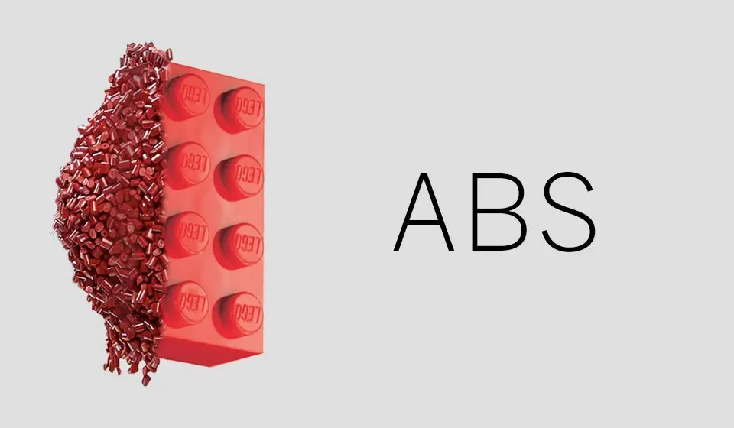
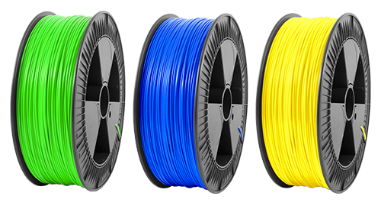
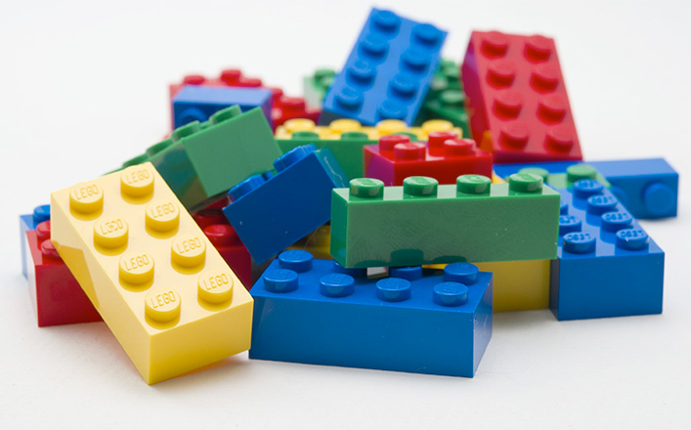
3D Printing Materials - ABS
ABS – Acrylonitrile Butadiene Styrene
Was the first material to be used for 3D printing, still popular today
Has great mechanical properties
Tough, impact resistant , durable, heat resistant
LEGO’s are created using ABS because of their mechanical properties!
Inexpensive
Great for making parts that are going to be used outdoors – temperature resistant
Notes:
https://www.simplify3d.com/support/materials-guide/

Slide 12
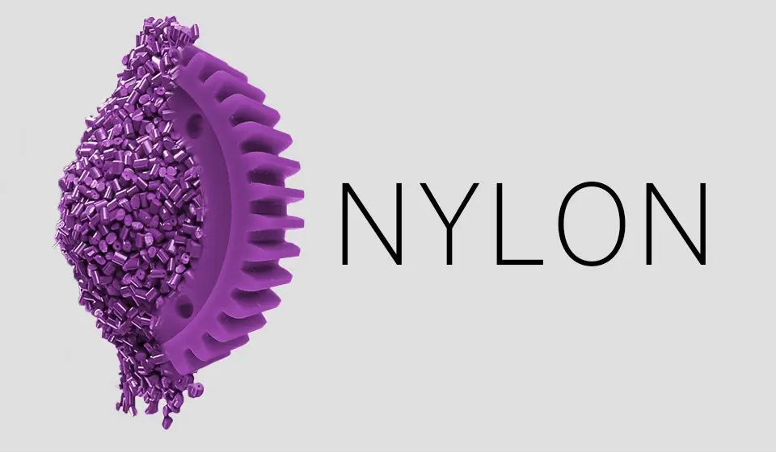
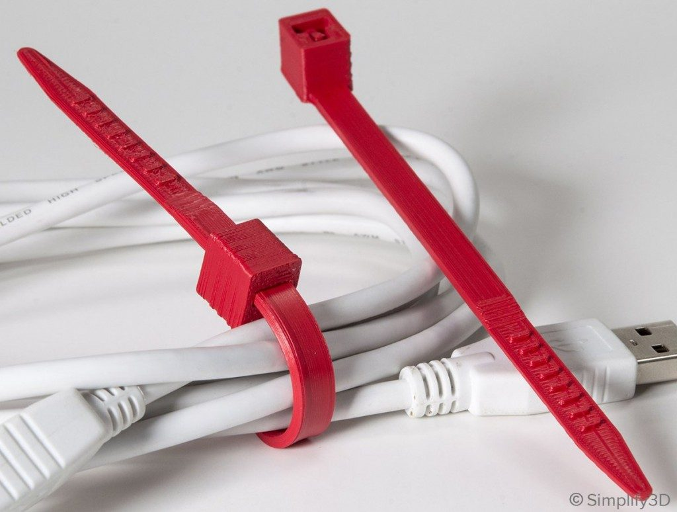
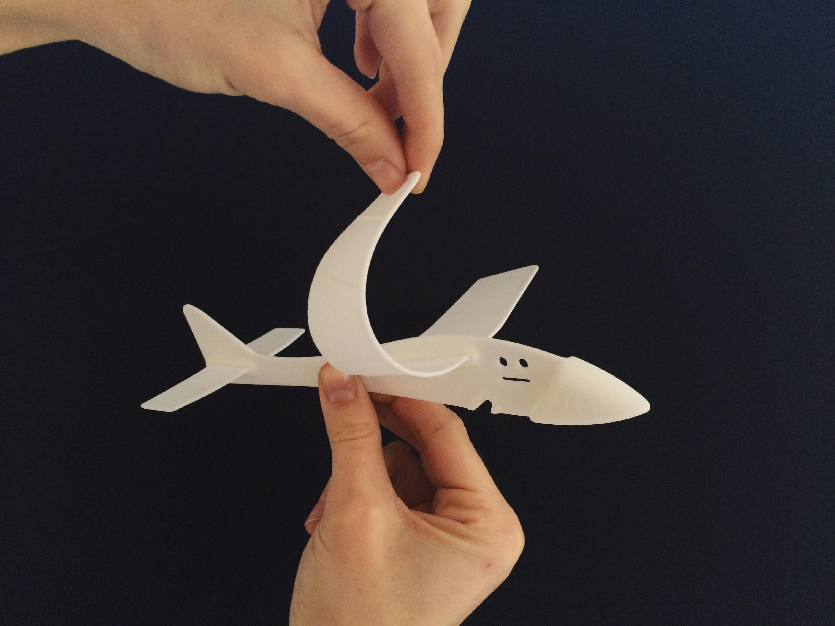
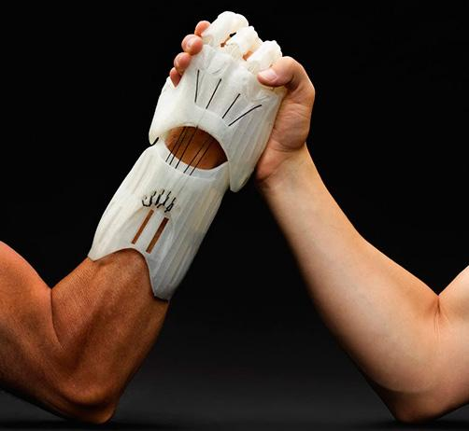
3D Printing Materials - Nylon
Nylon – Polyamide
Very flexible yet strong
Very durable
Widely used in the plastic industry
Used to create many kinds of parts
More expensive that ABS or PLA
Great mechanical properties
Heat resistant, impact resistant, fatigue resistant
Notes:
https://www.simplify3d.com/support/materials-guide/

Slide 13
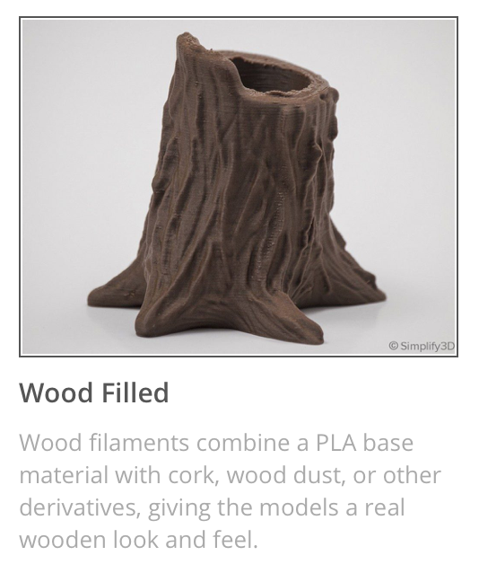
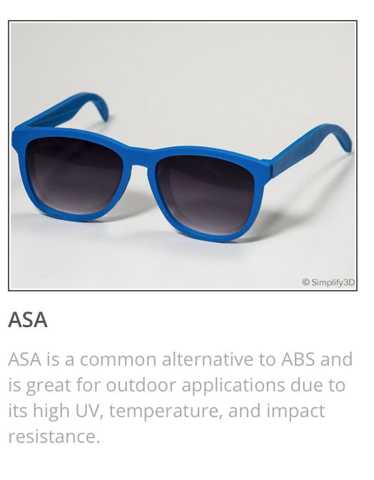
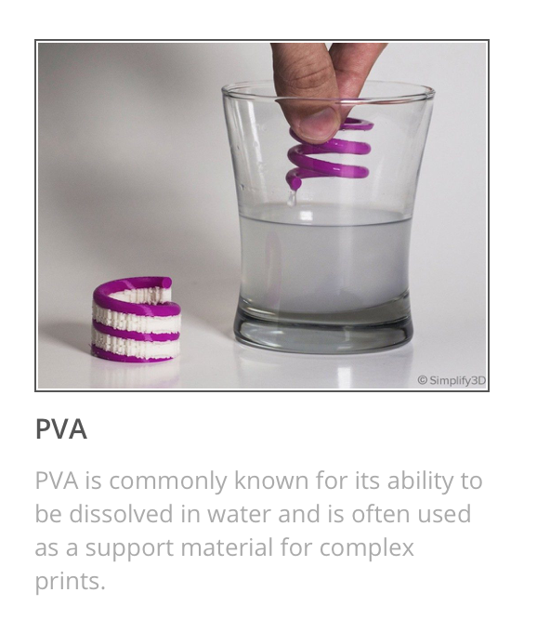
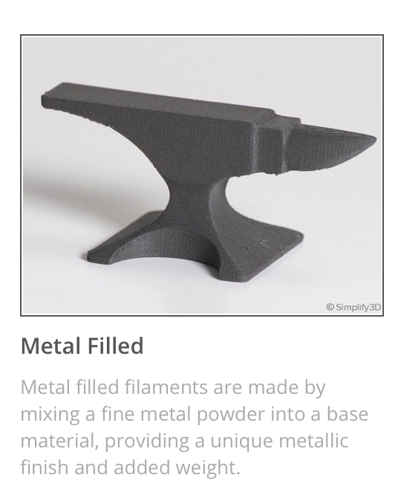
3D Printing Materials – Cool Materials
Here are some other materials used to 3D print that have cool properties for specific applications.
Notes:
https://www.simplify3d.com/support/materials-guide/

Slide 14
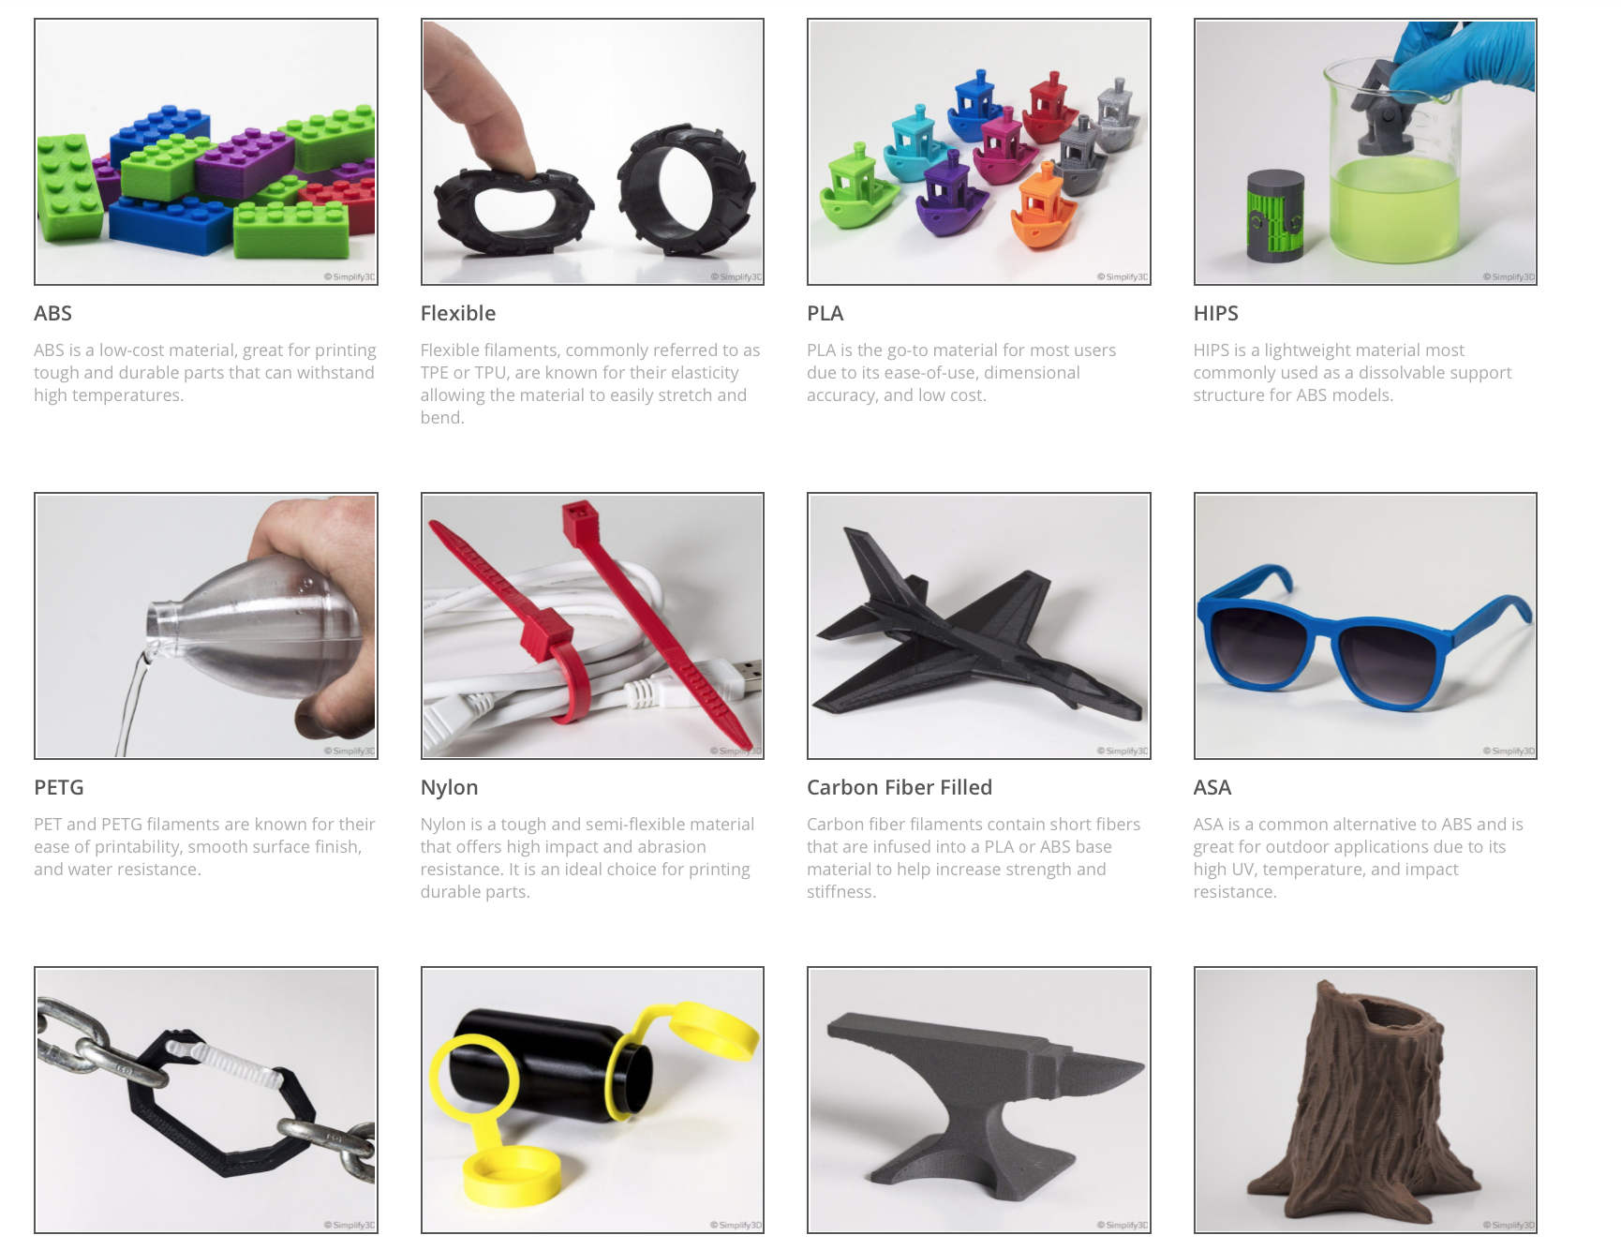
Activity Part 1 – 3D Printing Materials
Exploring Materials used in 3D Printing
Use the link below to see Simplify 3D’s Ultimate 3D Printing Materials Guide.
Click on the different types of materials to learn more about them.
Using the worksheet document key features for 3 different kinds of materials.
Ultimate 3D Printing Materials Guide

Slide 15
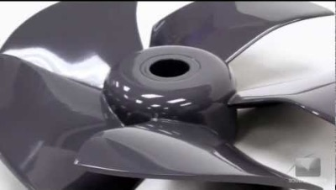
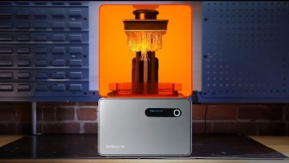
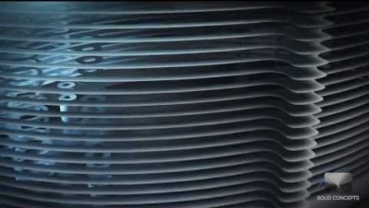
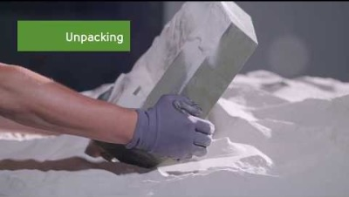
Activity Part 2 – 3D Printing Printers
Exploring Different 3D Printers
Watch the short videos below to learn more about different types of 3D printers.
FDM, SLA, SLS, Binder Jetting
For each video write down 3 Key takeaways from each video in the worksheet

Slide 16
What We Learned
There are different types of 3D printers and different materials used in 3D Printing. With this knowledge we can now see how 3D Printing is applied to many different applications!

