Slide 1
3D Printing:
How Can We Use It?
Toyota Production Systems Lab
Grade K-5

Slide 2
Let’s Review: 3D Printing
3D Printing is about utilizing a printer that builds a part or an object from the ground up, one layer at a time.
It adds one layer on top of another…like a cake!
Using computer software, it can print ideas in 3 Dimensions!
Can make very detailed designs… it brings ideas to life!

Slide 3
How is 3D Printing Used?
3D Printing can make almost anything; it can be used in lots of different ways!
It can be used to make so many different things.
Let’s explore what we can do with 3D printing!

Slide 4
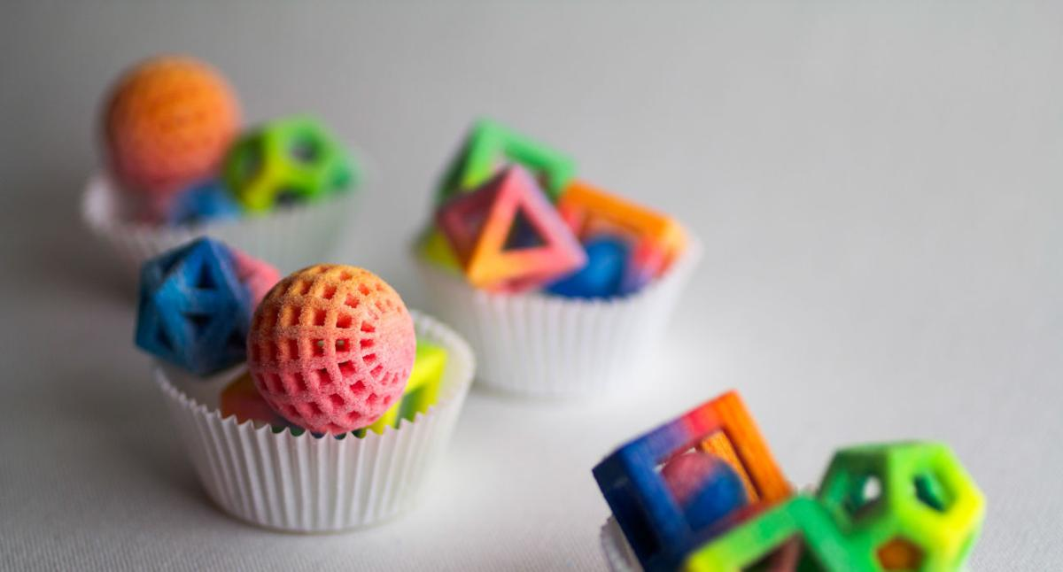
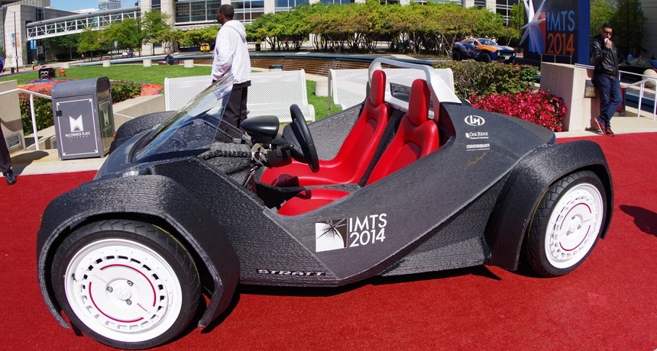
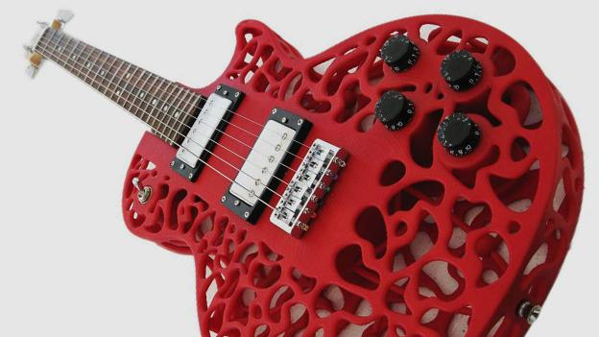
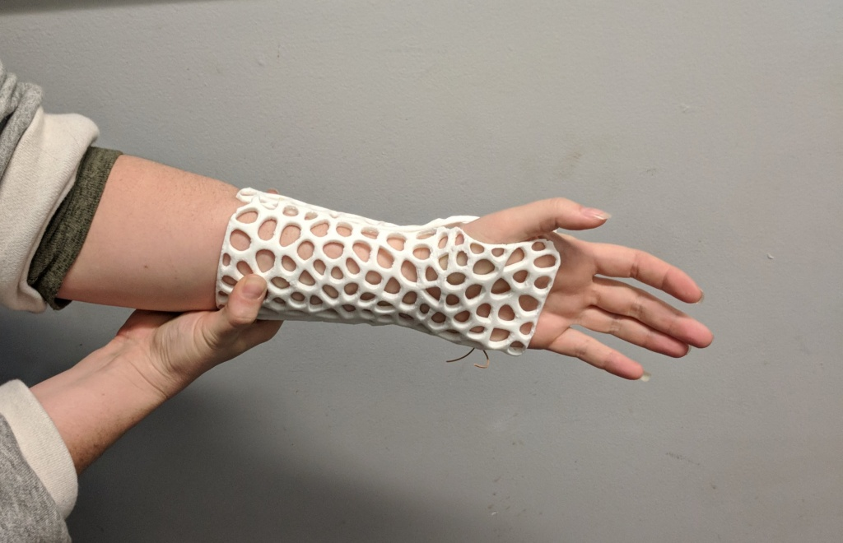
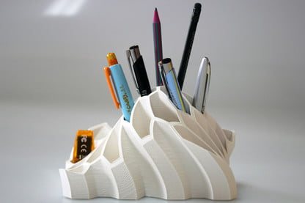
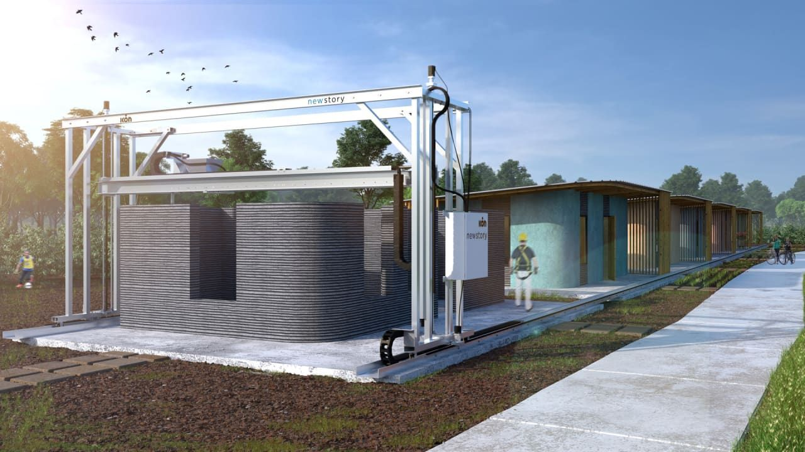
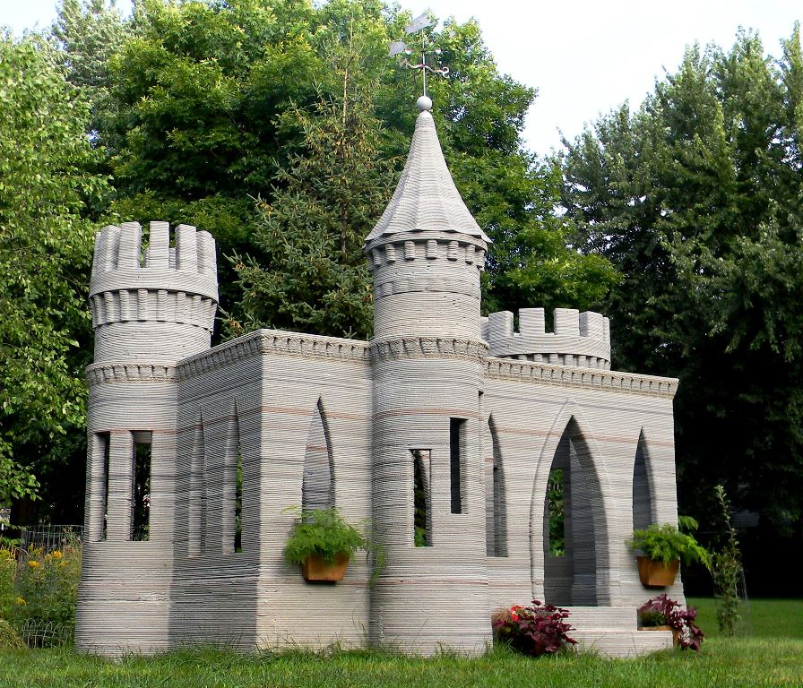
3D Printing can make…
Toys
Cars
Guitars
Casts
Pencil Holders
Houses
Castles

Slide 5
What Jobs use 3D Printing?
Now that we know some of the many things, we can make using 3D printers, we can see what different jobs use 3D printing.

Slide 6

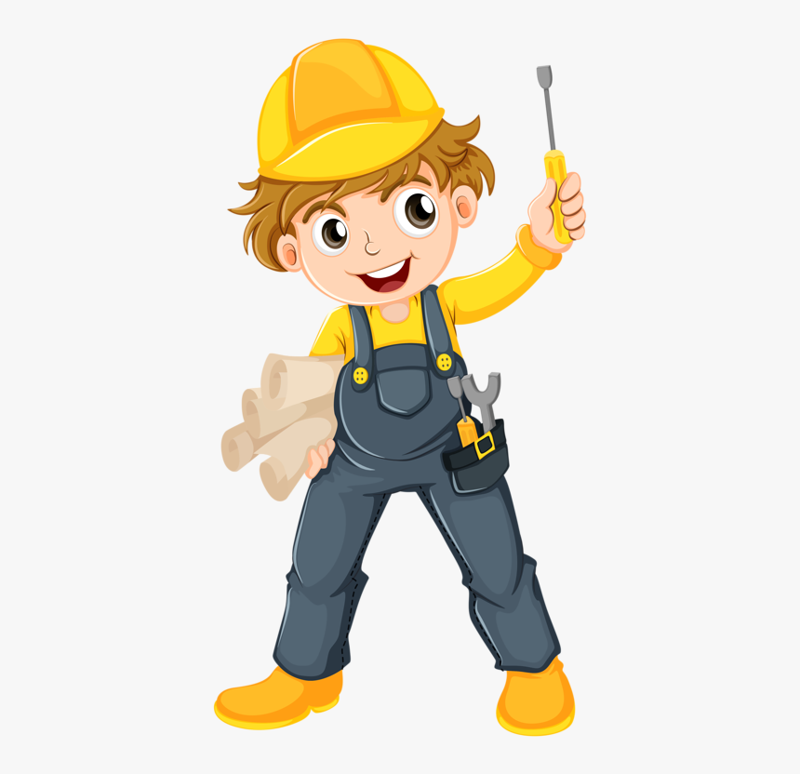
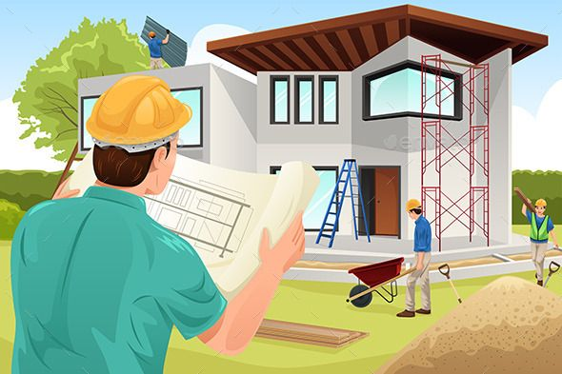
What Jobs use 3D Printing?
Doctors
Use it to make custom casts
Construction Workers
Use it to make parts for houses/buildings
Architects
Can design new and complex parts for houses

Slide 7
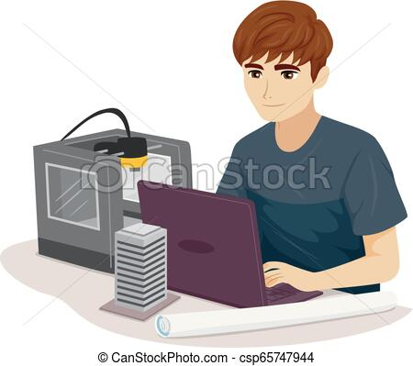

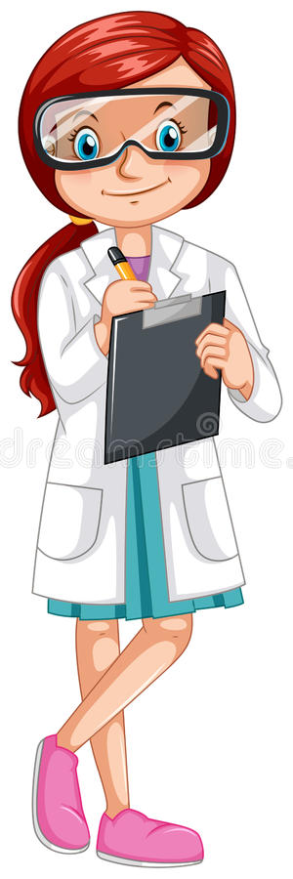
What Jobs use 3D Printing?
Engineers
Print models to test out parts for new ideas
Designers
Can model new ideas for concepts
Researchers
Can create models to find out new ways to 3D print

Slide 8
Activity
Matching Game!
Draw arrows to match which 3D printed part match up with the worker for each job!

Slide 9

What We Learned
3D printing can be used by workers from all different industries and jobs! They can make anything and discover new ways to use 3D printing everyday!

