Slide 1
3D Printing:
What is it?
Toyota Production Systems Lab
Grade K-5

Slide 2
3D Printing
3D Printing is about utilizing a printer that builds a part or an object from the ground up, one layer at a time.
It adds one layer on top of another…like a cake!
Using computer software, it can print ideas in 3 Dimensions!
Can make very detailed designs… it brings ideas to life!

Slide 3
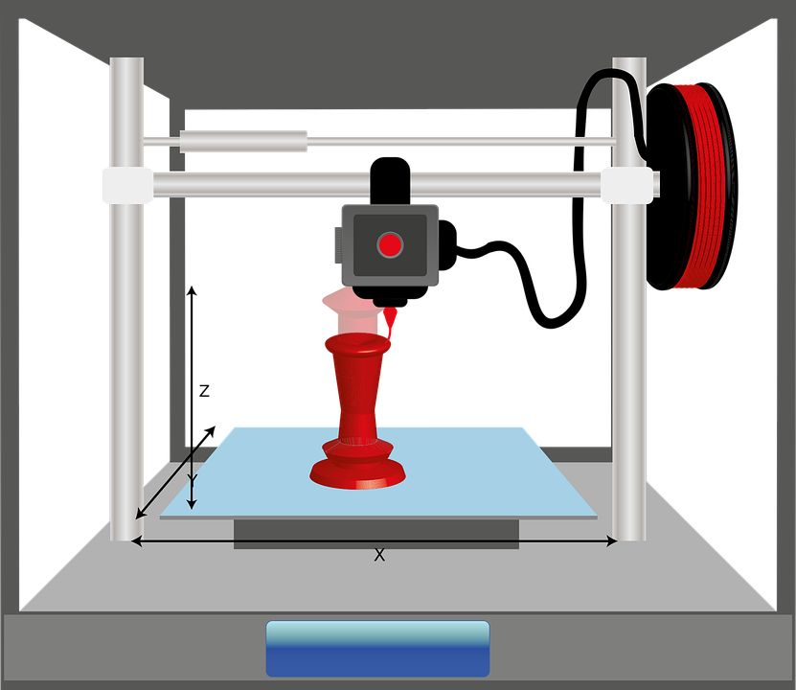
Parts of a 3D Printer!
Safety Box - protects the part and you from harm
Extruder – heats up the material so it is really soft and sticky and pushes it out a nozzle to create the part.
Part – is the design that we created that is coming to life layer by layer

Slide 4
Parts of a 3D Printer!
Material – usually it is a plastic called PLA that serves as the material we will use to create our part.
Base/Platform – this is the platform that the part will be built on.

Slide 5
Activity
Let’s Design a Part to 3D Print!
  Let us use what we learned to fill in the different parts of a 3D Printer!
  Then, we can utilize the blank space on the base/platform to create something that you want to 3D print.

Slide 6

What We Learned
You can take your designs and make anything with a 3D printer! There are 5 parts to a 3D printer, now that we know what a 3D printer is, let’s see how it works!

