Slide 1
Machine Learning in Manufacturing
STEM & Industrial Engineering
Toyota Production Systems Lab
Machine Learning: Grades 9-12

Slide 2
These are all areas of Industrial Engineering. Where does machine learning fit in this?
Industrial Engineering!
Notes:
possible definitions and explanations: https://www.seebo.com/machine-learning-ai-manufacturing/ and https://towardsdatascience.com/why-machine-learning-is-important-for-smarter-manufacturing-27da545de779
Need to have a slide that defines manufacturing before this, and then what machine learning is, and then how it is related to manufacturing

Slide 3
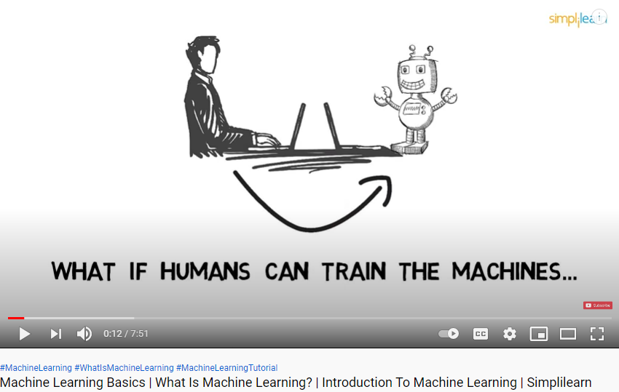
So what is Machine Learning?
Machines can use data & algorithms to identify problems, monitor, and analyze critical system variables during the manufacturing process, & make real-time decisions.
Click on the image to watch the video!
Notes:
video possibility: https://www.youtube.com/watch?v=ukzFI9rgwfU should be for older kids
back - up: https://www.youtube.com/watch?v=IQvH6NZOJNo
vid for younger kids: https://www.youtube.com/watch?v=F1wlCerC40E or this one https://www.youtube.com/watch?v=QghjaS0WQQU

Slide 4
Today’s Activity!
How does facial recognition work?
Notes:
Possible activity: https://scratch.mit.edu/studios/1891366/
https://scratch.mit.edu/projects/501934586/editor
https://www.iste.org/explore/Computer-Science/3-unplugged-activities-for-teaching-about-AI
http://www.cs4fn.org/teachers/activities/intelligentpaper/intelligentpaper.pdf
https://www.teachermagazine.com/sea_en/articles/ai-classroom-activity-facial-recognition#:~:text=The%20facial%20recognition%20task%20was,the%20person%20inside%20the%20photo.

Slide 5
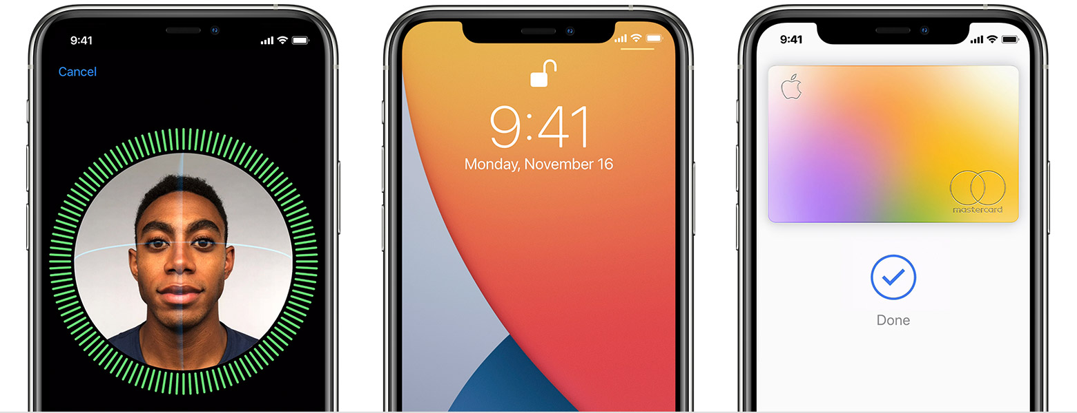
What is facial recognition and how does it relate to Machine Learning?
Facial recognition = technology that is capable of matching a person’s face from a digital image or video against a database of people!
Like iPhones with Apple Face ID to unlock your phone!
This relates to machine learning because:
The technology of the phone needs to be trained to automatically identify different features of the face and calculate a match!
Notes:
video possibility: https://www.youtube.com/watch?v=ukzFI9rgwfU should be for older kids
back - up: https://www.youtube.com/watch?v=IQvH6NZOJNo
vid for younger kids: https://www.youtube.com/watch?v=F1wlCerC40E or this one https://www.youtube.com/watch?v=QghjaS0WQQU

Slide 6
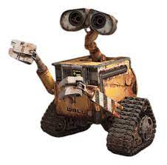
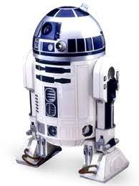
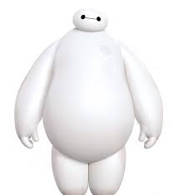
Today’s activity will walk you through facial recognition technology!
Facial recognition is an example of what machine learning can do
A computer can’t “see” a photo the way a human does, so how can it extract meaningful data from one photo and compare it with data from another?
Today, we are going to answer that by simulating our own facial recognition algorithm!
We will break down pictures of Disney characters into a list of identifiable features that can be used to compare and figure out the identity of a mystery character

Slide 7
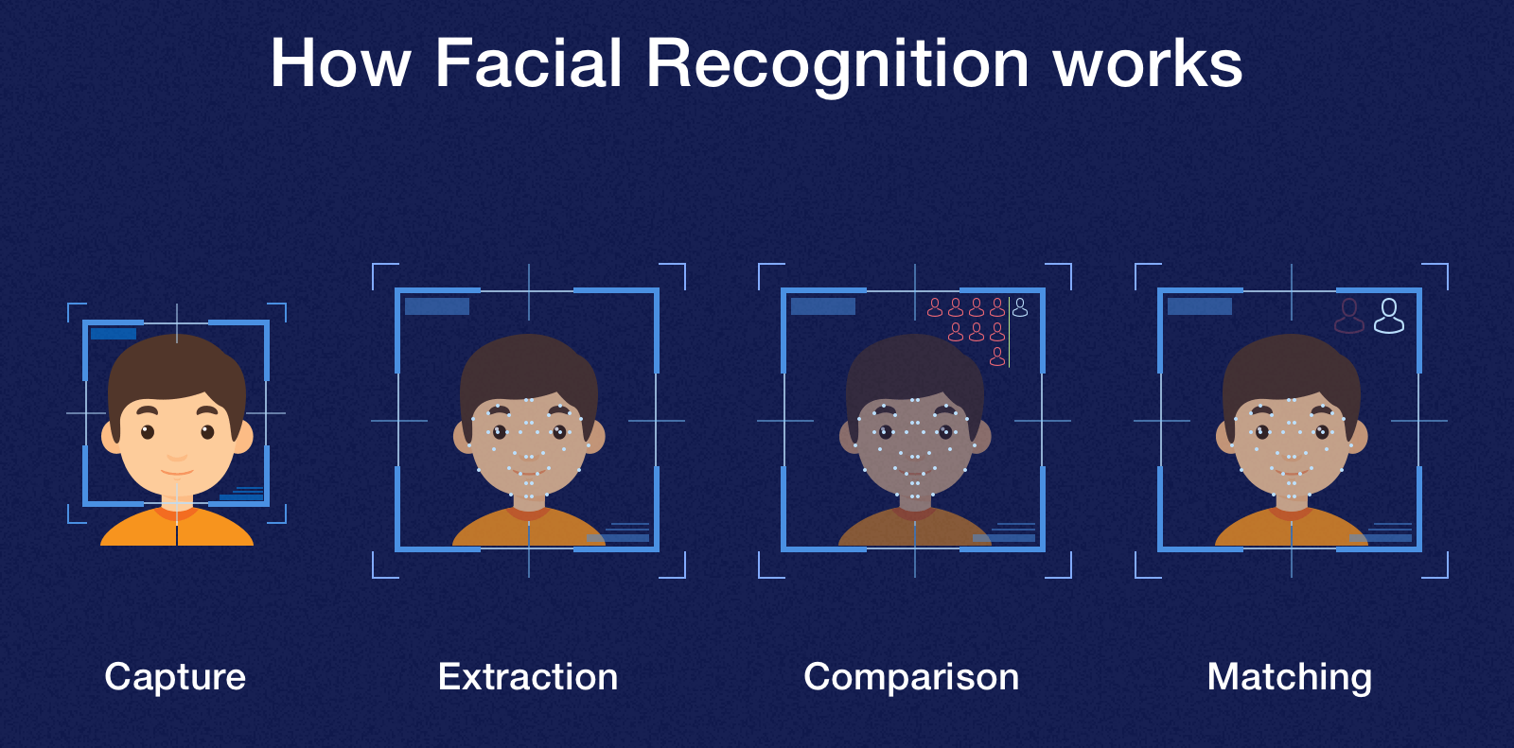
Step 1: We must understand how a computer can match two photos
The technology uses a pixel-by-pixel check to see if there are exact matches. As a person can change their posture or clothing, recognition by faces is the best as those features are distinct!
This shows feature extraction = changing the original data format to a list of distinct features that can be used to identify different objects
This is important because this allows the computer to behave like a real person in recognizing an individual in each picture!

Slide 8
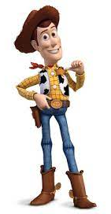
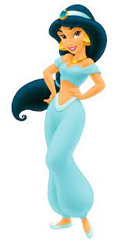
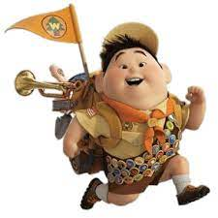
Step 2: Conduct feature extraction on our subjects
-You will answer questions about the following three Disney characters
- Use the sheet given to answer these questions accordingly in the following slides
Character 1
Character 2
Character 3

Slide 9
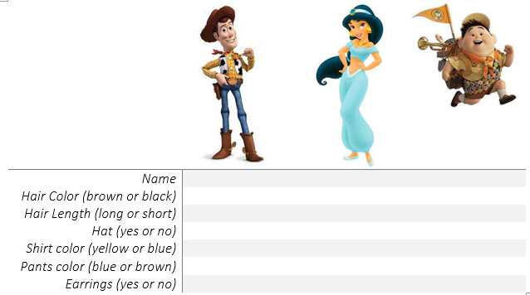
Step 2: Conduct feature extraction on our subjects: filling in the sheet
- Use the sheet given to answer these questions accordingly in the following slides

Slide 10
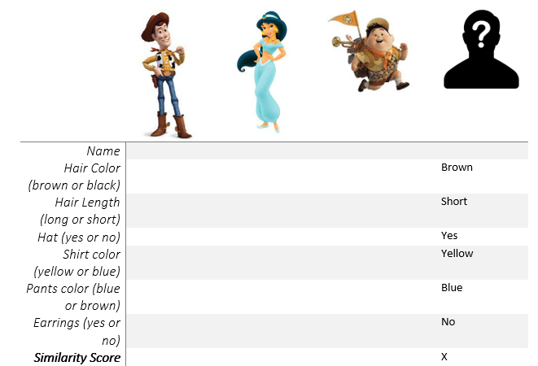
Step 3: Comparison of known characters to mystery character
-Compare the answers to our questions with the answers that describe the mystery character
-Calculate a similarity score between your known characters to the mystery one by adding up how many of the answer for each known character match the mystery character

Slide 11
Step 4: Based on the similarity score, who is the mystery person?
- The character that scored the highest similarity score should be the mystery person!
So, who is your guess?

Slide 12
Step 5: Face Reveal!
- The mystery character was...Woody!
- Were you correct?

Slide 13
Step 6: Redesign stage
At the right side of your table, come up with two more disney characters that your facial recognition program should learn to identify
- At the bottom of your table, come up with 3 more questions your facial recognition program should use to identify the characters. Answer these new questions for your characters
- Once you’ve completed this, ask a family member or friend to pick a character from your list and not tell you who it is!
- This person should use the questions from your table to describe the character, which you will try to guess based on the information you have

Slide 14
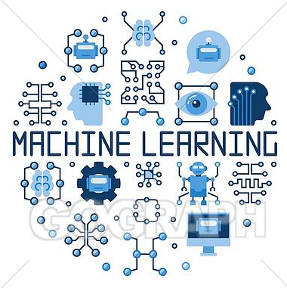
Step 7: Reflection: answer the questions about today’s activity
What do you think the pros and cons are of this technology?
List here:
Pros: Cons:
1] 1]
2] 2]
3] 3]
How does facial recognition technology impact the world?
How does machine learning impact the world?
What changes would you make to the technology to
improve it?
Extra: try out your changes! Do you like them?
Notes:
Ask middle school students to list pros and cons of the tech and how it impacts the world besides your phones
Ask high school students to also do that, and then come up with changes

Slide 15
Congratulations!
You have learned about machine learning!

Slide 16
Thank you!

