Slide 1
Machine Learning in Manufacturing
STEM & Industrial Engineering
Toyota Production Systems Lab
Machine Learning: Grades K-5

Slide 2
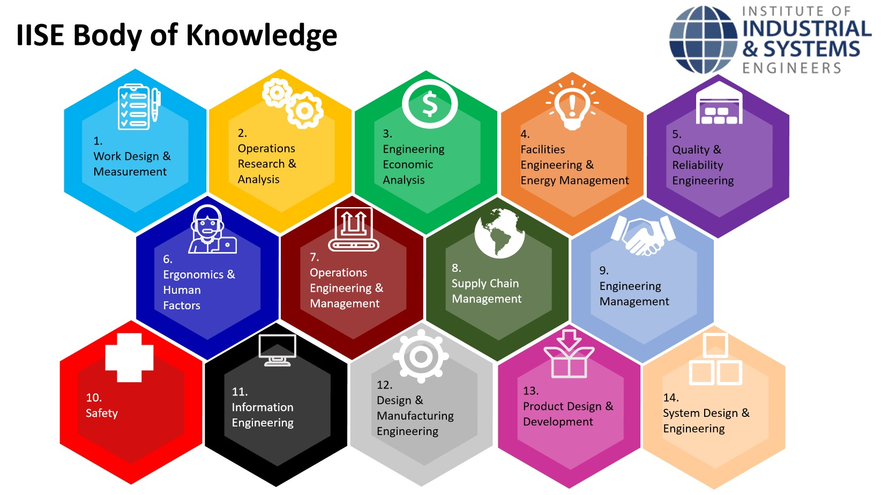
These are all areas of Industrial Engineering. Where does machine learning fit in this?
Industrial Engineering!
Notes:
possible definitions and explanations: https://www.seebo.com/machine-learning-ai-manufacturing/ and https://towardsdatascience.com/why-machine-learning-is-important-for-smarter-manufacturing-27da545de779
Need to have a slide that defines manufacturing before this, and then what machine learning is, and then how it is related to manufacturing

Slide 3
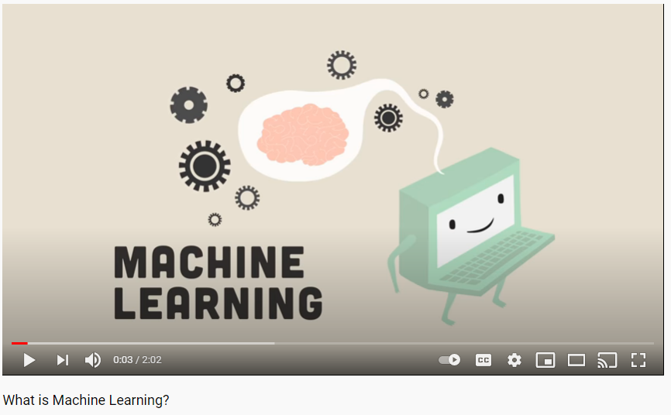
So what is Machine Learning?
Machines can use data & information to find problems, keep an eye on them, and check on machines during a manufacturing process, & make real-time decisions.
Click on the image to watch the video!
Notes:
video possibility: https://www.youtube.com/watch?v=ukzFI9rgwfU should be for older kids
back - up: https://www.youtube.com/watch?v=IQvH6NZOJNo
vid for younger kids: https://www.youtube.com/watch?v=F1wlCerC40E or this one https://www.youtube.com/watch?v=QghjaS0WQQU

Slide 4

Today’s Activity!
How does facial recognition work?
Notes:
Possible activity: https://scratch.mit.edu/studios/1891366/
https://scratch.mit.edu/projects/501934586/editor
https://www.iste.org/explore/Computer-Science/3-unplugged-activities-for-teaching-about-AI
http://www.cs4fn.org/teachers/activities/intelligentpaper/intelligentpaper.pdf
https://www.teachermagazine.com/sea_en/articles/ai-classroom-activity-facial-recognition#:~:text=The%20facial%20recognition%20task%20was,the%20person%20inside%20the%20photo.

Slide 5
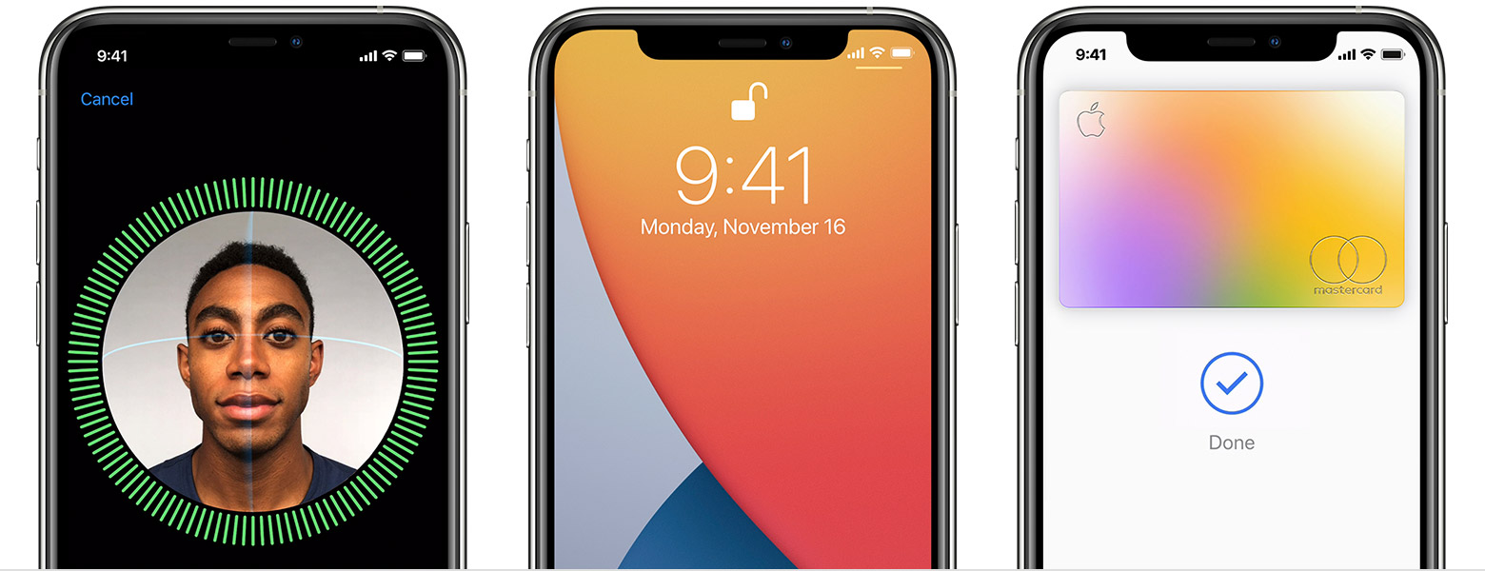
What is facial recognition and how does it relate to Machine Learning?
Facial recognition = this means a computer is able to know it’s you based on what you look like!
Like iPhones with Apple Face ID to unlock a phone!
This relates to machine learning because:
The computer of the phone needs to be taught how to identify different features of a face on their own, and figure out a match!
Notes:
video possibility: https://www.youtube.com/watch?v=ukzFI9rgwfU should be for older kids
back - up: https://www.youtube.com/watch?v=IQvH6NZOJNo
vid for younger kids: https://www.youtube.com/watch?v=F1wlCerC40E or this one https://www.youtube.com/watch?v=QghjaS0WQQU

Slide 6
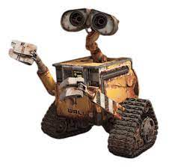
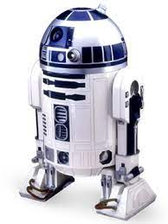
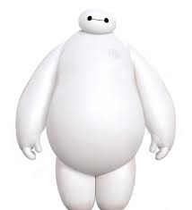
Today’s activity will walk you through how facial recognition works!
Facial recognition is an example of what machine learning can do
A computer can’t “see” a photo the way you do, so how can it find helpful information from one photo, and compare it to another?
Examples:
Today, we are going to answer that with our own facial recognition phone!
We will break down pictures of smiley faces into a list of their features that can be used to compare and figure out which smiley face the phone can open for

Slide 7
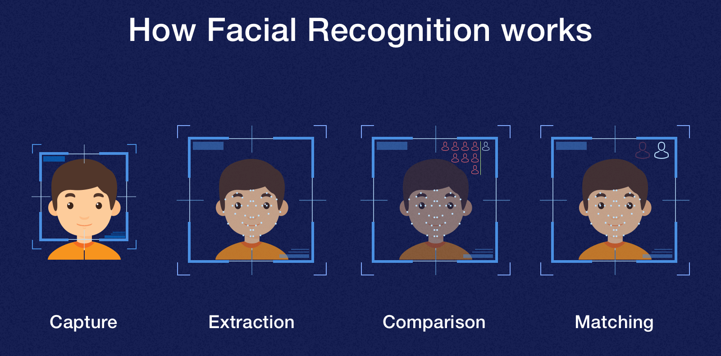

Step 1: We must understand how a computer can match two photos
Today, we are going to help find the owner of a phone by figuring out who it unlocks for - a specific smiley face!
The phone will check all parts of the face to see if there is a match to what it is expecting
This allows the phone to behave like a real person in recognizing an individual in each picture!

Slide 8


Step 2: Who is the phone set to unlock for?
Facial recognition on this phone can only store one smiley face in it’s database, so it can only open for that smiley face
This is like a locked door: it needs a specific key to unlock it, and in this activity, that is the one smiley face
So, these are the qualities that the phone has identified, and saved in its learned categories to unlock for:
Smiley face color = Orange
Eyes (Opened/Closed/Other)= Closed
Something on their cheek (Yes/No)= Yes
Are there eyebrows (Yes/No)= No
Open mouth or closed mouth = Closed

Slide 9
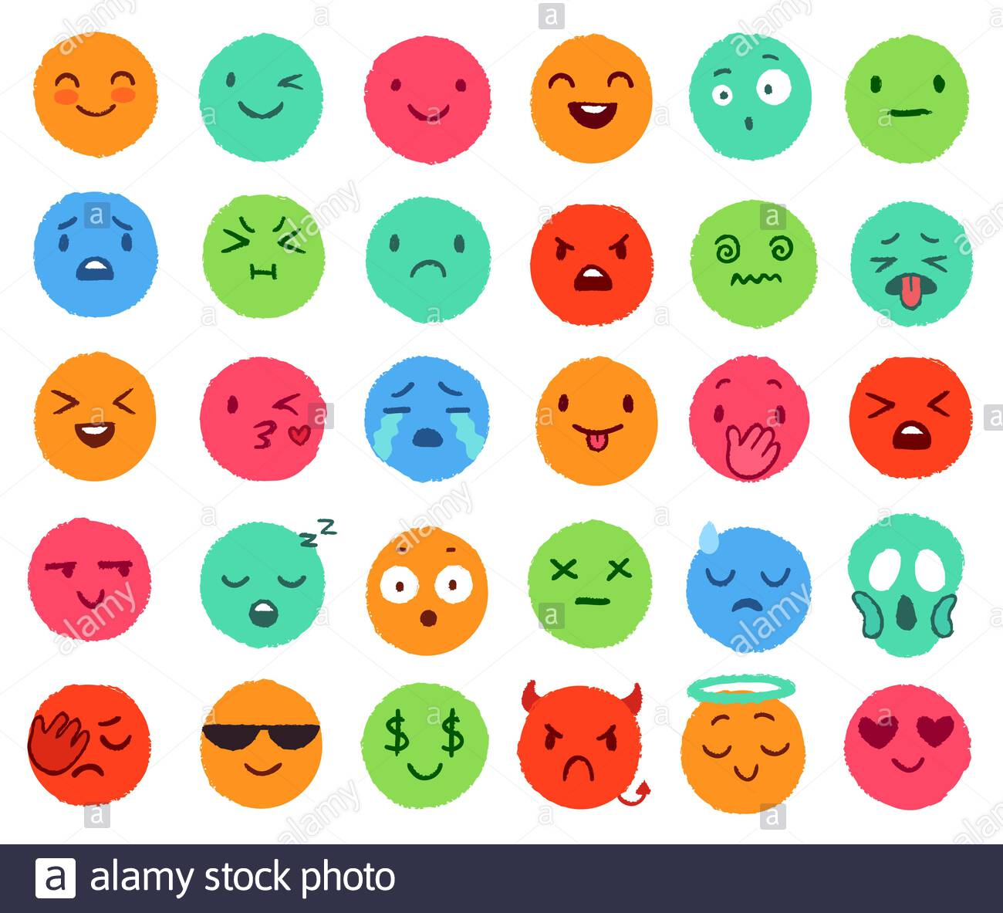
Step 3: Examination Time - Who is the owner of the phone
-You will answer each of the categories given on the slides following for each smiley face
- To find the owner of the phone, all of the answers in the rows you answered for need to match the ones given in the previous slide
Notes:
Go with smiley faces, one round one oval, and ask if the machine going to open up for that face?
Use analogy of key to unlock one door, needs key to turn on and that’s your face
Don’t use normal terminology

Slide 10
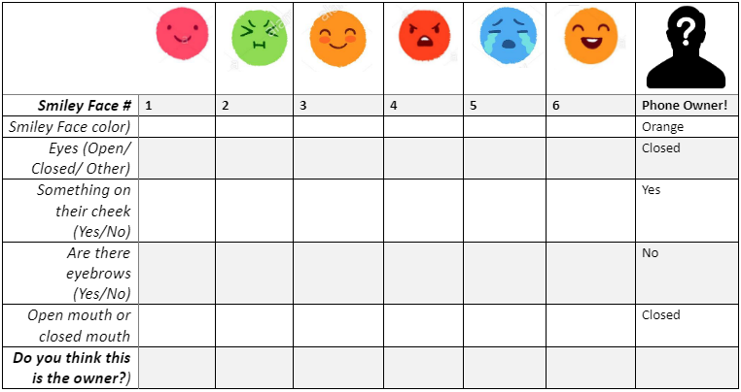
Step 3a: Testing the smiley faces to our system: filling in the sheet
- Use the sheet given to answer these questions accordingly in the following slides

Slide 11
Step 3b: Comparison of smiley faces to the mystery owner
-Compare the answers to our questions with the answers that describe the mystery smiley face who owns the phone and can unlock it
-Which smiley face has all the same answers as the mystery smiley?

Slide 12


Step 4: Based on your answers, who is the mystery smiley face?
- Remember, this is based on which smiley face with your answers best matched the mystery smiley face description
So, who is your guess?

Slide 13


Step 5: Face Reveal!
- The mystery smiley face was...Smiley face #3!
- This is the happy blushing smiley face, and owner of our phone! So, the phone only unlocks for them!
- Were you correct?

Slide 14
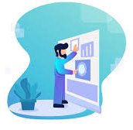

Step 6: Redesign stage
- At the bottom of your table, come up with two more questions that your facial recognition program in the shone should use to identify the owner. Answer these new questions for your smiley faces
- Once you’ve completed this, ask a family member or friend to pick a smiley face from your list and not tell you who it is!
- This person should use the questions from your table to describe the smiley face, which you will try to guess based on the information you have

Slide 15
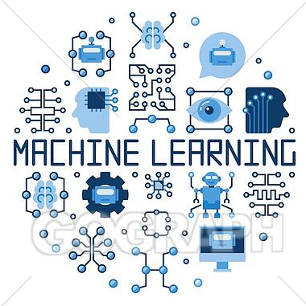

Step 7: Reflection: answer the questions about today’s activity
What do you like or dislike about this technology?
List here:
Likes: Dislikes:
1] 1]
2] 2]
3] 3]
Where else do you see facial recognition & machine
learning in your daily life?
How would you make the activity better?
Notes:
Ask middle school students to list pros and cons of the tech and how it impacts the world besides your phones
Ask high school students to also do that, and then come up with changes

Slide 16


Congratulations!
You have learned about machine learning!

Slide 17

Thank you!

