Slide 1
Introduction to Ergonomics
STEM & Industrial Engineering
Toyota Production Systems Lab
Ergonomics: Grades 6-8

Slide 2
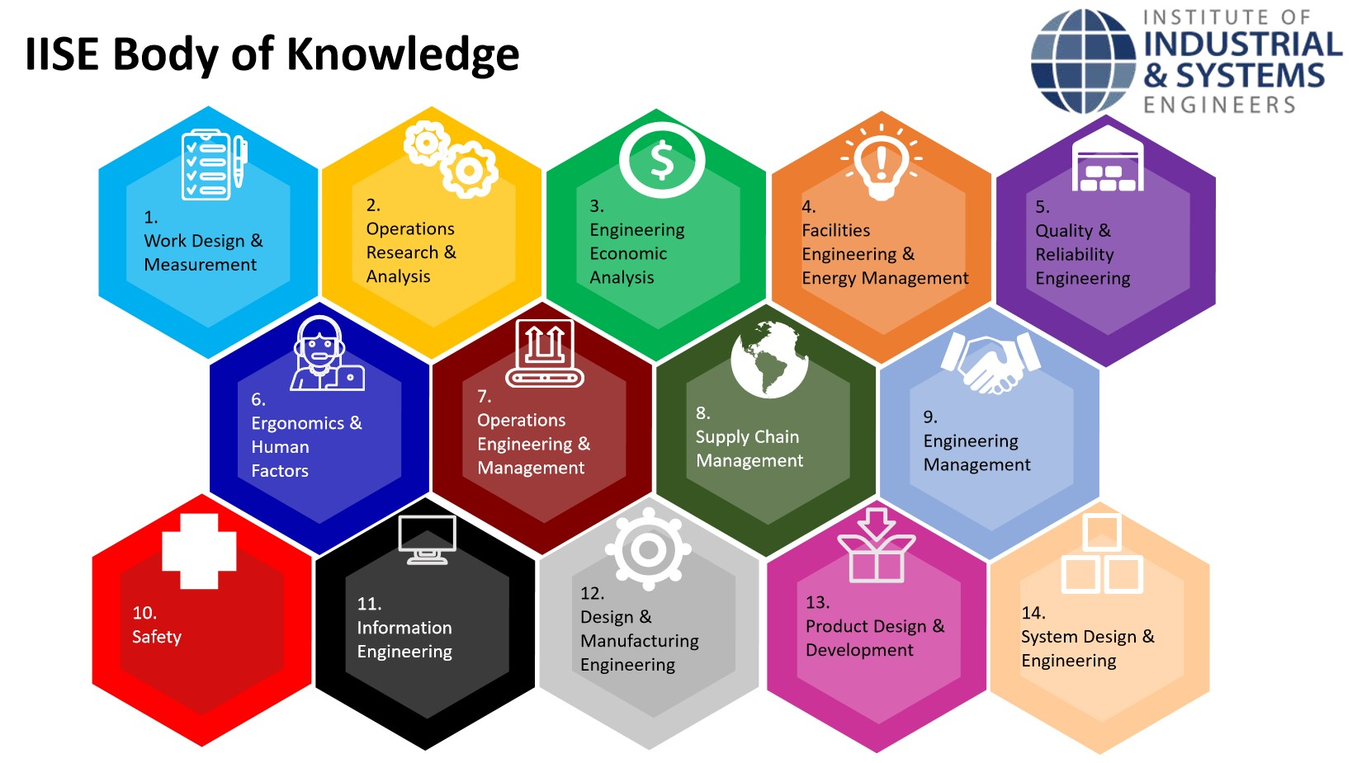
These are all areas of Industrial Engineering. Where does ergonomics fit in this?
Industrial Engineering!

Slide 3
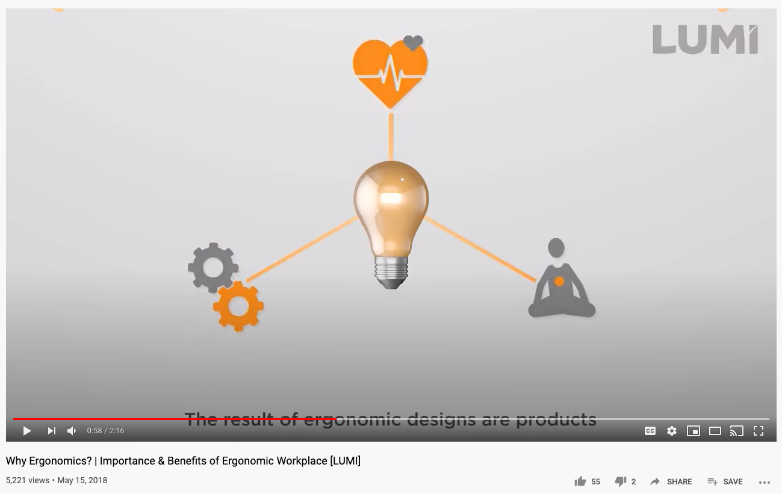
So what is Ergonomics exactly?
The study of how people work in their environment, their efficiency, how humans behave in relation to these elements.
Click on the image to watch the video!

Slide 4
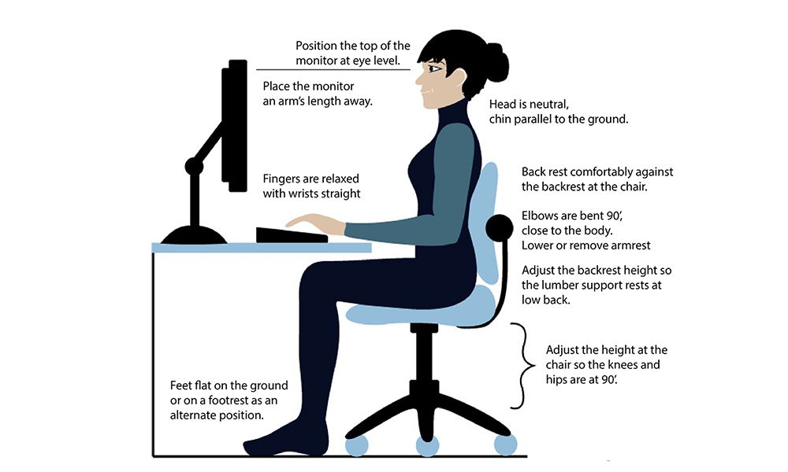
Today’s Activity!
How ergonomic is your daily life?

Slide 5


Step 1: Think about your everyday life around the house. What are five different items or environments you interact with every day? An example: your toothbrush, or the chair you’re sitting in
Try listing at least 1 from each room in your home!

Slide 6


Step 2:
-For each of those items/environments you found, do you think they’re ergonomic (designed to keep people safe and comfortable)?
-Put a check next to ones that are, and an “X” next to the ones that are not, and organize into like items!

Slide 7
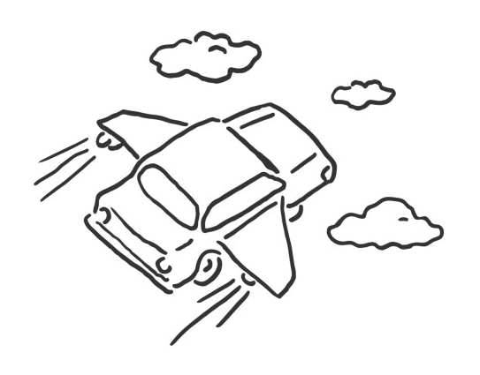


Step 3:
-Why did you say yes or no for each of those items? Explain.
-For the ones you said are not ergonomic, what would make them more ergonomic? Be creative and “outlandish” as you want!
Often in real life jobs, crazy brainstorms lead to positive ideas and thinking, that become real solutions!

Slide 8
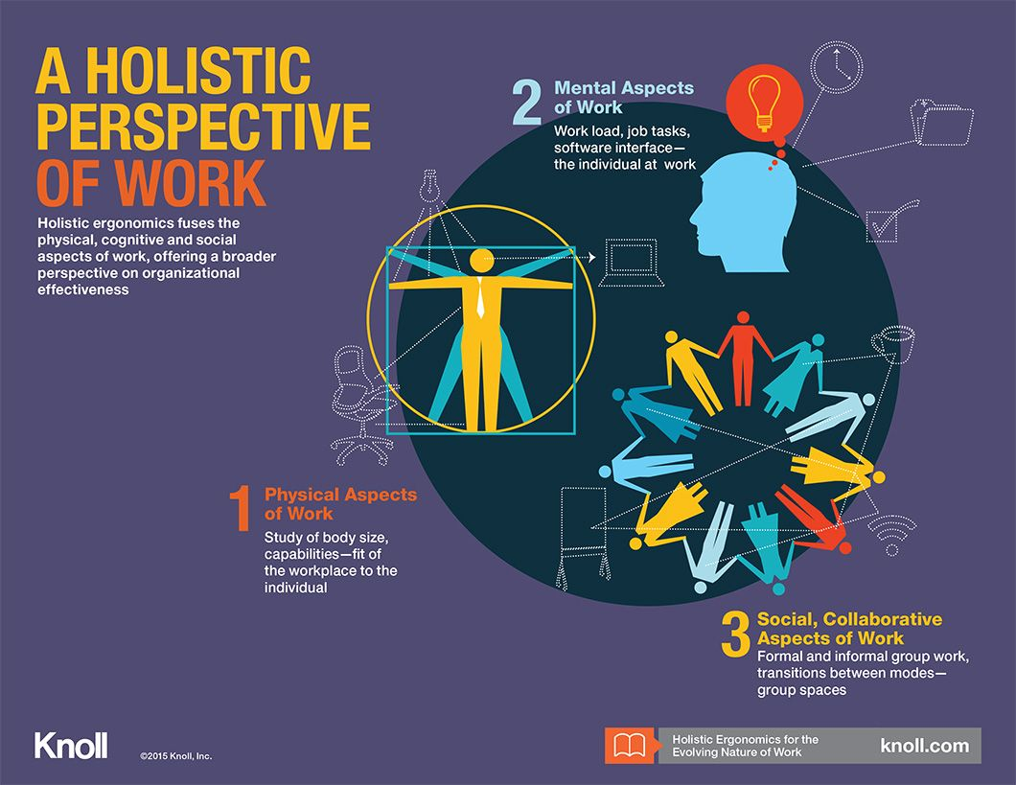
There are 3 areas of Ergonomics:
Physical
Cognitive
Organizational

Slide 9
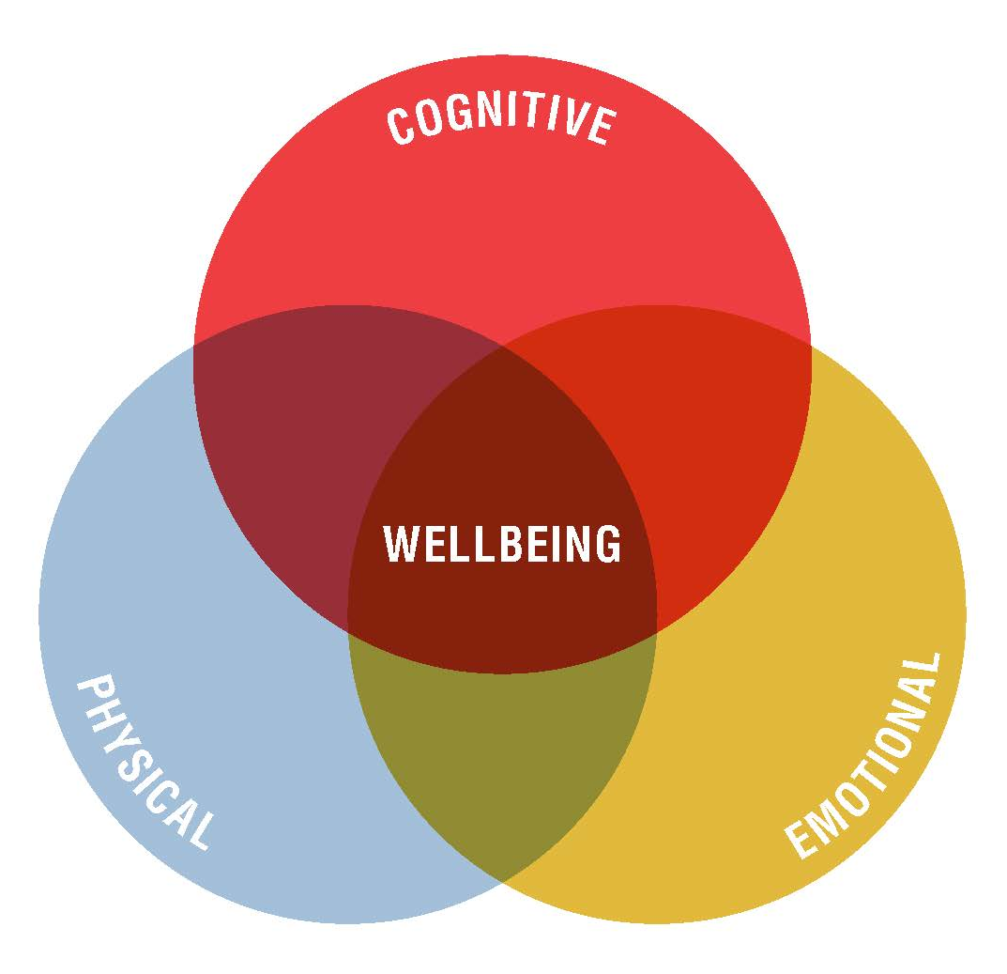

Step 4:
-Can you classify your solutions as one of the 3 types of ergonomic areas of:
Physical Cognitive Organizational
Takeaway: How do these interact for the wellbeing of you and your family?

Slide 10


Congratulations!
You have learned how to define ergonomics!

Slide 11

Thank you!

