Slide 1
Ergonomics: Hazards and Musculoskeletal Disorders
STEM & Industrial Engineering
Toyota Production Systems Lab
Ergonomics: Grades 6-8

Slide 2
These are all areas of Industrial Engineering. Where does ergonomics fit in this?
Industrial Engineering!

Slide 3
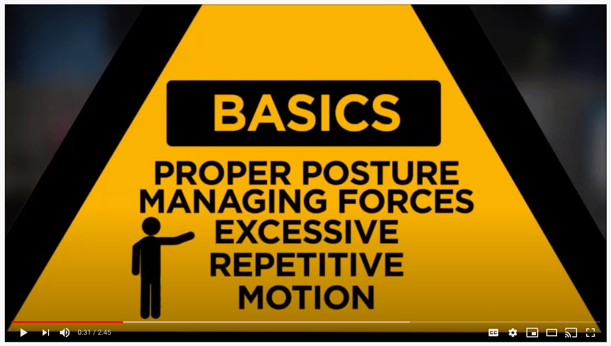
Ergonomics: Avoiding workplace hazards
-This part of ergonomics is about making objects and tasks both safe and comfortable for a worker so they are not harmed!
- Click on the image to learn about some ergonomic hazards that can occur in the workplace, or at home:

Slide 4
Ergonomics: Work-related musculoskeletal disorders
-This part of ergonomics is goes over possible injuries so you know best how to prevent them!
- Click on the image to learn about anatomy of the human body and its relation to work and home safety:

Slide 5
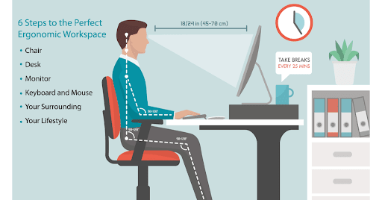
Today’s Activity!
Make your workspace more ergonomic!

Slide 6
Step 1:
Based on what you learned in the video, examine your workspace (maybe a desk, couch, or wherever you normally sit to do homework or study). It could look like one of these:
Write a list of potential ergonomic hazards associated with your current setup:
1)
2)
3)
4)

Slide 7
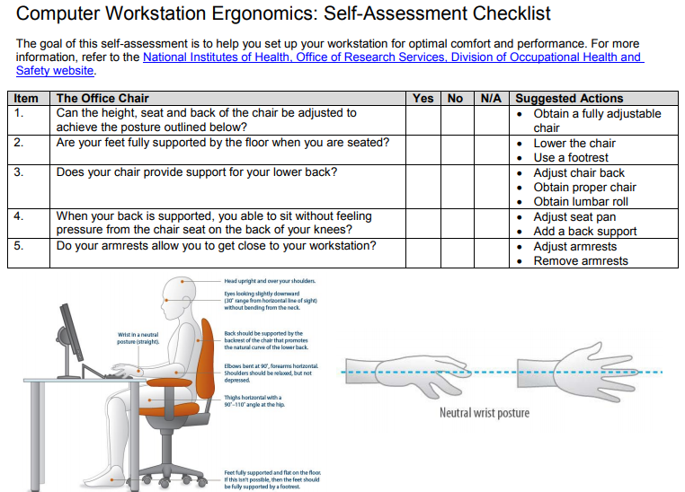
Step 2:
Read through or look over the given checklist (can download from where you find this file) titled, “Computer Workstation Ergonomics: Self-Assessment Checklist”, that you will be using for the next step.
This is from the National Institutes of Health, Office of Research Services, Division of Occupational Health and Safety website, with the goal of helping to set up your workspace for the best comfort and performance.
The 1st page will look like this:
Notes:
This is the online link to the checklist if the pdf is not accessible: https://www.ors.od.nih.gov/sr/dohs/Documents/Computer%20Workstation%20Ergonomics%20Self%20Assessment%20Checklist.pdf

Slide 8
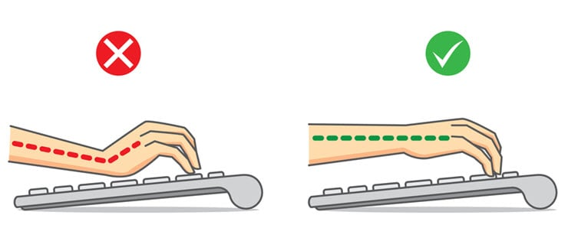
Step 3:
Following the checklist, identify additional areas for improvement.
Which of those adjustments can you make right now?
There are many changes you can make to improve the ergonomics of your space and prevent musculoskeletal disorders without buying fancy equipment! Write down a list of at least 5 changes you can make and then implement them in your space:
1) 4)
2) 5)
3)

Slide 9
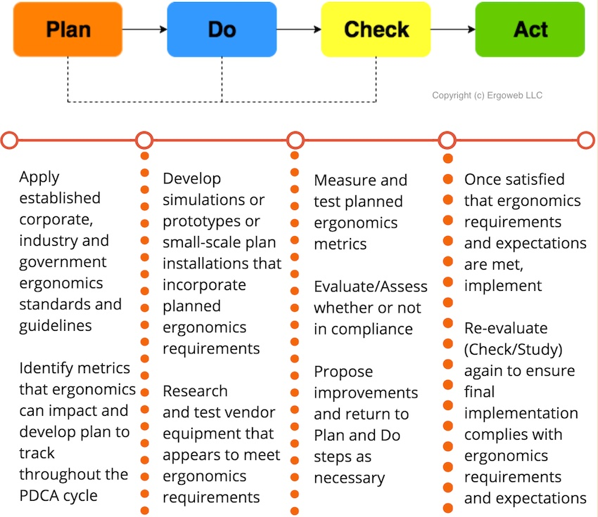
Step 4:
After testing your changes, do you notice a change?
Does your body feel less hurt?
Do you notice a change in performance? Is it negative or positive?
These questions and actions up to this point have been a part of the system called, “Plan Do Check and Act”:
Once they pass the “Check” questions above, you can permanently implement for “Act”.

Slide 10
Congratulations!
You have learned about workspace ergonomics, hazards, and work-related musculoskeletal disorders!

Slide 11
Thank you!

