Slide 1
Introduction to Sustainability
STEM & Industrial Engineering
Toyota Production Systems Lab
Sustainability: Grades 6-8

Slide 2
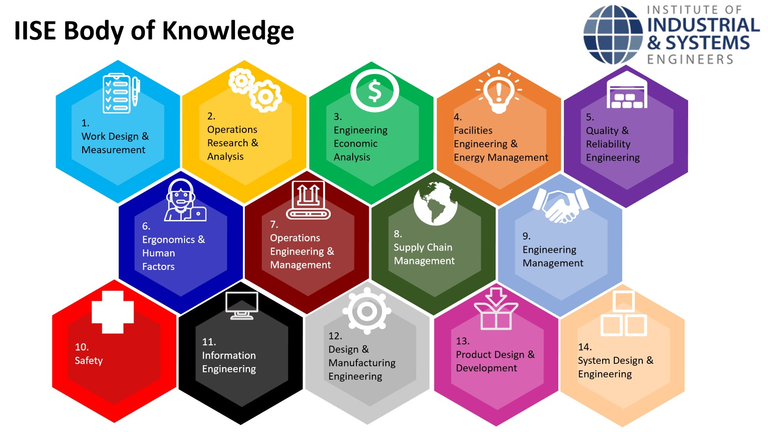
These are all areas of Industrial Engineering. Where does sustainability fit?
Industrial Engineering!

Slide 3
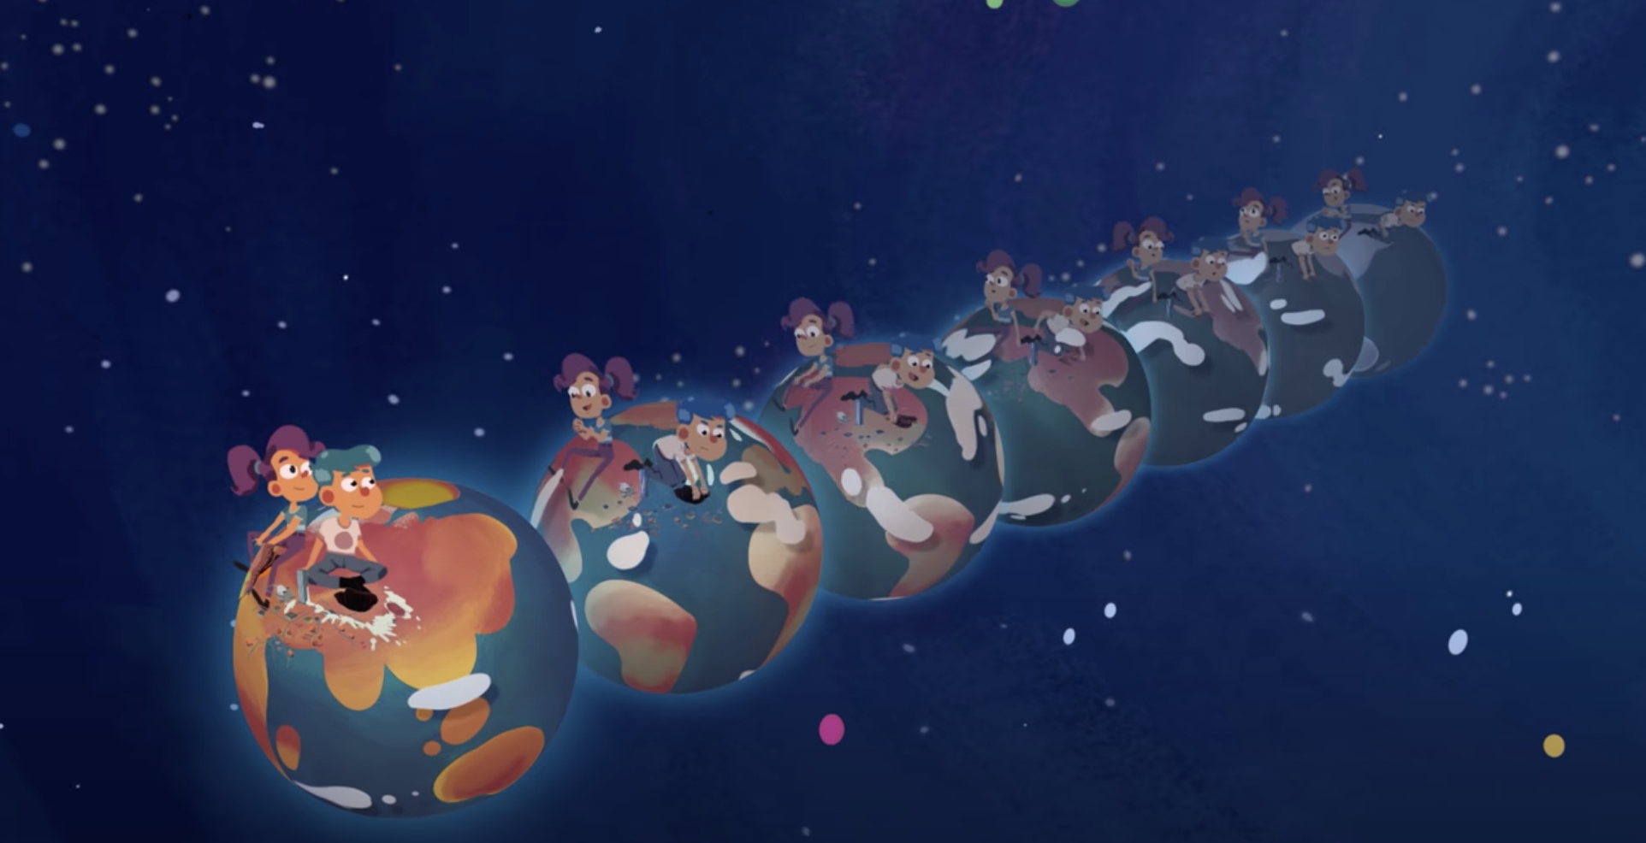
So what is sustainability?
If something is sustainable, that means we can keep using it or doing it for a long time. A lot of the ways humans have been using the earth’s natural resources, such as burning fossil fuels for energy and generating lots of waste, are not sustainable.
Watch this fun video to learn more!

Slide 4
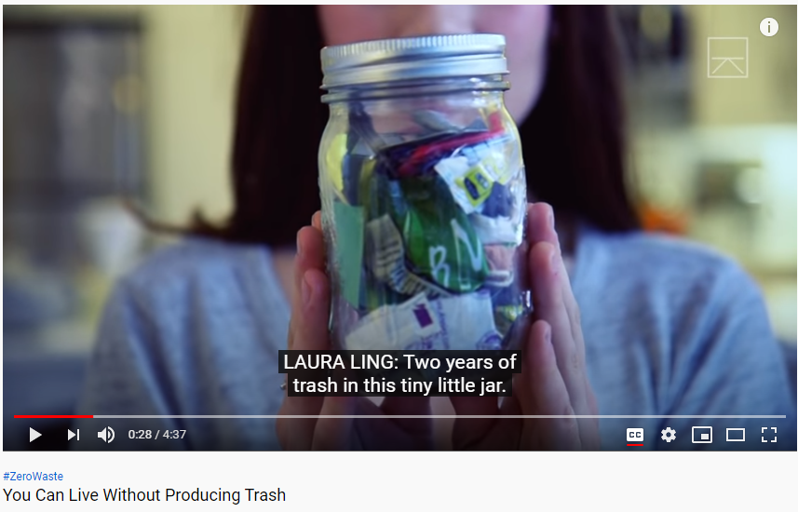
What are ways we can live without trash?
This New York woman is an example of how analyzing your trash makes a difference. She is making an effort to change the way she thinks about and creates waste, and asks us to do the same. Over the past two years, she has produced enough trash to fill just a 16 oz mason jar!
Click here to learn more!

Slide 5

Ask yourself: from these videos, are there actions the video participants took that you think you could do as well in your life?
Can you list 5 of these?
1.
2.
3.
4.
5.

Slide 6


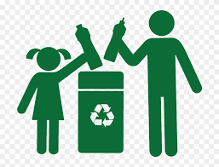
Today’s Activity!
The Cycle of Growing, Buying, and Trash

Slide 7
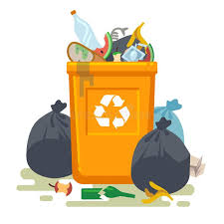
Part 1: Analyze your trash
Think about what you have thrown away today.
Make a list of those items.
Of those, what can be recycled and what can be thrown away?
For those that can only be thrown away, what are more sustainable options?
Did you find more things that were recyclables than trash? Did that surprise you?

Slide 8
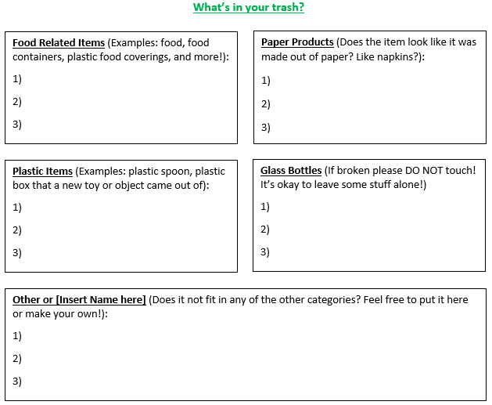
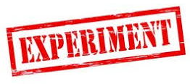
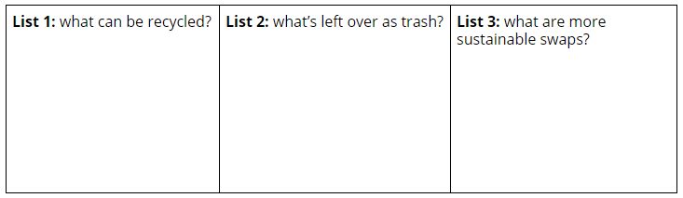
An example of how to format your list!:
You do not have to use this, but here is an example below! This is organized by the trash item’s primary function.
Steps 1 - 2
Steps 3 - 4

Slide 9
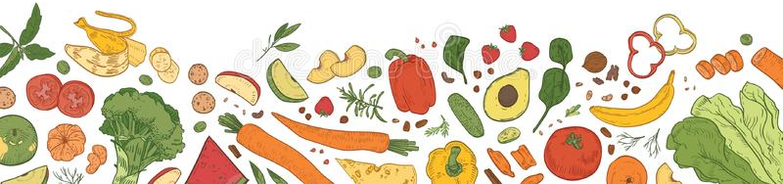
Part 2: Thinking about food
Take a look in your fridge, and think about items you and your family buy for food. Do any of these match food substances you may have thrown away?
Choose 6 items, and decide if these items can be grown/made yourself (imagine you have unlimited resources). If it cannot be, is there a restriction or method of production that only allows this item to be purchased?
If the item has to be bought, what are some things that could replace the item that could be obtained in more “green ways”?
Example: you can have a garden of veggies, maybe have your own apple tree, and have chickens for eggs!
How would creating your own food options make you feel? Is there a reason for feeling this way?

Slide 10
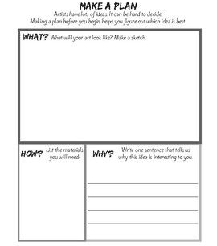
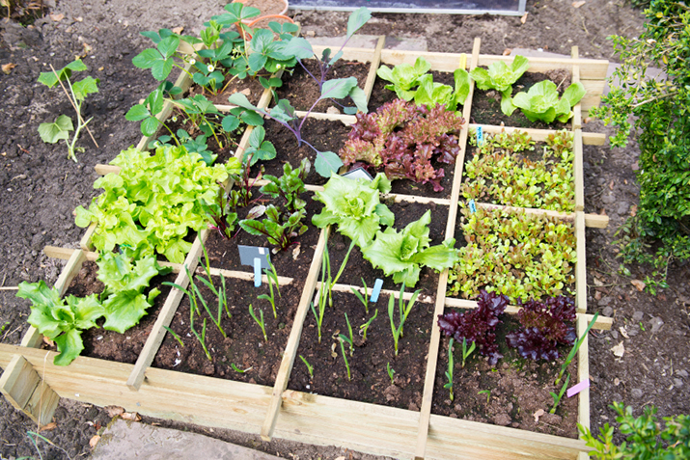
Part 3: Growing a garden
Look over the items that you decided could be grown yourself. Can you name 5 benefits of doing so? What do you need to grow one of these items?
Imagine you’re the lead gardner in your home! Make a plan to explain these benefits and how you would grow these items to your team/family! Use words or draw pictures if one would help you learn more than the other!
Step 1: This website has some tips for gardening
https://www.welcometothetable.coop/fresh-from-the-source/growing-your-own-food/designing-your-own-vegetable-garden.
Step 2: Here’s an example of how to make your plan and what to include!

Slide 11


Congratulations!
You have learned about sustainability!
Notes:
You can print this out to show your family!

Slide 12

Thank you!

