Slide 1
Building a Sustainable World
STEM & Industrial Engineering
Toyota Production Systems Lab
Sustainability: Grades 6-8

Slide 2
These are all areas of Industrial Engineering. Where does sustainability fit?
Industrial Engineering!

Slide 3
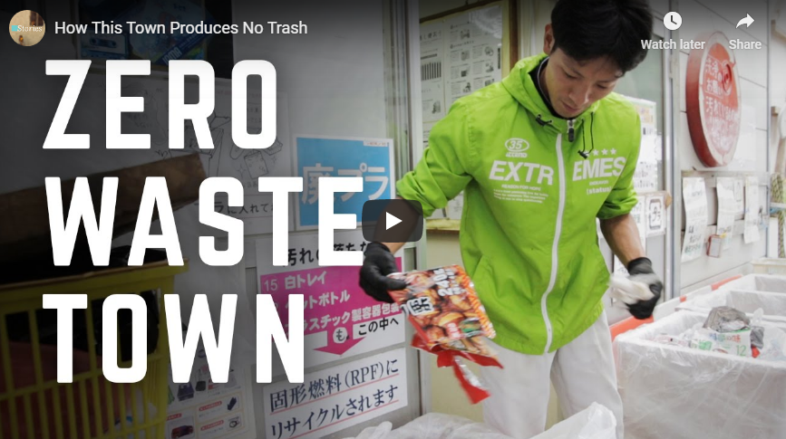
So what would a real, sustainable world look like?
Evidence that analyzing your trash and your choices affect the environment can be seen everywhere! Residents of this city in Japan sort their waste into 34 different categories to promote sustainable living!
Here is the video to see how this works!

Slide 4
How does an engineer help build a sustainable world?
Sustainability is the ability to coexist with the natural world around us, and maintain it. Sustainable engineers design and operate systems so they use energy and resources sustainably. Sustainability is also made of 3 pillars: environmental, social, and financial.
Click this video to learn about the pillars!

Slide 5
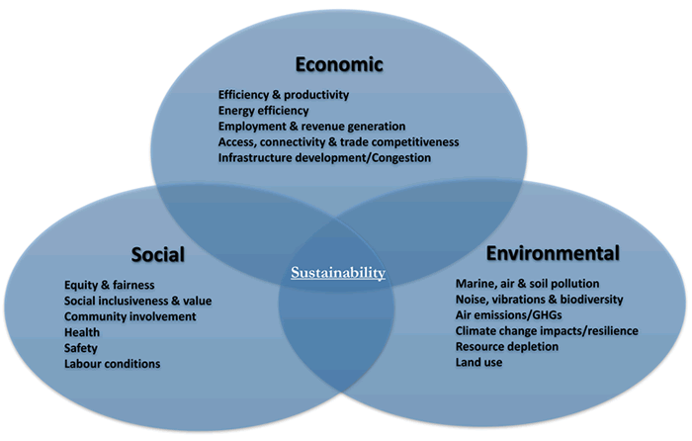
Ask yourself: from these videos, are there actions the video participants took that you think you could implement in your life?
Can you list 5 of these?
1.
2.
3.
4.
5.

Slide 6
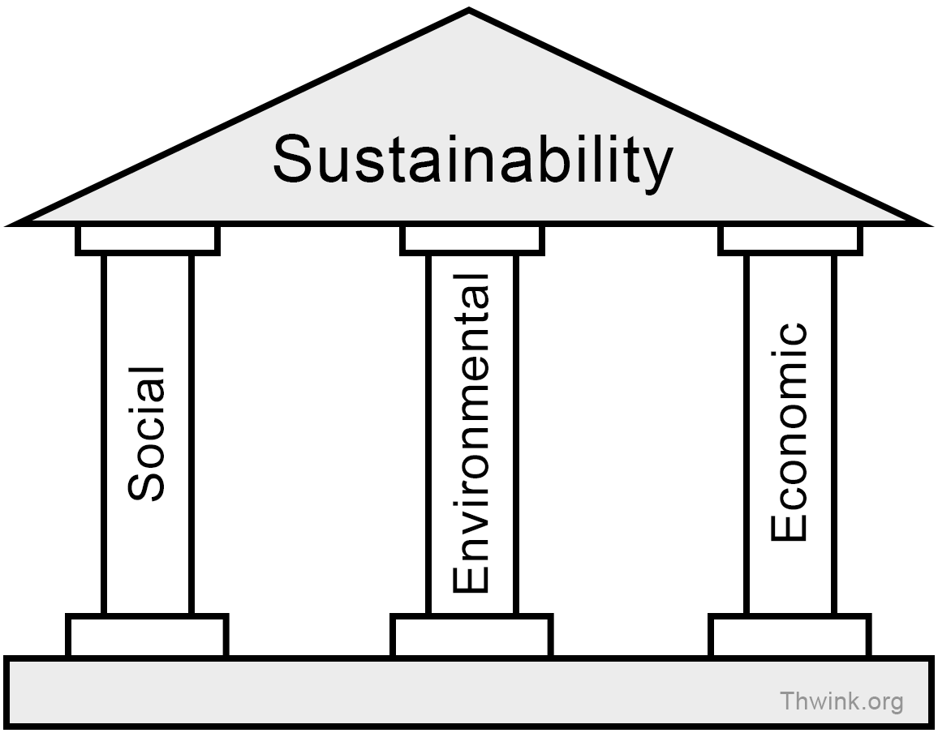
Today’s Activity!
Engineers Contributing to a Sustainable World!

Slide 7
Part 1: What can you find?
Pick 2 or 3 of your favorite brands
These can be clothes, technology, food, (ex. Toyota, Adidas, Disney) etc.
Do some research about how they think/act to create a more sustainable world or combat the environmental harm resulting from their work.
You can do this by googling their company name and looking at their website, or additionally googling their “company mission statement”.
Analyze what these findings tell you, or if they even mention sustainability related topics. What else could they be doing to be more sustainable?
Did any of your findings surprise you from what you originally thought?
Notes:
Limit yourself to 15-20 minutes of looking!

Slide 8
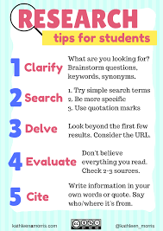
An example of how to format your findings:
You do not have to use this, but here is an example below!
Here are more important tips of how you can conduct your research!

Slide 9
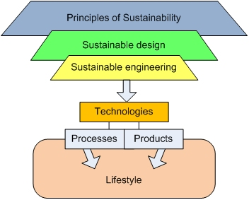
Part 2: Becoming the engineer
Now that you’ve seen what this company is doing to be sustainable, pick one that you would like to work for as a sustainable engineer.
Now that you work for them, they have asked you to add three ideas for their new sustainable program. You will add these to a page to their company website to show customers what they’re doing sustainably.
What are things you would want to hear from a company that they are doing to make the world a better place?

Slide 10
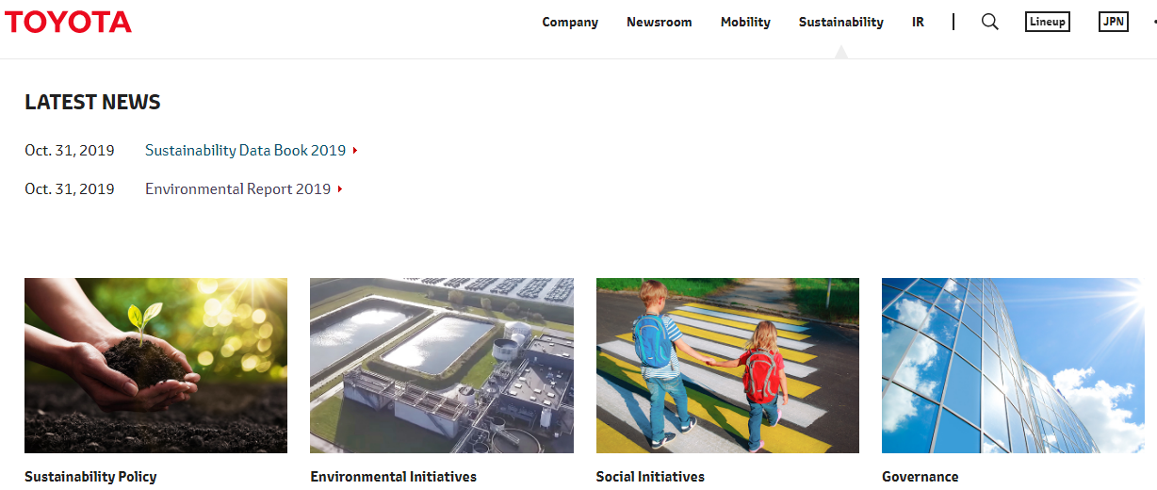
Part 3: Making a difference
What are your ideas? How would you show these to customers? Draw it out as a design for your very own tab of the company website!
Example: This is the real web-page from Toyota

Slide 11
Congratulations!
You have learned about working as a sustainable engineer!
Notes:
You can print this out to show your family!

Slide 12
Thank you!

