Slide 1
Introduction to Ergonomics
STEM & Industrial Engineering
Toyota Production Systems Lab
Ergonomics: Grades 9-12

Slide 2

These are all areas of Industrial Engineering. Where does ergonomics fit in this?
Industrial Engineering!

Slide 3

So what is Ergonomics exactly?
It is the study of how people work in their environment, their efficiency, how humans behave in relation to these elements.
Click on the image to watch the video!

Slide 4
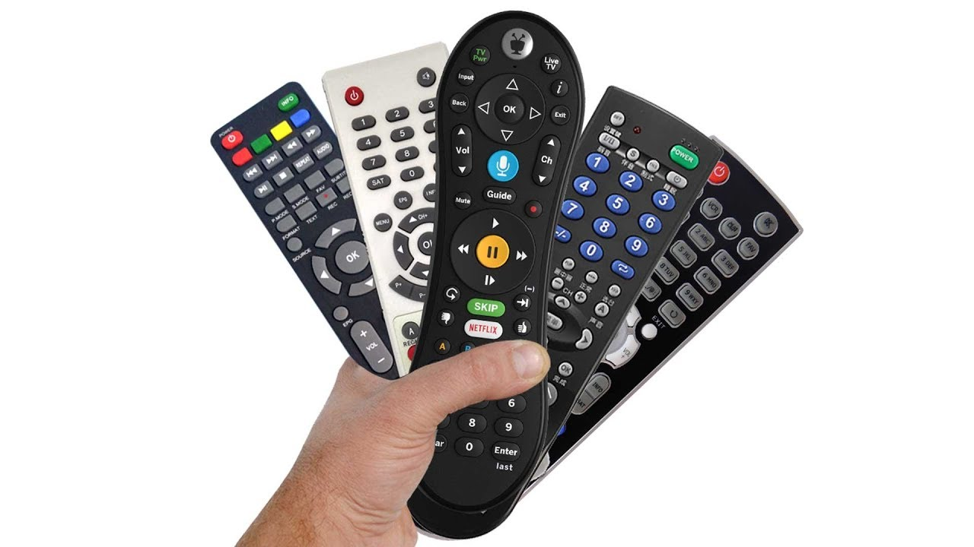
Today’s Activity!
Ergonomic Remote Design
Notes:
Reference for activity (you do not need to click this. This is just if you would like reference or more information! It will lead you to a website).

Slide 5
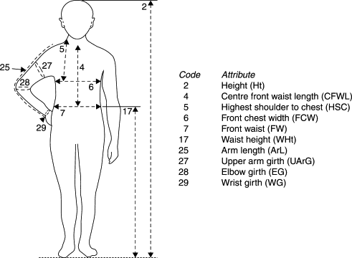
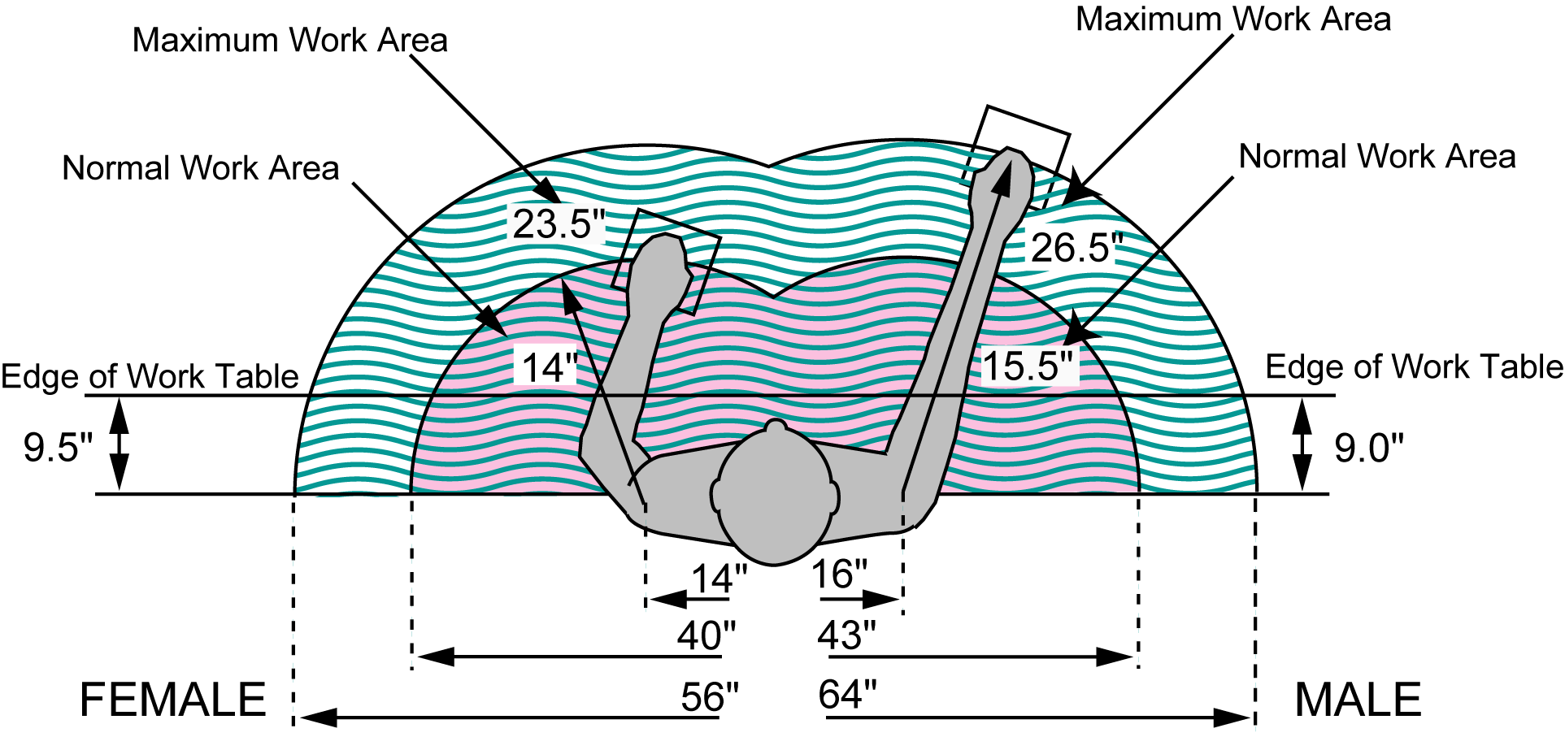
Background Information:
An important aspect of ergonomics is anthropometry:
the measurement of the human body. Engineers use measurements of the human body, from standing height to arm span, to design products and work spaces so they best fit the worker.
In this activity, you will play the role of an engineer designing an ergonomic TV remote control. Your goal is to accurately measure the features of your hand so that you can determine appropriate measurements for a new ergonomic remote control.

Slide 6
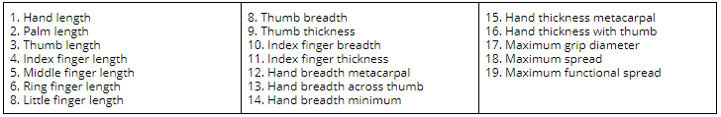
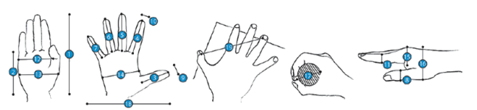
Step 1: Review hand measurements
The numbers located on the drawings (within the circles) match the features listed in the table. The lines that go through the numbered circles are the lengths you will measure on your own hand in a list later on.
For example, in order to measure the maximum spread (#18), you would measure from the end of the little finger to the end of the thumb while the hand is open.

Slide 7
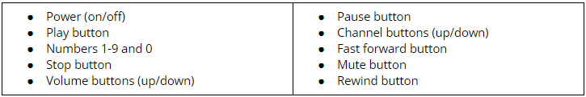
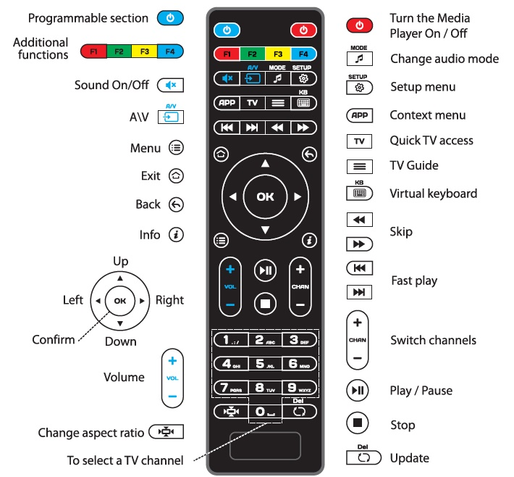
Step 2: Design Specifications
Using your measurements, you must design a remote control that will be used to turn a TV on and off, change the channels, adjust the volume, and play videos or DVDs. Your remote control must have the following buttons:
You must ultimately be able to determine (1) the length, width, and height of the remote control and (2) the placement of the 10 buttons on the remote control (listed above, not in the picture).

Slide 8
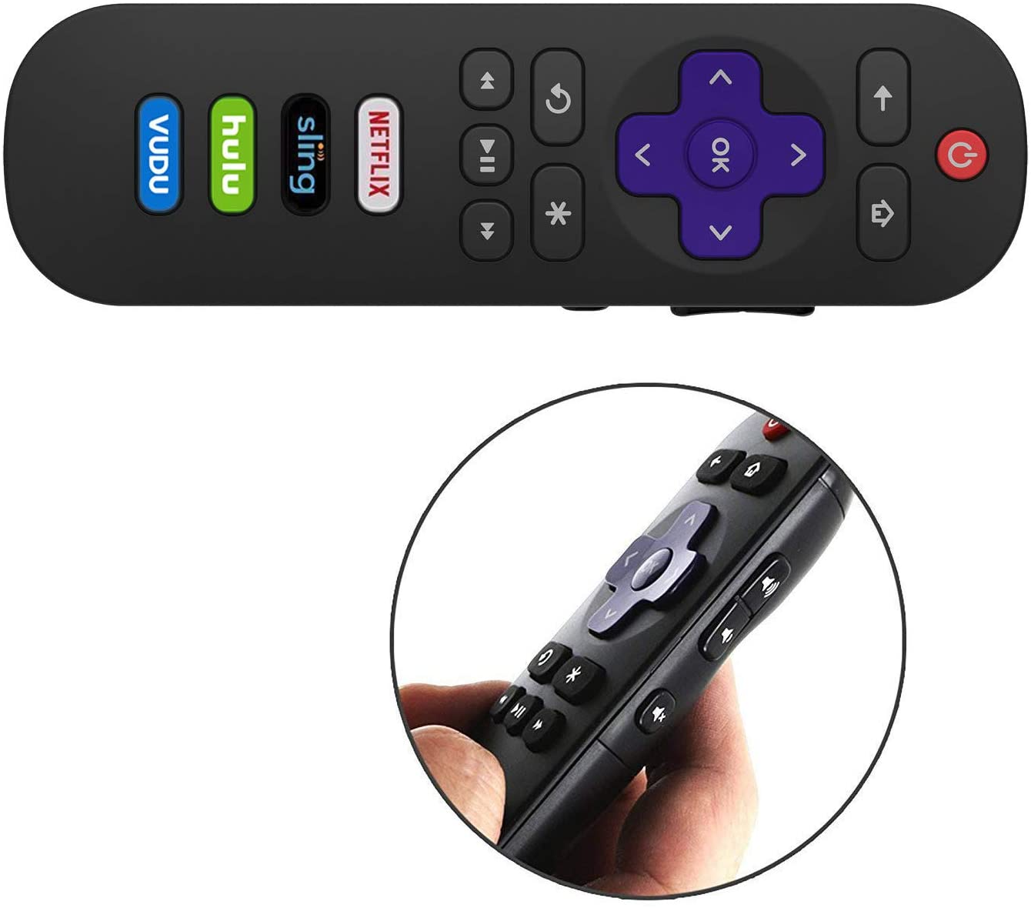
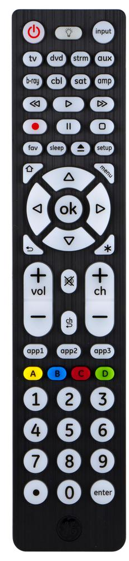
Step 3: Determine what features to measure
In order to determine which hand features to measure, you will need to observe how you (or a partner) use a regular remote control. Hold a remote in your hand and do the following tasks. Then record your observations below.
Press the power (on/off) button.
What finger(s) did you use to press the button?
How was the remote positioned in your hands when you pressed the button?
How easy or difficult was it for you to reach the button?
Press the numbers 1-9 and 0 buttons.
What finger(s) did you use to press these buttons?
How was the remote positioned in your hands when you pressed the button?
How easy or difficult was it for you to reach these buttons?
Press the channel (up/down) buttons.
What finger(s) did you use to press these buttons?
How was the remote positioned in your hands when you pressed the buttons?
How easy or difficult was it for you to reach these buttons?
You can repeat these questions for the other buttons if you like.

Slide 9

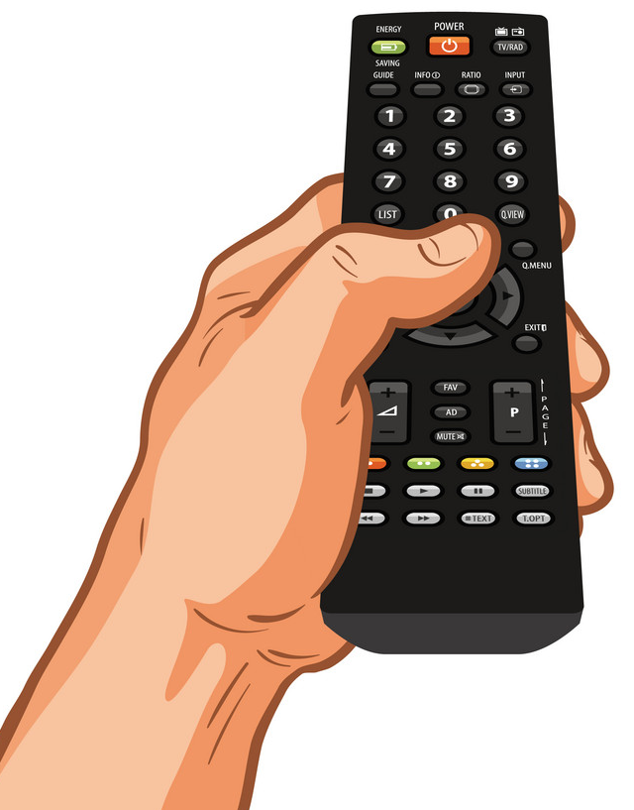
Step 4: Take measurements
Using the features listed in the table in Step 1 and your observations in Step 2, choose up to 10 features of your (or a partner’s) hand to measure.
Remember, be sure to choose features that will help you determine an appropriate length, width, and height for the remote control and the best location of the buttons relative to your hand. To make your measurements easy, you can measure each feature to the nearest centimeter.
This link will take you to an online ruler if you do not have one of your own. Simply hold your hand up to the screen, or make markings on a separate piece of paper.
Notes:
The link in the slide will take you to a website on the internet.

Slide 10
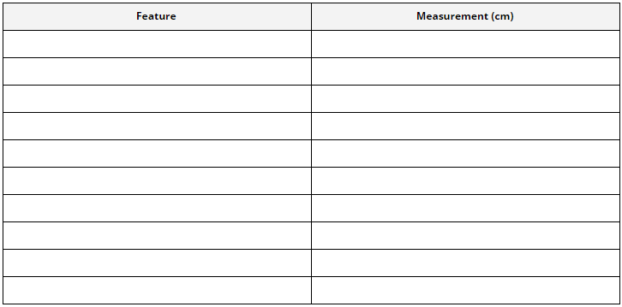

An example of how to format your list!:
You do not have to use this, but here is an example below! The feature you are measuring goes on the left (or if it’s a distance say “from point A to point B”), and the measurement is recorded on the right.

Slide 11
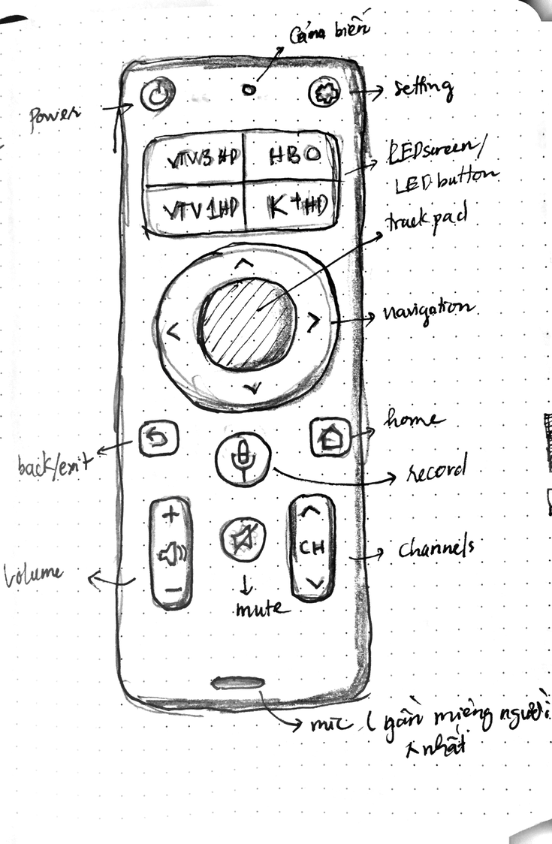
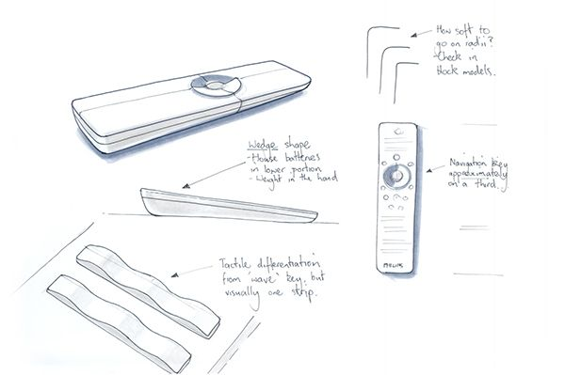
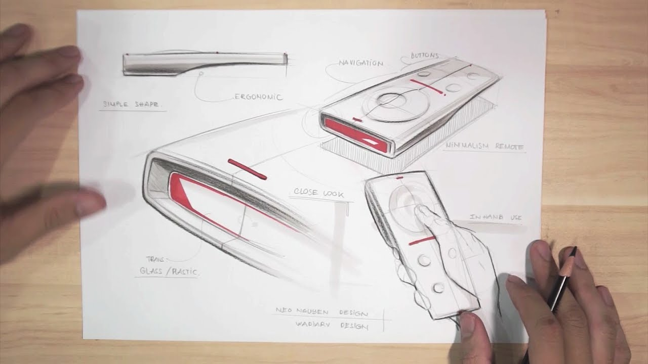
Step 5: Sketch your design
Now that you have measured important features of your (or partner’s) hand, come up with a sketch of your remote control design with measurements included. Include the length, width, and height along with all 10 buttons listed in Step 3. You may realize that you might need to use a little bit of math to determine the remote control’s final measurements.
Examples:

Slide 12
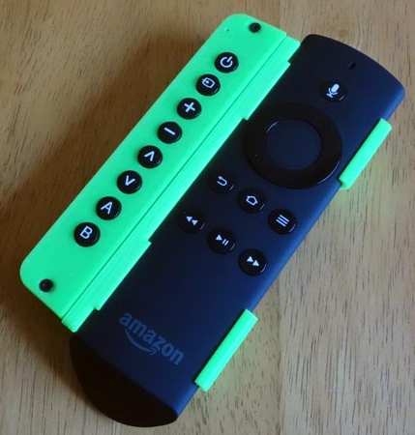
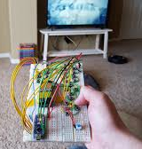
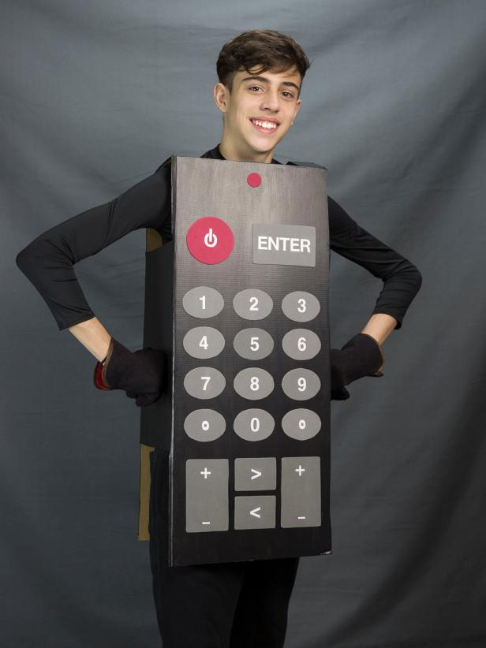
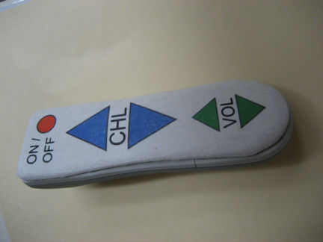
Step 6 (Optional): Prototype your design
Using materials available in your house that are okay to use, build a prototype of your remote based on the sketch you generated in Step 5.
Be sure to measure correctly before cutting any of your materials! If you realize that your remote control’s measurements are not what you expected (example: your remote control was too long or it was too wide), check your calculations and make any adjustments to your prototype.
Examples:

Slide 13
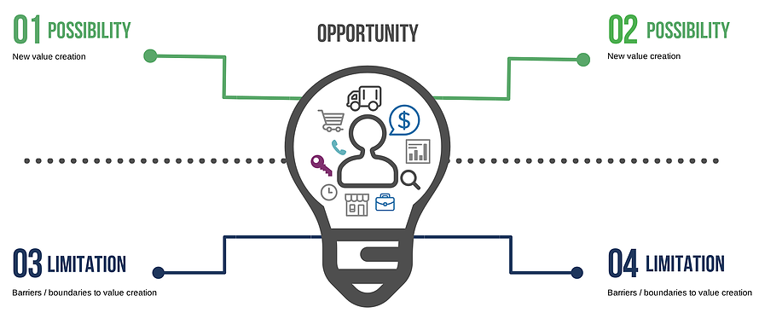
Step 7: Assess Your Design
Now that you have finished building your prototype, hold the prototype and press some of the buttons. Then, answer the following questions:
Were you (or your partner) able to use the remote easily and comfortably? If not, what changes would you make to your design?
Were the anthropometric features you chose in Step 4 helpful when calculating the remote’s measurements? If not, which features would you have measured?
How important is it to know math when solving engineering problems?

Slide 14


Congratulations!
You have learned how to define and measure ergonomics!

Slide 15
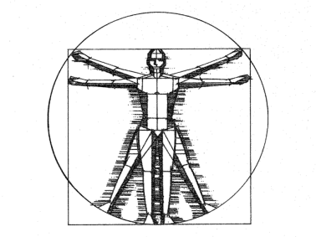
Now that you’ve been introduced to the main topic of Ergonomics, here are some subtopics that are part of this domain you can learn next!:
Anthropometry (this lesson and activity)
Human & Job Hazards
Musculoskeletal Disorders
Human Factors and it’s tie to Ergonomics
These subtopics and their lessons and activities can be found on the RIT Toyota Lab website as next to follow after the, “Introduction to Ergonomics” download powerpoint!

Slide 16

Thank you!

