Slide 1
Building a Sustainable World
STEM & Industrial Engineering
Toyota Production Systems Lab
Sustainability: Grades 9-12

Slide 2
These are all areas of Industrial Engineering. Where does sustainability fit?
Industrial Engineering!

Slide 3
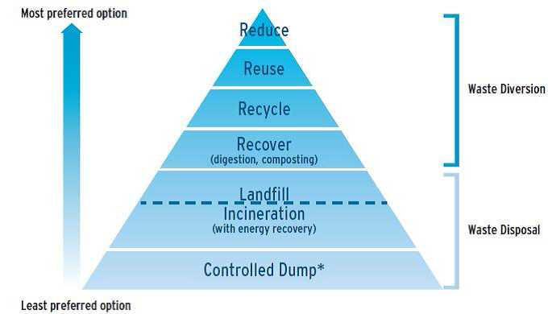
So what is sustainability?
If something is sustainable, that means we can keep using it or doing it for a long time. A lot of the ways people have been using the earth’s natural resources (such as burning fossil fuels for energy and generating lots of waste) are not sustainable.

Slide 4
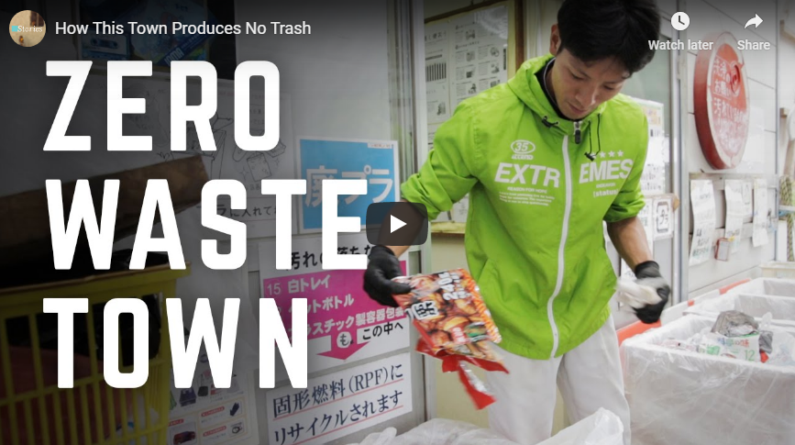
So what would a real, sustainable world look like?
Evidence that taking action and analyzing your choices affect the environment can be seen everywhere! An example of this is being aware of what you throw away. Residents of this city in Japan sort their waste into 34 different categories to promote sustainable living!
Here is the video to see how this works!

Slide 5
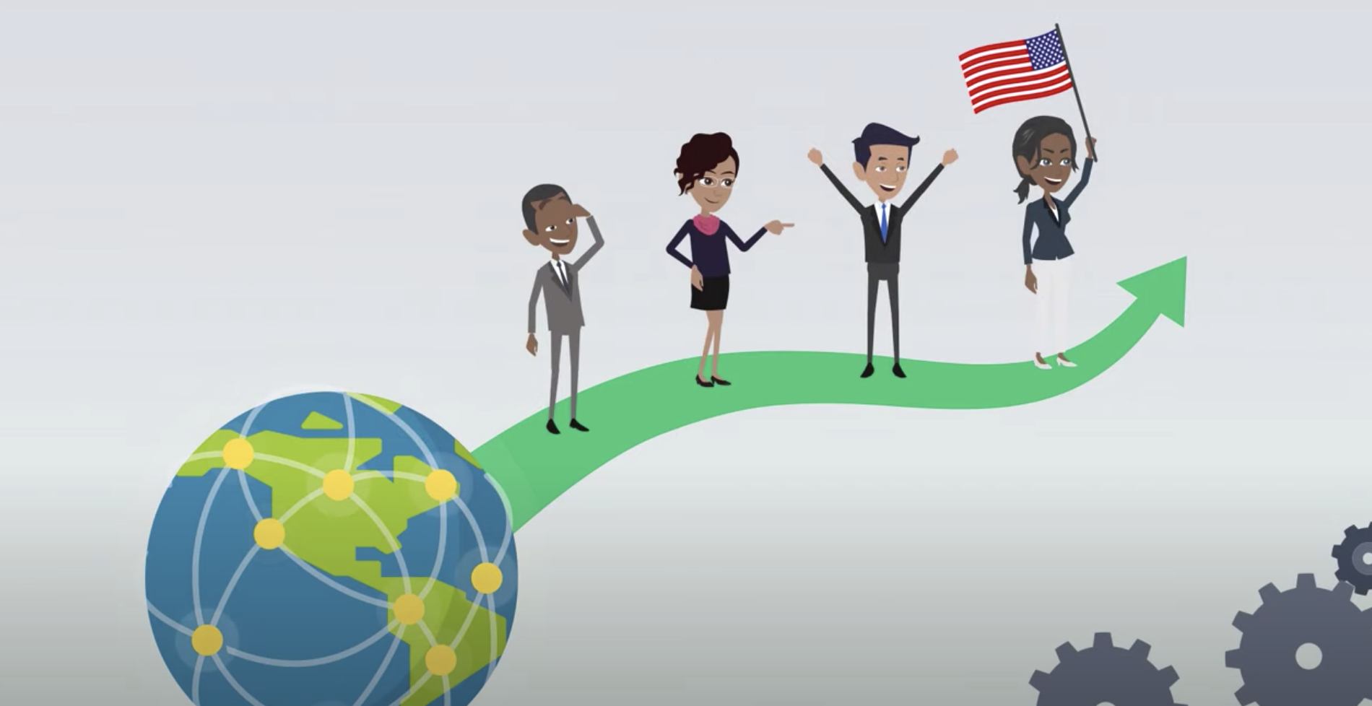
So what goes into making a sustainable world?
Now that you have an idea of what sustainability is, what it means and how actions are connected, you can analyze choices and interactions within this topic. Sustainability is made of 3 pillars: environmental, social, and financial.
Click this video to learn about the pillars!

Slide 6
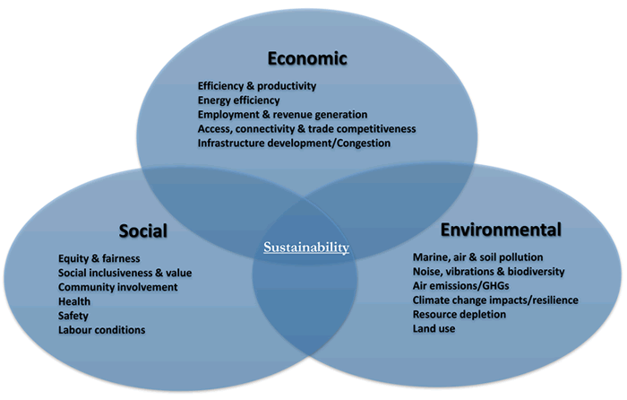
Ask yourself: from these videos, are there actions the video participants took that you think you could implement in your life?
Can you list 5 of these?
1.
2.
3.
4.
5.

Slide 7
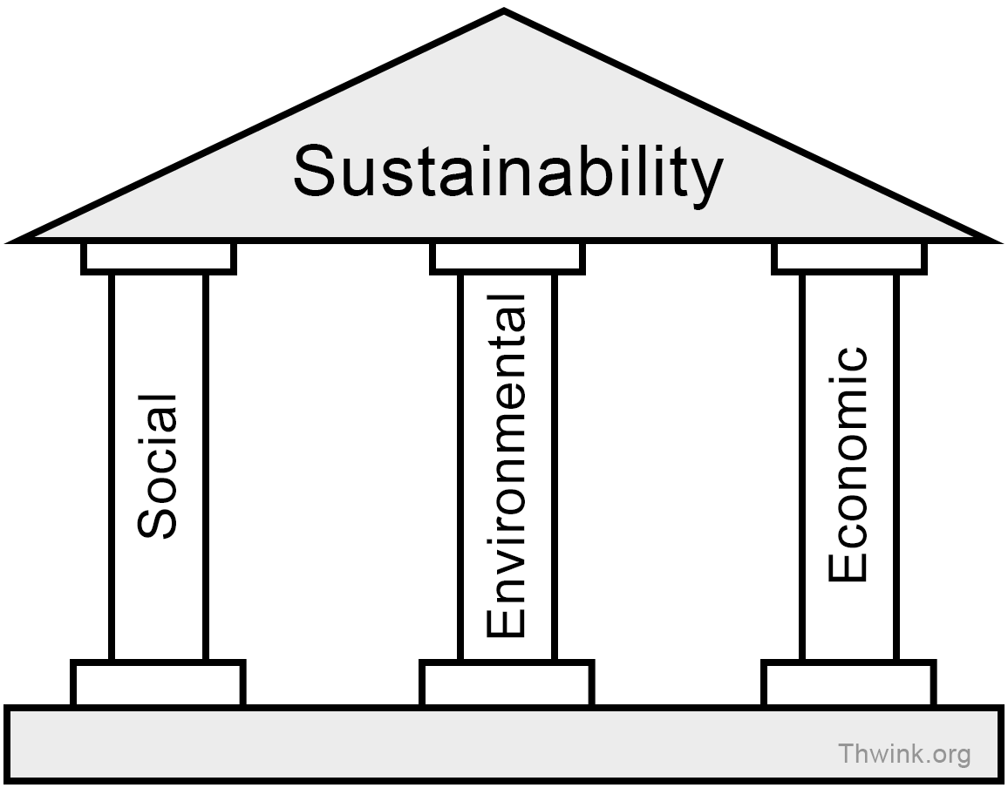
Today’s Activity!
Sustainability Practices in Companies
Notes:
This activity will include allowing your student to conduct research on the internet through basic lookups.

Slide 8
Part 1: What can you find?
Pick 2 or 3 of your favorite brands
This can be clothes, technology, food, (ex. Chipotle, Apple, Nike) etc.
Do some research about how how they’re thinking about/acting to create a more sustainable world or combat the environmental harm of their production.
You can do this by googling their company name and looking at their website, or additionally googling their “company mission statement”.
Analyze what these findings tell you, or if they even mention sustainability related topics. What else could they be doing to be more sustainable?
Did any of your findings surprise you from what you originally thought?
Notes:
Limit yourself to 15-20 minutes of looking!

Slide 9
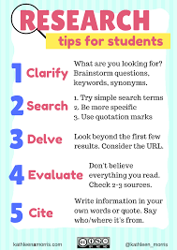
An example of how to format and record your findings:
You do not have to use this, but here is an example below!
Here are more important tips of how you can conduct your research!

Slide 10
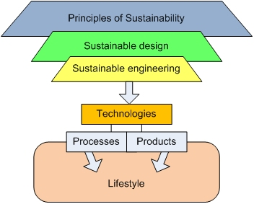
Part 2: Becoming the engineer
Now that you’ve seen what this company is doing to be sustainable, pick one that you would like to work for as a sustainable engineer.
Now that you work for them, they have asked you to add three ideas for their new sustainable program. You will add these to a page to their company website to show customers what they’re doing sustainably.
What are things you would want to hear from a company that they are doing to make the world a better place?

Slide 11
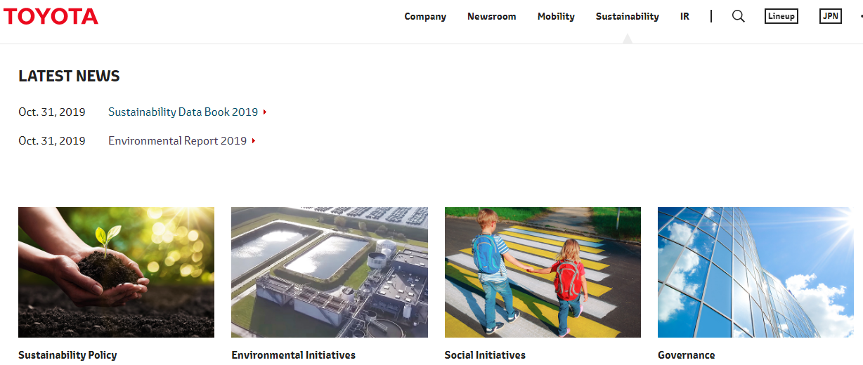
Part 3: Making a difference
What are your ideas? How would you show these to customers? Draw it out as a design for your very own tab of the company website!
Example: This is the real page from Toyota

Slide 12
Congratulations!
You have learned about working as a sustainable engineer!
Notes:
You can print this out to show your family!

Slide 13
Now that you’ve been introduced to sustainability, this lesson and the second one both introduce you to sustainability, but also have separate subtopics that include:
What sustainable engineers do
Building a sustainable world
Renewable energies
These subtopics and their lessons and activities can be found on the RIT Toyota Lab website as next to follow under the, “Sustainability” topic folder to download the powerpoints!

Slide 14
Thank you!

