Slide 1
Sustainability: Renewable Energy
STEM & Industrial Engineering
Toyota Production Systems Lab
Sustainability: Grades 9-12

Slide 2

These are all areas of Industrial Engineering. Where does sustainability fit?
Industrial Engineering!

Slide 3
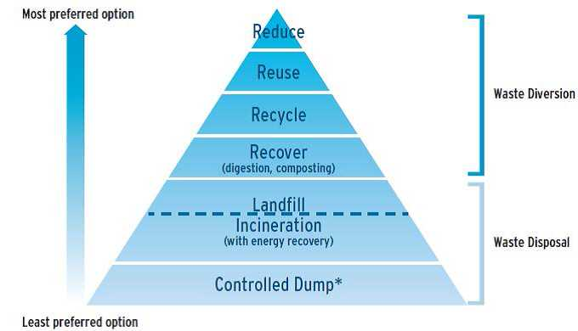
So what is sustainability?
Here is an overview if you haven’t seen the first activity!
If something is sustainable, that means we can keep using it or doing it for a long time. A lot of the ways people have been using the earth’s natural resources (such as burning fossil fuels for energy and generating lots of waste) are not sustainable.

Slide 4
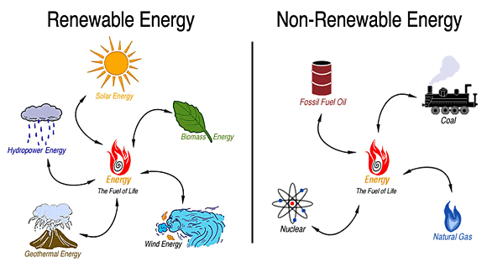
The power of renewable energy
Renewable resources that produce energy are: natural resources that replenish to replace any amount depleted by usage and consumption. This done through natural reproduction or other naturally recurring processes within a finite amount of time.
Some examples of renewable and non-renewable resources (cannot be replaced) include:

Slide 5
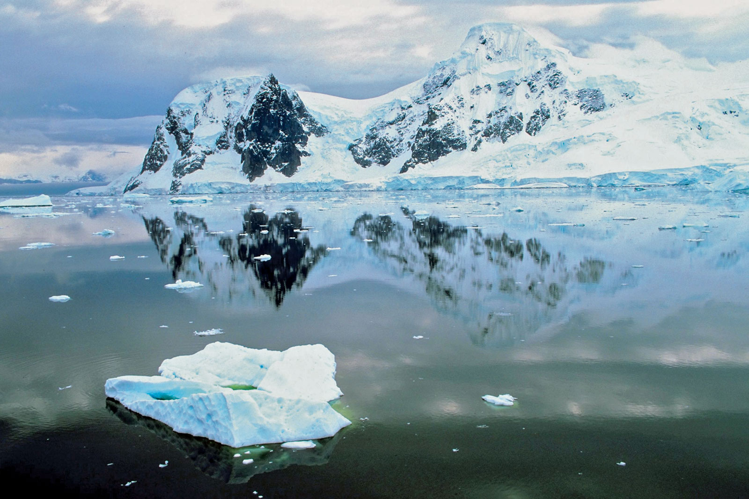
Today’s Activity!
900 Miles in Antarctica on Renewable Energy
Notes:
This activity will require using the internet to visit the Spark101 education website. This will require making a free account, where after this activity, you can have access to more activities you wish to browse.

Slide 6
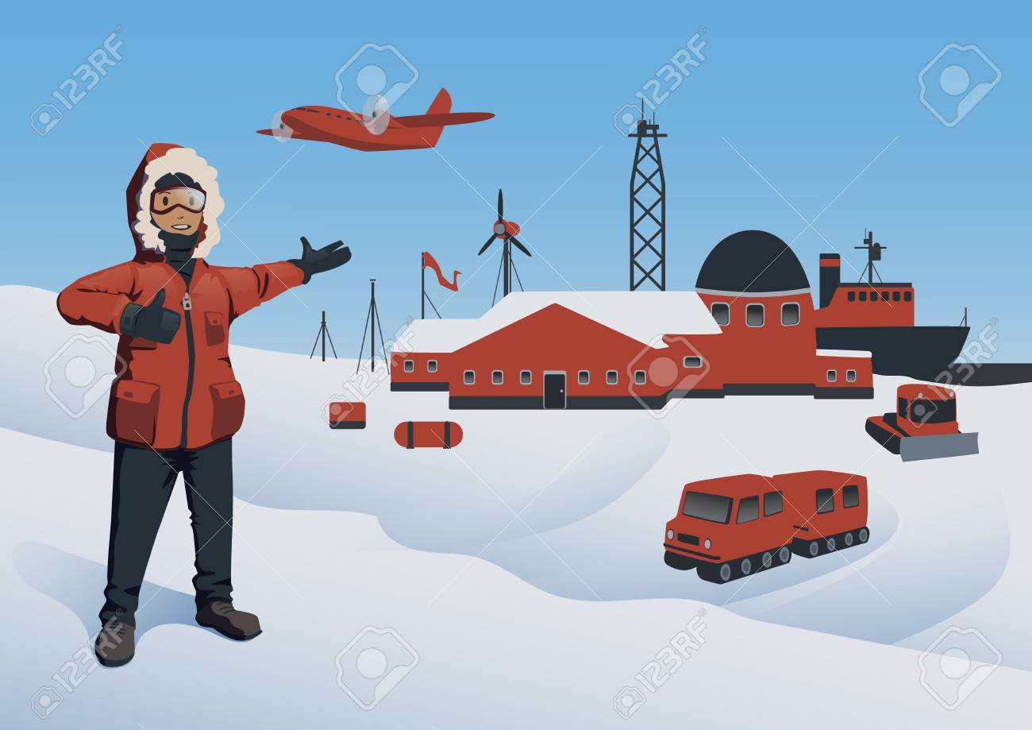
What does this mean for us?
Transitioning to renewable energy is one of the fundamental shifts that will need to happen in order for companies and our society to become more sustainable.
In this video/case study activity we will conduct today, you will help determine the viability of renewables for an Antarctica expedition.
After watching the video, you’ll analyze, discuss, and create a plan to determine the most sustainable energy resources required to explore one of the last unexplored frontiers on earth, and in the process, learn about how renewable energy could be applied to frontiers closer to home.

Slide 7

Step 1:
Register for a free Spark 101 account. Type, “Spark 101” into your google search engine and click on the 1st option that says “.org”. Once on the website, click on and fill in the boxes for first name, last name, and email address. Then for the options below:
Again, this website is FREE! With these options chosen it will allow you to get to the activity we will be doing today, and activities like it.
Search for the activity named on the website called “900 Miles on Renewable Energy”. Click on the name.
Notes:
Limit yourself to 15-20 minutes of looking!

Slide 8



Step 2:
Before beginning the activity, imagine you’re going on a camping trip. Make a list of all the items you need to bring. Your list may have the format to fill in on the lines:
Look at the items you listed above. Circle the ones that would be useful to you on an Antarctic Expedition, where the average temperature is -30°F.
How are you going to eat and drink? What could you use as a water source?

Slide 9
Step 3:
Next, watch the first part of the video we clicked on (pause it at 03:17).
This highlights Lockheed Martin’s effort to help Robert Swan, noted polar explorer, assess renewable energy for a 50-day, 900-mile journey from the South Pole to the coast of Antarctica. Consider the team’s requirements below:
Enough energy for 8 people to melt snow for drinking water, heat food, charge radios and cameras, and stay warm for at least 50 days. Energy sources need to be renewable.
Technologies that are light and compact enough to fit on a sled.
Inexpensive materials (less than $30,000)

Slide 10
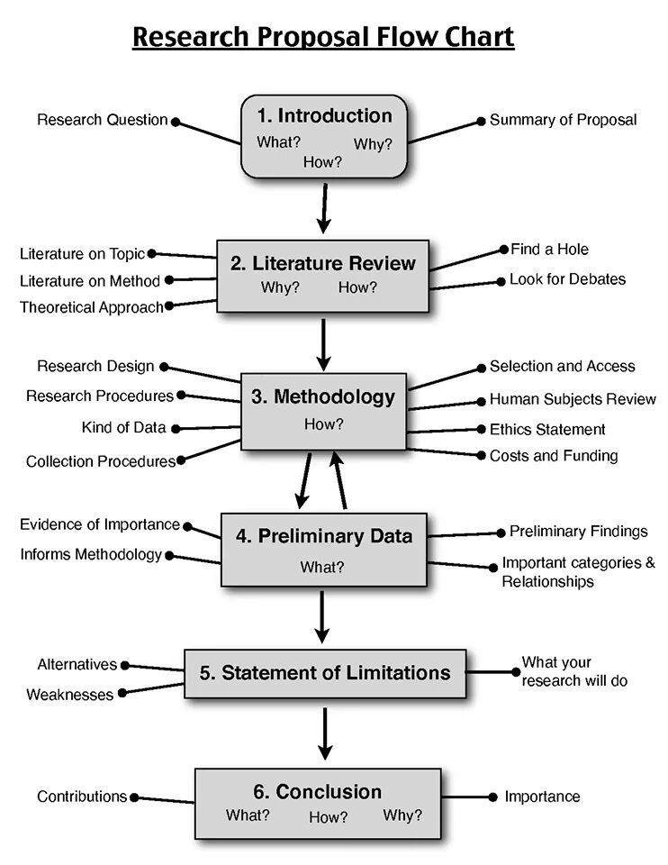

Step 4:
Based on these requirements, draft a final proposal that details your Antarctic expedition plan.
As this will be a written document, consider the following tips:
Write about the things you feel like will be the most important!

Slide 11
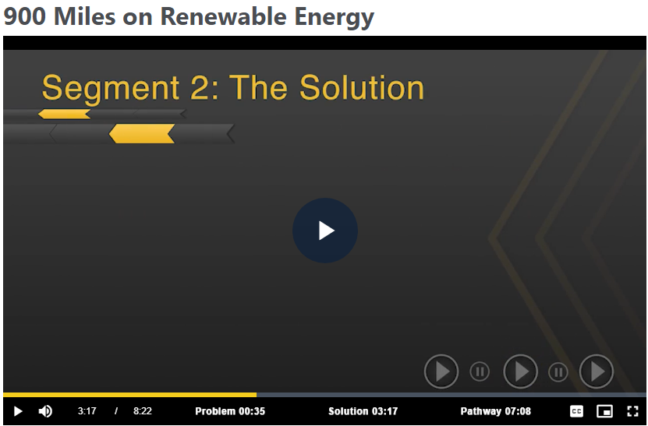
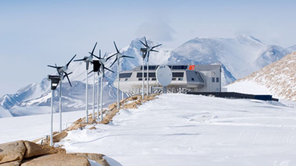
Step 5:
Watch the second part of the video (beginning at 3:17, then pause at 7:08):
Answer the following Questions:
Which technologies did the team end up using? How did they work?
Where did the team test the technologies? Why did they do this?

Slide 12
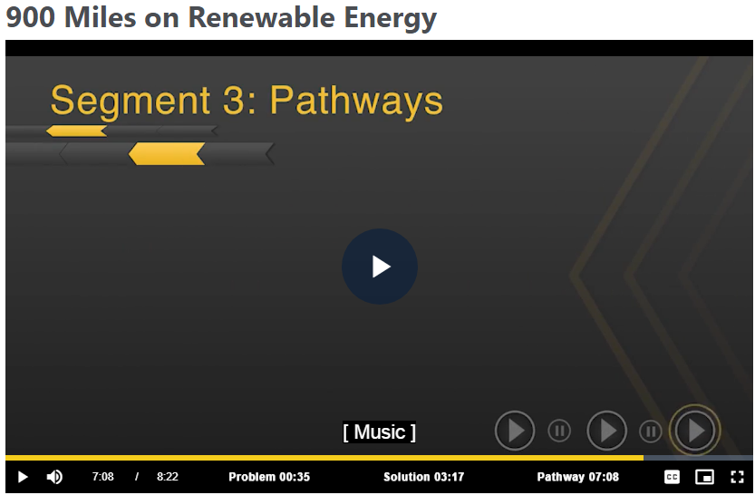


Step 6:
Starting again where you left off (7:08), watch the video until the end:
Answer the following Questions:
How were your solutions similar to those generated by the team? How were they different?
In cases where they were different, which solution was better? Why?

Slide 13


Congratulations!
You have learned about working as a renewable energies!
Notes:
You can print this out to show your family!

Slide 14

Now that you’ve been versed in sustainability, this lesson and the other one both introduce you to sustainability, but also have separate subtopics that include:
What sustainable engineers do
Building a sustainable world
Renewable energies
These subtopics and their lessons and activities can be found on the RIT Toyota Lab website as next to follow under the, “Sustainability” topic folder to download the powerpoints!

Slide 15

Thank you!

