Slide 1
Introduction to Ergonomics
STEM & Industrial Engineering
Toyota Production Systems Lab
Ergonomics: Grades K-5

Slide 2
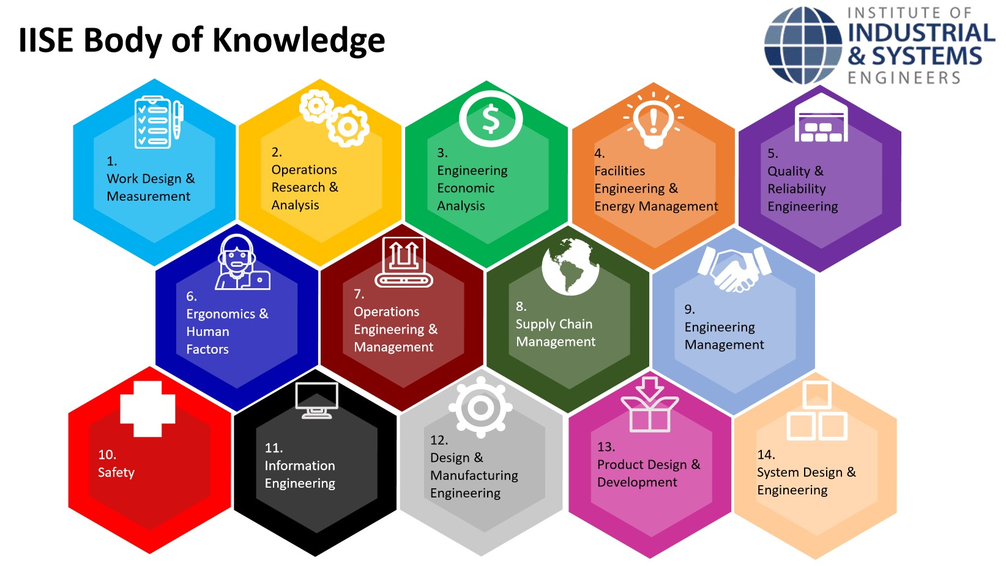
These are all areas of Industrial Engineering. Where does ergonomics fit in this?
Industrial Engineering!

Slide 3
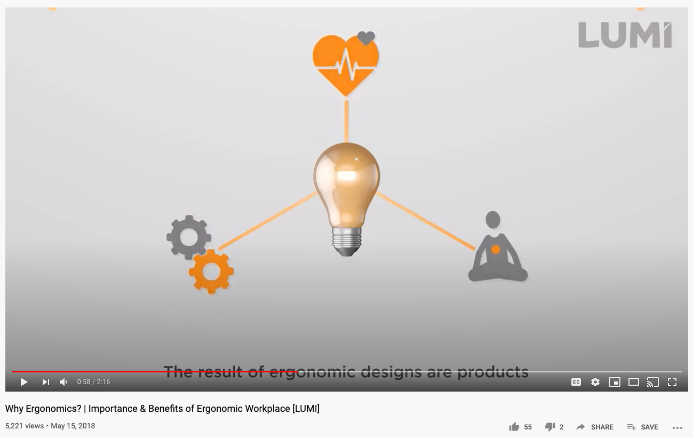
So what is Ergonomics exactly?
The study of how people work in their environment, how well they work, and their reactions to their work!
Click on the image to watch this two-minute video to learn about ergonomic design!

Slide 4
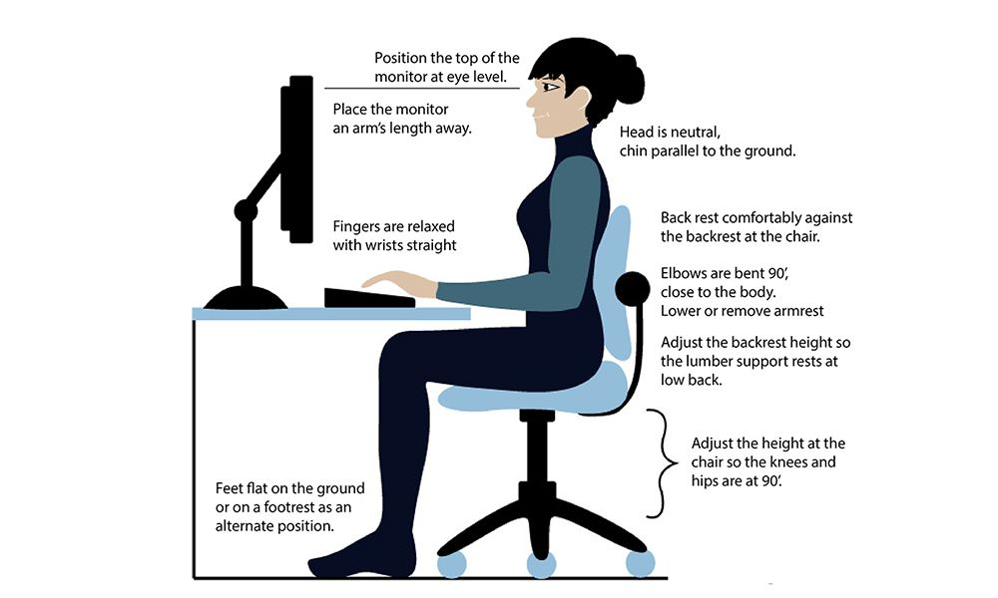
Today’s Activity!
How ergonomic is your daily life?

Slide 5


Step 1: Think about your everyday life at home. What are five different items or environments you interact with every day?
Two examples are: your toothbrush and the chair you’re sitting in!
Set-up your list as:

Slide 6


Step 2:
For each of those items or environments, do you think they’re ergonomic (designed to keep humans safe and comfortable)? Put a check mark next to the ones that are and an “X” next to the ones that are not!

Slide 7
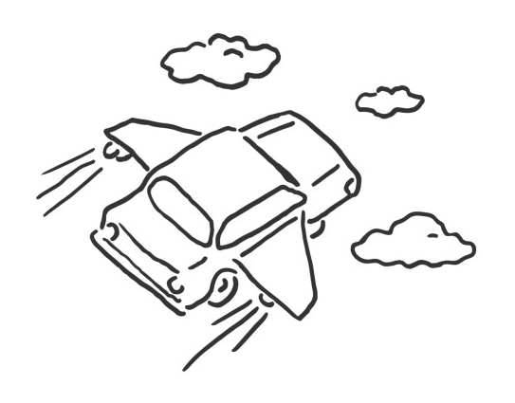


Step 3:
-Why did you say yes or no for each of those items? Explain.
-For the ones you said are not ergonomic, what would make them more ergonomic? Be as creative as you want!
Often in real life jobs, crazy brainstorms lead to positive ideas and thinking, that become real solutions!

Slide 8
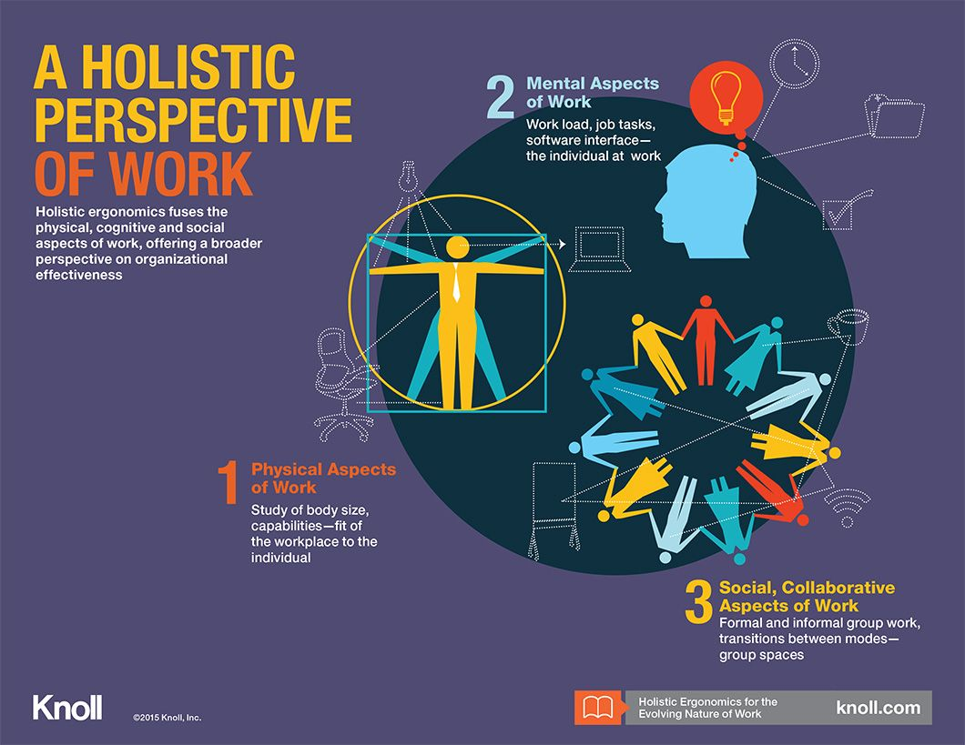
There are 3 areas of Ergonomics:
Physical
Cognitive
Organizational
Read about them here!

Slide 9
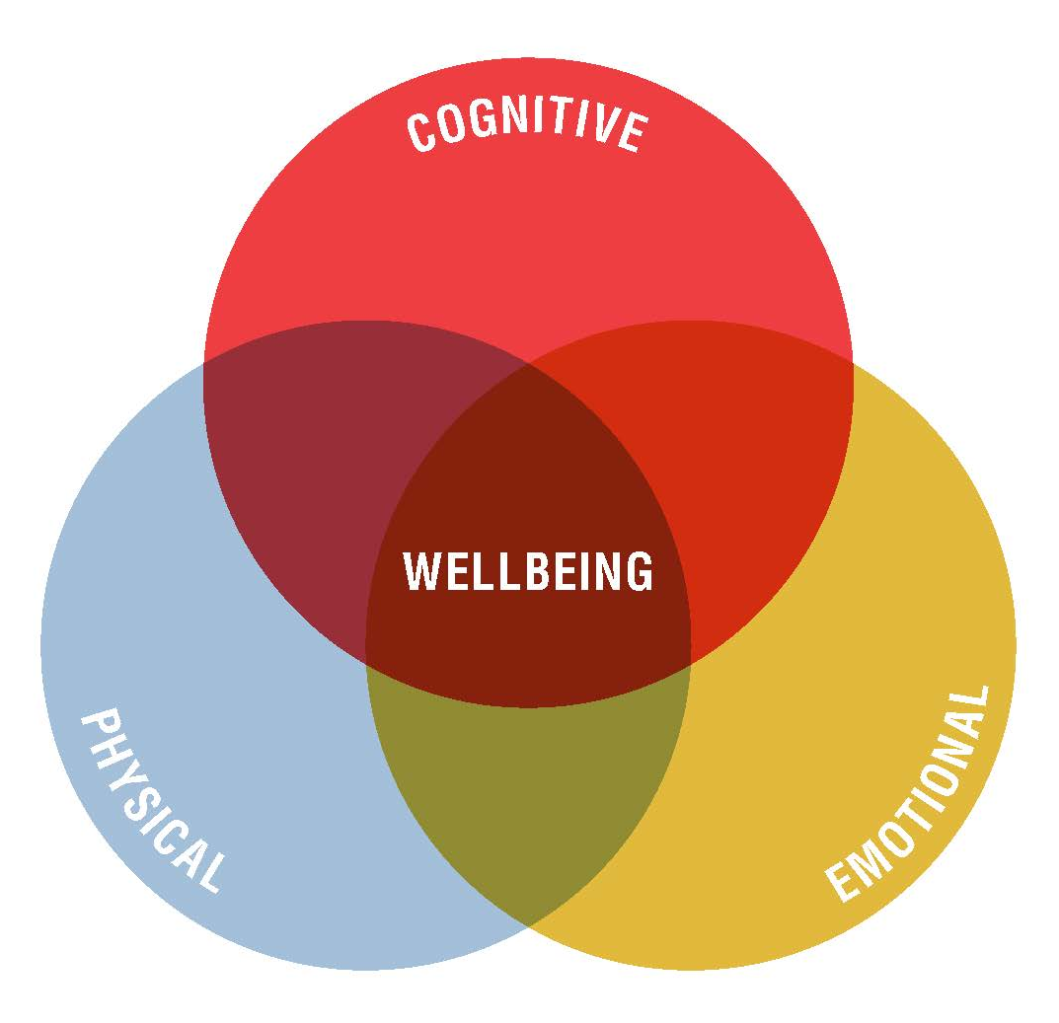

Step 4:
-Can you classify your solutions as one of the 3 types of ergonomic areas of:
Physical Cognitive Organizational
Takeaway: Do you think these affect you or your family every day? = Yes!

Slide 10


Congratulations!
You have learned how to define ergonomics!

Slide 11

Thank you!

