Slide 1
Introduction to Sustainability
STEM & Industrial Engineering
Toyota Production Systems Lab
Sustainability: Grades K-5

Slide 2

These are all areas of Industrial Engineering. Where does sustainability fit?
Industrial Engineering!

Slide 3
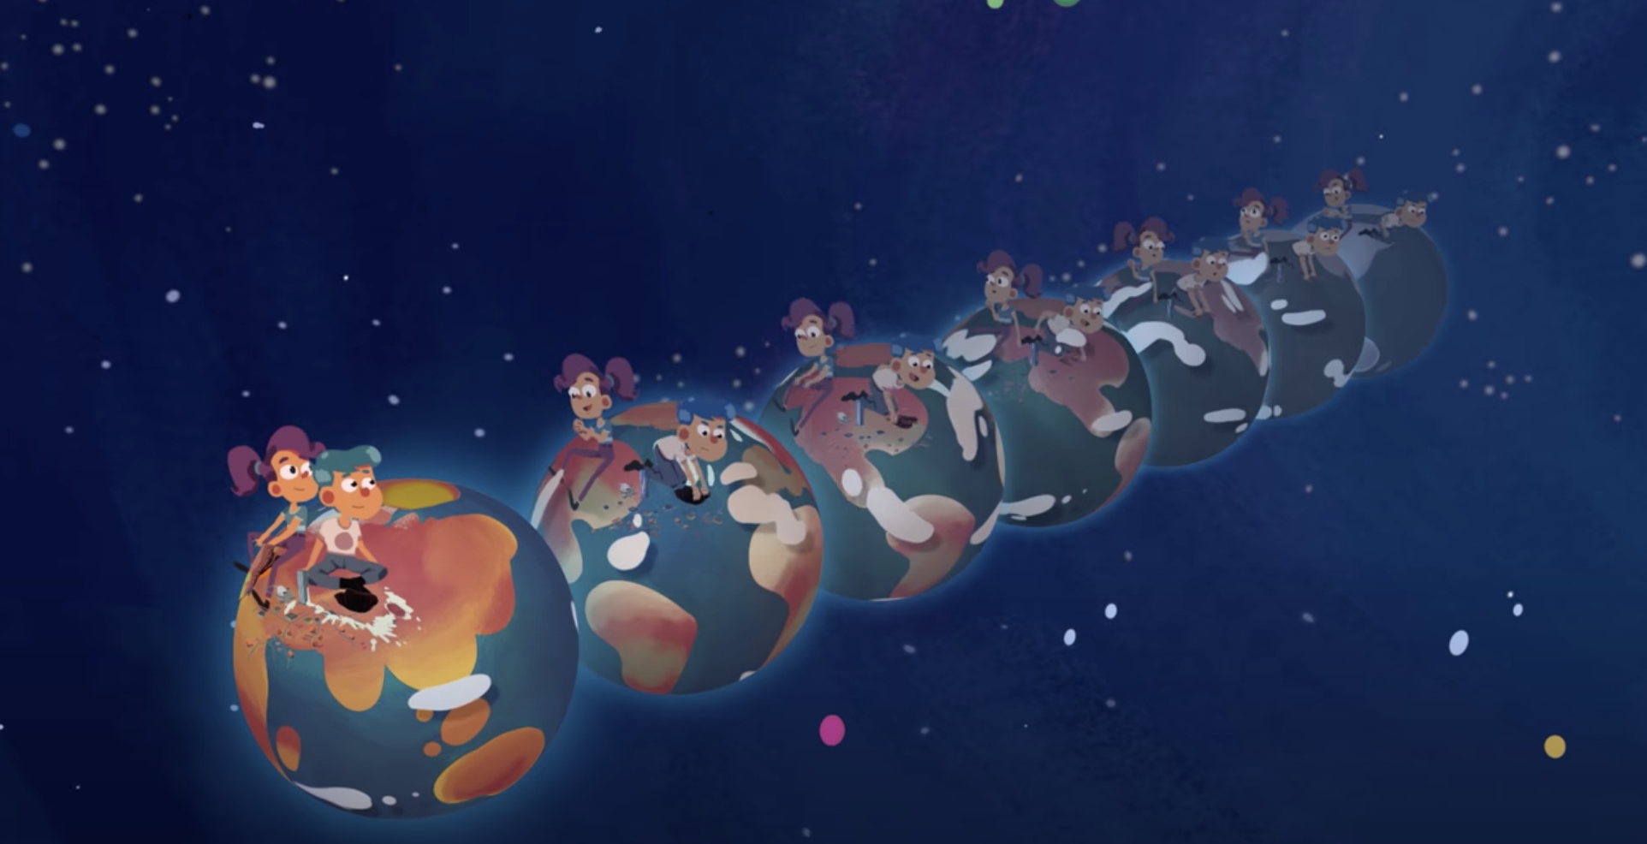
So what is sustainability?
If something is sustainable, that means we can keep using it or doing it for a long time. A lot of the ways humans have been using the earth’s natural resources, such as burning fossil fuels for energy and generating lots of waste, are not sustainable.
Watch this fun video to learn more!

Slide 4

Ask yourself: where do you see this applied in your daily lives?
What are some examples that affect you?
Where would you like to see changes?
Can you list 5 of these?
1.
2.
3.
4.
5.

Slide 5

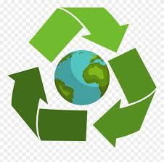
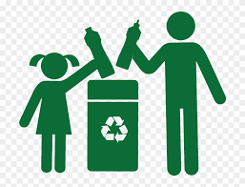
Today’s Activity!
What’s in your trash?

Slide 6
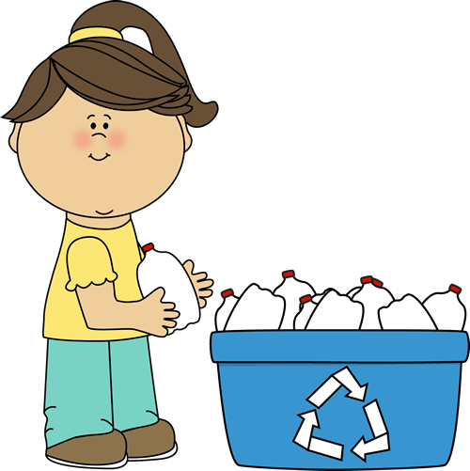
There are 2 ways to do this activity:
Put a piece of paper and a pen next to your garbage can. For the rest of the day, every time someone in your house uses the garbage can, write down what they threw away.
OR
Lay down some newspaper or a garbage bag and put on some gloves to avoid making a mess. Pick a garbage can in your house and dump it out on the newspaper: what do you see? Write a list of everything you find in the garbage can.
Pick the one that works best for you in your home!

Slide 7
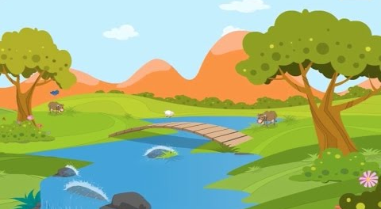
Why do this activity?:
Being aware of what is thrown away on an average day at your home allows you to be mindful of what
But what is the environment?
  The environment is: is everything around you! It is all of our surroundings which includes air, soil, water, plants, and animals. We all need a healthy environment in order to survive and be happy!
This is an example of the environment! Do you see things your recognize? They are all work together to make up the environment!

Slide 8
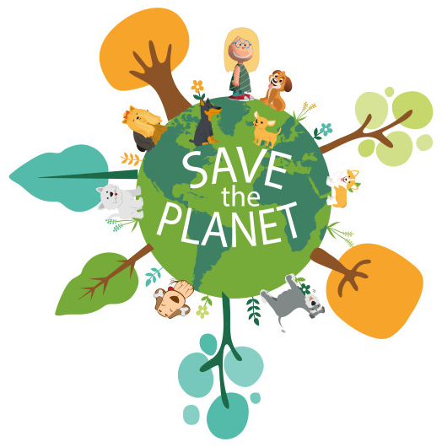
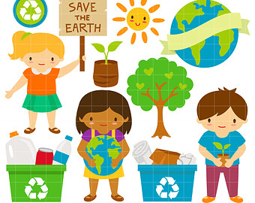
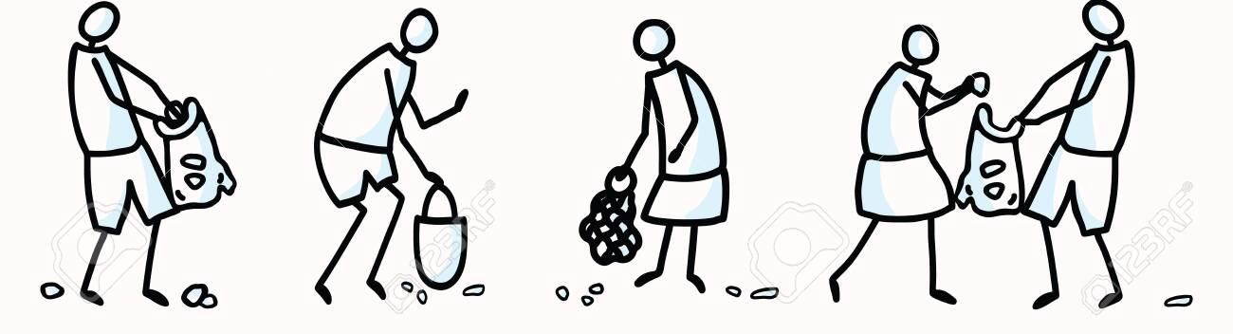
Damage to the environment! What does that mean?:
Trash that is thrown away and not recycled by any average person will most likely end up in a landfill, or incinerated (which means to be burned), or will hurt the environment in other ways. Generally, the more trash that can be recycled, the less we damage the natural environment!
This can sound scary, but being aware, making changes, and talking about topics like this can make a difference!
Sharing this with your family and friends allows them to be more aware too! It also gives you an opportunity to talk about what you can do in your daily lives to help the earth!

Slide 9
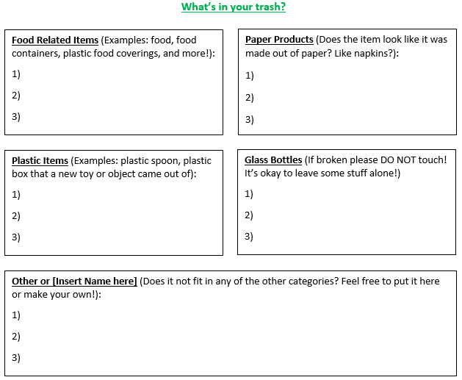
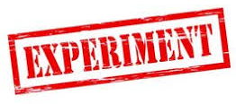
An example of how to format your list!:
You do not have to use this, but here is an example below! This is organized by the trash item’s primary function.
Notes:
You can download this file with your presentation!

Slide 10


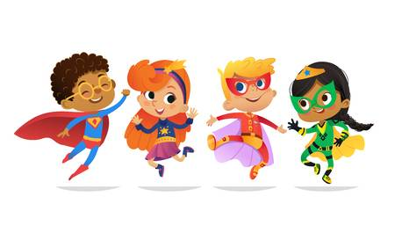
So what’s next?:
Make sure you keep your list! If you decide to do the next learning activity, we will look at your list and talk about choices that you can make to be more sustainable! We will use your hard work to make a difference!

Slide 11


Congratulations!
You have learned about sustainability!
Notes:
You can print this out to show your family!

Slide 12

Thank you!

