Slide 1
Building a Sustainable World
STEM & Industrial Engineering
Toyota Production Systems Lab
Sustainability: Grades K-5

Slide 2
These are all areas of Industrial Engineering. Where does sustainability fit?
Industrial Engineering!

Slide 3
How can engineers help build a more sustainable world?
The job of Industrial engineers can include helping companies create more sustainable products and processes. They suggest better materials, alternative sources of energy, and other ways of reducing waste that help save the planet.

Slide 4
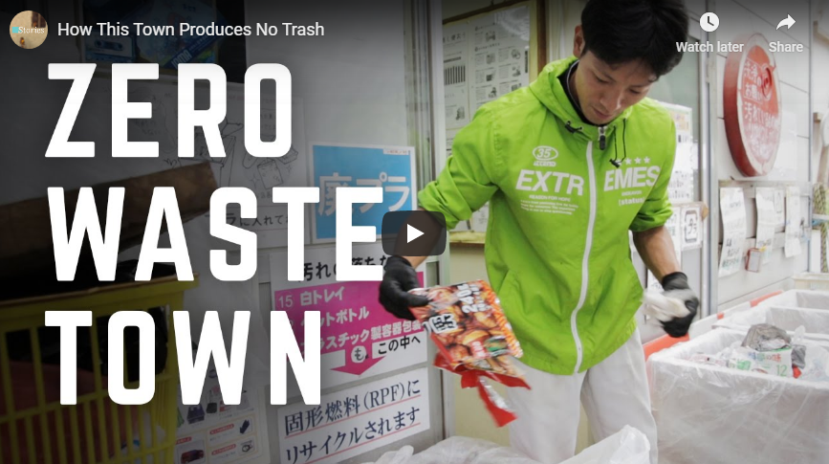
So what would a real, sustainable world look like?
Evidence that analyzing your trash and hwere it comes from can affect and help your environment are seen everywhere! Residents of this city in Japan sort their waste into 34 different categories to promote sustainable living!
Here is the video to see how this works!

Slide 5
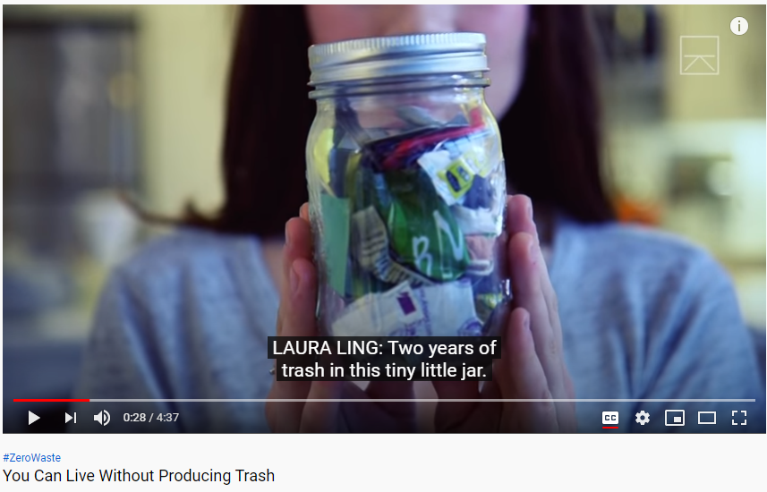
What are ways we can live without trash?
This New York woman is an example of how analyzing your trash makes a difference. She is making an effort to change the way she thinks about and creates waste, and asks us to do the same. Over the past two years, she has produced enough trash to fill just a 16 oz mason jar!
Click here to learn more!

Slide 6
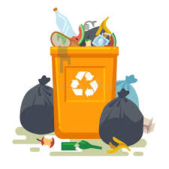
Ask yourself: from these videos, are there actions the video participants took that you think you could do as well?
Can you list 5 of these?
1.
2.
3.
4.
5.

Slide 7
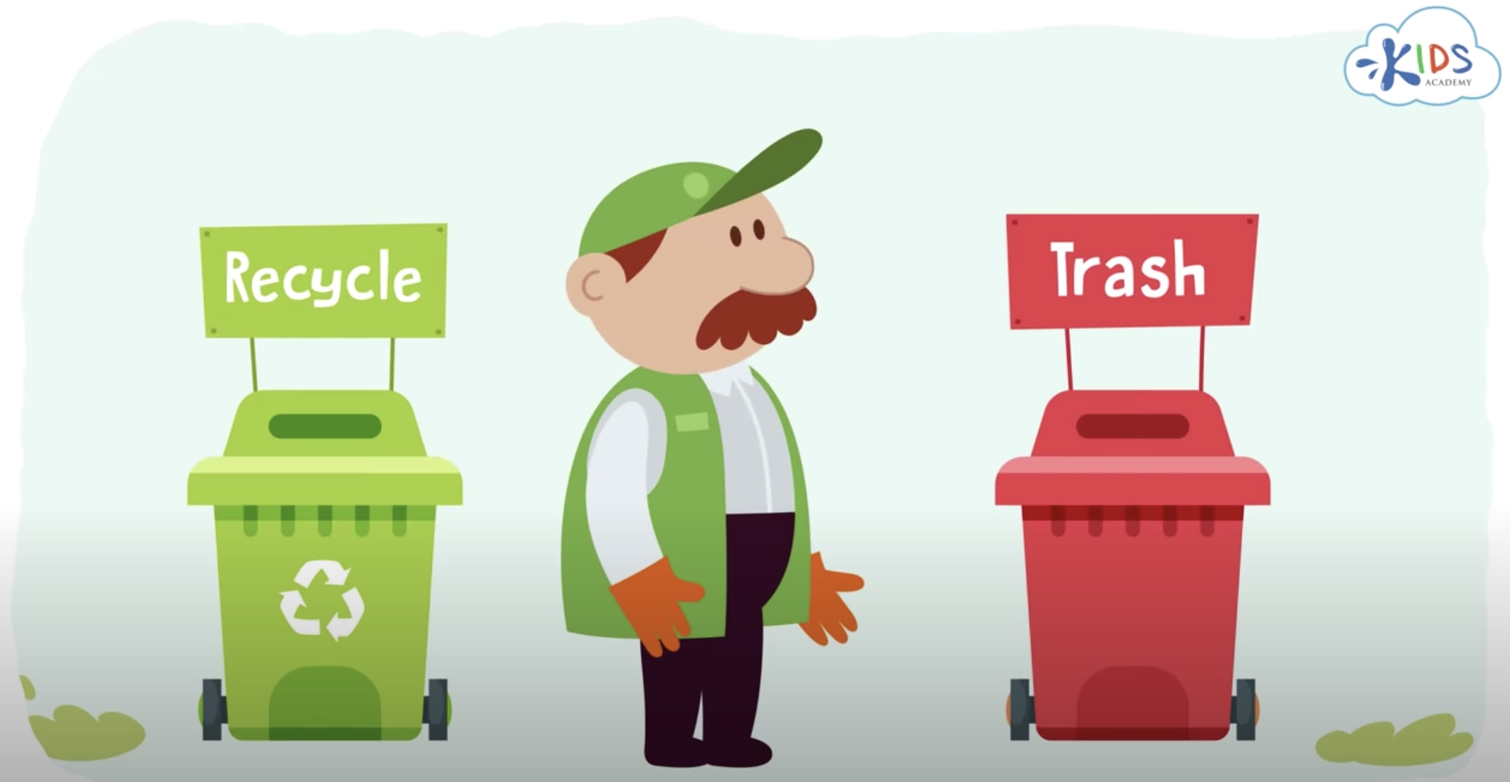
Today’s Activity: Green your trash!
Create a list of trash you would typically see in your trash (or if you already have one from previous activities use that), and watch a recycling video by clicking on the image above to learn more about the types of waste that can be recycled:

Slide 8
How to do this activity:
Let’s make three new lists from the one you currently have.
Write down everything that could be recycled or composted in the first list.
In the second list, write down the things that should go in the trash.
In the third list, come up with as many ideas as you can for things that could have more sustainable alternatives next time.
Examples: reusable bags instead of single-use ones, or metal forks instead of plastic ones.
You can set up your list to look like the one above! Use your ideas and put them into action!

Slide 9
Reminder: Why do this activity?:
Being aware of what is thrown away on an average day at your home allows you to be mindful of what
But what is the environment?
The environment is: is everything around you! It is all of our surroundings which includes air, soil, water, plants, and animals. We all need a healthy environment in order to survive and be happy!

Slide 10
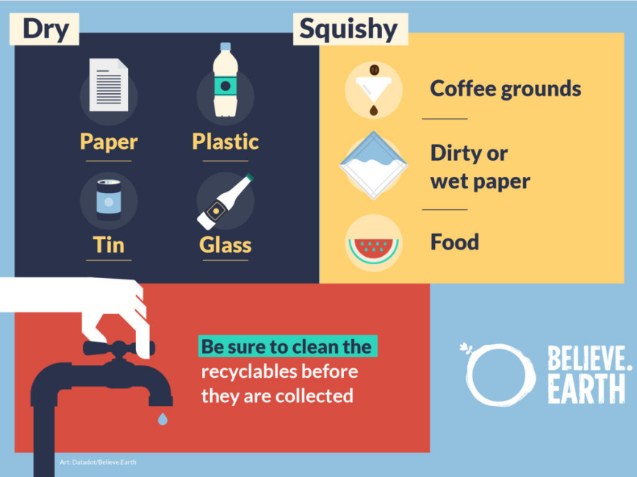
The following slides will help you classify the items on your list, and show you how they can be dealt with!
Part 1: Dry v. Wet and Cleaning
Notes:
https://believe.earth/en/13-tips-on-sorting-waste/

Slide 11
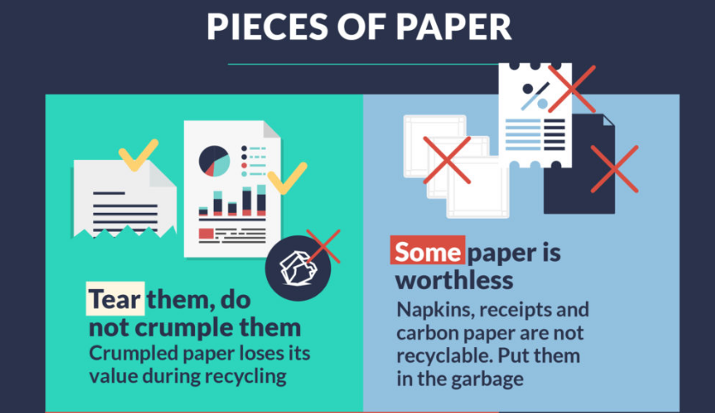
Part 2: Paper Products
Notes:
https://believe.earth/en/13-tips-on-sorting-waste/

Slide 12
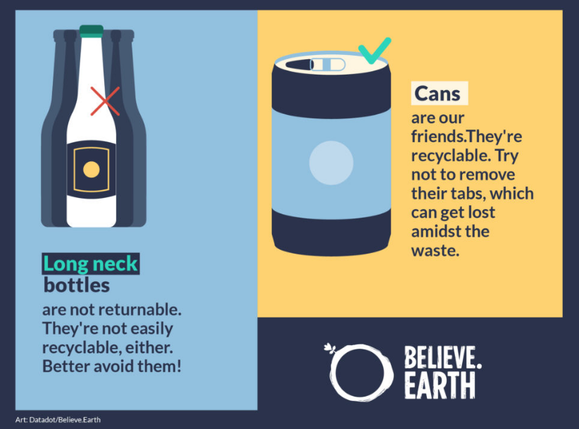
Part 3: Drink Containers
Notes:
https://believe.earth/en/13-tips-on-sorting-waste/

Slide 13
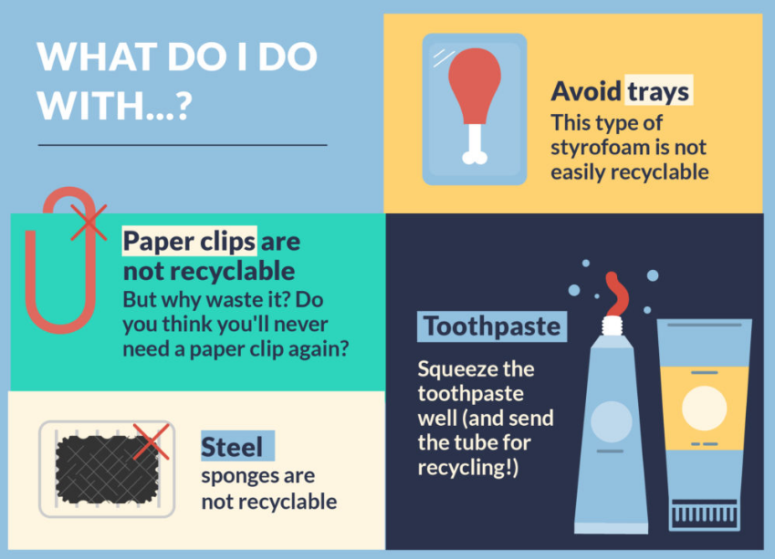
Part 4: Other things you may find!
You can find more information and tips on sorting waste in an article found on https://believe.earth/en/13-tips-on-sorting-waste/. This is content made for education purposes, and is supported by UN Environment, and is part of the global campaigns #BeatPlasticPollution and #Clean Seas.
Notes:
https://believe.earth/en/13-tips-on-sorting-waste/

Slide 14
Congratulations!
You have learned about the effects of sustainability and how to help build a better world!
Notes:
You can print this out to show your family!

Slide 15
Thank you!

