Slide 1
Facilities Planning
STEM and Industrial Engineering
Toyota Production Systems Lab
Facilities: Grades 6-8

Slide 2
What is Facilities Planning?
A facility is a building that is used to help people. Some examples are your house, a factory, and even the White House!
Planning is something you do before you do something important.
Facilities planning is used to plan any change in a facility to make sure it’s done properly!

Slide 3
Who uses Facilities Planning?
Anyone can use facilities planning!
Engineers use facilities planning to optimize the flow of a facility.
Your parents used some facilities planning when they put the couches and TV in the living room!
YOU probably use aspects of facilities planning without even knowing it!

Slide 4
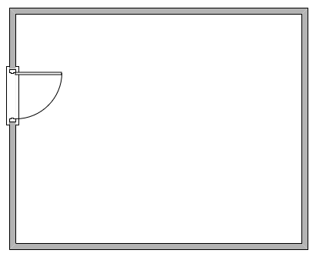
Facilities Planning Example
Pretend we have this empty room with a door. Our parents decided to make it a living room. They’re going to put 2 couches, a TV, and 2 of their favorite plants in the room.
They have to figure out a good way to do this!

Slide 5
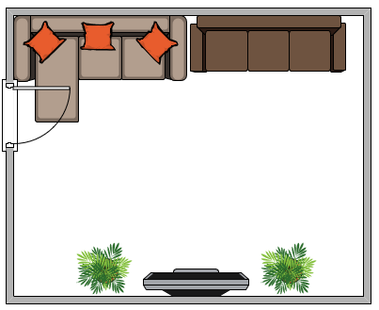
Facilities Planning Example
Say they decided to arrange everything like this. Soon after, they realize the door hits the couch EVERY time they open it, and they can’t even open the door all the way. It’s a disaster! They have to rearrange the room.

Slide 6
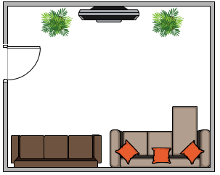
Facilities Planning Example
This is a pretty easy fix. They can rearrange the room so the couches are on the other side! This way, there is no issue with the door and everything is perfect! This is an example in your house that increases flow. Facility planners use this method for entire factories to make sure everything works!
Flow - How easily everything works together. After we fixed it, the room has a good flow.

Slide 7
What do facility planners do?
Facility planners can have little projects and really big projects.
A small project could be rearranging an assembly line to reduce the time to make a part.
A big project could be redesigning an entire factory!
They usually work in teams so they can collect all of the information they need. There’s a lot!

Slide 8
What things do facility planners look at?
Facility planners have many tools that they use to help them make decisions. We’ll be learning about some of them later this week!
Some examples are: Spaghetti diagrams (not real spaghetti), and material handling!
Sometimes simulation is even used to help map out how materials (or people) will flow in a facility!
These tools help them make decisions while they look for places they can improve.

Slide 9
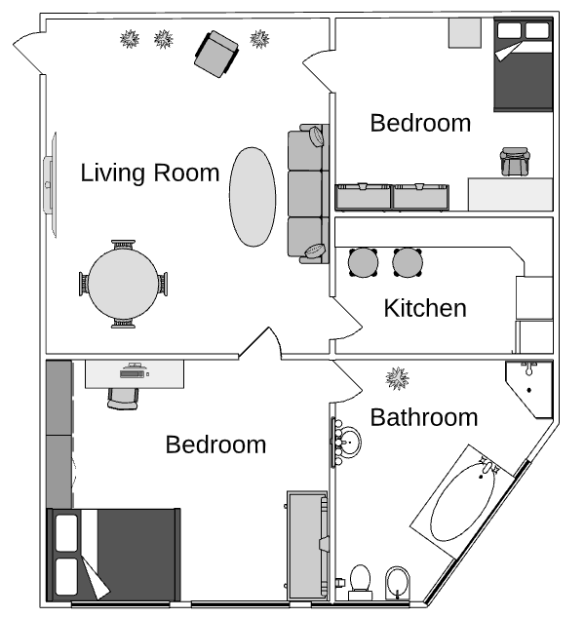
Spaghetti Diagrams
When we look at this house, it looks pretty good right? Everything is organized. If we use a spaghetti diagram, we might find out that this layout isn’t as good as we think! Go to the spaghetti diagram slideshow to learn more about how to fix this layout!

Slide 10
Simulation
Simulation is a very powerful tool. It’s used by companies to predict important decisions for their stores. For example, if Starbucks knows how many customers will be coming to the store, and how often they arrive, they can figure out how many baristas (servers) they need to serve their customers so they don’t wait too long!
Here’s a link to a short YouTube video that uses Simio to model a Starbucks line. Simio is a commonly used simulation software.
https://www.youtube.com/watch?v=A-ll2k3uxZ8

Slide 11
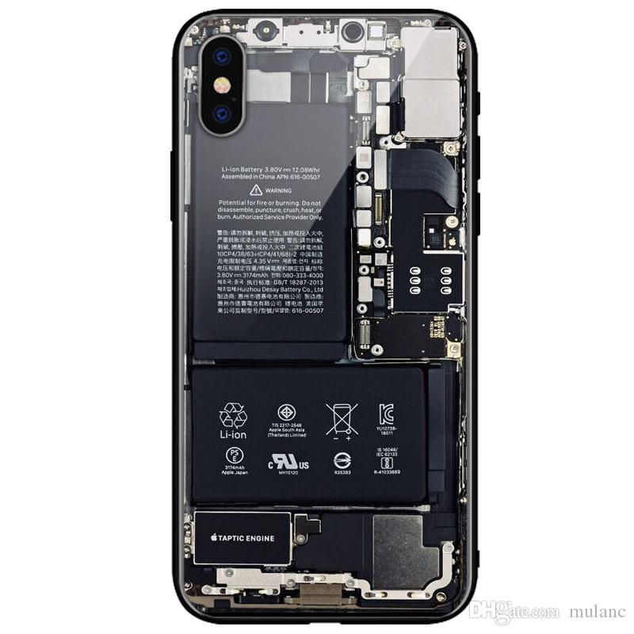
Material Handling
Materials are everywhere! Your phone and computer have really tiny pieces inside of them. But they also have big pieces too! These are all things that we have to consider when planning facilities. Different machines or systems might be needed.
Look at the inside of an iPhone 10! There are so many tiny pieces that go into it.

Slide 12
Why is facilities planning so important?
Without proper planning, a facility that is built could miss out on millions of dollars of profit because of lost time and resources.
It takes time and money to fix something after it’s already done.
Things are always changing, so there is always something that can be improved!

Slide 13
Thank you!

