Slide 1
Material Handling:
How we handle items to make
products work!
STEM and Industrial Engineering
Toyota Production Systems Lab
Facilities: Grades 6-8

Slide 2
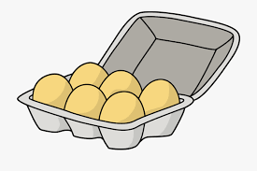



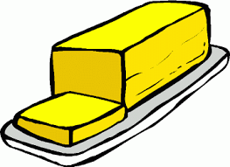


What are materials?
Materials are things you use to make something else!
Think about making a cake, you would need:
Eggs
Flour
Sugar
Butter
Frosting
Candles

Slide 3
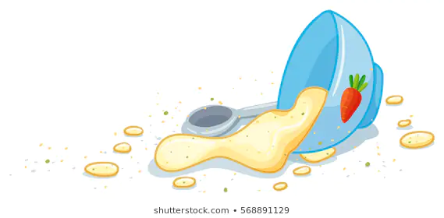
Materials Handling
Material can be very fragile, just think of the eggs in the cake example!
If you try holding onto the eggs too hard, they can break!
If you hold the sugar the wrong way, it can spill!
If one material is gone, you can’t make the cake!

Slide 4

Being careful with materials!
You have to be very careful with materials, you don’t want to drop the eggs and not make a cake!
It is important to make sure you are moving the materials safely!
If you juggle eggs, you are much more likely to drop them, make sure you are holding the materials correctly.

Slide 5
When materials break:
We talked about eggs cracking, but most materials have their own weaknesses and are very complex for factories.
Places that build phones have to deal with very tiny electronic parts.These parts are very fragile like eggs, but also can’t get wet or dusty without breaking. These materials take a lot of skill not to break.
Other factories that build planes and cars deal with materials harder to break, but very heavy parts that cannot be moved by a single person

Slide 6

Very fragile and small materials
Click on the video above!

Slide 7
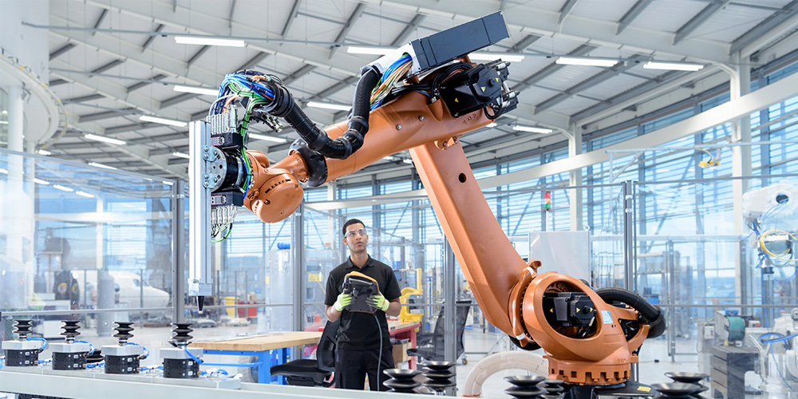
Very fragile and small materials
That video shows a very small computer chip usually smaller than one inch.
The chip is very small and fragile, so that’s why most steps were done by robots who are more precise and can handle the fragile materials better than humans can.
Some materials are too small to be handled by people without breaking!

Slide 8
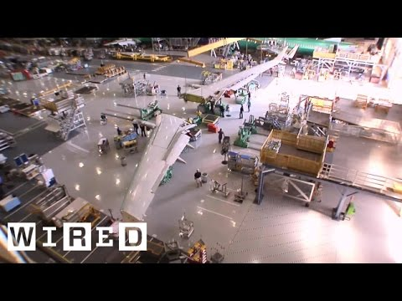
Very large and heavy materials
Click on the video above!

Slide 9
Very large and heavy materials
The wing of that airplane is incredibly heavy and requires the use of special machines to move to the right spot.
Some materials are too heavy for people to move by themselves but other heavy items can be moved, but with great difficulty! Think about a heavy bag you had to carry and how much more difficult that was than your backpack
Different materials require different ways of moving them.

Slide 10

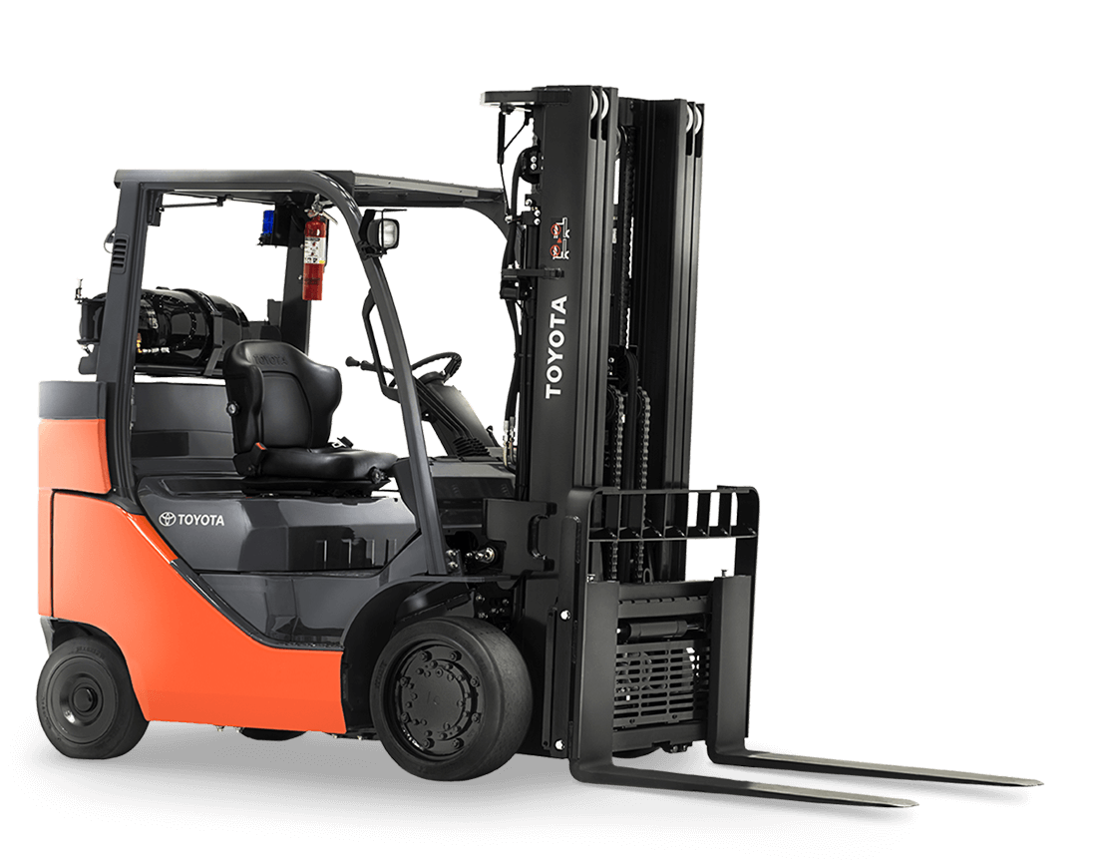
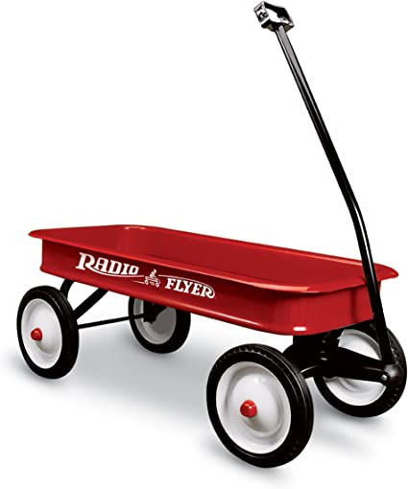
Very large and heavy materials
Often, heavy materials are moved by a vehicle

Slide 11

Dangerous materials
Machines aren’t just used for fragile and heavy materials, but also for materials that are dangerous for humans to hold.
Think about the game hot potato and how difficult it would be making a cake if all the ingredients are hot potatoes
It wouldn’t be very easy…

Slide 12
Material Locations
Going back to the cake example, we have a lot of different materials
Butter, eggs, and icing: have to be kept cold before baking
Sugar, salt, candles: can be left outside
Since some of the materials need to be cold, they’re probably in the fridge, while the sugar and salt are in a cabinet, and the candles are in another room!
Different materials are often in different locations around the house, so part of material handling is finding everything and bringing them to where you want them (in this case the kitchen counter)

Slide 13
Material Picking
For some places, picking materials is very difficult and complex.
Think about an Amazon warehouse. Someone may order a TV, a book, and some toothpaste in one order. Those three items are far apart in a very large warehouse.
To get the order, all three materials need to be brought from where they are, to the boxing station to get boxed up and sent to the person who ordered them. Amazon also uses robots to do this!

Slide 14
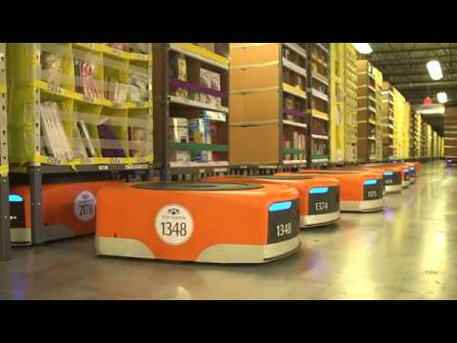
Amazon Picking Process
Click on the video above!

Slide 15
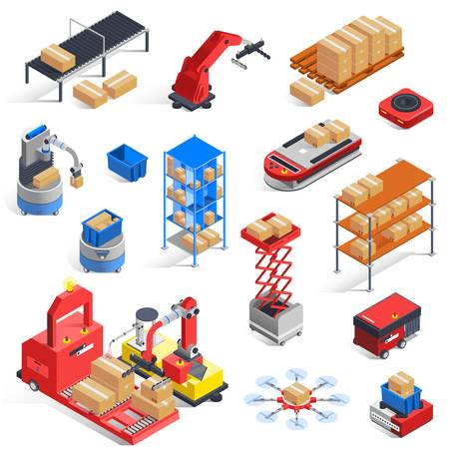
Activity for today!

Slide 16
Material Handling Activity
Think about the way you handle materials in your house
For laundry, do you get all of your clothes out at one time and carry them in your hands?
What are the advantages of this method?
What are the disadvantages?

Slide 17
Material Handling Activity
Say you are bringing ten apples and 2 bags of chips to a picnic far away.
What’s the best way of bringing all those items?
Remember:
You don’t want any apples to fall
You don’t want the chips to get crushed by the apples
You have to carry the materials for a while

Slide 18
Material Handling Activity
Pretend you are packing the groceries at the supermarket:
Do you put all the heavy items in one bag?
Do you mix the heavy items with fragile ones?
Do you pack the bags that are going to the freezer when they get home in one bag?

Slide 19
Material Handling Activity Conclusion
For many of those questions there is no one correct answer, but it is important to think about these things before you handle materials.
It can be the difference between safety and doing something dangerous, and also the difference between breaking materials or keeping them all in one piece!
Is there anything else you noticed?

Slide 20
What did we learn?
Materials need to be handled carefully and remember that each material has their own:
Weaknesses (some are fragile, some can’t get too wet or hot)
Weight (light and heavy parts)
Shapes (some limiting)
Difficulties handling (some can’t be held directly)
Difficulties picking (lots of small and different parts)

Slide 21

Thank you!

