Slide 1
Space Utilization
STEM and Industrial Engineering Toyota Production Systems Lab
Facilities: Grades 6-8

Slide 2
What is space?
When talking about facilities, space is the amount of area inside a facility!
Space is important to know as otherwise we cannot determine what can fit in that room.

Slide 3
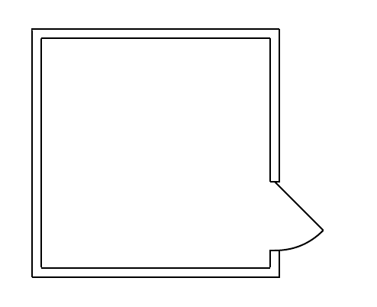
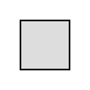
What is space?
Let’s say an ice cream shop wants to order some barrels of ice cream!
The boxes are all 2 feet by 2 feet and can only be stored in the freezer room, but no one knows how big the room is.
?
2’
2’
?
?
?

Slide 4
What is space?
Since the ice cream shop does not know how much space is available, they might order too little ice cream.
They could have ordered a lot more ice cream, now the freezer room is almost all empty!

Slide 5
What is space?
They could also order too much ice cream!
They completely fill up the room
and the boxes that don’t fit have
to stay outside and will melt.

Slide 6
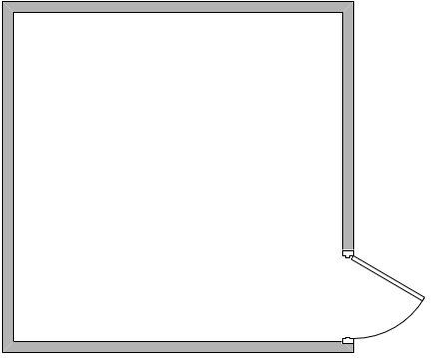
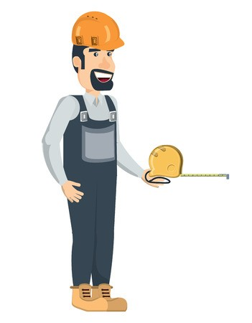
What is space?
The ice cream company decides to get someone to measure the room before they order so they don’t make any mistakes!
10’
10’
10’
10’

Slide 7
How to view a facility
As we just saw with the freezer room, a facility can be as small a single room. But it can also be much larger, some examples of large facilities are:
Hospitals
Schools
Skyscrapers
Large factories and more!

Slide 8
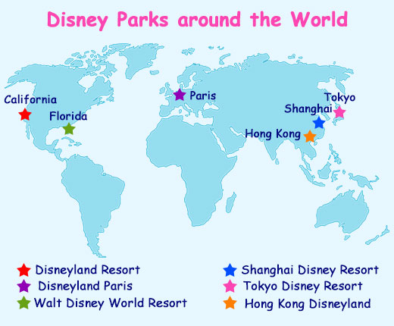
Global View
When a large company is considering their facilities, they often need to look at the entire WORLD!
Disney has several parks over three continents!

Slide 9
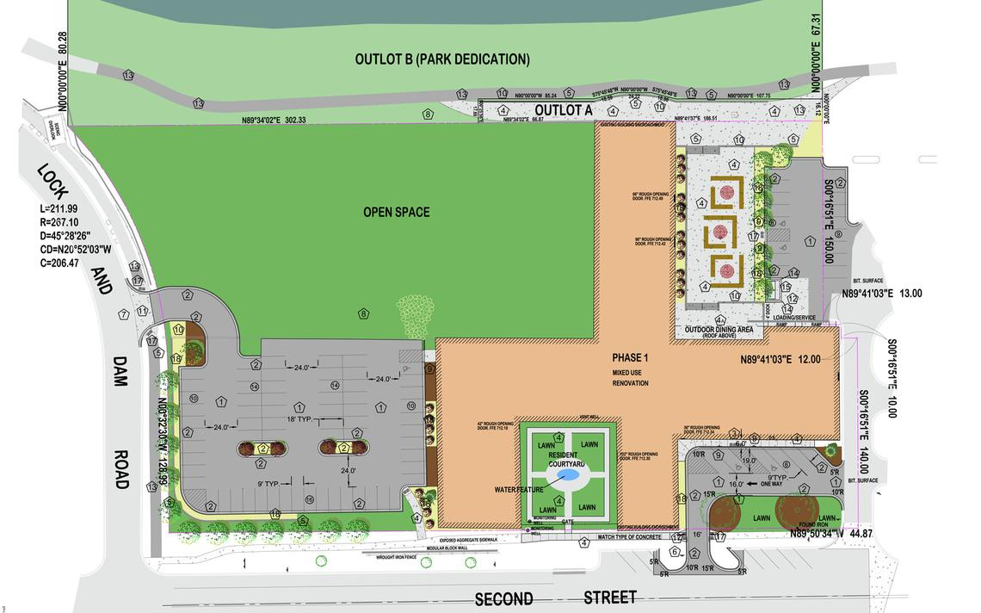
Site View
A closer view goes into a site. These sites can contain multiple buildings and open spaces!
When companies want several buildings close to each other they try to a pick a good site!

Slide 10
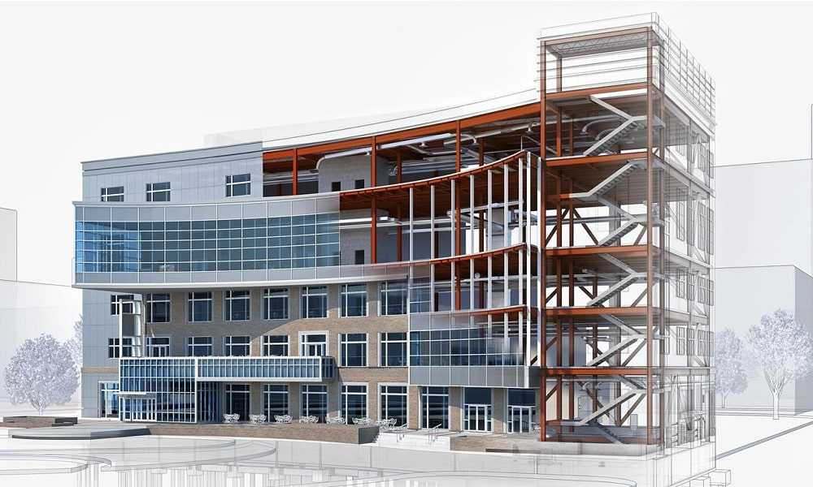
Building View
Some facilities must plan for an entire building and organizing it.
If a security desk is needed, that will most likely have to go on the first floor.

Slide 11
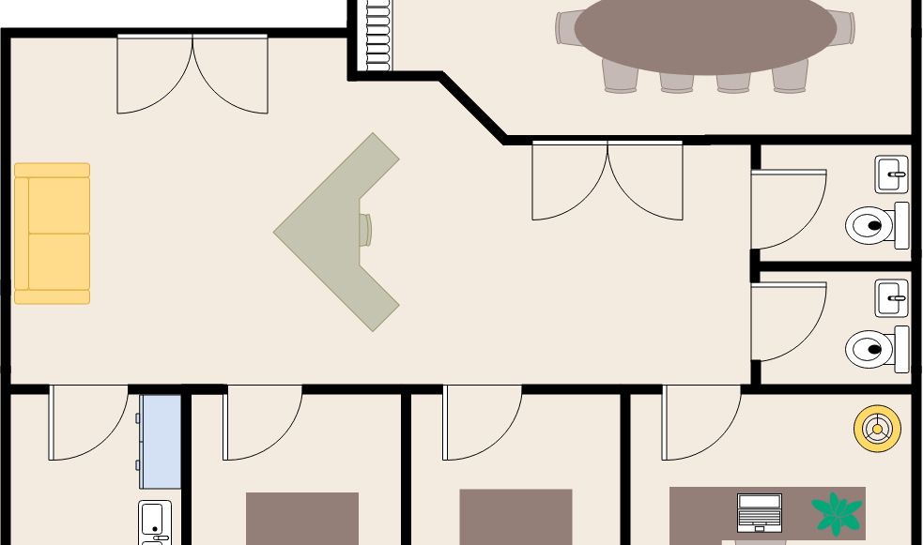
Floor View
For each building the layout is considered floor by floor to make sure everything is where it needs to be.

Slide 12
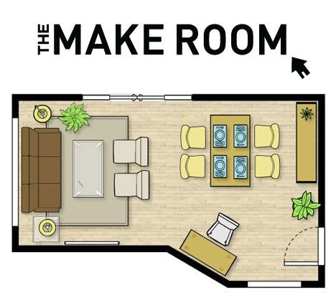
Floor View
Finally a layout can go to a specific room to get the most detail.

Slide 13
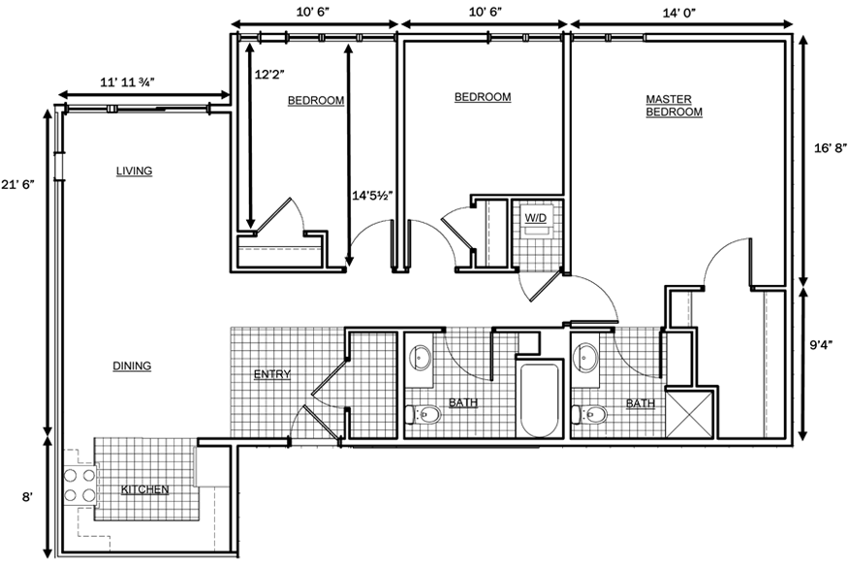
Dimensions
Whether the layout is small or large it is important to know the dimensions.

Slide 14
Usable space
Going back to the ice cream company, now it knows how much room is in the freezer room. Now they can order the right amount of boxes!
10’
10’
10’
10’

Slide 15
Usable Space
They order 25 boxes, enough to completely fill the room!
But since the room is completely filled there’s no way for someone to get in!

Slide 16
Usable Space
They order 25 boxes, enough to completely fill the room!
If the ice cream employee wants to get to the box with the star on it, he can’t as all the other boxes are blocking the way.

Slide 17
Usable Space
Since all layouts involve people it’s important that they can use the layout.
There should always be enough space where no one has to squeeze in or climb over objects to get to where they need to go!

Slide 18
Important Objects
When drawing out a room, it’s important to have some objects there.
If an object is big, hard to move, or must be in that room, it should be in the drawing.

Slide 19
For example:
The couch
Chairs
Tables
And desks
Are all important to include

Slide 20
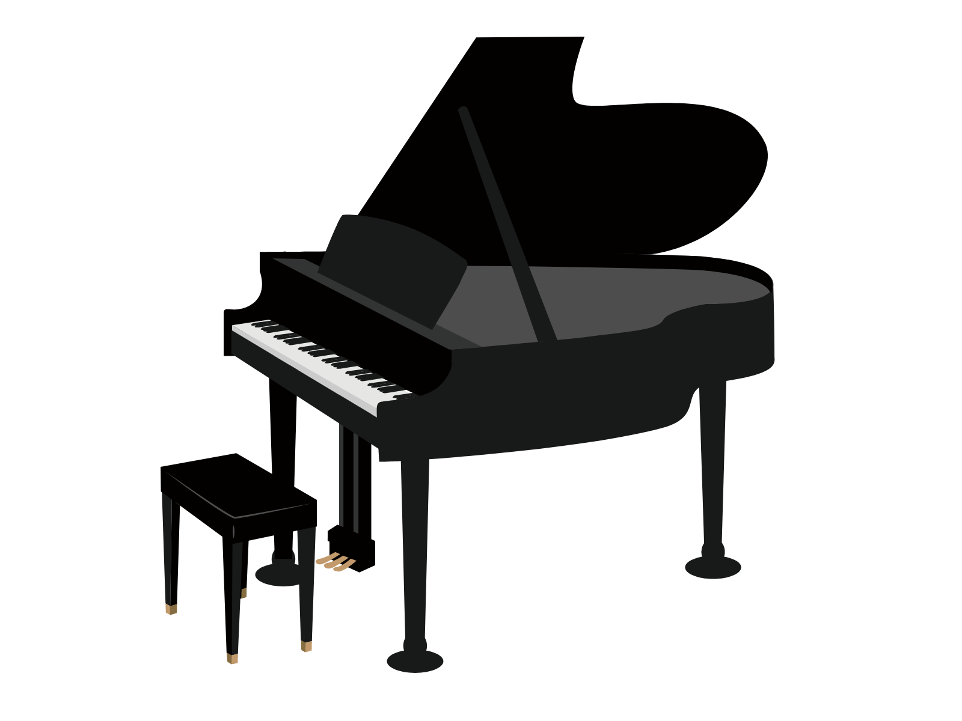
Important Objects
If those weren’t included, someone would think there is more space free to use than there is.
Otherwise someone may try to move a new piano in, only to see there’s no room!

Slide 21
Unimportant Objects
Some things shouldn’t be included in drawings though, mainly things that are:
Small
Easy to Move
Only there for a short time

Slide 22
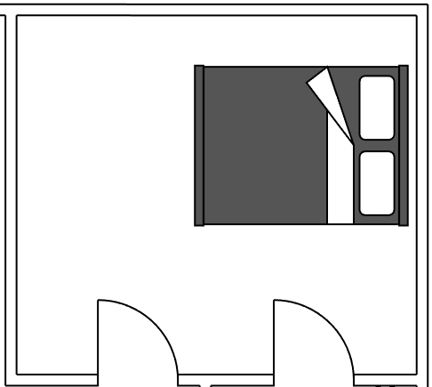


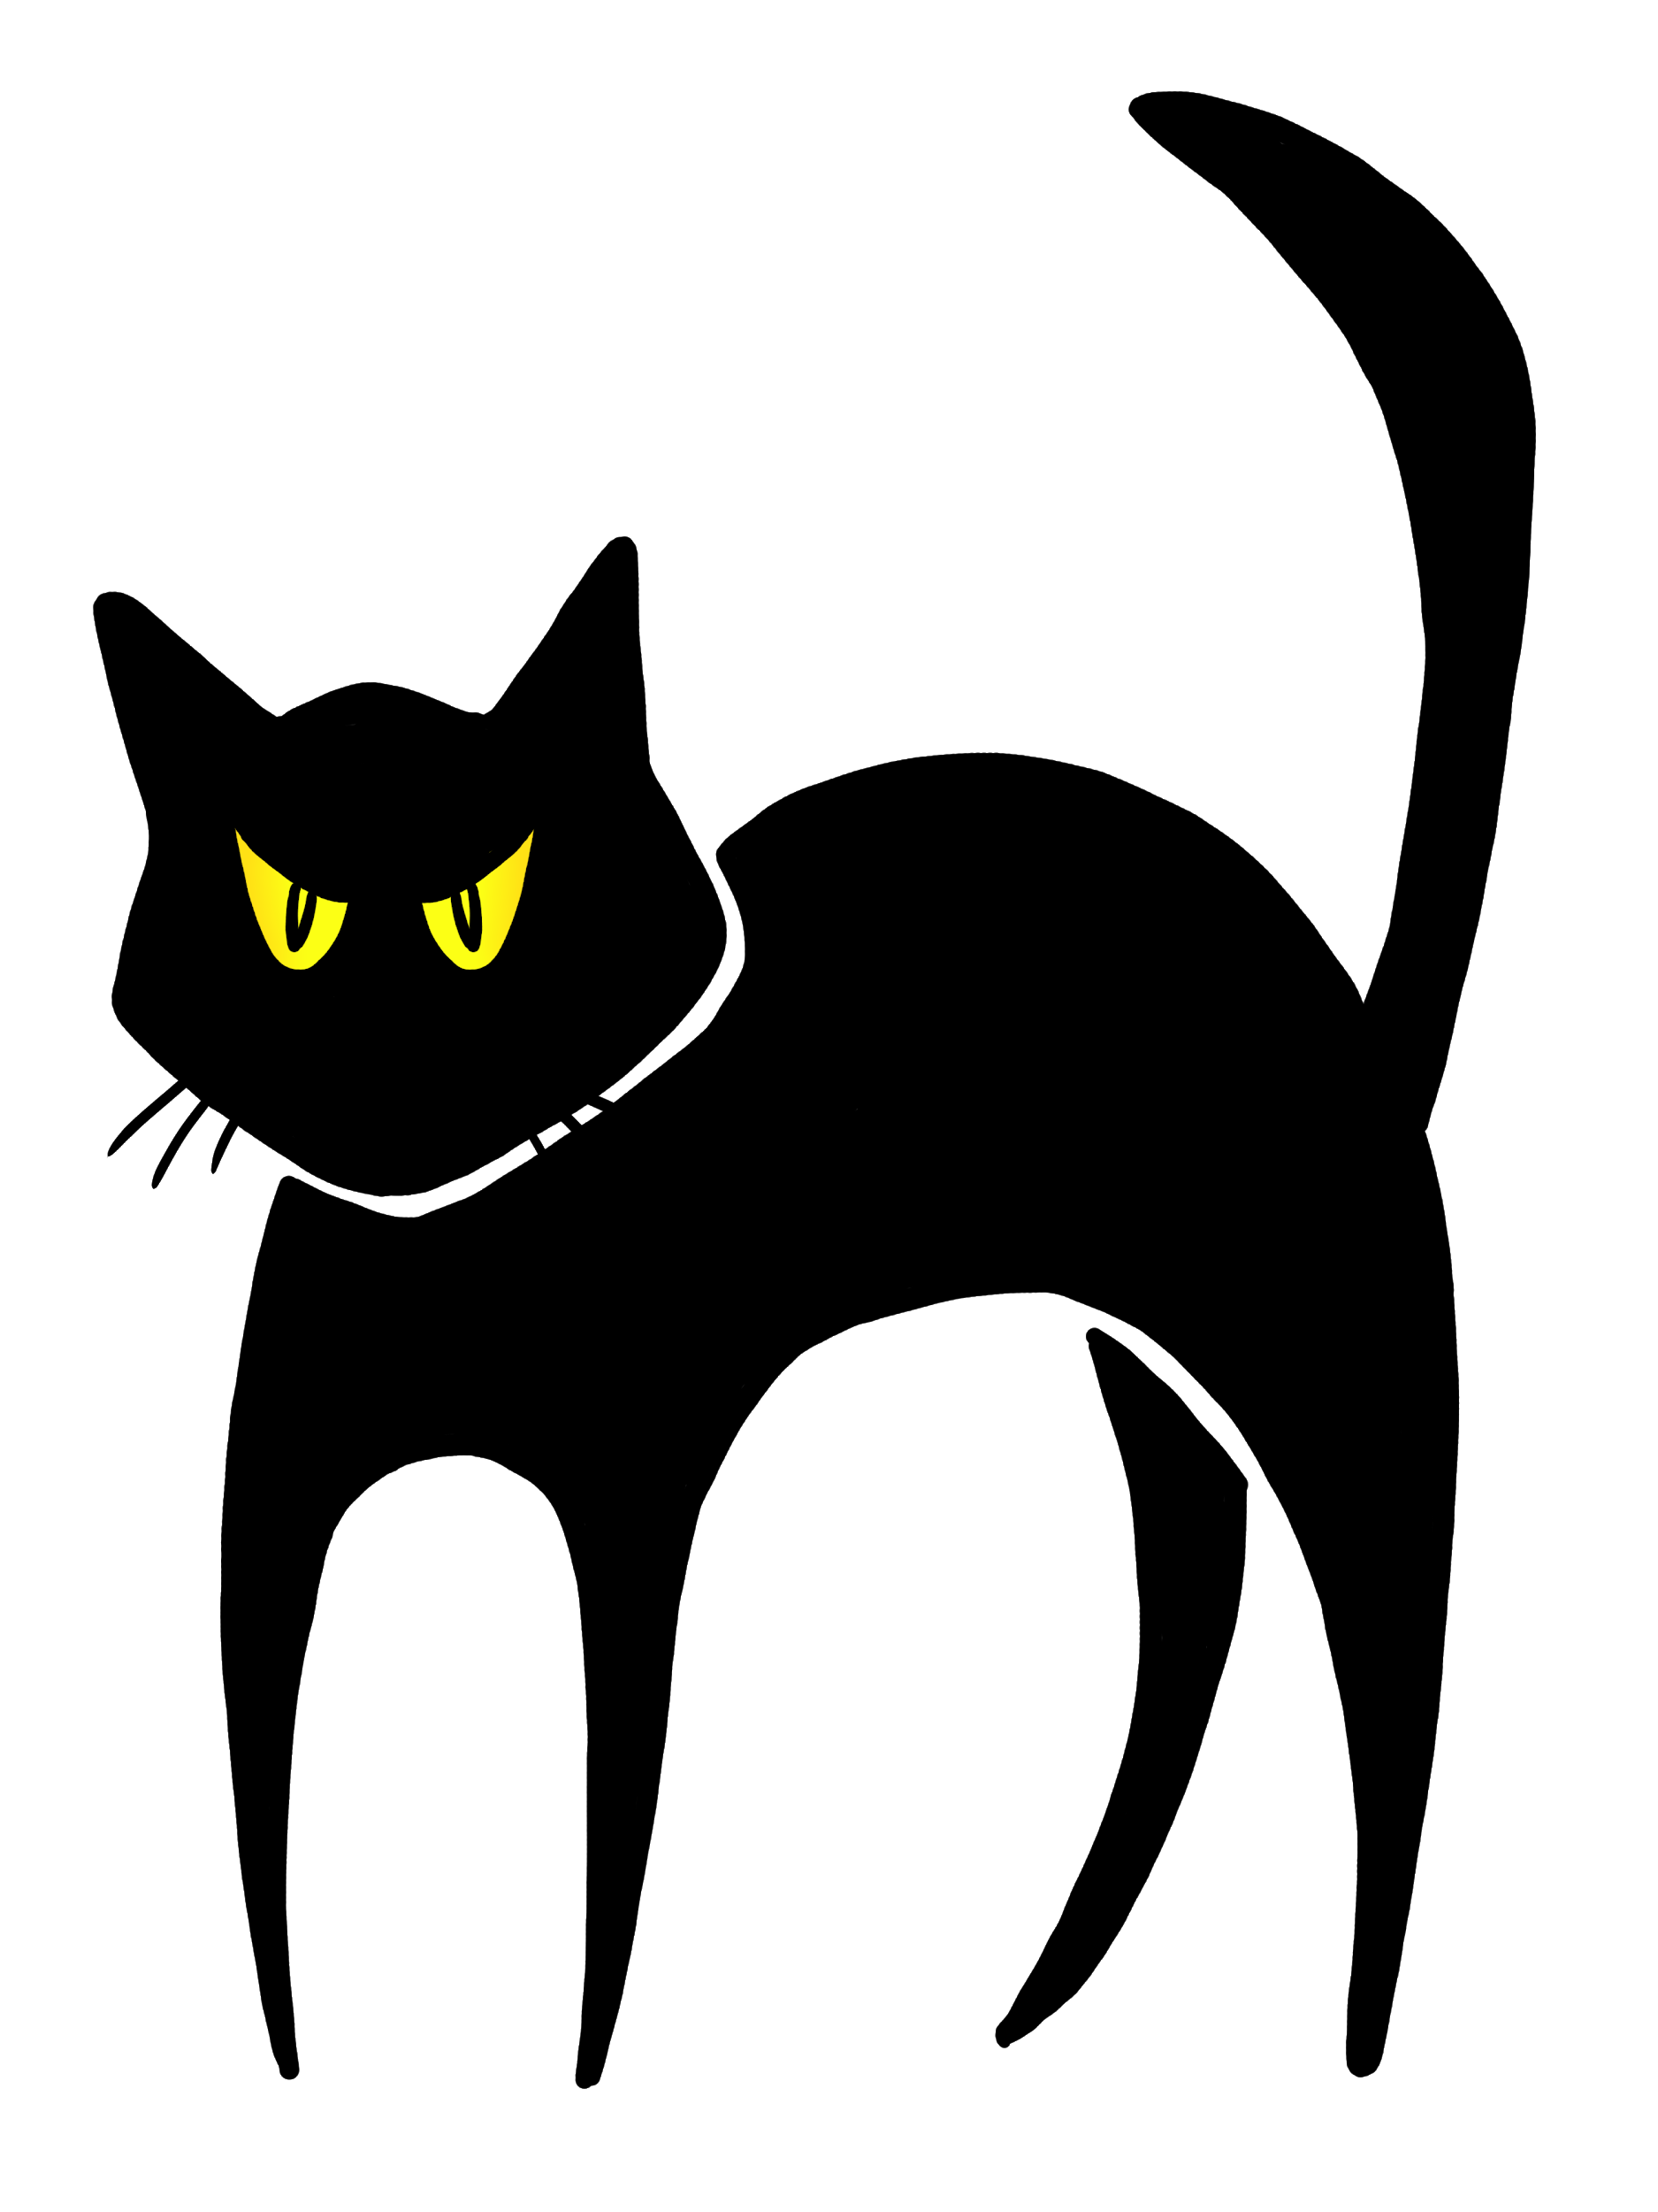
Unimportant Objects
Exclude items like:
Random items on the floor
Cats/Pets/Animals
Bags

Slide 23
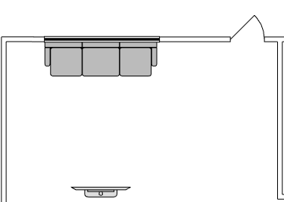
Space needed for use
Not only the space for an item is important to consider, but the space needed to use it!
The red is the space of the couch, but the orange around it is the space needed to use the couch!

Slide 24
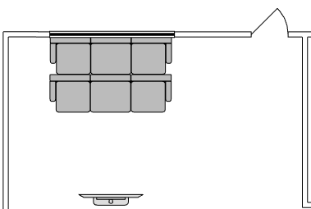
Space needed for use
If another couch was right in front of the first couch, then no one would be able to use the first couch!

Slide 25
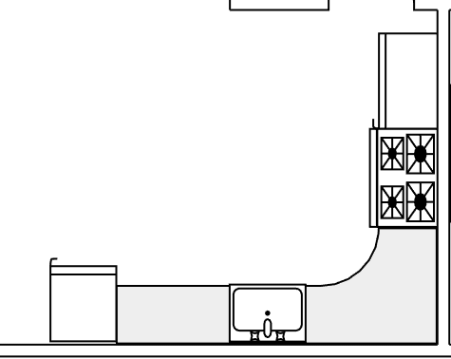
Space needed for use
Some items need to face a certain direction.
Let’s look at the fridge
The fridge needs to open out in the direction of the red arrow.

Slide 26
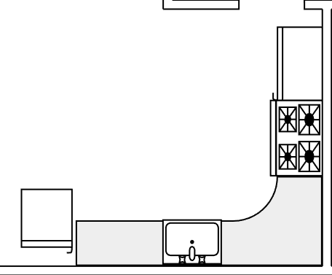
Space needed for use
If the fridge is facing the other way then no one can open it, as the wall is in the way.
You wouldn’t want your TV screen to face the wrong way either!

Slide 27
How to redesign your room
Try to draw out your room with furniture in the room:
bed(s)
cabinet(s)
desk(s)
chair(s) and any other items large enough or hard to move
Use a piece of paper and a pencil or if you can access https://www.lucidchart.com/ then it is an easy way of drawing your room.

Slide 28
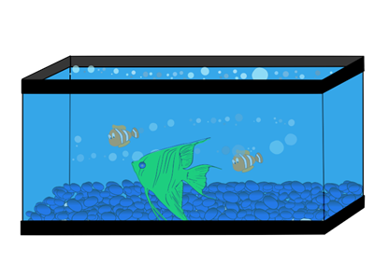

Adding items
Once you’ve drawn your room, try placing in some new items!
?
Aquarium
4 feet by 2 feet
Anything you want!
? feet by ? feet
TV
6 feet by 1 feet

Slide 29
Redesign your room
Feel free to move things around and rotate them to make them fit.
Think about the space you need around items to use them! If there isn’t enough space then leave it out!
You can also think about how big you need your room to be to fit everything you want!

Slide 30
What did we learn?
When designing a layout you have to know what is and isn’t important to draw.
Remember that items need space to be used and people have to be able to use a layout for it to work!

Slide 31

Thank you!

