Slide 1
Spaghetti Diagram
STEM and Industrial Engineering Toyota Production Systems Lab
Facilities: Grades 6-8

Slide 2
Youtube Links
https://www.youtube.com/watch?v=ol3i-GiWAM0

Slide 3
Think about your house
How many rooms does it have?
Where are the doors?
Is there large furniture like beds and TVs?
These are all questions that you need to know to create a spaghetti diagram!

Slide 4
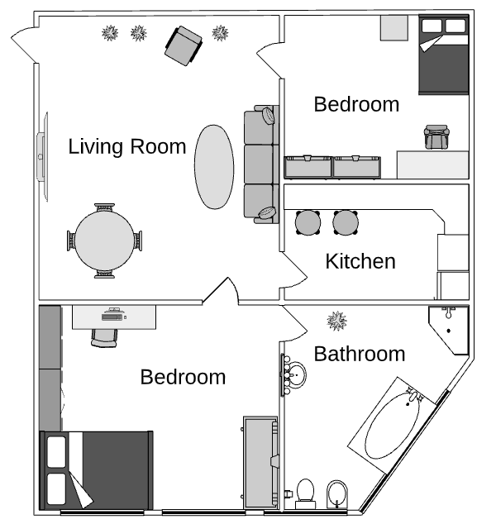
This house has 5 rooms.
Can you spot all four plants?
How many doors are there?

Slide 5

What is flow?
When people walk around in their house, at the grocery store, or at a park
Think about a lunchline and how people walk on the same path
Point B
Point A

Slide 6

Slide Time!

Slide 7
Bike Time!

Slide 8
Billy can take multiple paths to the bike
Path 1 (In Red) is shorter
Path 2 (In Pink) takes a longer time

Slide 9
Since Billy took the shorter path
he got to the bike sooner!

Slide 10

What is a Spaghetti Diagram?
They show us the path we take when
we move around!
You can use them to rearrange
how a room looks, or even
move entire rooms around!
It looks just like spaghetti!

Slide 11
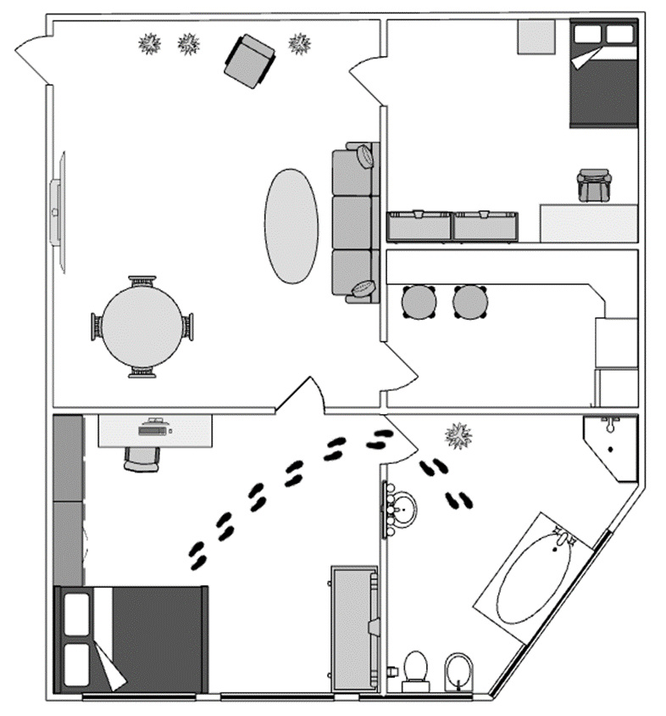
The footsteps show the
path from
one bedroom
to the
bathroom

Slide 12
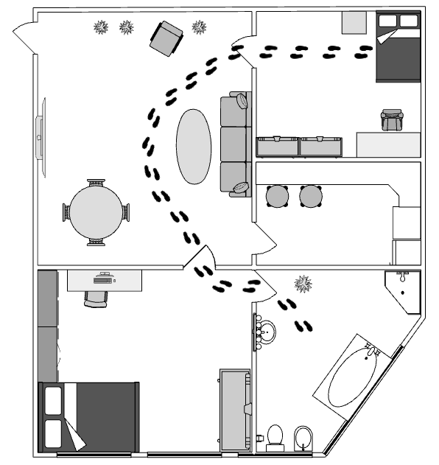
This shows the path from the other bedroom to the bathroom

Slide 13
The spaghetti diagram shows how much longer the blue path is than the red one

Slide 14
You can add as many paths as you want!
Each line has its own point A and B
Yellow goes from the Kitchen to the Table
The more lines you have the more it looks like Spaghetti!

Slide 15

Activity for today!

Slide 16
How to use a spaghetti diagram
Ask yourself: Where are the longest lines?
Ask yourself: How can you make them shorter?
Move objects around to make the lines shorter!

Slide 17
Let’s make our own!
Grab a piece of paper and draw the rooms in your house
Think of paths you take in your house, for example going to the kitchen, going to watch TV, and other activities.

Slide 18
Drawing our lines!
Get up and walk to a few places around your house and count how many steps it takes to get there! Draw the lines on your paper and write how many steps it took!
Take a look at the longest lines. How can you make them shorter? What will happen to the lines that are already short?

Slide 19
Rearrange our house
Draw your house again but put the rooms you use a lot closer together.
If you draw the lines again, they’ll be a lot shorter!

Slide 20
What did we learn?
Moving furniture or rooms around can save a lot of steps. This can save a lot of time!
Spaghetti diagrams help us see how we can get rid of steps by making our long lines shorter.

Slide 21

Thank you!

