Slide 1
Building Information Modeling (BIM)
STEM and Industrial Engineering
Toyota Production Systems Lab
Facilities: Grades 9-12

Slide 2

Facilities Planning
It is extremely important for companies to learn their space needs and be able to redesign their buildings.
You also may be familiar with how difficult it is to draw a layout after mapping out a model flow

Slide 3
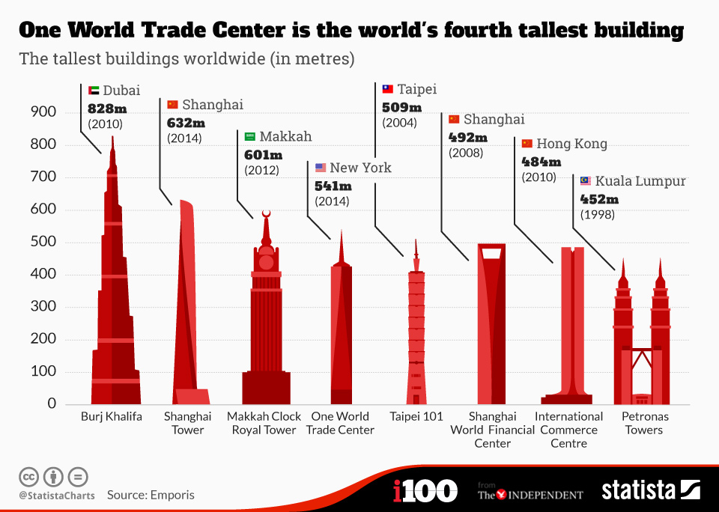
Facilities Planning
Drawing a facility is very difficult, especially when done by hand. While most layouts were originally done by hand, buildings and facilities have become larger and more complex and usually have to be done in a shorter amount of time than before.
The majority of the largest buildings in the world have been built in the past twenty years using advanced software

Slide 4
Facilities Planning
Without a computer software, the design of these buildings would require drawing each floor by hand. The Burj Khalifa has 163 floors which would take a lot of work! And a minor error or difference in layouts could cause a huge error and lead to costly repairs during construction.

Slide 5
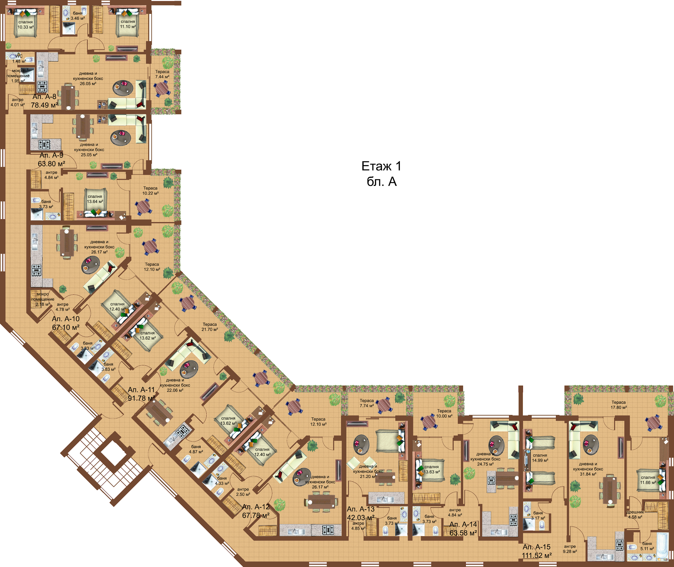
Facilities Planning
While drawing by hand works well for simple rectangular rooms, more complex floors are harder to draw accurately or at least take a longer time to do.
Imagine having to draw the floorplan below by hand. This is only one part of one floor!

Slide 6
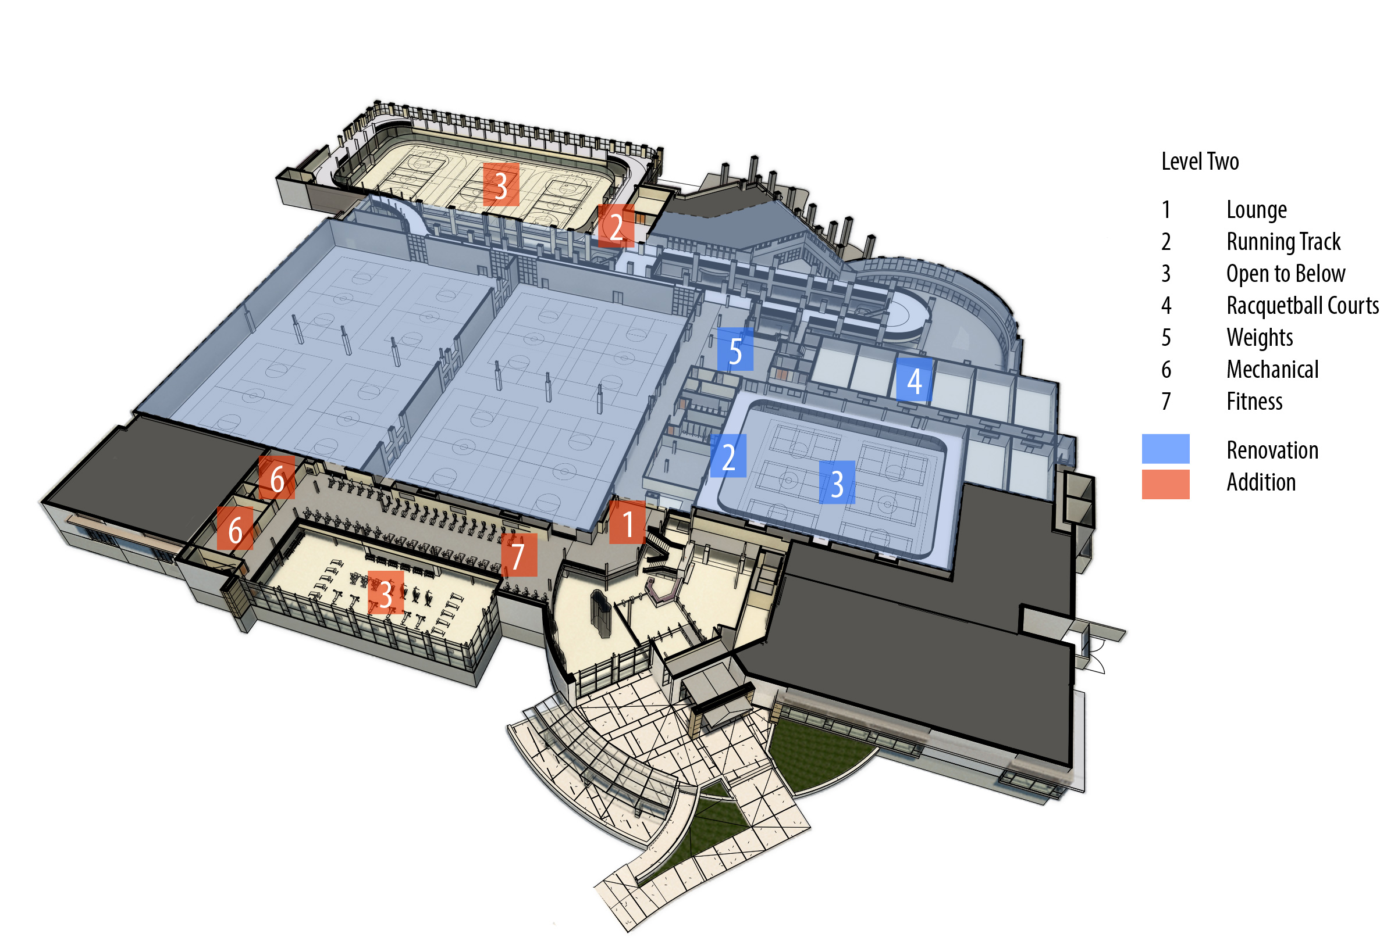
Facilities Planning
Software also allows for easily adding new parts and seeing the entire building as a 3D model instead of looking at it by each floor.
This makes it a lot easier to view and change the building before construction begins.

Slide 7


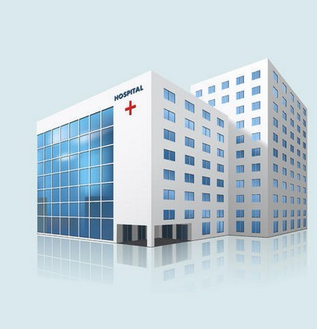

Not all software are the same however, as companies have different needs.
If a small mom-and-pop shop needed to rearrange their one-room store, having an advanced software may not be worth the money. On the other hand, someone building a hospital would need a more advanced software.

Slide 8
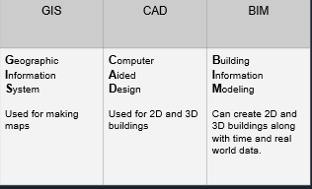
Different Types of Software

Slide 9
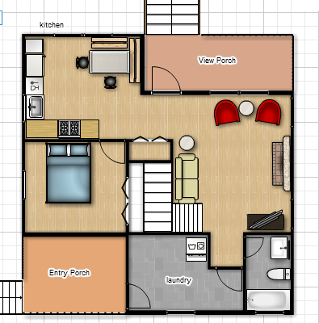
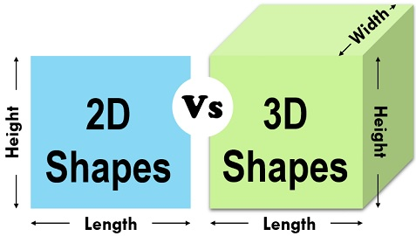
2D Layouts
Those terms may have been confusing, but let’s simplify it!
A 2D layout is exactly like the ones we made last time. It’s a bird eye’s view where everything is flat. Think about a picture or poster, those are two dimensional since they are flat. If the drawing on the right was 3D then you would be able to see how tall the walls are.

Slide 10
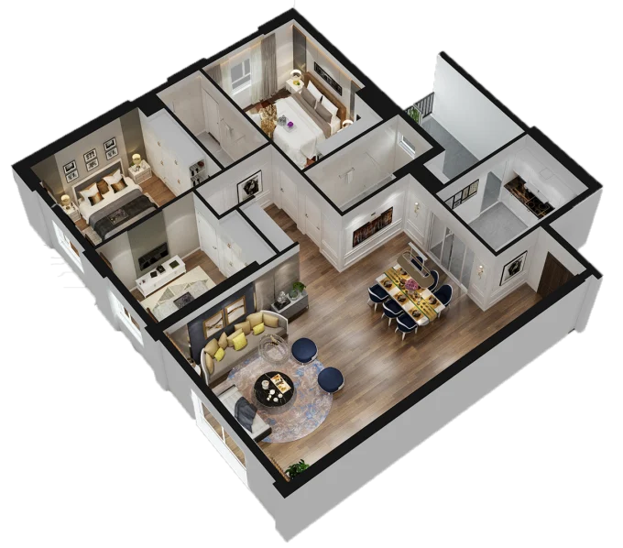
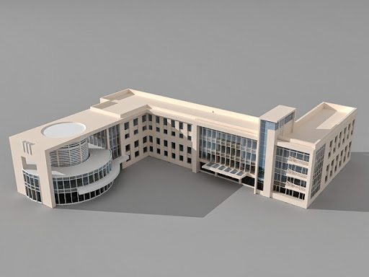
3D Layouts
As buildings and factories can get very tall, most of them require 3D software. However 3D software can also be used for apartments and other buildings that can also be done in 2D. When planning what furniture to buy for your home, the height of the item may be important to consider.

Slide 11
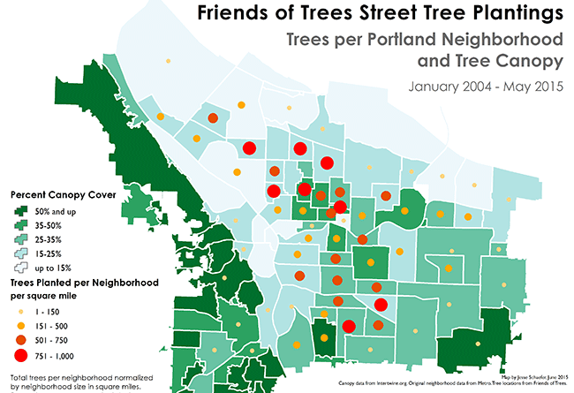
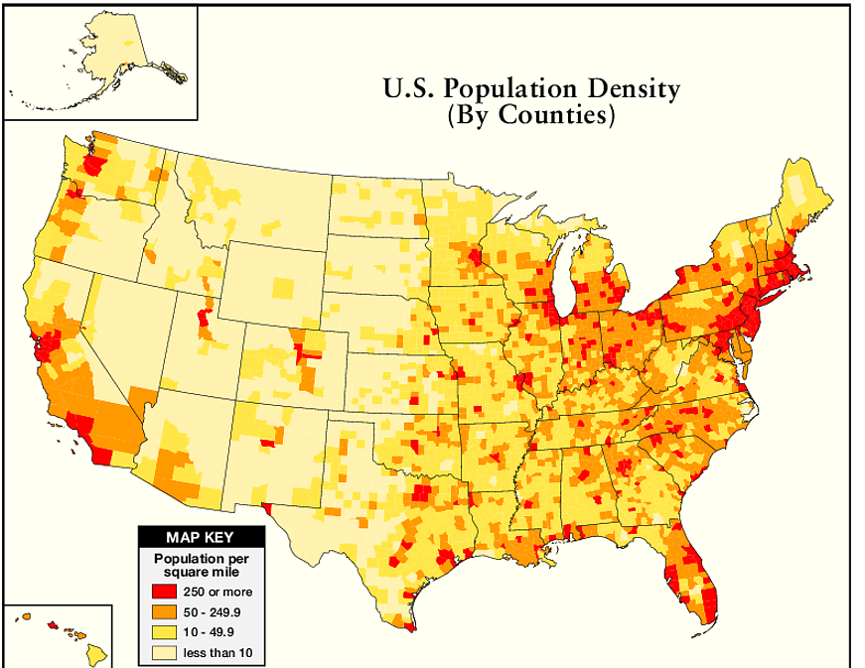
GIS
GIS is not useful for designing a single room, but it allows the user to map out anything like the number of trees in a certain city on the left or population for the entire US. This could be very useful in determining where to build a park, or where to build a new apartment building.

Slide 12
4D Layouts & BIM
Buildings aren’t built in one day, and time is an important factor in designing a building.
If you only have 2 weeks to build a factory, you probably won’t be able to build a 5 story building. A 4D layout allows you to determine what steps to do first!
Do you put in the walls first?
Which room has to be built first?
What supplies do we need when?
4D software can answer these questions!

Slide 13
5D Layouts & BIM
Buildings don’t only take time to build but are also around for a long time as well. As buildings exist over time they are impacted by the environment.
Think about how the different seasons affect where you live. In the winter you have to shovel the outside of our house to get out. The environment also impacts buildings in other ways.
Some larger buildings in cities have a problem with heat over time. Here’s an example:
As a building got older, the windows expanded due to the heat of the sun and the windows being the wrong material. This caused the windows to fall out of the building and onto the ground below! BIM capabilities can model this and prevent it from happening.

Slide 14
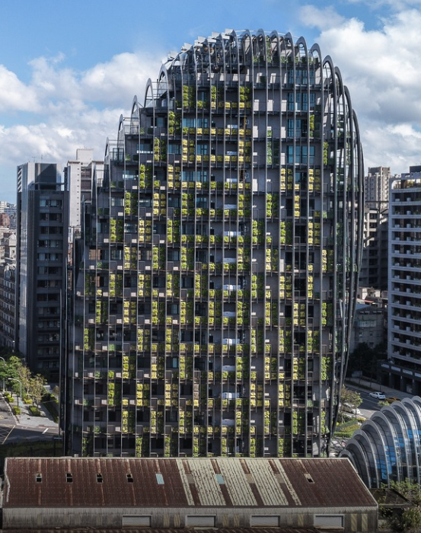
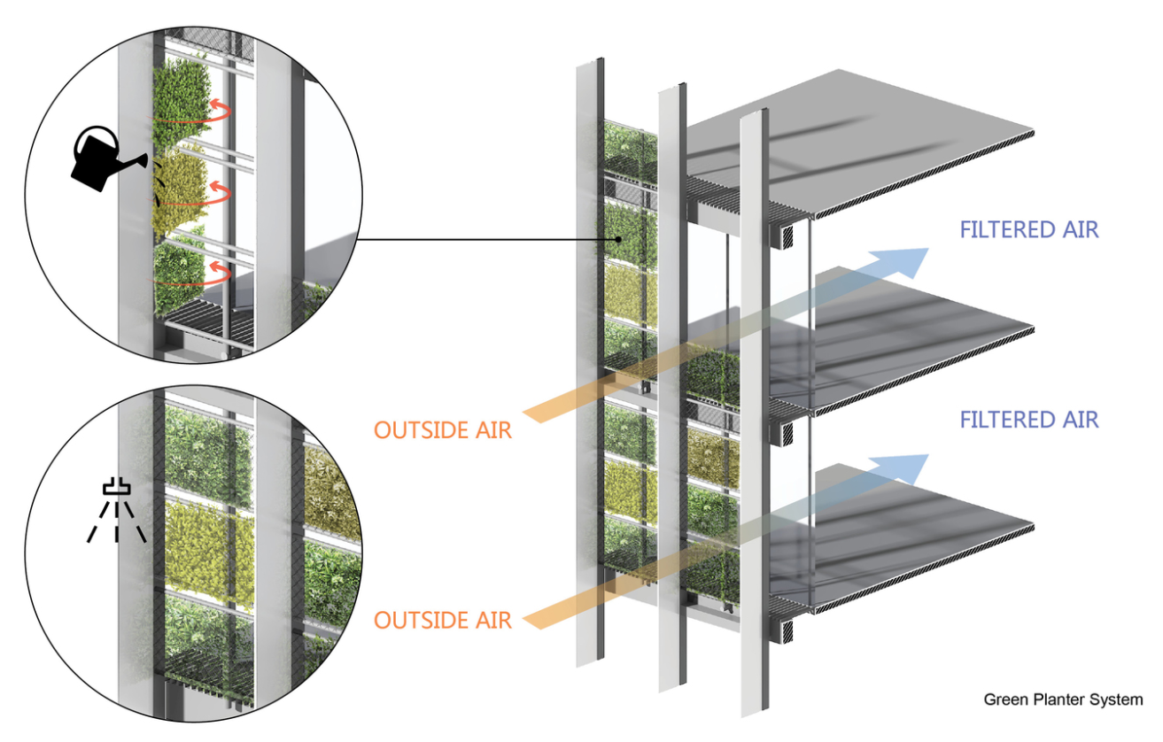
BIM
These softwares can show not only the effect of temperature on the building but also airflow, and wind! This can allow for great opportunities like this building below where modeling air allowed for building a wall of vegetation.

Slide 15
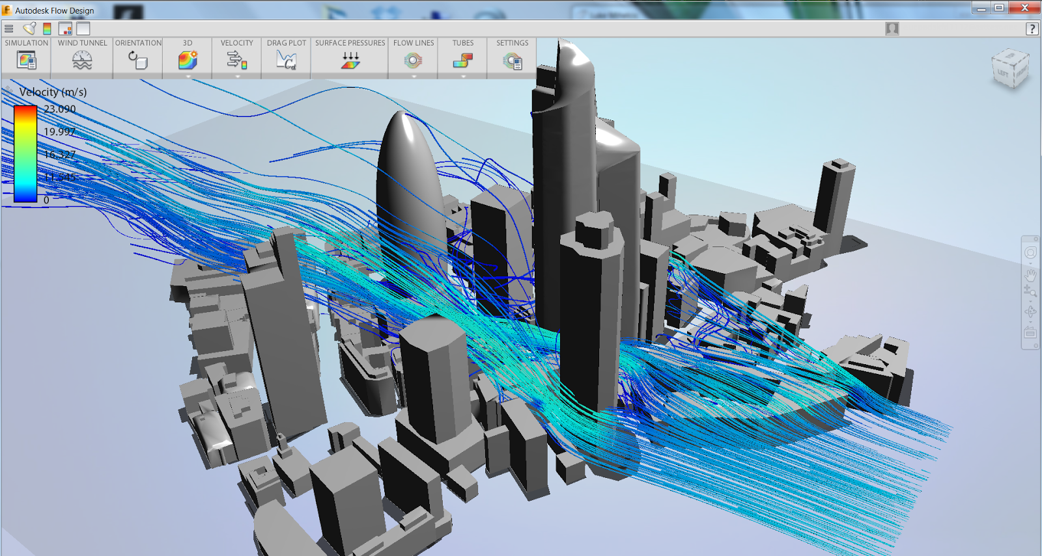
BIM
Understanding wind flow can help make sure the building is built with the right materials to stand up to the pressure.

Slide 16
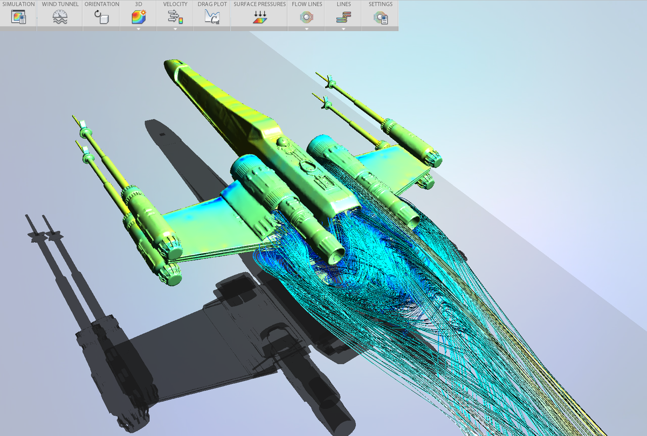
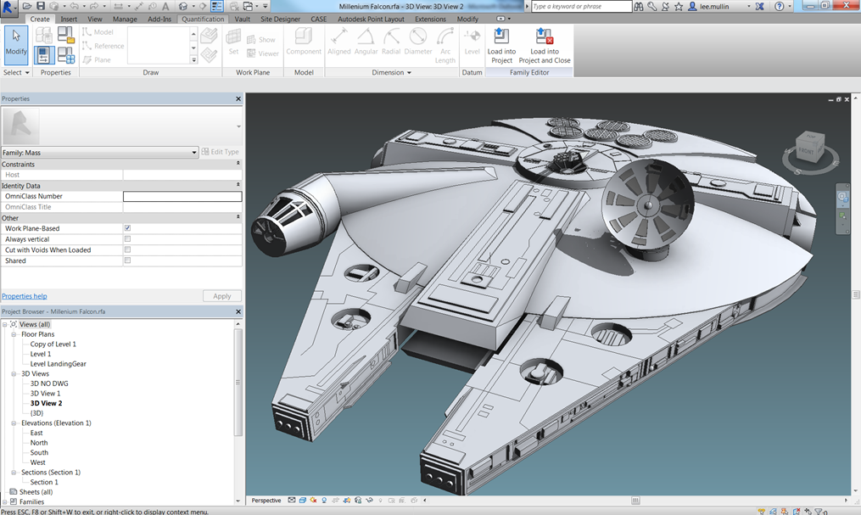
BIM
These softwares can not only model buildings but practically any 3D object!

Slide 17
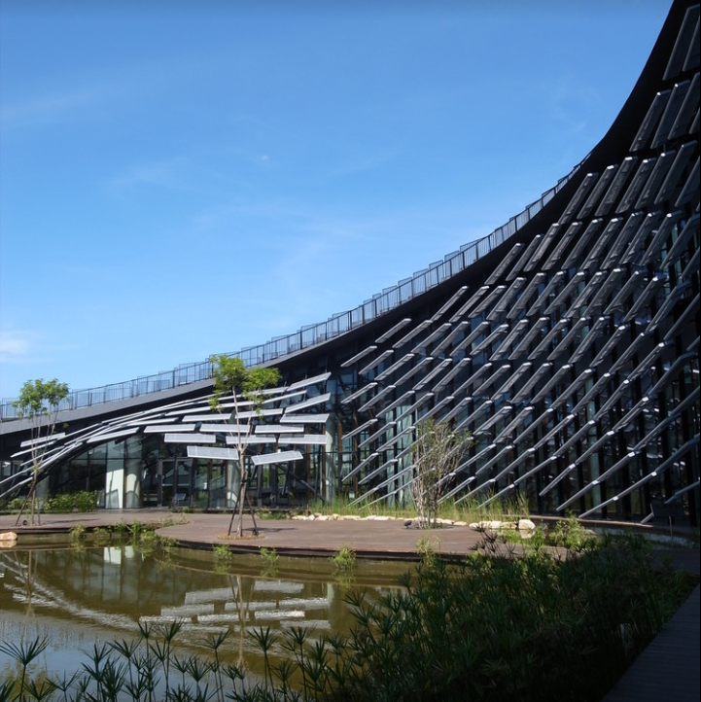
As BIM shows the interaction of the building on the environment over time, it has been used to reduce CO2 emissions during construction by creating a more environmentally friendly construction like for the building below where CO2 emission was reduced by 10% than initially planned.

Slide 18
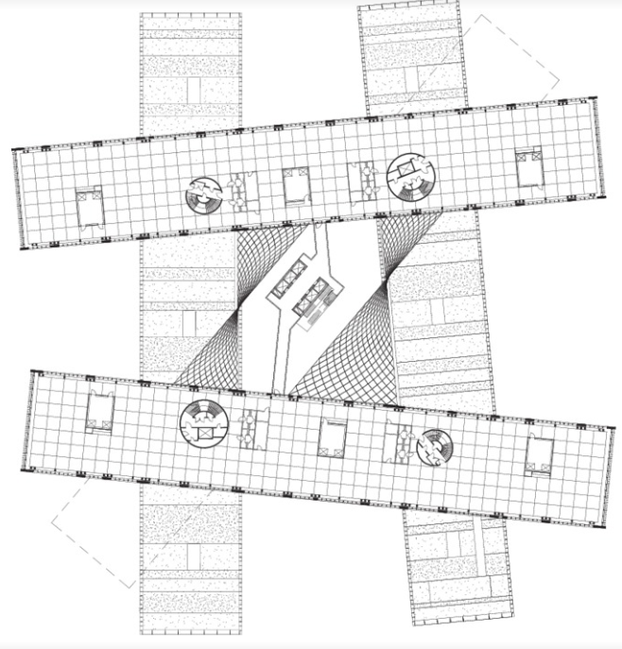
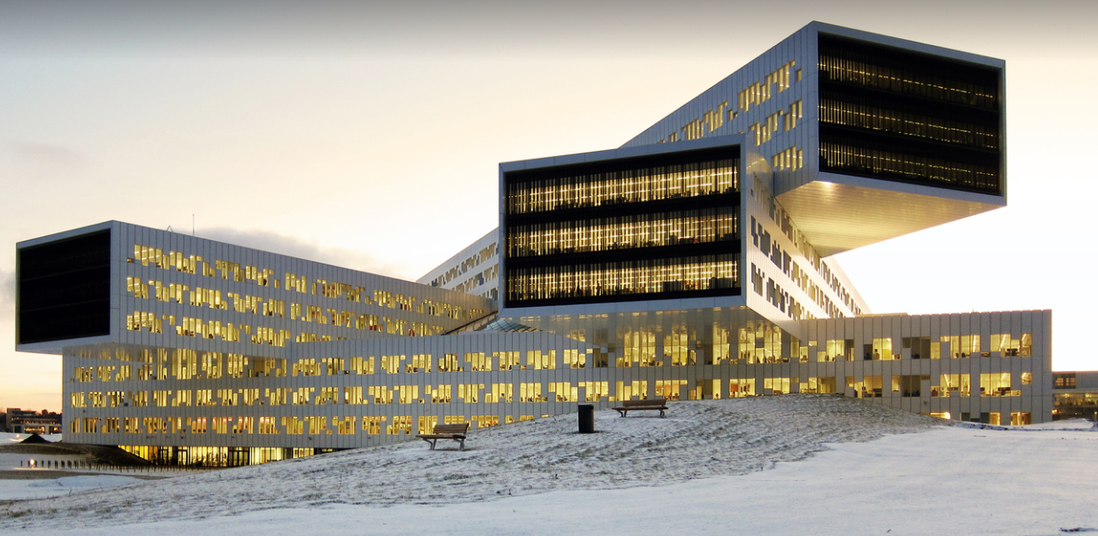
BIM Projects
BIM software can be used to model incredibly complex layouts like the one seen below far easier than the other software

Slide 19
What did we learn?
BIM is a software that helps engineering teams understand the interactions that go on both inside and outside of a building.
BIM can give a 3D model, but it’s capable of so much more! It can give information about wind, airflow, building structure, task sequences for building, etc.
There are numerous applications, and BIM is only becoming more well-known. In the future, most construction projects will be completed using some type of BIM software

Slide 20

Thank you!

