Slide 1
Facilities Planning and Simulation

Slide 2
What is Facilities Planning?
A facility is a building that is used to help people. Some examples are your house, a factory, or even an Amazon warehouse.
Planning is something you do before you do something important.
Facilities planning is used to plan any change in a facility to make sure it’s done properly!

Slide 3
Who uses Facilities Planning?
Anyone can use facilities planning!
Engineers use facilities planning to optimize the flow of a facility. This helps lower operational costs significantly.
Your parents used some facilities planning when they laid out your house!
YOU probably use aspects of facilities planning without even knowing it!

Slide 4
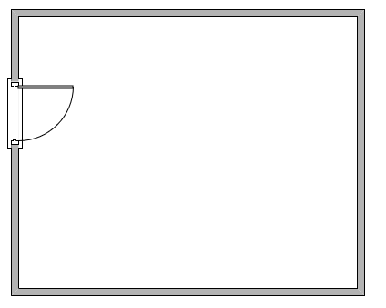
Facilities Planning Example
Pretend we have this empty room with a door. Our parents decided to make it a living room. They’re going to put 2 couches, a TV, and 2 of their favorite plants in the room.
They have to figure out a good way to do this!

Slide 5
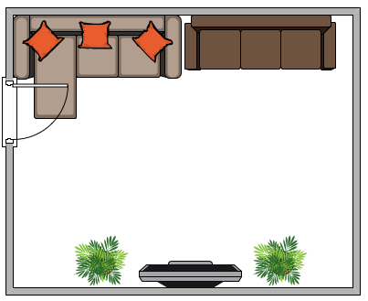
Facilities Planning Example
Say they decided to arrange everything like this. Soon after, they realize the door hits the couch EVERY time they open it, and they can’t even open the door all the way. It’s a disaster! They have to rearrange the room.

Slide 6
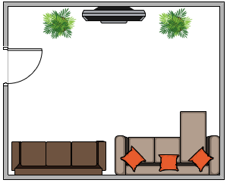
Facilities Planning Example
This is a pretty easy fix. They can rearrange the room so the couches are on the other side! This way, there is no issue with the door and everything is perfect! This is an example in your house that increases flow. Facility planners use this method for entire factories to make sure everything works!
Flow - How easily everything works together. After we fixed it, the room’s flow improved.

Slide 7
What do facility planners do?
Facility planners can have little projects and really big projects.
A small project could be rearranging an assembly line to reduce the time to make a part
A big project could be redesigning an entire factory!
They usually work in teams so they can collect all of the information they need

Slide 8
What is model flow?
IE’s have many tools that help them improve flow within a facility. Model flow diagrams can show how certain decisions impact future decisions, and how multiple outcomes can affect something like total wait time.
We’ll take a look at how a model flow diagram can be used to improve a facility layout later this week.

Slide 9
What is Simulation?
Simulations play a big part in decision making for companies. They are used to predict how a situation might play out. Usually, large companies have tons of data about their stores, and they can plug all of this information in and run a simulation. These simulations can give them valuable feedback about their systems.

Slide 10
How can simulation be used?
If Starbucks knows how many customers will be coming to the store, and how often they arrive, they can figure out how many baristas (servers) they need to serve their customers. They can adjust the simulation to see how different setups would affect service time as well as many other quantitative results.
Here’s a link to a short youtube video that uses Simio to model a starbucks line. Simio is a commonly used simulation software.
https://www.youtube.com/watch?v=A-ll2k3uxZ8

Slide 11
Introduction to Building Information Modeling
BIM software is used when simple drawings are not enough. It can show the entire building in 3D, and even how it is affected over time. BIM has the capability of displaying vast amounts of information and facilitates collaboration between group members. Some of the tallest buildings in the world were made using BIM software!

Slide 12
Why is facilities planning so important?
Without proper planning, a facility that is built could miss out on millions of dollars of profit because of lost time and resources.
It takes time and money to fix something after it’s already done. Do it right the first time!
Things are always changing, so there is always something that can be improved!

Slide 13
Why is simulation so important?
Not using simulation is like throwing away a free opportunity for savings. Large companies already collect tons of data from their stores, so why should they guess on how many baristas to have at each store on a day like the 4th of July, or any other day? If they’re going to guess, they better make an educated guess (using simulation)!

