Slide 1
Mapping Model
Flow: Mapping out the steps we take
STEM and Industrial Engineering
Toyota Production Systems Lab
Facilities: Grades 9-12

Slide 2
Floor layouts
We learned previously how processes have more than one step, and often involve movement.
While some processes have all their steps in the same location, many require going to use or get a certain item in a different location.
Think about making an entire dinner without moving from one spot; does it seem possible?

Slide 3

Why is it important to think about movement?
From the dinner example, if one of the ingredients is in a different room, it can cause the entire process to take longer.
In the airport example from yesterday, the security station may be very far away from your gate! If you only plan to have enough time for the security step and ignore the time it takes to travel to your gate, you may be late.

Slide 4
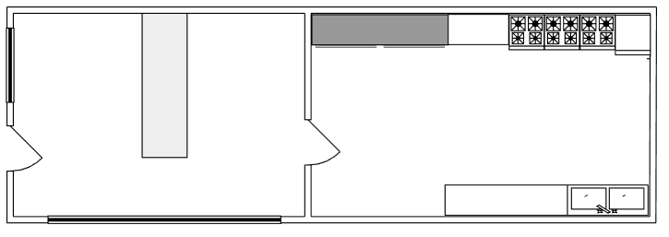
Why is it important to think about movement?
The airport is an extreme example, but even distances from one room to another can be a problem.
Imagine we have a bakery that sells donuts, and Steve works as the cashier

Slide 5
Why is it important to think about movement?
When someone orders a donut, Steve has to get them from the other room.
The donut table is 20 feet away and pass the door

Slide 6
Why is it important to think about movement?
So what looks simple now involves the new steps of opening the door which takes an extra 5 seconds each time

Slide 7
Why is it important to think about movement?
Then Steve grabs the donut and puts it in the bag which takes 10 seconds

Slide 8
Why is it important to think about movement?
Then Steve needs to walk back to the counter which is another 20 feet, and open the door again on his way there which is another 5 seconds.
Altogether with walking time, it takes Steve 40 seconds to get a donut

Slide 9
Why is it important to think about movement?
Those times and distances may not seem like a lot, but let’s say there is a new order every minute!
That means Steve is walking 40 feet every minute!
Give Order
5
3
Get Donut
Open
1
4
Take Order
2
Open

Slide 10
Why is it important to think about movement?
If Steve is walking 40 feet every minute and he works 8 hours a day that’s
19200 feet each day he’s walking from one room to another. 19200 feet is a little more than three and a half miles, that’s a lot of walking, and Steve will be too tired to do that every day.
z
z
z

Slide 11
Why is it important to think about movement?
Also the time it should take Steve to get a donut is 40 seconds, but if he’s slow (which he will be if he’s tired) that time might take longer than one minute

Slide 12
Why is it important to think about movement?
If customers are ordering faster than Steve can get food, then orders will build up and customers will start getting angry!
!
!
!

Slide 13
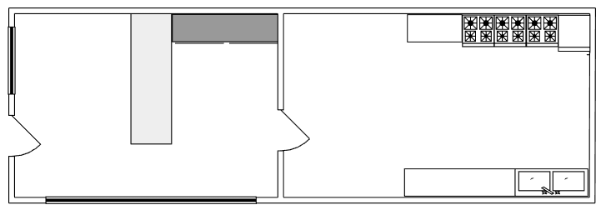


Why is it important to think about movement?
Instead, Steve moves the Donut desk next to him so that he does not have to move at all! This also makes the time it takes to get a donut a lot faster, leaving happy customers!

Slide 14
Making Decisions
Now that was a simple example to show how steps having different locations can have a big impact
While some processes have all their steps in the same location, many require going to use or get a certain item in a different location.
Think about making an entire dinner without moving from one spot, does it seem possible?

Slide 15
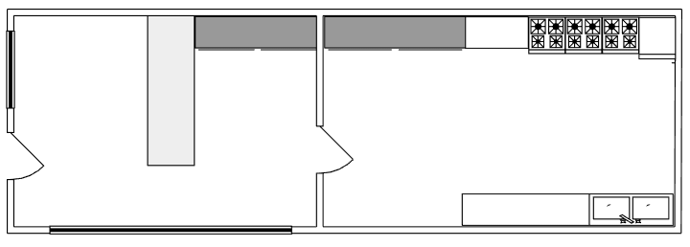
Making Decisions
Going back to the bakery example, let’s say there are now 2 donut desks
One for regular donuts in the front room
One for vegan donuts in the other room
Donuts
Vegan Donuts

Slide 16
Making Decisions
Now when a patient orders, they can choose between getting a donut or a vegan donut.
As we said before, going to the other room and back takes about 40 seconds while the same room would take about 5 seconds...
Donuts
Vegan Donuts

Slide 17
Depending on the choice the customer makes, Steve may have to spend 40 seconds getting the order or 5 seconds.
This one decision changes the entire time of the process as shown below
This shows the result if the answer is Yes
Decisions like this one are often shown like this
Yes
40 Seconds
Do I want a vegan donut?
Do I want a vegan donut?
This shows the result if the answer is No
No
5 Seconds

Slide 18
Decisions can have more than two options. Most ice cream shops have at least vanilla, chocolate, and strawberry. But depending on the ice cream store there can be 50 or more choices!
In the ice cream store example, there is another decision on how to pay
20 Seconds
Cash
How should I pay?
How should I pay?
Credit Card
10 Seconds
50 Seconds
Check

Slide 19
Making Decisions
The ice cream shop now has two decisions, though some processes can have 0 decisions and some processes can have hundreds of decisions.
It is important to remember the order of decisions, as one decision can impact another, only the customer who pays in cash has to get change
20 Seconds
30 Seconds
Cash
Yes
Do I have change?
How should I pay?
Credit Card
10 Seconds
50 Seconds
Check
0 Seconds
No

Slide 20
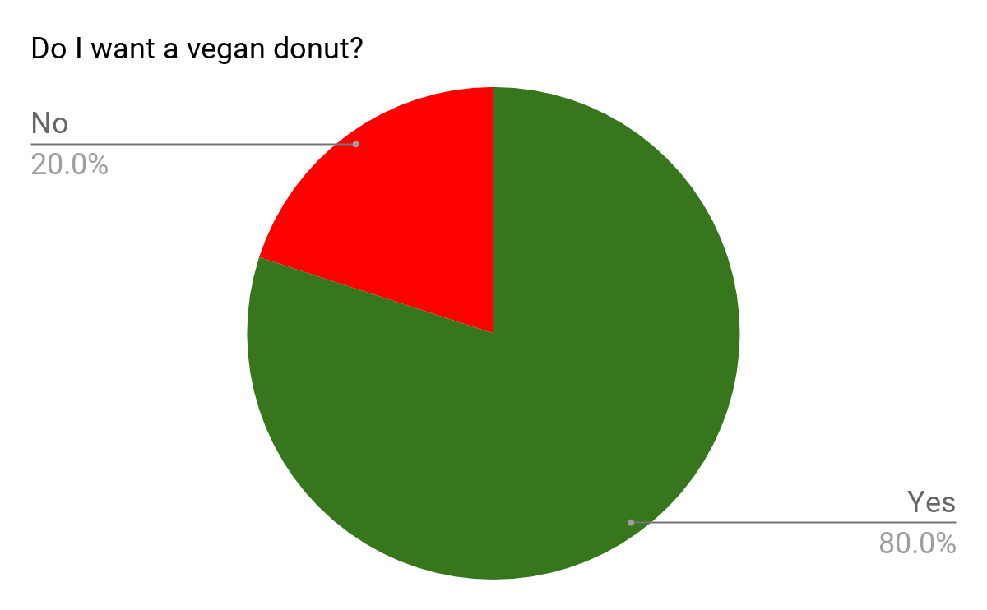
Making Decisions
Just because there are multiple options, that does not mean that there is an equal chance of them being chosen.
For example, the donut shop may be in a heavily vegan neighborhood where 80% of customers will ask for a vegan donut
40 Seconds
Do I want a vegan donut?
Yes
5 Seconds
No

Slide 21
Making Decisions
It’s important to think about how many people choose each option. If more people want vegan donuts, that means Steve has to go to the other room more often to get the vegan donuts. It may be better to move the vegan donuts to the first room, so the task that is done more often is the faster task.
40 Seconds
Do I want a vegan donut?
Yes
5 Seconds
No

Slide 22
Modeling Flow activity
Think about getting ready for school and the steps associated with that and where in the house each step takes place.
For example, getting changed may involve a closet, brushing your teeth in the bathroom, and getting food from the kitchen.

Slide 23
Modeling Flow activity
When you are including the steps that you do each morning, think about the decisions you make and how that affects the process.
For example if it’s snowing, you will probably have to put on boots which will take longer than putting on sandals or sneakers. Another decision is whether to skip a step, especially if you are running late!

Slide 24
Modeling Flow activity
The first step is to draw the layout of your house, either with on paper or by using https://www.lucidchart.com/ if you have access.
The layout does not have to be 100% accurate, if your room is 10 feet and 2 inches long, you can shorten that to 10 feet. If your house is very complex, try making simple rectangles/squares for each room and hallway.

Slide 25
Modeling Flow activity
Make sure to include relevant items in your house. If you have to go down stairs, include them. If getting ready for school involves getting clothes from a cabinet that should be included as well.
Generally, don’t try to draw everything and focus on larger pieces of furniture and appliances (beds, desks, fridges, etc…)

Slide 26

Modeling Flow activity
Try to time how long each step takes by timing yourself on your phone or by counting.
Remember the importance of travel time in the donut shop. If one step involves going to the bathroom to brush your teeth, time how long it takes for you to go from your bedroom to the bathroom. Feel free to use estimations!

Slide 27
Modeling Flow activity
Map out the times for each path for decisions like seen below.
20 Seconds
30 Seconds
Cash
Yes
Do I have change?
How should I pay?
Credit Card
10 Seconds
50 Seconds
0 Seconds
Check
No

Slide 28
Modeling Flow activity
With all your steps known, map them out in your house like the steps are mapped out below! Remember that decisions can lead to different rooms.
Give Order
5
3
Get Donut
Open
1
4
Take Order
2
Open

Slide 29
Modeling Flow activity
Once everything is mapped out in your layout, imagine actually starting the process you just modeled and go down different pathways. See how long each route takes.
Is there a certain decision that takes a lot of time?
What is the shortest time to get ready for school?
What is the longest time?
How can you change the process to go faster? (Try moving items if you can)

Slide 30
What did we learn?
We learnt that almost every process has decisions and travel times that can make a large impact on how long it takes!
Drawing the layout and knowing the travel times and knowing which steps are done more often can help you redesign the layout to make improvements!
Simple processes can be more complex than they seem

Slide 31

Thank you!

