Slide 1
Simulation:Capturing Real World Uncertainty
STEM and Industrial Engineering
Toyota Production Systems Lab
Facilities & Simulation: Grades 9-12

Slide 2
What is Simulation?
Simulation is modeling a real-world system using a computer
Real-world systems are parts that work together toward one purpose:
An airport is a good example: there is check-in, security, and checking the ticket at the gate.
These are all activities needed in getting a person from their car to their flight!
People enter the system, go through all the steps, and then leave!

Slide 3
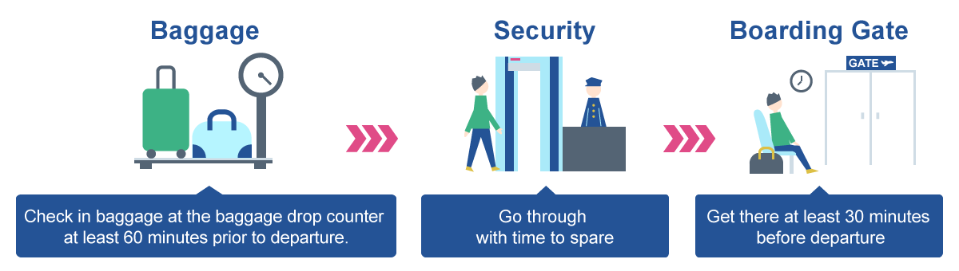
The main steps at an airport
Check In Baggage
Security
Gate

Slide 4
Why is it useful?
In the airport example, those steps do not always take the same time.
If you have flown before think, about how much longer the line was near Thanksgiving and other holidays compared to other days.
X-ray machines can also break down, so more people would have to use fewer lines. Going through security also may take longer for old people, so for a 20 year old security may take one minute, but it could take 4 minutes for an 80 year old to go through security.

Slide 5
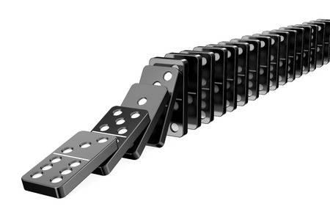
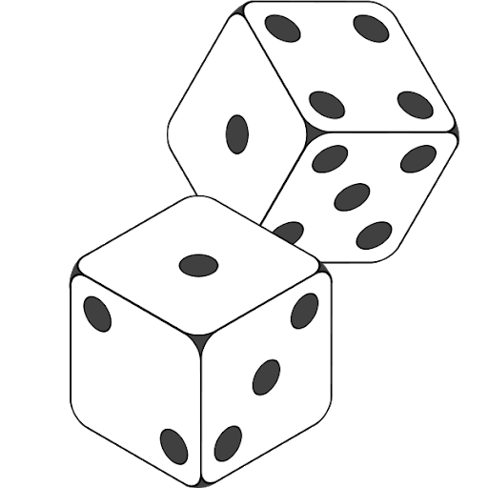
Randomness
If one person takes 4 minutes to go through security, that affects everyone else in the line behind them, like a domino effect.
And since times for security changes from person to person, the time is random and hard to predict.
Combine both and you can see how these systems are very hard to do by hand and require the use of a computer simulation!

Slide 6
Each step can have variation in times
Check In Baggage
Security
Gate
10 to 30 minutes
1 to 4 minutes
1 to 50 minutes

Slide 7
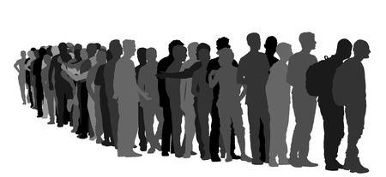
Importance of Randomness
If the airport doesn’t consider the randomness (variation) in time, they might plan around having security taking one minute per flyer. But when some flyers take longer to go through, this will create long lines and unhappy flyers who miss their flights!

Slide 8
Simulation Size
Simulation models can be as long or short as you want! And you can add any animations to make it look nicer!
You could model just the security section of the airport, or the entire airport itself as seen in the video on the next slide.
In simulation there is no one right answer, as long as it gets the important results you need (such as the wait times for those waiting to go through security).

Slide 9
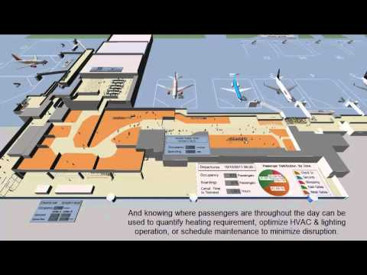
Vancouver Airport Simulation
(Press Control+ Click the picture to watch)

Slide 10
After Running the Simulation
After running a simulation model, the airport could see that people spend too much time in security on the weekends, and so they can add more scanners at security to help more people at once and make the process faster!
Since adding scanners is expensive, the airport can first put them in the model to see what the change would be, rather than try it out in the real world and take a large amount of time and money and possibly not work.
Run Model
Make Changes

Slide 11
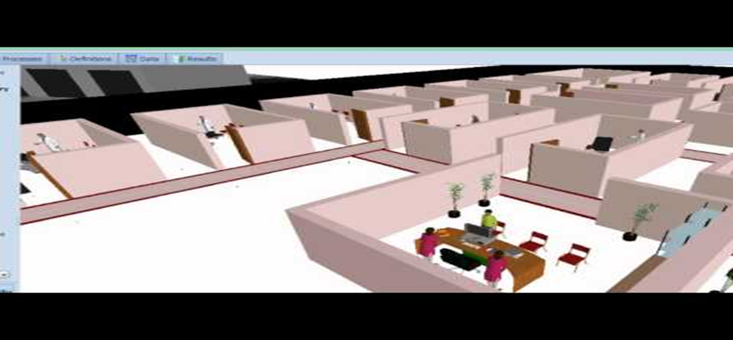
Other Examples – Hospitals
(Press Control+ Click the picture to watch)

Slide 12
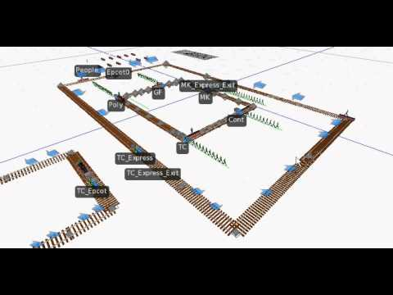
Other Examples - Disney World Monorail
(Press Control+ Click the picture to watch)

Slide 13
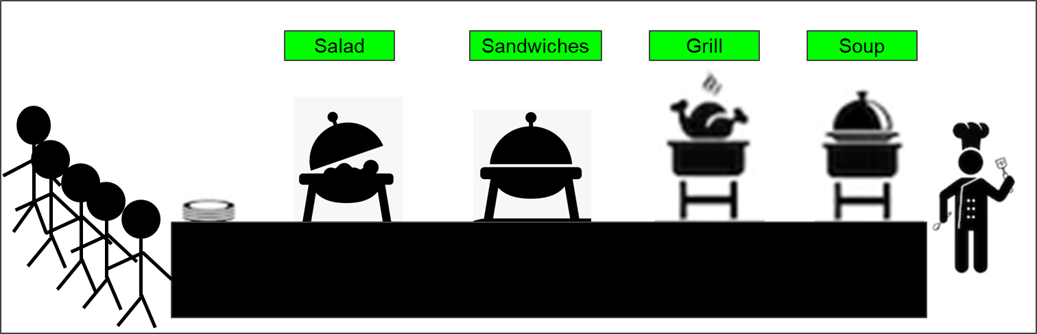
Dice Rolling Activity
Let’s pick a different example to think about, how about a buffet!
There are four different stations a person can go to, and a long line!

Slide 14
Let’s Prepare!
You can use one six sided die or several if you have them at home, if not there are many sites including https://www.random.org/dice/?num=2
The Dice will represent that variation mentioned earlier. Each customer rolls 1 die to decide whether to get food from the station or to skip it and go to the next station. If they go to a station roll 2 dice. This will be the time they spend at the station in minutes. Once they are done at the last station they leave and we record their time.

Slide 15

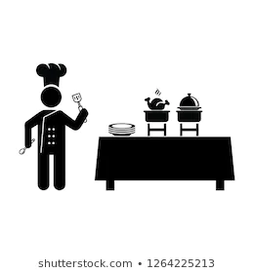

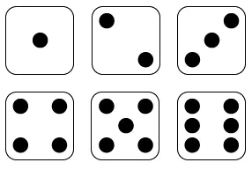
Example Run!
The dice numbers under each station shows the chance the person goes to that station. If there are 2 dice numbers, the person has a 2/6, or 1/3, chance of going there.
Let’s do the run one person at a time!
Roll =
Salad
Sandwiches
Grill
Soup

Slide 16
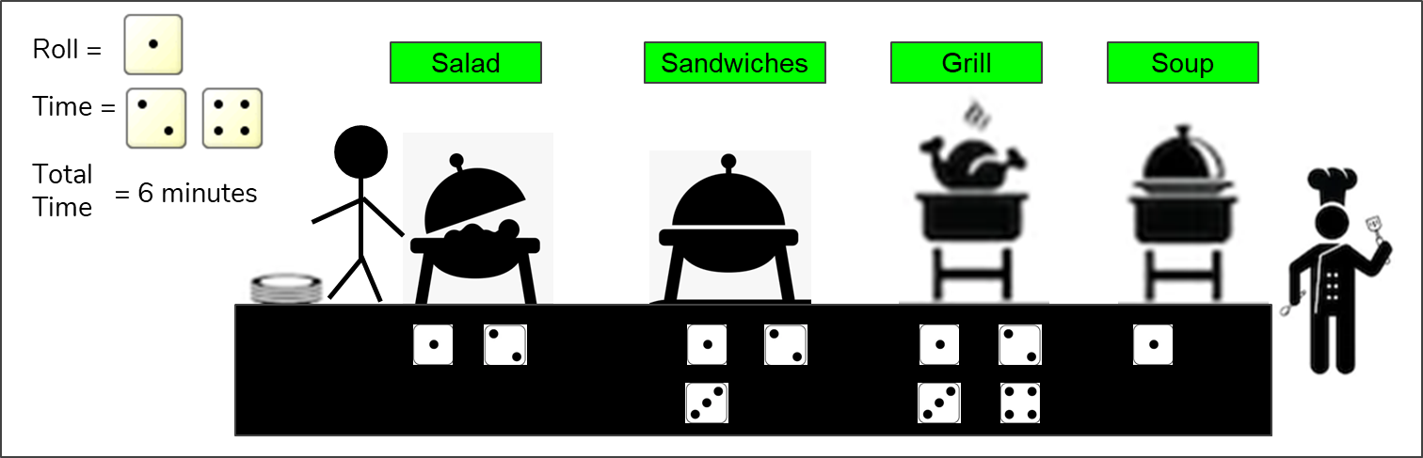
Example Run!
Since I got a 1 on my first roll, the person stops at the salad station since 1 is one of the two numbers below the station. I then rolled two dice for time as the person is at that station and got the rolls of 2 and 4, which means the person spent 6 minutes at the salad station

Slide 17


Example Run!
Since I rolled a 2, the customer stops at sandwiches and spends 3 minutes there. Be sure to add this time to the total time.
Roll =
Salad
Sandwiches
Grill
Soup
Time =
Total Time
= 9 minutes

Slide 18

Example Run!
I then rolled a 6, so the person skips the grill to go to the soup station. The total time remains the same but I did not roll 2 dice for time, so the total time remains the same.
Roll =
Salad
Sandwiches
Grill
Soup
Time =
Total Time
= 9 minutes

Slide 19

Example Run!
Finally I rolled a 2 so the soup station is skipped and the customer leaves having spent 9 minutes at the buffet. Now we can repeat the process with the next customer.
Roll =
Salad
Sandwiches
Grill
Soup
Time =
Total Time
= 9 minutes

Slide 20
Trying running it yourself!
Have at least 5 people go through the process and record their total times.
Were their times different?
Did they all go to the same stations?
Fun fact: Each person has only a 1 in 54 chance to stop at all of the stations.

Slide 21
Think About
What if each station took different times?
What if the chance of going to the soup station was not a one in six chance but one in 573?
What if the amount of people going through were 1,000 and they all went at the same time?
These would all make it very difficult to find the times by hand, but using computer simulation we could quickly and easily set up and run a model with these changes

Slide 22
What did we learn?
Systems in the real world have a lot of randomness and variability which makes them hard to predict by hand.
Computer simulation can be designed for many different problems ranging from a simple buffet to a huge airport, and can calculate large amounts of data and randomness far easier than we can.
Simulation can be used to test real world changes to save time and money!

Slide 23

Thank you!

