Slide 1
Bill of Materials
STEM and Industrial Engineering Toyota Production Systems Lab
Facilities: Grades K-5

Slide 2

What is a Bill of Materials?
A Bill of Materials is commonly used in manufacturing.
They break down the bigger parts of a finished product into smaller parts (like splitting a water bottle into a bottom and a top)
The top of the water bottle might have screws (like this one!)
All materials are included, even the paint that you need!

Slide 3
How do you make a Bill of Materials?
An indented Bill of Materials usually includes each item’s level and name of the part.
A Bill of Materials has different levels. Level 0 is the finished product (like a water bottle).
Level 1 would be everything that you need to put together to make the water bottle (let’s use the top as an example).
Level 2 would be what you need to make the top (the screws and handle).
The next slide has an example!

Slide 4

Water Bottle Example
A Bill of Materials has its levels indented as well! Let’s take a look at the water bottle from earlier and make a Bill of Materials.
Level 0: Water Bottle
Level 1: Bottle Cap
Level 2: Screws
Level 2: Plastic Handle
Level 1: Bottle body
Level 2: Paint

Slide 5

Being Careful
When you make a Bill of Materials, be careful not to forget anything! If you forget one thing on there, the water bottle might not come out right. Imagine if you forgot to put paint on it! It would look something like this, and the customer wouldn’t be happy.

Slide 6
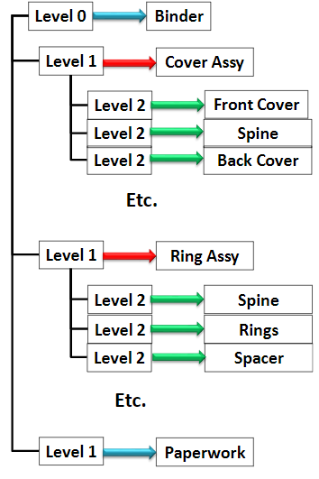
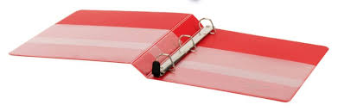
This is an example for a 3-ring binder!
Notice: Everything that everything that goes into the cover is included at level 2!
Assy. stands for “assembly”!

Slide 7
Why are they so important?
Engineers can make sure they aren’t missing a step in the assembly process
They give an idea of where machines should be placed
It helps engineers track parts while they move in a facility

Slide 8
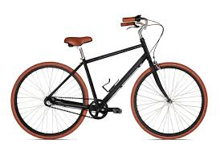
Let’s Try Our Own!
Try making a Bill of Materials for this bike!
Click for some hints
The red circle is the entire body of the bike
Handlebars
Hand brakes
Seat
Water bottle holder
Body
Gear belt
Tire spokes
Tires

Slide 9
Hint 1/3
Split the bike into different sections
Click for another hint with some examples

Slide 10
Hint 2/3
Section Examples: handlebars, tires, body, seat
Click for another hint!

Slide 11
Hint 3/3
Don’t forget the paint!
Go to the next slide for an answer

Slide 12
Bill of Materials Solution Example
Level 0: Bicycle
Level 1: Body
Level 2: Black Paint
Level 2: Water Bottle Holder
Level 3: Black Paint
Level 1: Tires
Level 2: Tire Spokes
Level 2: Gear Belt
Level 1: Handlebars
Level 2: Handbrakes
Level 1: Seat

Slide 13
How can you use the Bill of Materials?
Everyone wants to try building something every once in a while.
Next time you want to build something, try making a bill of materials!
It will make your project much easier, and you can buy everything you need much easier. That’s because everything will be organized!

Slide 14
What did we learn?
The Bill of Materials can be helpful in many ways!
They show what materials are necessary to make a part
They make sure you have everything you need
Things to remember:
Be careful not to forget small details!
The completed part is always level 0!

Slide 15

Thank you!

