Slide 1
Intro to Industrial Engineering
Toyota Production Systems Lab
Grade 1-5

Slide 2
Accompanying worksheet
Please follow along with the worksheet titled “IntroIE-1-IntroIEWS”, and the crossword “IntroIE-1-IntroIECW”
Notes:
Link to worksheet here

Slide 3
Agenda
What is Engineering?
What is Industrial Engineering?
History of Industrial Engineering
Kahoot game and/or crossword

Slide 4

What is Engineering?
“Engineering is the process of creating and building structures, products, and systems by using math and science.”
Engineers solve problems by creating and inventing
What are some different types of Engineering?
Industrial, Mechanical, Electrical, Chemical, Computer, Biomedical, Civil
What type of work can Engineers do?
Designing and building buildings, bridges, roads
Designing and making cars, trains, airplanes
Designing and building computers, robots, cell phones
And much more!
Notes:
Use this slide to start a discussion,
Ask what the students think engineering is and the type of work engineers typically do before telling them
Give quick description of each type of engineering
Go through info on the slide
https://study.com/academy/lesson/engineering-lesson-for-kids-definition-facts.html

Slide 5
What is Industrial Engineering?
Industrial Engineers focus on design, development, and optimization of systems and processes
What types of environments do you think an Industrial Engineer works in?
Link to video about IE
Factories, hospitals, amusement parks (Disney World), transportation/logistics (airplanes, trains, boats), etc.
“Engineers make things. Industrial Engineers make things better.”
Notes:
Ask students what they think IE is and where they think IEs work before telling them
Go through info on slide
Then watch video: https://www.youtube.com/watch?v=WMbJuTlajsw
Recap what types of industries IEs can work in

Slide 6
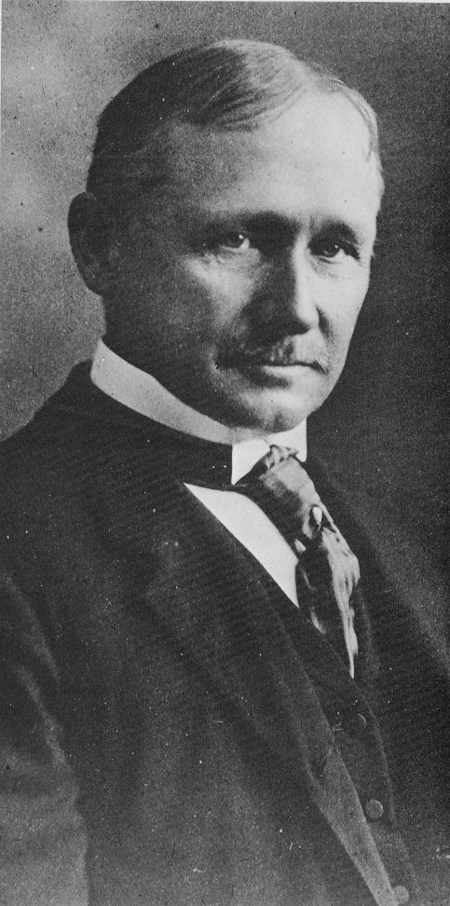

Frederick W. Taylor (1856-1915)
Taylor worked as both a laborer and a manager at Midvale Steel
Taylor wanted the most efficient work environment
Created Scientific Management
Use work method that is based on scientific study - created time studies
Time Study - process of observing and measuring work by establishing how much time the work takes to be completed
Divide all work into equal chunks - every worker has the same amount of work
Taylor believed that production efficiency could be improved by close observation of the individual worker and elimination of wasted time
Notes:
Ask if anyone knows who Frederick Taylor is
Go through info on slide
Emphasize the importance of time studies and how they are used to balance a line
Video of unbalance line: https://www.youtube.com/watch?v=HZ5HrkN52j8
https://www.pbs.org/wgbh/theymadeamerica/whomade/taylor_hi.html
https://www.britannica.com/biography/Frederick-W-Taylor
http://www.netmba.com/mgmt/scientific/
Define time study: https://www.ims-productivity.com/page.cfm/content/Time-Study/

Slide 7
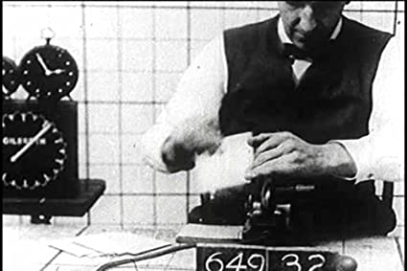
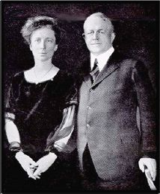
Frank (1968-1924) and Lillian Gilbreth (1978-1972)
Frank and Lillian worked together at Frank’s construction company
Both worked with and built off of Taylor’s Scientific Management
Created time and motion studies by using motion picture films to analyze jobs
Time and motion study - process of analyzing work through timing each step and finding where too much time was spent.
Determined to find the “one best way” to do any task
Extra video
Place a clock next to worker to evaluate time taken to complete the task
Notes:
Ask if anyone know who Frank and Lillian Gilbreth is
Ask if anyone has ever heard of Cheaper by the Dozen
Movie is based of of them - they had 12 kids and wanted to make tasks in their household efficient
Go through info on the slide
Video about Frank & Lillian: https://www.youtube.com/watch?v=w0U-pkIKVtc
If there is time show video but not necessary
https://www.engineergirl.org/123474/Lillian-Moller-Gilbreth
Videos:
https://www.youtube.com/watch?time_continue=289&v=_9RlfBdLvE8&feature=emb_logo
https://www.youtube.com/watch?v=HYQRbc4msWc

Slide 8
Time Studies
Observe the process
Break up process into steps
Start stopwatch and let it run
Record time on stopwatch after worker completes each step
Take difference to find time for each step
Look for opportunities to improve the process to reduce time for each step
Notes:
Review how to do a time study
Mention how motion can be observed to look for opportunities for improvement

Slide 9
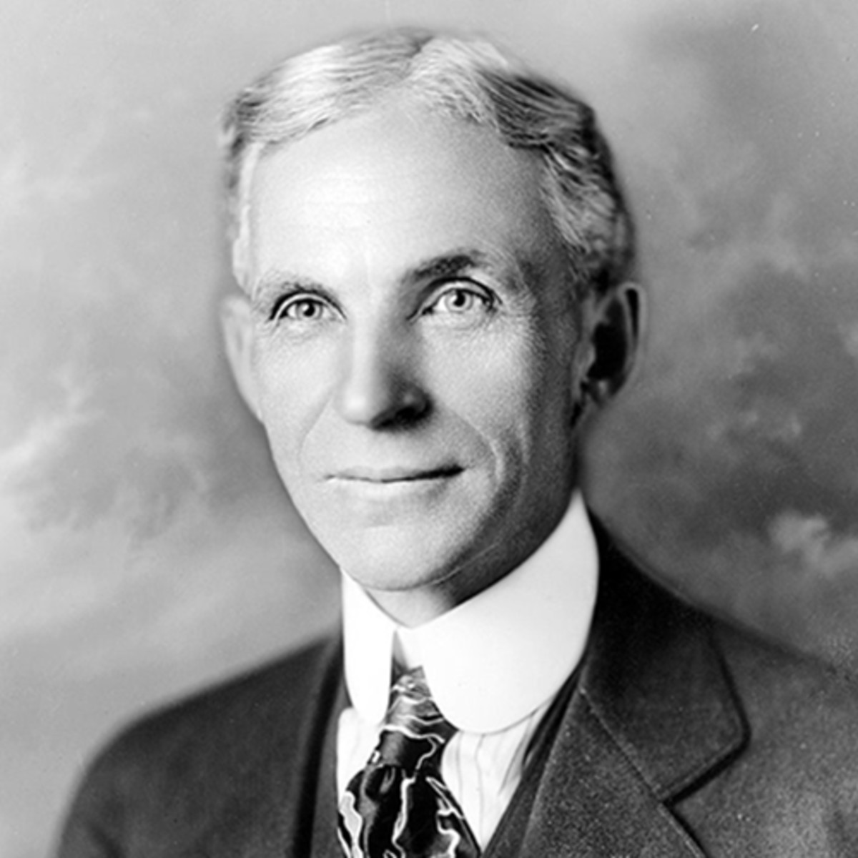
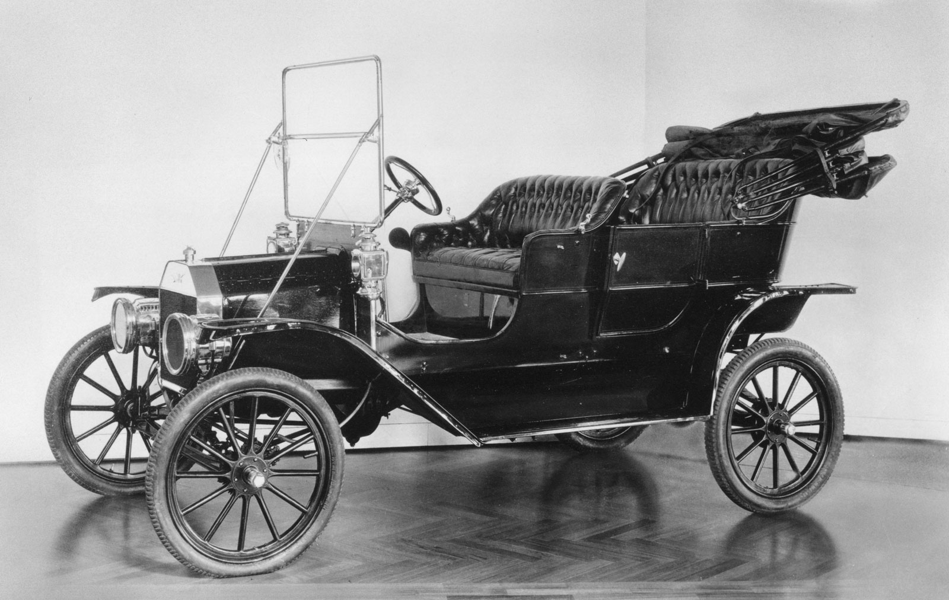
Henry Ford (1863-1947)
Ford wanted everyone to be able to own and drive a car
It is not just meant for the wealthy
Ford needed to find a way to reduce the price to make cars affordable for everyone
December 1, 1913 was the “first moving assembly line for mass production of an entire automobile”
Workers were trained to do one job repeatedly
Less need to have skilled workers that can build the entire car
Time reduction of ~9.5 hrs (12hrs → 2.5hrs) which significantly reduced the cost to build each car
Link to video of current Ford Factory
Ford Model T (first model built on an assembly line)
Notes:
Ask if anyone has heard of Henry Ford and what is he known for
Go through slide
Watch video
https://www.history.com/this-day-in-history/fords-assembly-line-starts-rolling

Slide 10
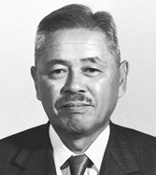
Taiichi Ohno (1912-1990)
Manager of Toyota Motor Company
Also known as the “Father of the Toyota Production System”
The Toyota Production System (TPS) is the foundation of lean manufacturing
Lean - “creating more value for customers using fewer resources”
Link to video about Toyota
Notes:
Ask if anyone has heard of Taiichi Ohno and what is he known for
Go through info on slide
Show video
http://www.leansixsigmadefinition.com/glossary/taiichi-ohno/
https://www.lean.org/whatslean/
Videos:
https://www.youtube.com/watch?v=v429BrFiYEk

Slide 11
Kahoot/Crossword
Link to Kahoot Quiz
There is a crossword in the drive folder
Notes:
Kahoot only has 8 questions, we can make it longer if need be

