Slide 1
Product Development

Slide 2
Accompanying worksheet
Please follow along with the worksheet titled “IntroIE-1-ProdDevWS”
Notes:
Link to worksheet here

Slide 3
Coming up with a product
Before beginning to design a product:
5 W’s: What, Why, where, when, and for who need to .
  If one of these isn’t answered before production begins, issues will occur. For example: If the “where” isn’t correct for a luxury car, you may be trying to sell it to a group of people that can’t afford it.
Another that must be decided upon before production can begin is the three part tradeoff of time, quality, and cost.
  Usually this means picking two of these qualities to focus

Slide 4
Activity: Surviving a Deserted Island
Take 5-10 minutes to think of three things that could help you if you were on a deserted island. Some examples of things you might want could be a shovel, a tent, or a fishing pole. You could even come up with a new product idea!
After coming up with your products, try to fill in the questions on the worksheet for this activity.
Notes:
Offer examples, change time to 5- 10 mins
Remove line about covid, change to island

Slide 5
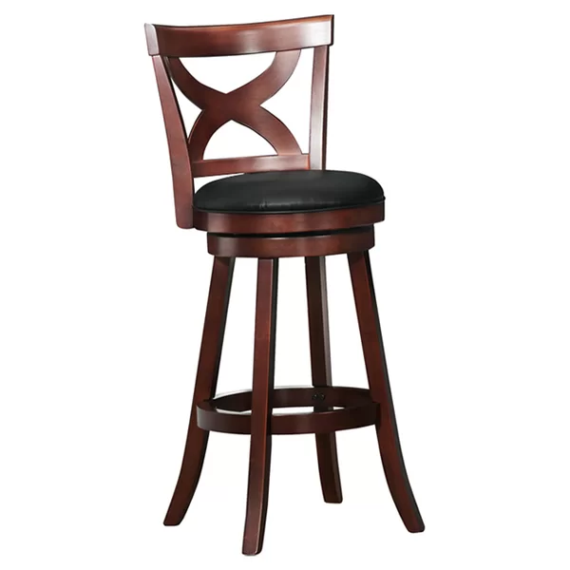
Bill of materials
A bill of materials is a way to organize all of the parts in a product, or assembly, into an easy to read format that usually takes into account the order that things must be mad in.
Try to come up with a list of the parts needed to make the chair on the right.
Our labels and Bill of Materials are on the next slide.
Notes:
Insert slide talking about subassemblies for older students
Bill of materials instead of BOM

Slide 6
Upper Back
Middle Back
Part | Quantity | Description
Upper Back | 1
Lower Back | 1
Middle Back | 1
Upper Side | 2
Cushion | 1
Seat Base | 1
Upper Ring | 1
Leg | 4
Bottom Ring | 1
Lower Back
Upper Side
Cushion
Seat Base
Upper Ring
Leg
Bottom Ring

Slide 7
Activity: Bill of Materials Creation
Try to create a Bill of Materials for one of the products you chose to help you survive on the island.
Sketching your product out can really help you decide on how many parts there are.

Slide 8
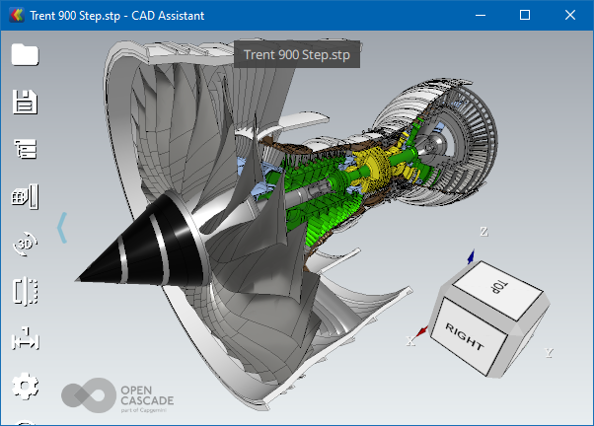
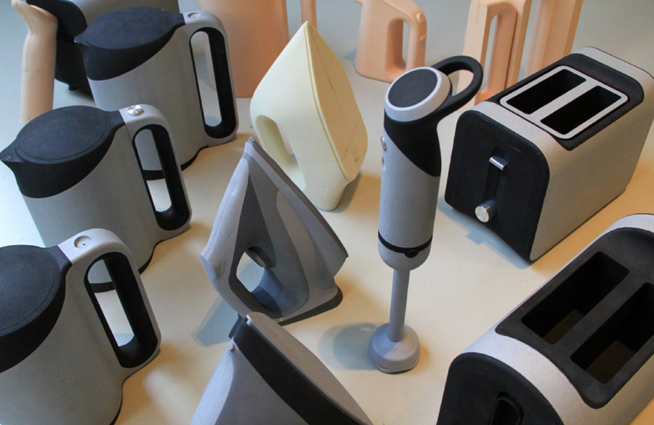
Designing your product
What you did earlier is just an example of the first few phases of product development. After coming up with a rough outline of what the product should be, companies usually head into an in depth design phase. Normally, this involves the use of 3d modelling software, and then prototype versions.

Slide 9
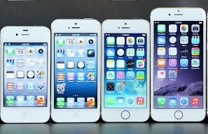
After Production
Even after production has started on a product, the process is not over. The team (you in this case) needs to fix issues found by customers in either the current or future versions, and needs to decide when to phase out production and support of older models. The easiest place to see this process is in phones where after roughly two years of sales, the phones are no longer sold in stores, and after 5-6 years are no longer supported by the manufacturer.

Slide 10
What kinds of engineers work on these projects?
Project Manager: Makes sure all aspects of the project are going smoothly. Often in charge of making sure that things are completed within budget and before their due date. In charge of facilitating large discussions and decisions.
Team Lead: Leader of a specific subteam within a project. The team can be made up of one type of engineer or multiple types.
Team Member: Usually the workforce of the operation, usually makes less of the decisions and does more of the design work.
Notes:
What kinds of engineers do you think work in each of these roles?
Where do industrial engineers usually work?

