Slide 1
Quality and Statistics

Slide 2
Accompanying worksheet
Please follow along with the worksheet titled “IntroIE-1-QualityWS”
Notes:
Link to worksheet here

Slide 3
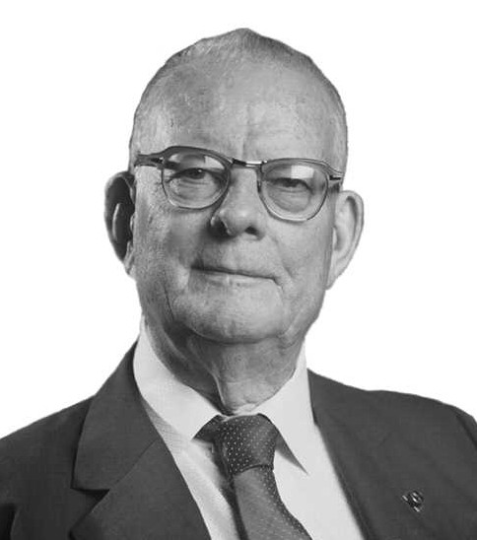
W. Edwards Deming (1900-1993)
Deming worked on continuous improvement of quality and overall operation
Some of Deming’s 14 points for Total Quality Management
Cease dependence on inspection - create products that have built in quality
Continuous improvement
Drive out fear - everyone can work effectively without fear of bringing up problems
Notes:
Ask if anyone has heard of W. Edwards Deming
Go through info on slide
https://deming.org/deming/deming-the-man

Slide 4
What is a defect?
Before we begin, fill out question 1 on the worksheet.

Slide 5
Defects
There are two major kinds of defects:
Design Defects: these are when there are issues with the design of the product.
Manufacturing Defects: Product Design is fine, but things went wrong in the manufacturing process. These are the ones that we, the consumers, see most often and are things like sharp edges or problems that cause early failure.
Answer question 2 on the worksheet
Notes:
https://www.hg.org/legal-articles/three-types-of-product-defects-for-product-liability-lawsuits-24105

Slide 6

Example: Drive Thru Orders
Everybody has gotten the wrong item in their bag at a drive thru at some point. How hard can it be for them to send out only % correct orders?
For this exercise, you will need a coin to flip.
Notes:
https://www.qsrmagazine.com/content/drive-thru-performance-study-order-accuracy

Slide 7
Procedure
For this activity, we are going to assume that any item in our order has a ½ chance of being made incorrectly. To simulate this, any tails we get when flipping the coin are going to count as a failure. We will also assume that our order has 3 items in it, so we have to flip the coin 3 times for each order.
Flip the coin and record if it is a heads or tails
Repeat step one three times
Record the number of tails on the graph on the next slide by marking an x above the number of tails, example below.
Repeat steps 1-3 five times.
X
X X X
X X X X
0 1 2 3 4 5

Slide 8
Results
How often did your "order" have no mistakes? If you did everything correctly, you should have 0 or 1, but don't worry if you have more. It's all chance, and you could have gotten all five with no mistakes.
What would happen if you tried the same thing with dice? Would you get more or less “Mistakes” in your order?

Slide 9
Procedure
This time, we will be using some dice to decide if our order is made correctly or not. Instead of looking for Tails, we will be looking for 6
Roll the die and record if it is a 6 or not
Repeat step one three times
Record the number of sixes on the graph on the next slide by marking an x above the number of sixes, example below.
Repeat steps 1-3 five times.
X
X X X
X X X X
0 1 2 3 4 5

Slide 10
Final Results
How many times did you get no sixes? If done right, it should be 0 or close to it. This is because the chance of getting a heads is higher than the chance of rolling a six, so the “mistakes” show up more often.

