Slide 1
Quality and Defects

Slide 2
Accompanying worksheet
Please follow along with the worksheet titled “IntroIE-6-QualityWS”
Notes:
Link to worksheet here

Slide 3
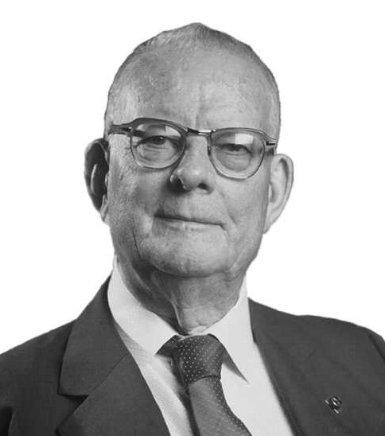
W. Edwards Deming (1900-1993)
Deming worked on continuous improvement of quality and overall operation
Some of Deming’s 14 points for Total Quality Management
Cease dependence on inspection - create products that have built in quality
Continuous improvement
Drive out fear - everyone can work effectively without fear of bringing up problems
Notes:
Ask if anyone has heard of W. Edwards Deming
Go through info on slide
https://deming.org/deming/deming-the-man

Slide 4
What is a defect?
Before we begin, fill out question 1 on the worksheet.

Slide 5
Defects
There are two major kinds of defects:
Design Defects: these are when there are issues with the design of the product.
Manufacturing Defects: Product Design is fine, but things went wrong in the manufacturing process. These are the ones that we, the consumers, see most often and are things like sharp edges or problems that cause early failure.
Answer question 2 on the worksheet
Notes:
https://www.hg.org/legal-articles/three-types-of-product-defects-for-product-liability-lawsuits-24105

Slide 6
Example: Drive Thru Orders
Everybody has gotten the wrong item in their bag at a drive thru at some point. How hard can it be for them to send out only % correct orders?
For this exercise, you will need a coin to flip.
Notes:
https://www.qsrmagazine.com/content/drive-thru-performance-study-order-accuracy

Slide 7
Procedure
For this activity, we are going to assume that any item in our order has a ½ chance of being made incorrectly. To simulate this, any tails we get when flipping the coin are going to count as a failure. We will also assume that our order has 5 items in it, so we have to flip the coin 5 times for each order.
Flip the coin and record if it is a heads or tails
Repeat step one five times
Record the number of tails on the graph on the next slide by marking an x above the number of tails, example below.
Repeat steps 1-3 five times.
X
X X X
X X X X
0 1 2 3 4 5

Slide 8
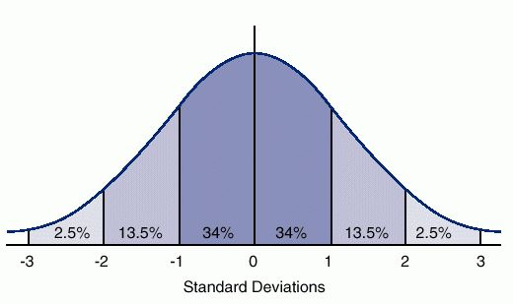
Results
Based on your results, what is the chance of getting an order with all items correct? You can calculate this by dividing the total number of tests with only heads by the total number of tests taken(5 in this case).
If we average everyone's results together, we should get somewhere around 3%, and the whole class plotted on a chart should look like a bell curve (pictured to the right) where there are more results closer to our average than further away from it. But how can we get the number our data is centered on without lots of flipping coins?

Slide 9
Calculating our expected mean without testing
We could find the center of our curve by doing lots of testing and averaging the results afterwards, but for larger projects, that would require 100’s and 1000’s of tests at the minimum. So, to solve for the mean without all of this testing, the first thing we need is the chance to get a “correct” answer for each item. In this case, we have a ½ or 50% chance for the item to be right.
To find the probability of a full order, we need to multiply the chance for each individual item to be correct together. That means that for five items, the chance for all of them to be correct is ½ x ½ x ½ x ½ x ⅚ = 0.03125 , or 3.125% chance for no tails.

Slide 10
Real World example
What we just did was an exaggerated version of what happens for drive thrus in real life. We gave them a 50% chance to get each item right. In the real world, they have a 90% chance of getting not each item, but the whole order right.
To get to this level of accuracy, that means that each item in an order with five parts needs to have a 98% chance of being correct.
This shows that even a 10% difference in accuracy per part can add up to a much lower average overall.

