Slide 1
Intro to Industrial Engineering
Toyota Production Systems Lab
Grade 9-12

Slide 2
Agenda
What is Engineering?
What is Industrial Engineering?
History of Industrial Engineering
Kahoot game and/or crossword

Slide 3
Accompanying worksheet
Please follow along with the worksheet titled “IntroIE-9-IntroIEWS”
Notes:
Link to worksheet here

Slide 4

What is Engineering?
“Engineering is the process of creating and building structures, products, and systems by using math and science.”
  Engineers solve problems by creating and inventing
What are some different types of Engineering?
  Industrial, Mechanical, Electrical, Chemical, Computer, Biomedical, Civil
What type of work can Engineers do?
  Designing and building buildings, bridges, roads
  Designing and making cars, trains, airplanes
  Designing and building computers, robots, cell phones
  And much more!
Notes:
Use this slide to start a discussion,
Ask what the students think engineering is and the type of work engineers typically do before telling them
Give quick description of each type of engineering
Go through info on the slide
https://study.com/academy/lesson/engineering-lesson-for-kids-definition-facts.html

Slide 5
What is Industrial Engineering?
Industrial Engineers focus on design, development, and optimization of systems and processes
What types of environments do you think an Industrial Engineer works in?
  Link to video about IE
  Factories, hospitals, amusement parks (Disney World), transportation/logistics (airplanes, trains, boats), etc.
“Engineers make things. Industrial Engineers make things better.”
Notes:
Ask students what they think IE is and where they think IEs work before telling them
Go through info on slide
Then watch video: https://www.youtube.com/watch?v=WMbJuTlajsw
Recap what types of industries IEs can work in

Slide 6
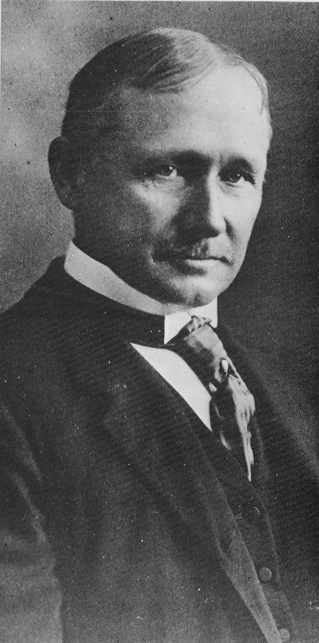

Frederick W. Taylor (1856-1915)
Taylor worked as both a laborer and a manager at Midvale Steel
Taylor wanted the most efficient work environment
Created Scientific Management
  Use work method that is based on scientific study - created time studies
    Time Study - process of observing and measuring work by establishing how much time the work takes to be completed
  Divide all work into equal chunks - every worker has the same amount of work
Taylor believed that production efficiency could be improved by close observation of the individual worker and elimination of wasted time
Notes:
Ask if anyone knows who Frederick Taylor is
Go through info on slide
Emphasize the importance of time studies and how they are used to balance a line
Video of unbalance line: https://www.youtube.com/watch?v=HZ5HrkN52j8
https://www.pbs.org/wgbh/theymadeamerica/whomade/taylor_hi.html
https://www.britannica.com/biography/Frederick-W-Taylor
http://www.netmba.com/mgmt/scientific/
Define time study: https://www.ims-productivity.com/page.cfm/content/Time-Study/

Slide 7
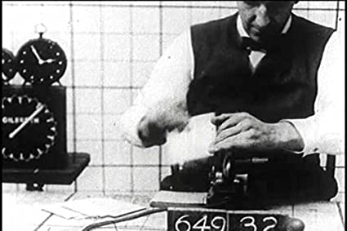
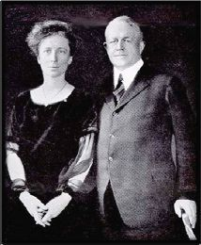
Frank (1968-1924) and Lillian Gilbreth (1978-1972)
Frank and Lillian worked together at Frank’s construction company
Both worked with and built off of Taylor’s Scientific Management
  Created time and motion studies by using motion picture films to analyze jobs
    Time and motion study - process of analyzing work through the time it takes to complete the task and evaluating the motion of worker
  Determined to find the “one best way” to do any task
Extra video
Place a clock next to worker to evaluate time taken to complete the task
Notes:
Ask if anyone know who Frank and Lillian Gilbreth is
Ask if anyone has ever heard of Cheaper by the Dozen
Movie is based of of them - they had 12 kids and wanted to make tasks in their household efficient
Go through info on the slide
Video about Frank & Lillian: https://www.youtube.com/watch?v=w0U-pkIKVtc
If there is time show video but not necessary
https://www.engineergirl.org/123474/Lillian-Moller-Gilbreth
Videos:
https://www.youtube.com/watch?time_continue=289&v=_9RlfBdLvE8&feature=emb_logo
https://www.youtube.com/watch?v=HYQRbc4msWc

Slide 8
Time Studies
Observe the process
Break up process into steps
Start stopwatch and let it run
Record time on stopwatch after worker completes each step
Take difference to find time for each step
Get most repeatable time
Look for opportunities to improve the process to reduce time for each step
Notes:
Review how to do a time study
Mention how motion can be observed to look for opportunities for improvement

Slide 9
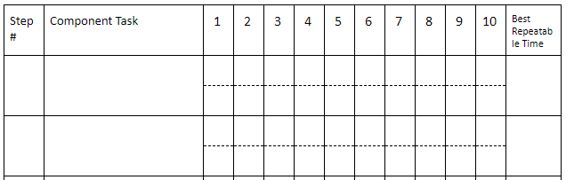
Time Observation Sheet
Record time for each step
Record best repeatable time
Record steps of the process
Record elapsed time on stopwatch
Notes:
Explain what goes in each box for the time observation sheet

Slide 10
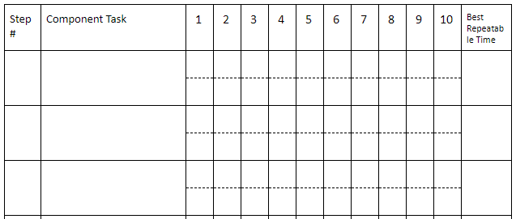
Time Observation Sheet PB&J Example
I made 5 PB&J sandwiches
21
19
21
22
21
Take out 2 slices of bread and place on plate
1
21
21
19
21
22
21
53 - 21 = 32
It took 32 seconds to spread jelly in the 5th trial
Spread jelly on one slice of bread
56
51
53
51
53
2
32
35
32
32
29
32
82
82
84
81
84
Spread peanut butter on other slice of bread and put 2 pieces together
31
3
26
31
31
30
31
Notes:
Walk through this example to further explain what goes in each box

Slide 11
Time Study Activity
I Love Lucy Chocolate Factory Video
Watch video up until 0:41 and write down steps to wrap the chocolate
Watch video again and time the steps for one of the workers
What problems did the workers run into?
Is there any way to make this process more efficient?
How would you split the work between multiple people?
Notes:
I Love Lucy Clip only have them time up until 0:41
For step 2 have them watch the entire video but tell them they can stop timing at 0:40
Ask questions in slides
Screws (use first half of video [0:32 - 2:15]): https://www.youtube.com/watch?v=IUu9CNuKGYY
Watch 0:32 - 2:15 and have students write down steps
Watch 0:32 - 2:15 and have students time the steps
Ask for possible solutions to make the process more efficient
Other potential videos that can be used:
Shop floor (oil): ttps://www.youtube.com/watch?v=27DRPtJ1_Lk
Stuffing folder: https://www.youtube.com/watch?v=rDWrOddHnR8

Slide 12
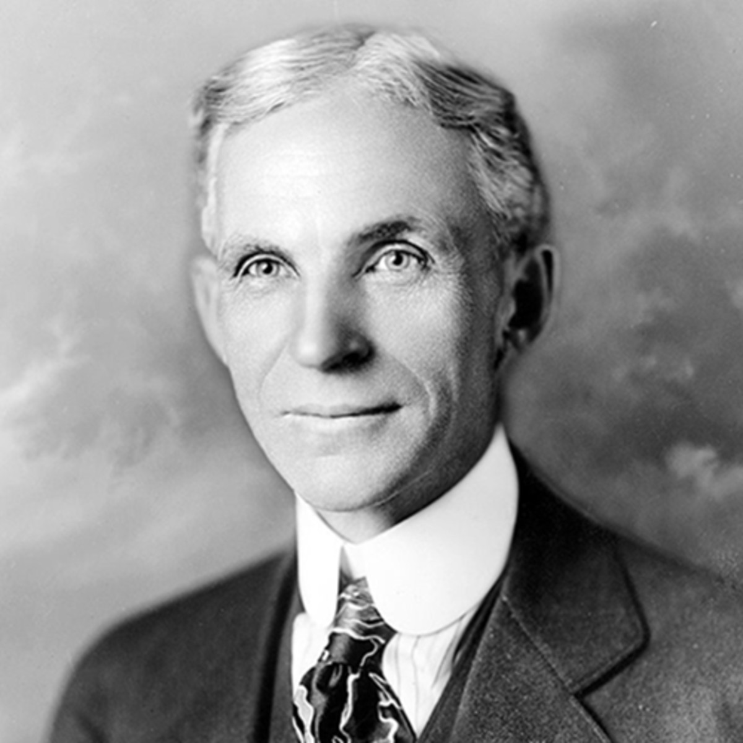
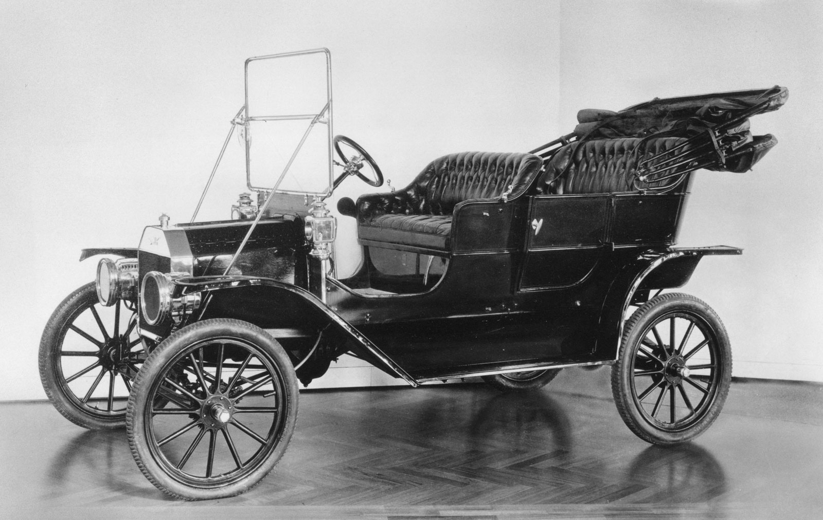
Henry Ford (1863-1947)
Ford wanted everyone to be able to own and drive a car
  It is not just meant for the wealthy
  Ford needed to find a way to reduce the price to make cars affordable for everyone
December 1, 1913 was the “first moving assembly line for mass production of an entire automobile”
  Workers were trained to do one job repeatedly
  Less need to have skilled workers that can build the entire car
  Time reduction of ~9.5 hrs (12hrs → 2.5hrs) which significantly reduced the cost to build each car
Link to video of current Ford Factory
Ford Model T (first model built on an assembly line)
Notes:
Ask if anyone has heard of Henry Ford and what is he known for
Go through slide
Watch video
https://www.history.com/this-day-in-history/fords-assembly-line-starts-rolling

Slide 13
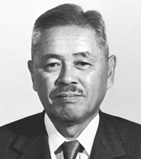
Taiichi Ohno (1912-1990)
Manager of Toyota Motor Company
Also known as the “Father of the Toyota Production System”
The Toyota Production System (TPS) is the foundation of lean manufacturing
  Lean - “creating more value for customers
  using fewer resources”
  Link to video about Toyota
Notes:
Ask if anyone has heard of Taiichi Ohno and what is he known for
Go through info on slide
Show video
http://www.leansixsigmadefinition.com/glossary/taiichi-ohno/
https://www.lean.org/whatslean/
Videos:
https://www.youtube.com/watch?v=v429BrFiYEk

Slide 14
Kahoot/Crossword
Link to Kahoot Quiz
There is a crossword in the drive folder
Notes:
Kahoot only has 8 questions, we can make it longer if need be

