Slide 1
Lean:
5S & Organization
Toyota Production Systems Lab
Grade K-5

Slide 2
Industrial Engineers & 5S
Industrial Engineers are known for organization. When we make improvements it is important to remember the 5S’s and do them all the time. That way you will make sure that your improvements do not turn back into problems.

Slide 3

The 5S’s
Sort
Set in Order
Shine
Standardize
Sustain

Slide 4


5S - Sort
To organize items that are similar into categories.
Example: Toys, books, games, puzzles, clothing

Slide 5
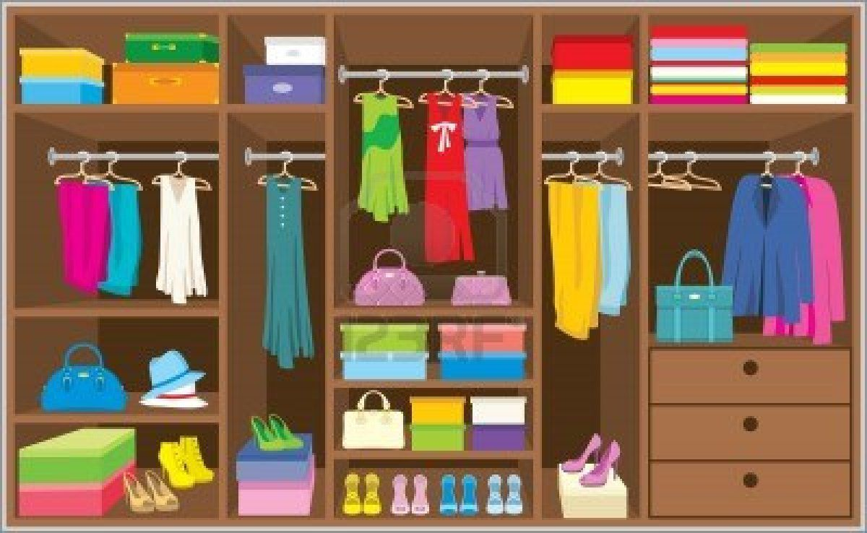
5S – Set In Order
To put things things away in their proper location.
Example: Clothes go in your closet, books in a bookshelf.

Slide 6
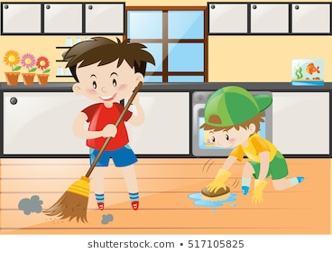
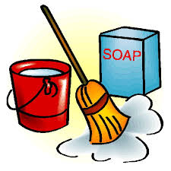
5S - Shine
Clean! Make sure everything is clean and neat!
Dust, wipe off stains, wash dirty clothes.

Slide 7
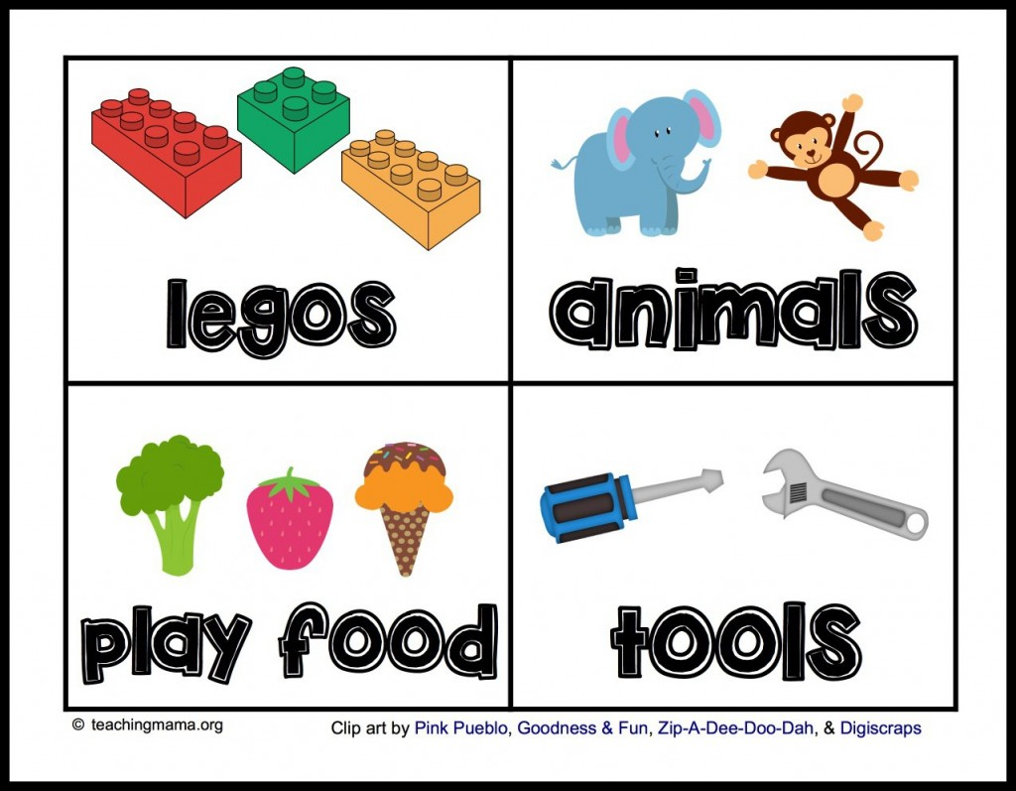

5S - Standardize
Make a chart of everything you have and write down where it is located so you always know where to go to find something.
Labels really help!

Slide 8

5S - Sustain
Always look at the chart! You do not want to do all this work for nothing. Follow the chart so that things do not get disorganized and messy.

Slide 9
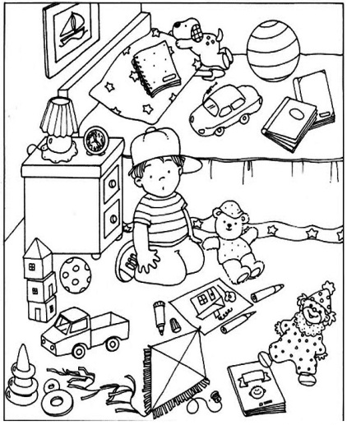
Activity
1: Help John clean his room using 5S!
John has never heard of 5S before, and his bedroom is really messy. He cannot find any of his toys and needs some help cleaning it up. Can you identify all of the things that are out of place using 5S?
2: 5S Your Bedroom!
Do you think you could use 5S to clean up your bedroom? Let’s use 5S to make some improvements and make your room clean and KEEP your room clean!

Slide 10

What We Learned
5S can be applied to any process, even everyday activities in your own home! By making these improvements we can see lean at work, making our lives both easier and better.

