Slide 1
Lean:
Eliminating Waste
Toyota Production Systems Lab
Grades K-5

Slide 2
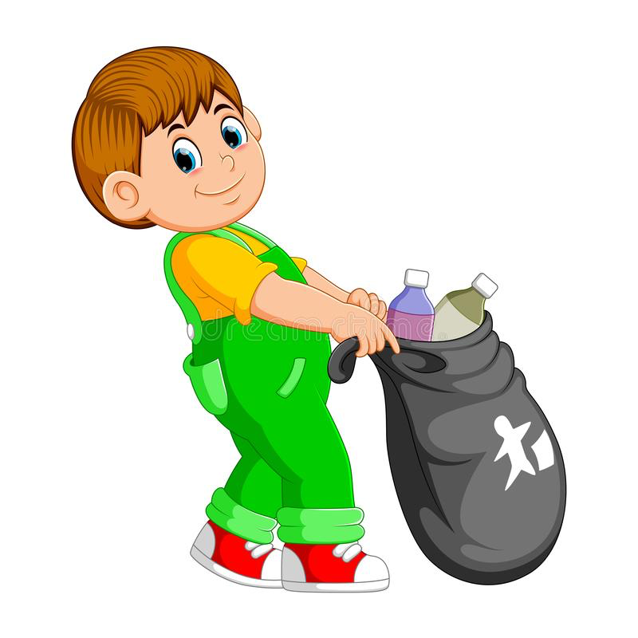
Lean Thinking
Lean is all about eliminating waste.
When we get rid of things it makes our lives…
Cleaner
More Organized
Better!
This concept is an important part of what Industrial Engineers do, and the best part is that anyone at any age can do it!!

Slide 3

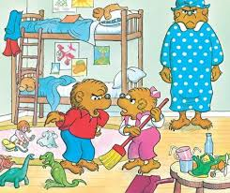
Why do we want to use Lean?
Helps us stay organized.
We know where everything is!
Do not trip over items that are in your way.
Keeps the space clean and tidy.
We don’t want our rooms looking like this…

Slide 4
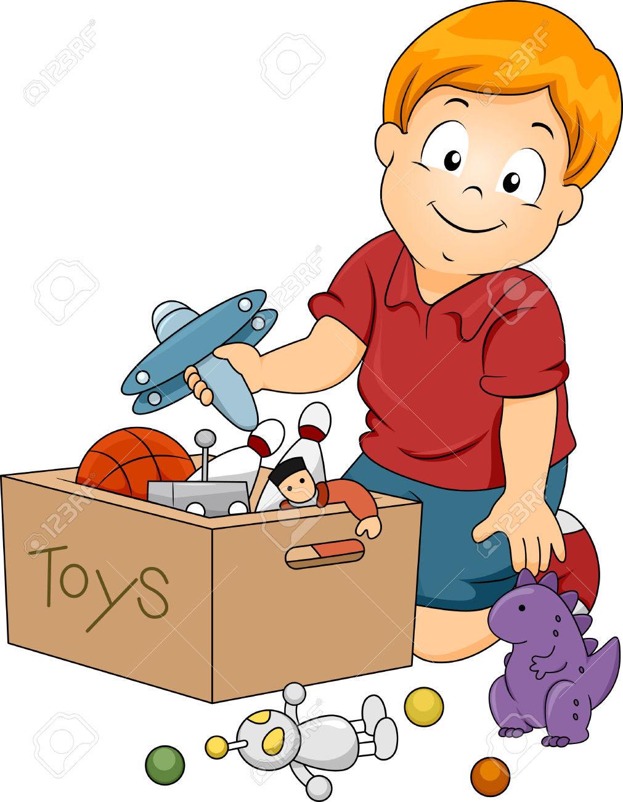

How can we get rid of Waste?
Here are some examples:
Donating toys, books and games that you no longer play with.
Taking out the garbage
Cleaning up your room
Making sure that there are no toys on the floor.

Slide 5
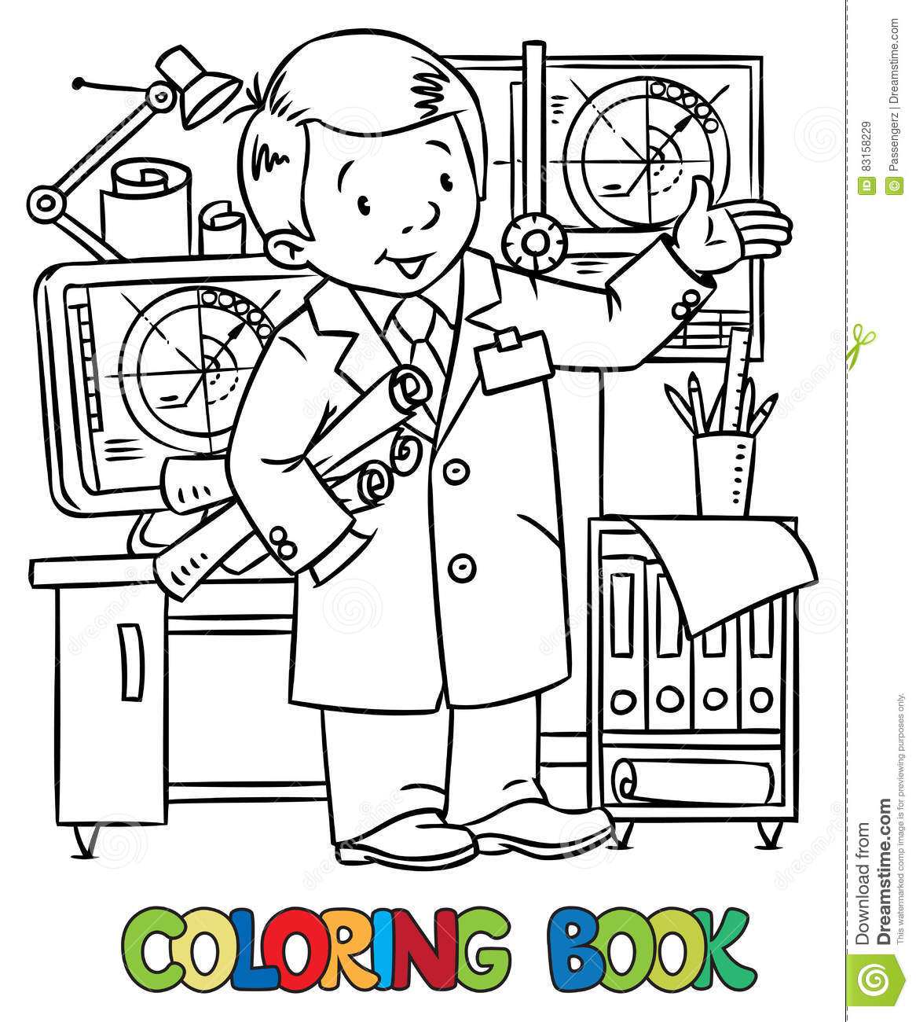
Activity
Industrial Engineer Coloring Page
Throughout this week we will talk about lean and go through some fun activities to help you become a lean expert just like all the Industrial Engineers out there!
Color in this picture of an Industrial Engineer with whatever colors you like!
See worksheet for details.

