Slide 1
Lean:
Lean Master Certificate
Toyota Production Systems Lab
Grade K-5

Slide 2

Congratulations!
You have completed all the topics and activities and are now a Lean Master!
You know what you to do when you see waste, and ways to eliminate waste so that you can make your life, and the lives of those around you better!
Remember, lean is a way of thinking, when you think lean you can improve anything!

Slide 3
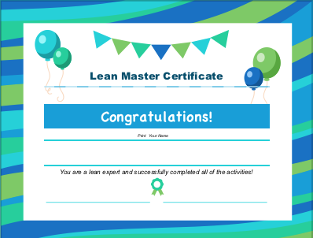
Lean Master Certificate
Download the Lean Master Certificate worksheet and print it out.
Write your name on it and hang it somewhere you can see it!

