Slide 1
Lean:
Value Stream Mapping
Toyota Production Systems Lab
Grade K-5

Slide 2
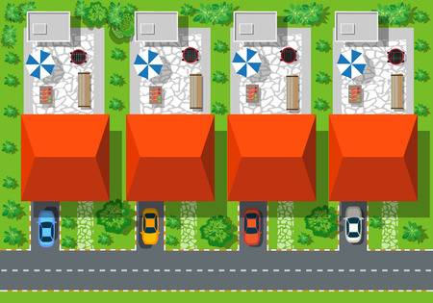
Value Stream Mapping
Value Stream Mapping is a great tool that Industrial Engineers use in order to see the process from a “birds eye view”.
This means that they can see everything going on and can identify areas of improvement where they can help!

Slide 3


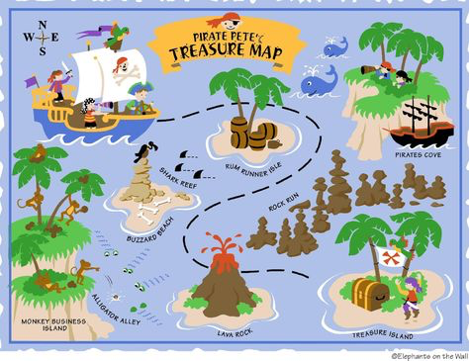
What is a Value Stream Map?
Let’s think of it like a Treasure Map!
Value
Something that has meaning… like buried treasure!
Stream
Like a river, which flows from one place to another, so does the path of a treasure map, it flows from one step to another to reach the value or treasure!
Map
A piece of paper that shows you where everything is in an area and where to go, just like a treasure map.

Slide 4
Parts of a Value Stream Map
Now that we know what a Value stream Map is, let's find out what are the important parts that help engineers create lean in a process.

Slide 5
Parts of a Value Stream Map
Numbering the steps: 1,2,3,4,5
It is always good to put a number starting at 1 for the first step all the way to the last step.
Name for each step: Start, End
So we know what happens at each step in the process.
Put arrows to show the path:
This helps us see where we need to go.
Star areas for Problems:
Engineers put stars where we can see problems or danger ahead. The stars will stand out on the map and tell us where we can improve!
Create a list of Solutions for the Stars:
Engineers see the stars and then think of ways to go around them and come up with solutions to help them reach their goal, the buried treasure!

Slide 6
Activity
Lean Treasure Map with Pirate Pete!
Pirate Pete loves searching for buried treasure, he finds lots of valuable objects and loves adventure. He and his crew are setting out on a new treasure hunt and want to be sure that they do not encounter any danger on the way. The map below shows his plan. Pirate Pete added you to the crew to make sure that they can get to the buried treasure safely. Can you help Pirate Pete and his crew by using the Value Stream Map elements we just learned?
See worksheet for instructions & details.

